Slide 1
iCMR Factoids 2017
These are intended as helpful suggestions, not commercial endorsements.
Some are off-label or investigational.

Slide 2
iCMR introduction for newbies
T Rogers et al, “MRI Catheterization in cardiopulmonary disease,” Chest, 2014;145:30.
Pubmed ID: 24394821

Slide 3
Basic Hardware for MRI catheterization 2017
(Not intended as product endorsements)
Hardware | Basic | Deluxe
Audio Communications | Hand signals (unsatisfactory) | Opto-Acoustics IMROC IR or IMROC multichannel
Hemodynamic Recording | MRI monitoring system Example: Philips In Vivo Expression | Homemade front-end: NIH PRiME: http://nhlbi-mr.github.io/PRiME/ Pinmed PELEX-MAX (Investigational) MiRTLE Medical (Investigational) Imricor EP Mapping (CE-marked, Investigational in USA)
Video displays | LCD projectors, shielded at home | LCD projectors, commercial MRI shielded, Example: Gaven Industries LCD displays Example: Big MRI vendors
Patient transfer | Conventional gurney | MRI-X-ray dedicated transfer & scanning tables Example: Siemens Combi-Table
MRI real-time host | Commercial scanner real-time MRI | Dedicated iCMR host Example: HeartVista rtHAWK Siemens IFE and successor Philips iSuite GE
Nitric Oxide Provocation | Extension tubing, stay within NO2 limits | Ikaria MRI Inomax
MRI Defibrillator (in-bore) | Evacuate outside MRI suite | Investigational products under development

Slide 4
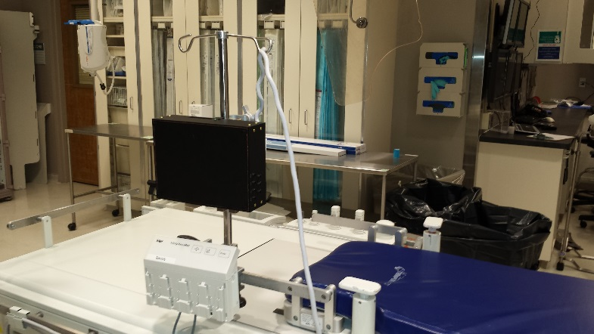
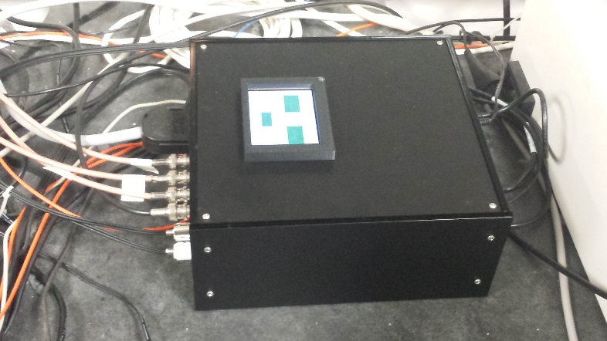
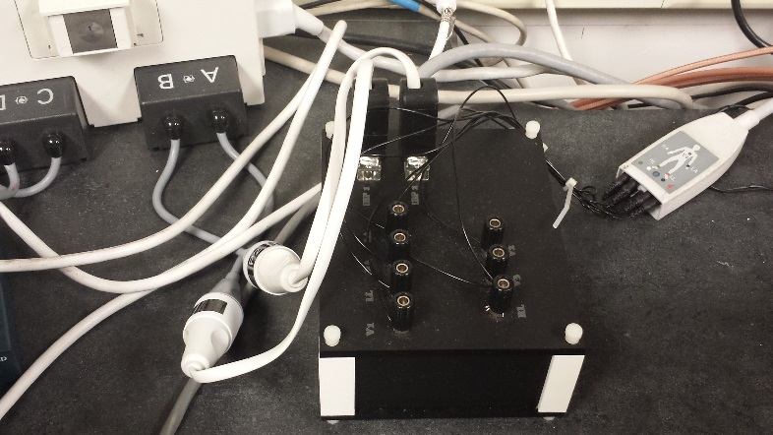

Hi-Fi Hemo Recording: PRiME (Physiological Recording in MRI Environment)
Connect to your cath lab hemo system (GE MacLab, Siemens Sensis), for Early Adopters
  Assemble at your home institution
  All schematics, PC board layouts, mechanical designs, bill of materials and software code.
  Provided at no cost with no licenses required at http://nhlbi-mr.github.io/PRiME/
  Estimated cost (hardware + software): $13-20,000
Figure 1. Physiological Acquisition System (black box) on IV Pole
Figure 2. Control System and Adaptive Filter System located in the MRI control room
Figure 3. Physiological Converter System located in MRI control room
John Kakareka
Signal Processing and Instrumentation Section,
Division of Computational Bioscience, Center for Information Technology, NIH
John.Kakareka@nih.gov

Slide 5


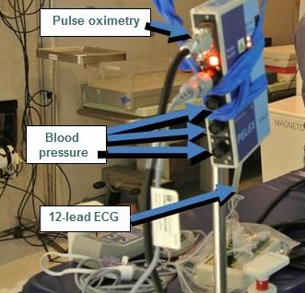
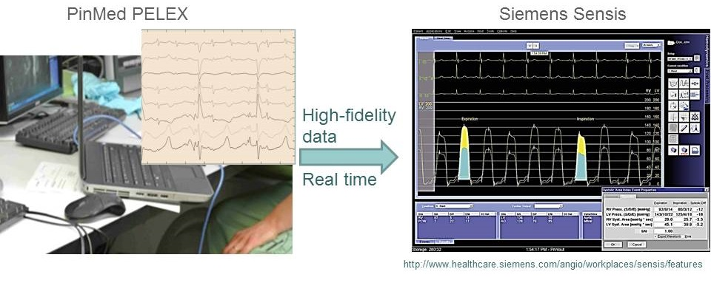
Hi-Fi ECG & Hemodynamic Recording Options:
Commercial Systems Still Investigational
Pinmed, Inc
Pittsburgh, PA
Front-end for hemo
recording system
MiRTLE Medical
Andover, MA
12-lead ECG
Provided by speakers with no conflict of interest. Not intended as a product endorsement

Slide 6
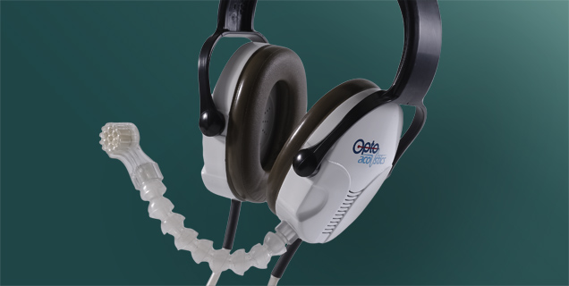
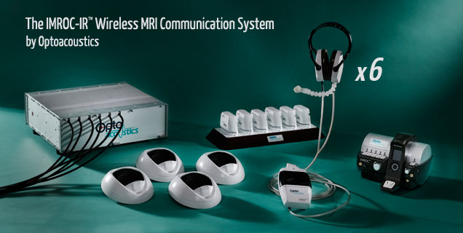
iCMR Audio Communications System
Opto-Acoustics IMROC
http://www.optoacoustics.com
Available in wired and wireless flavors
Up to 6 staff headsets
“Open microphone” conversations
Up to 2 parallel conversations
Provided by speakers with no conflict of interest. Not intended as a product endorsement

Slide 7
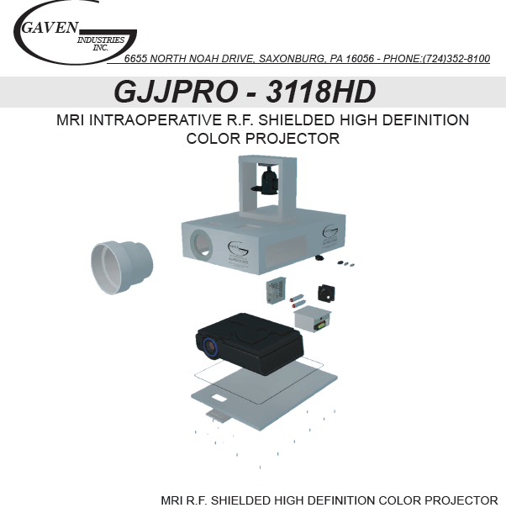
RF shielded RF projector useful for iCMR
Gaven Industries
CNMC/NHLBI have absorbed startup costs
CNMC & NIH each have 2 banks of 4 projectors, at head and at foot
Provided by speakers with no conflict of interest. Not intended as a product endorsement

