Slide 1
iCMR at SCMR 2015
Group Hug

Slide 2
2015 iCMR news
Clinical investigation of MRI Electrophysiology
New sites starting iCMR
Industry R&D allocations towards iCMR
Hands-on iCMR workshop ~November 2015

Slide 3
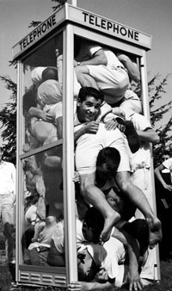
Hands-on iCMR Workshop at NIH
Tentative November 2015 in Bethesda Maryland USA
Observe a patient MRI catheterization procedure
Lectures: how to start a MRI catheterization program
Hands-on MRI catheterization on a large animal
Using NHLBI vendor (Siemens Interactive Front End)
To participate, contact me directly lederman@nih.gov

Slide 4
SBIR contracts for iCMR & pediatric devices
Year |  | Topic | Status
2012 | #69 | Wireless Physiologic Telemetry for iCMR | Awarded
2013 | #76 | MRI Myocardial Biopsy Forceps | Awarded
2014 | #83 | MRI Myocardial injection needle | Awarded
2014 | #81 | MRI Passive guidewire | Awarded
2015 | #89 | In-bore defibrillation for invasive MRI procedures | Reviewing
2016 |  | Others for pediatrics & iCMR | Pending
http://www.nhlbi.nih.gov/funding/sbir/
Do you have a good iCMR topic suggestion? Contact us!

Slide 5
Today’s Agenda
iCMR Technical (T Schaeffter, D Herzka)
Schmooze & Refresh 09:45-10:15
iCMR Electrophysiology (G Wright, E Kholmovski)
Schmooze & Refresh 11:45-12:30
iCMR Cardiac & Vascular (V Muthurangu, T Rogers)
Adjourn 14:00

Slide 6
Participation Log!
Please fill it out the one-page form
We use this to lobby SCMR for a 2016 workshop
interventional@googlegroups.com

Slide 7
Ground Rules
Newcomers are the most welcome here
Plan to begin iCMR?
Just browsing?
Invited speakers: 12 minutes + 3 minutes Q&A
Open mic: newcomers to express interest, revival-style
Industry tidbits: 3 minute teasers about iCMR technology & products
Interruptions are good: don’t speak, shout!
Please introduce yourself when you speak

