Slide 1
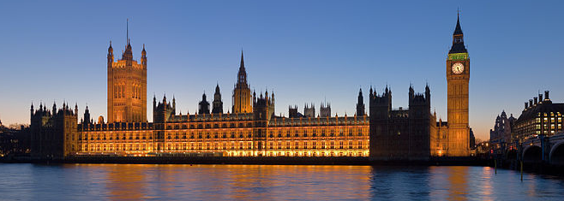
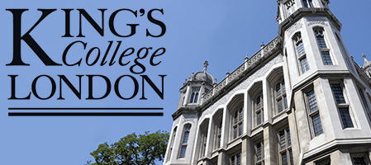
Data Processing and Visualization for CMR
Rashed Karim, Msc PhD

Slide 2
Outline
Data processing – Late enhancement CMR
Clinical application 1
Data visualization – Left atrium
Clinical application 2
Image database for data processing

Slide 3
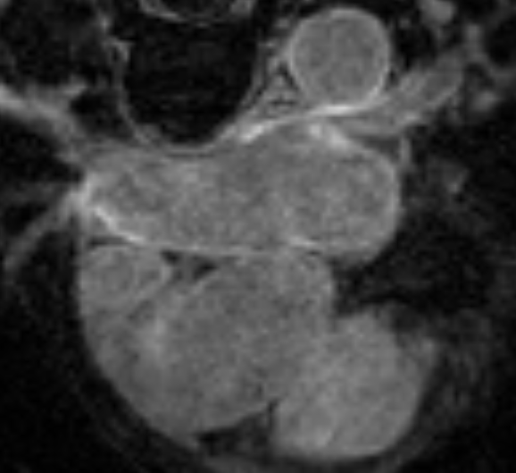
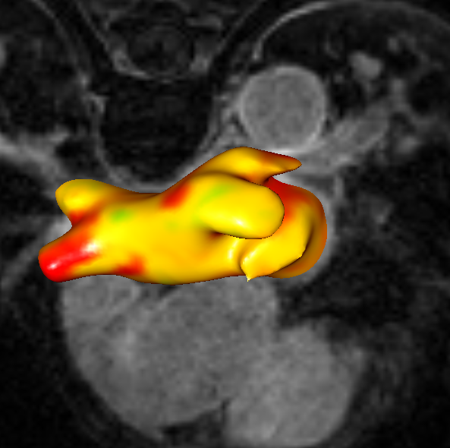
Late enhancement CMR Processing
Registration
References:
1. Knowles B, Caulfield D, Cooklin M et al., 3-D visualization of acute RF ablation lesions using MRI for the simultaneous determination of the patterns of necrosis and edema, IEEE Transactions Biomedical Engineering, 2010

Slide 4
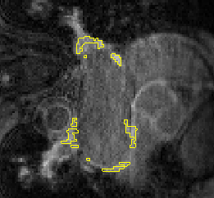
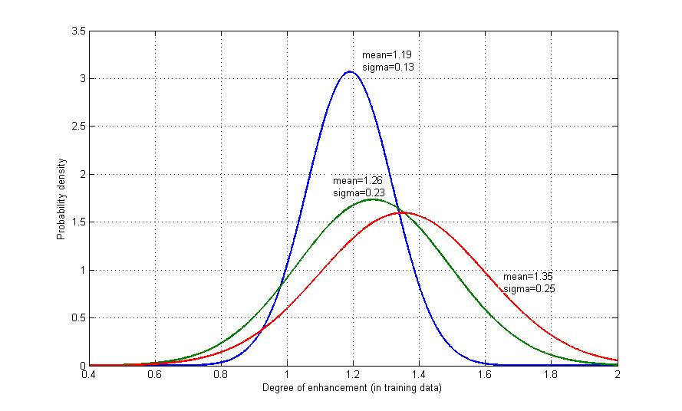
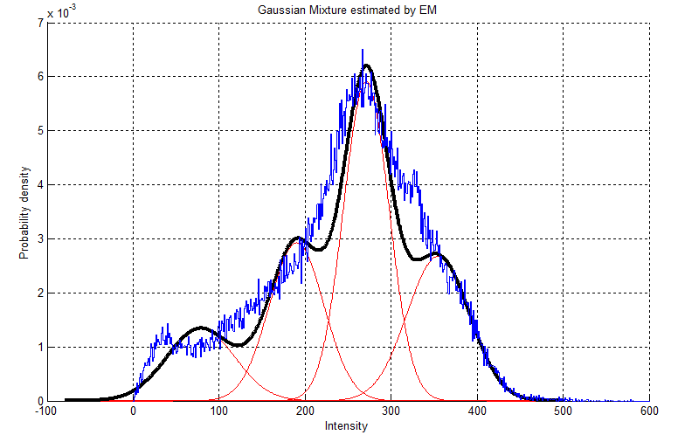
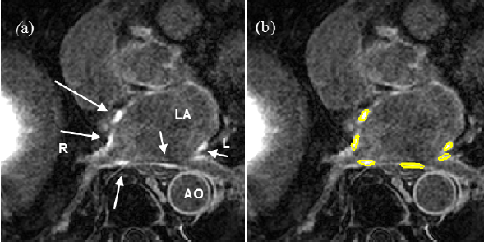
Late enhancement CMR Processing
Scar
Scar training
Training images
Examples of scar intensity distributions
P1
P2
P3
Non-scar
Non-scar tissue model
References:
1. R. Karim, A. Arujuna, R. Housden, et al. A Method to Standardize Quantification of Left Atrial Scar From Delayed-Enhancement MR Images, IEEE Translation Engineering in Health and Medicine, 2014

Slide 5
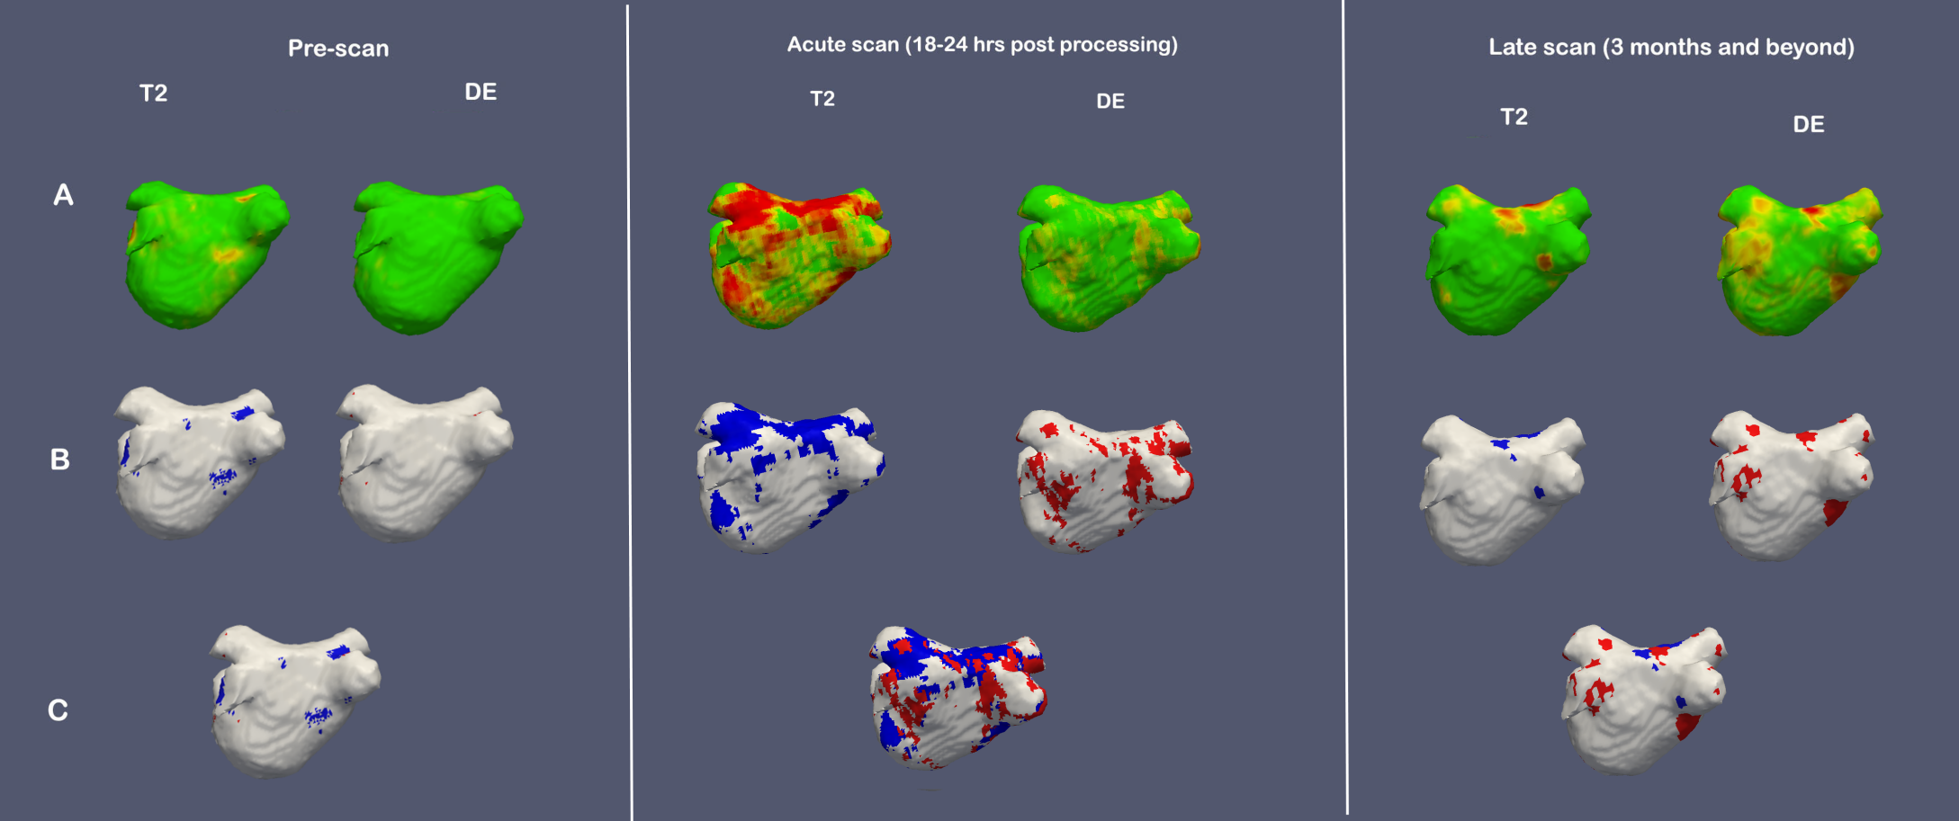
Clinical Application
References:
1 A. Arujuna, R. Karim, D. Caulfield, B. Knowles, K. Rhode, T. Schaeffter, B. Kato, C. A. Rinaldi, M. Cooklin, R. Razavi, M. O’Neill and J. Gill , Acute pulmonary vein isolation achieved by a combination of reversible and irreversible atrial injury following catheter ablation. Evidence from MRI. Circulation: Arrhythmia and Electrophysiology, 2012.

Slide 6
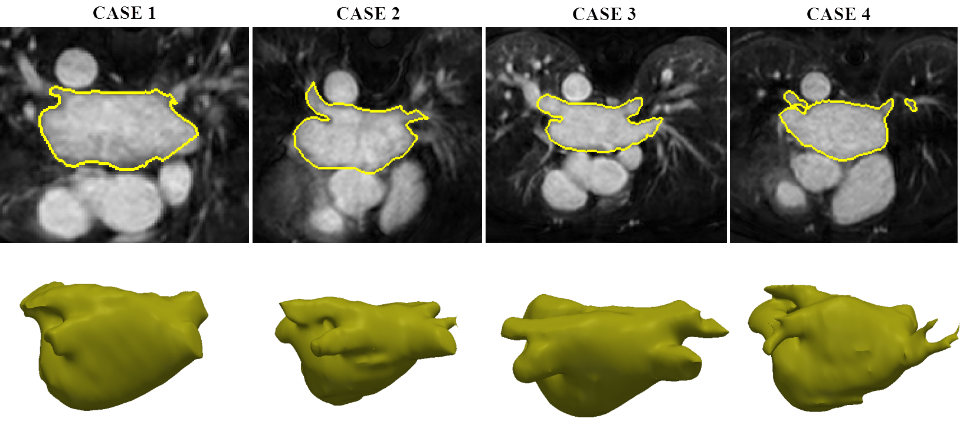
Visualization of Left atrium

Slide 7
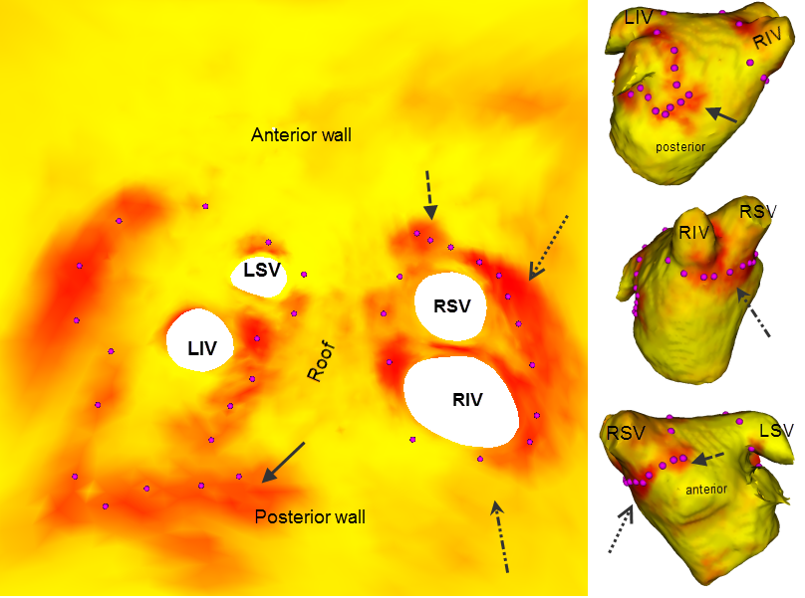
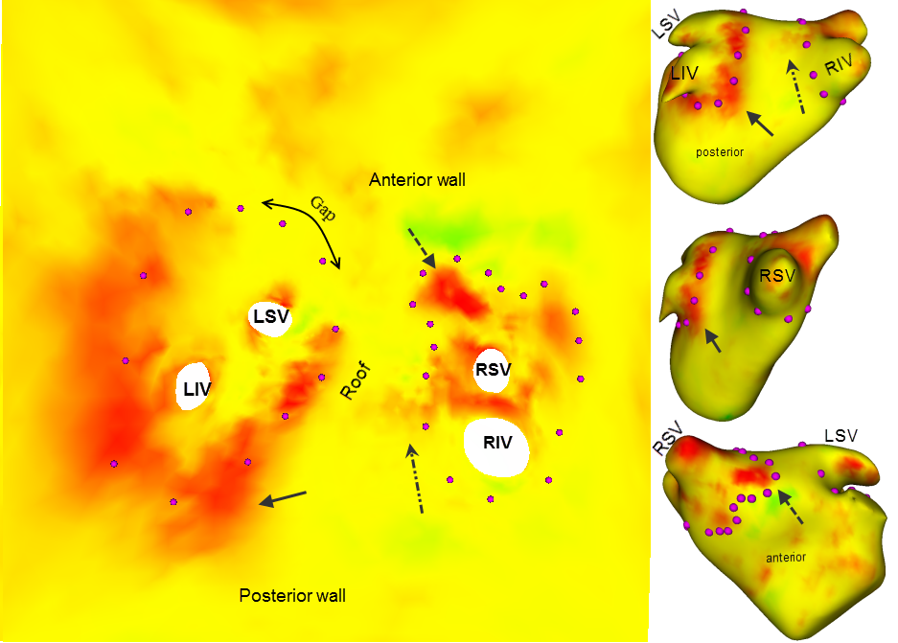
Visualization of Left atrium
References:
1. Karim R, Ma Y, Munjung J, Housden RJ, et al. Surface flattening of the human left atrium and proof-off-concept clinical application, Computerized Medical Imaging and Graphics, 2014 .

Slide 8
Clinical Application

Slide 9
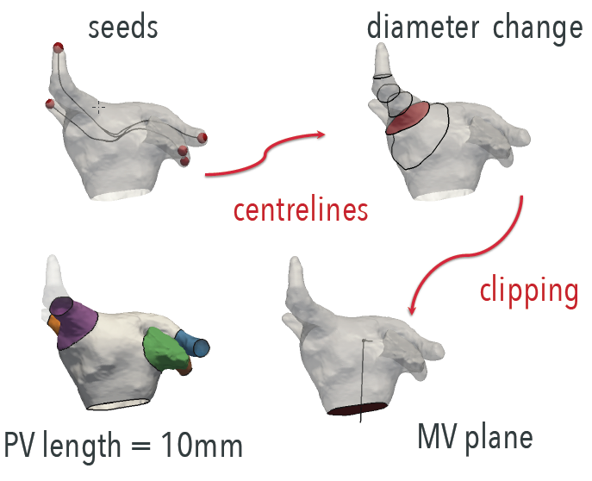
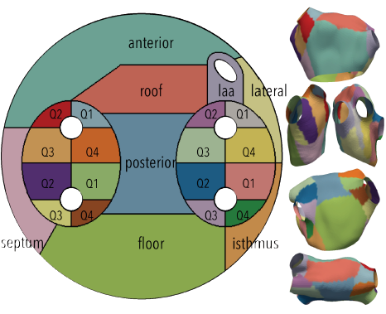
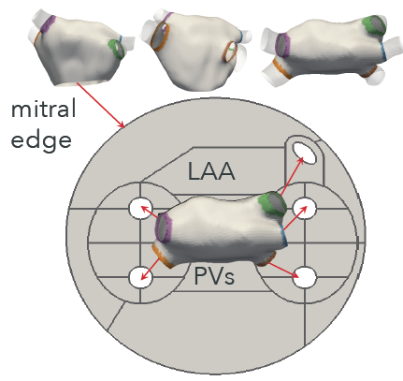
Left atrium Standard Template

Slide 10
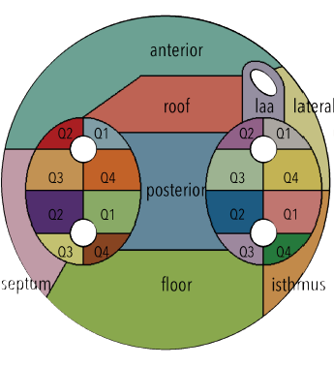
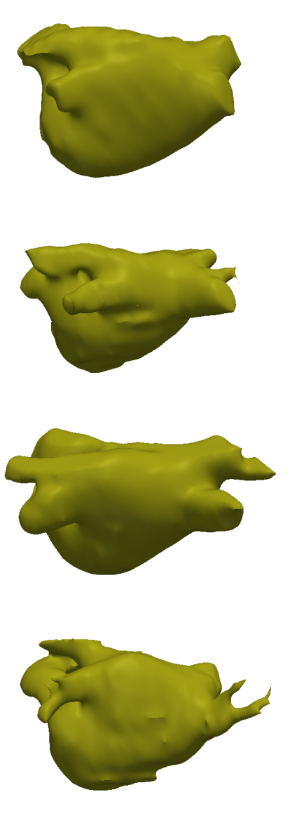
Left atrium Standard Template

Slide 11
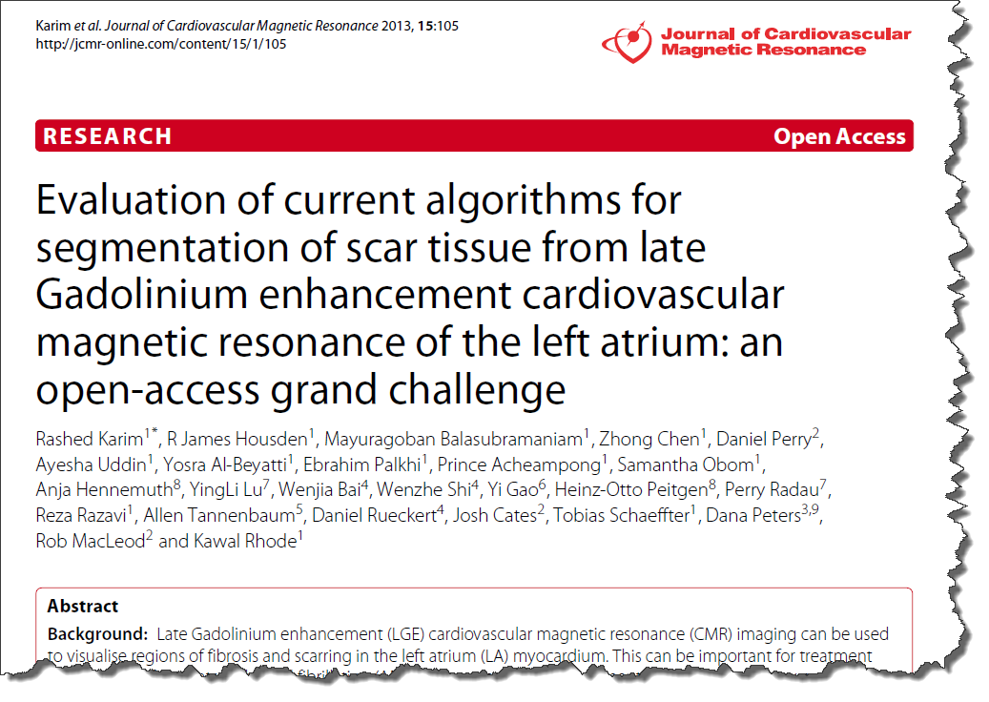
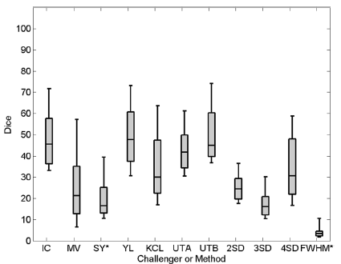
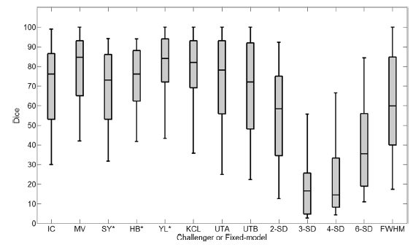
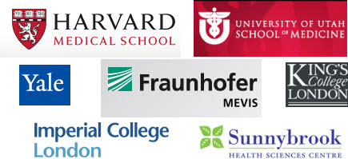
Late enhancement CMR Database
Left atrium DE-MRI challenge¹
30 Pre and 30 Post-ablation DE-MRI
References:
1. Karim R, Housden James, R. Balasubramaniam M., et al. Evaluation of current algorithms for segmentation of scar tissue from late Gadolinium enhancement cardiovascular magnetic resonance of the left atrium. Journal of Cardiovascular Magnetic Resonance 2013.

Slide 12
Late enhancement CMR Database
http://www.doc.ic.ac.uk/~rkarim/lv_framework/

Slide 13
Acknowledgments
Dr. Kawal Rhode
Prof. Reza Razavi
Dr. Aruna Arujuna
Dr. R. James Housden
Dr. Jaswinder Gill
Prof. C. Aldo Rinaldi
Dr. Christian Sohns
Dr. Mark O’Neill
Dr. YingLiang Ma
Dr. Catalina-Tobon Gomez
Dr. Zhong Chen
Prof. Tobias Schaeffter

