Slide 1
Regulatory Approval of New Devices
SCMR 2015 Interventional CMR Workshop
Technology for Interventional cMRI
Steve Wedan

Slide 2
Regulatory Approval
Vital to help ensure true safety and effectiveness of new devices
Tool to help:
Guide us to collective body of safety knowledge: standards
Hold us accountable for careful and methodical design, manufacture, and testing of devices
Force us to make a proof argument for the safety and effectiveness of new devices

Slide 3
Regulatory Approval
Vital to help ensure true safety and effectiveness of new devices
Tool to help:
Guide us to collective body of safety knowledge: standards
Hold us accountable for careful and methodical design, manufacture, and testing of devices
Force us to make a proof argument for the safety and effectiveness of new devices

Slide 4
Where are the iCMR devices?
We have seen presentations and posters for years that show the feasibility of iCMR devices
Yet very few have made it to clinical practice
Regulatory approval process is extremely demanding
MR safety testing can be tricky (applicable standards not always available)
Standards based patient safety requirements can make MR compatibility solutions challenging

Slide 5
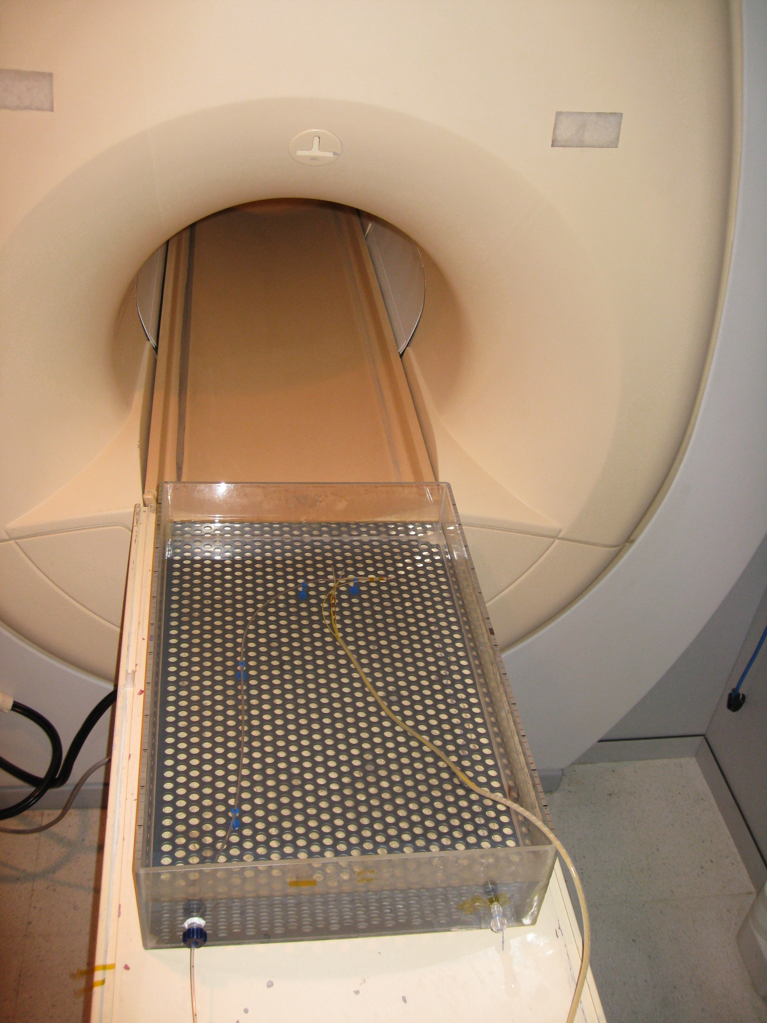
Example: RF Heating of a Catheter
Non-magnetic catheter with no RF heating mitigation technology
ASTM F2182 Phantom
Saline 4.7 mS/cm
SAR = 4 W/kg

Slide 6
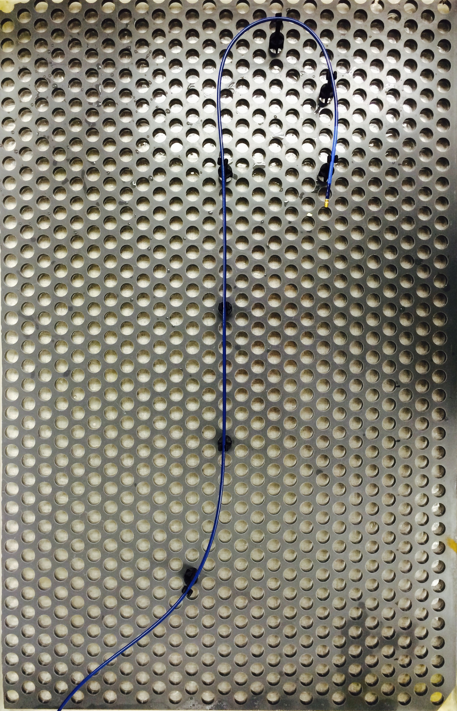
Example: RF Heating of a Catheter
Non-magnetic catheter with no RF heating mitigation technology
ASTM F2182 Phantom
Saline 4.7 mS/cm
SAR = 4 W/kg
Anatomical Trajectory
ΔT = 2.3 °C

Slide 7
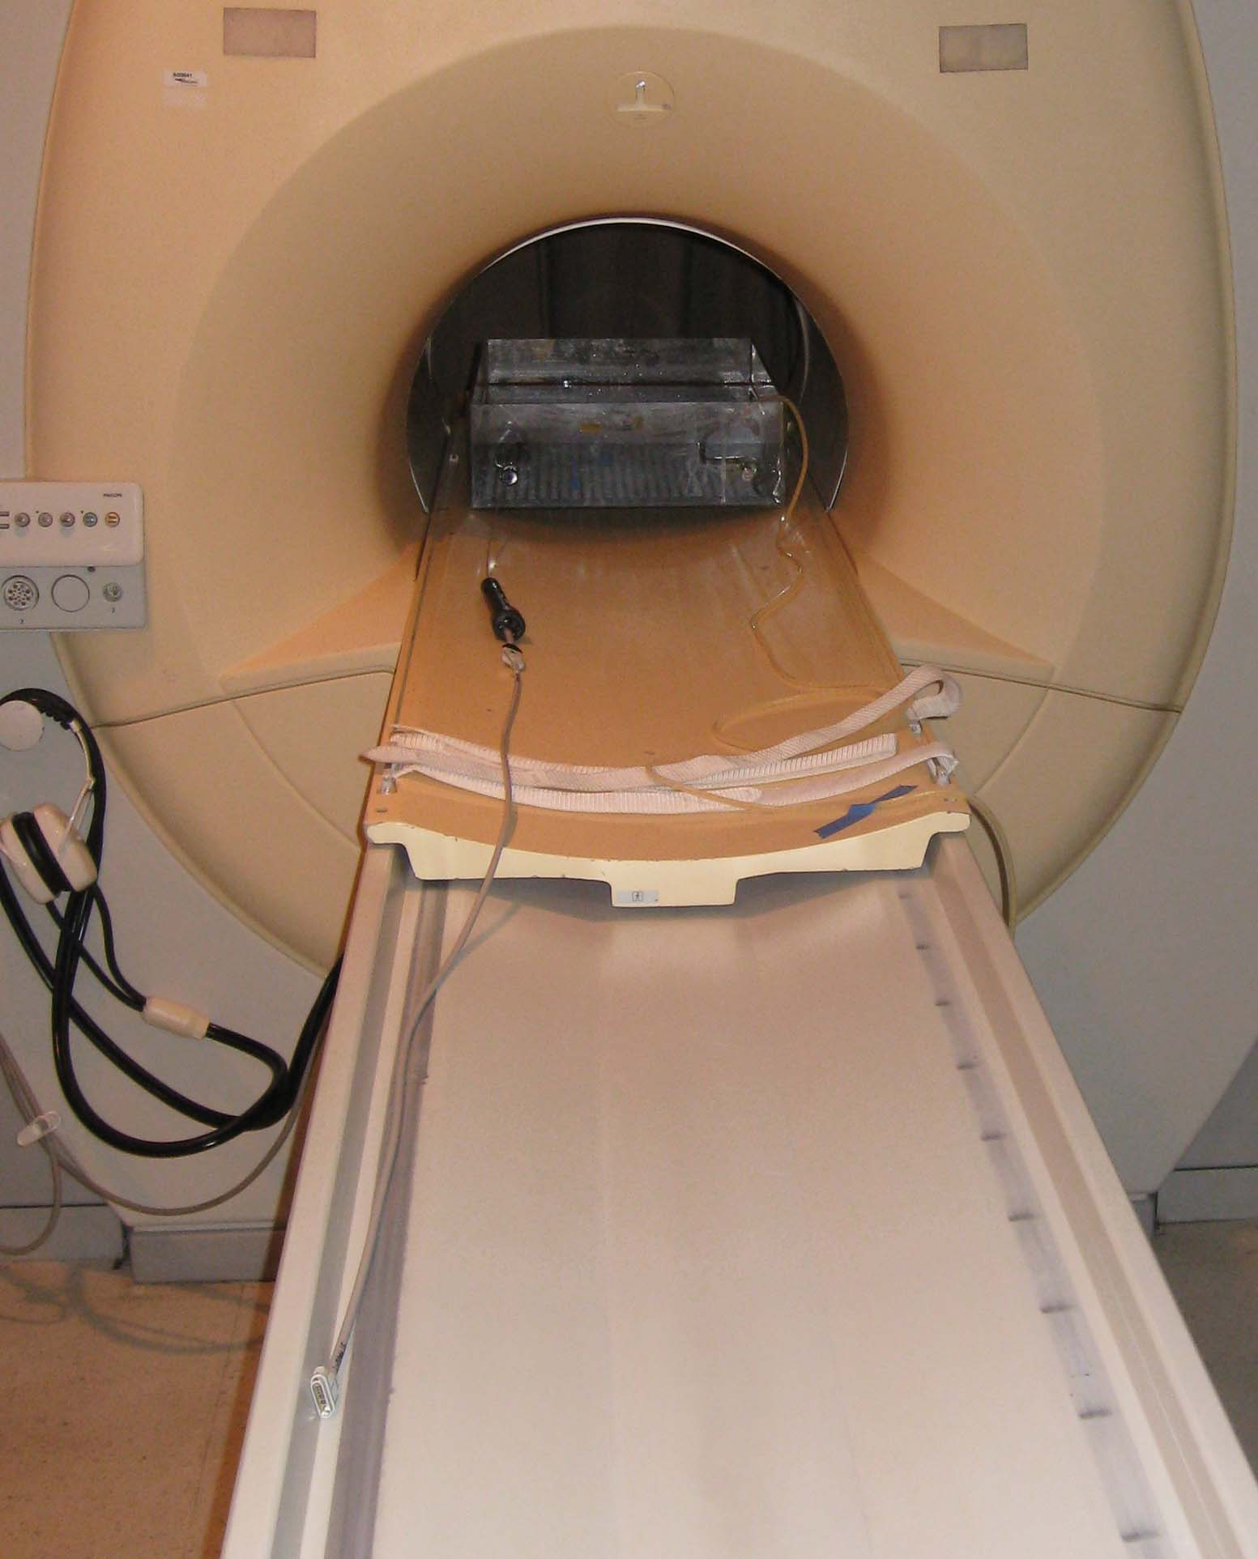
Example: RF Heating of a Catheter
Non-magnetic catheter with no RF heating mitigation technology
ASTM F2182 Phantom
Saline 4.7 mS/cm
SAR = 4 W/kg
Anatomical Trajectory
Catheter Cable Attached
ΔT = 2.3 °C

Slide 8
Example: RF Heating of a Catheter
Non-magnetic catheter with no RF heating mitigation technology
ASTM F2182 Phantom
Saline 4.7 mS/cm
SAR = 4 W/kg
Anatomical Trajectory
Catheter Cable Attached
ΔT = 2.3 °C
ΔT = 3.0 °C

Slide 9
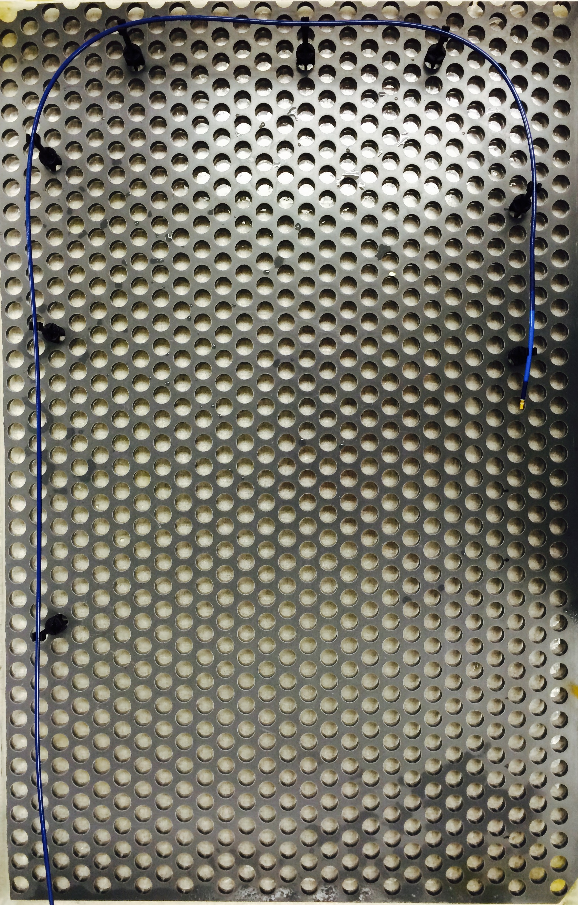
Example: RF Heating of a Catheter
Non-magnetic catheter with no RF heating mitigation technology
ASTM F2182 Phantom
Saline 4.7 mS/cm
SAR = 4 W/kg
Anatomical Trajectory
Catheter Cable Attached
Improved Test Trajectory
ΔT = 2.3 °C
ΔT = 3.0 °C

Slide 10
Example: RF Heating of a Catheter
Non-magnetic catheter with no RF heating mitigation technology
ASTM F2182 Phantom
Saline 4.7 mS/cm
SAR = 4 W/kg
Anatomical Trajectory
Catheter Cable Attached
Improved Test Trajectory
ΔT = 2.3 °C
ΔT = 3.0 °C
E

Slide 11
Example: RF Heating of a Catheter
E fields in the body
are complex

Slide 12
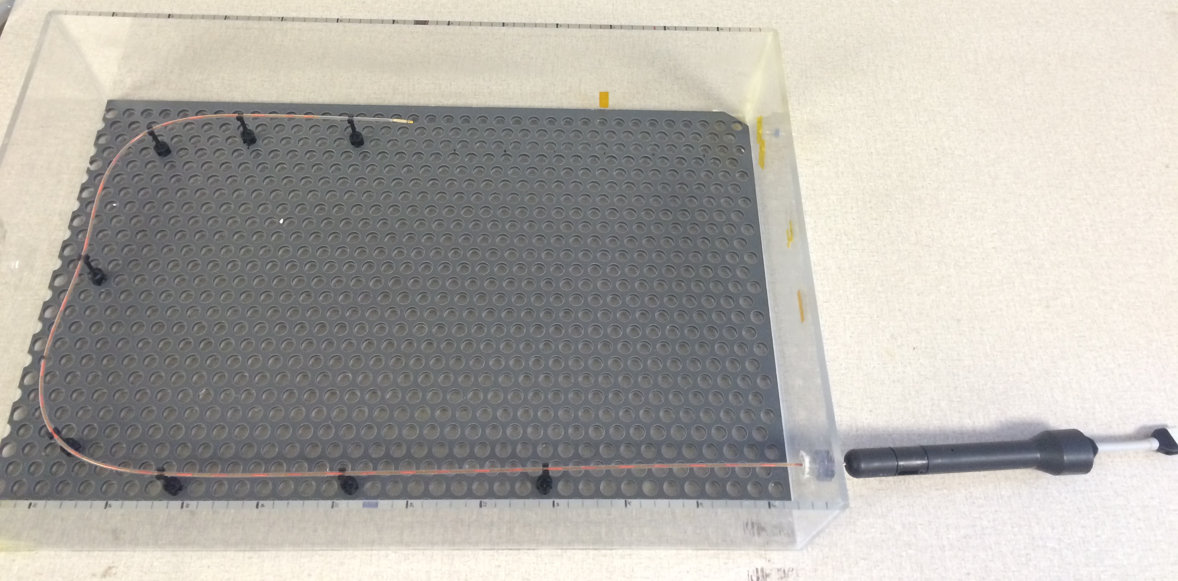
Example: RF Heating of a Catheter
Non-magnetic catheter with no RF heating mitigation technology
ASTM F2182 Phantom
Saline 4.7 mS/cm
SAR = 4 W/kg
Anatomical Trajectory
Catheter Cable Attached
Improved Test Trajectory
Varying Insertion Depths
ΔT = 2.3 °C
ΔT = 3.0 °C

Slide 13
Example: RF Heating of a Catheter
Non-magnetic catheter with no RF heating mitigation technology
ASTM F2182 Phantom
Saline 4.7 mS/cm
SAR = 4 W/kg
Anatomical Trajectory
Catheter Cable Attached
Improved Test Trajectory
Varying Insertion Depths
ΔT = 2.3 °C
ΔT = 3.0 °C
ΔT = 14 °C

Slide 14
Example: RF Heating of a Catheter
Non-magnetic catheter with no RF heating mitigation technology
ASTM F2182 Phantom
Saline 4.7 mS/cm
SAR = 4 W/kg
Catheter Cable Attached
Improved Test Trajectory
Varying Insertion Depths
ΔT = 2.3 °C
ΔT = 3.0 °C
ΔT = 14 °C

Slide 15
Example: RF Heating of a Catheter
Non-magnetic catheter with no RF heating mitigation technology
ASTM F2182 Phantom
Saline 4.7 mS/cm
SAR = 4 W/kg
Catheter Cable Attached
Improved Test Trajectory
Varying Insertion Depth
ΔT = 2.3 °C
ΔT = 3.0 °C
ΔT = 14 °C
ΔT = 22 °C

Slide 16
Example: RF Heating of a Catheter
Non-magnetic catheter with no RF heating mitigation technology
ASTM F2182 Phantom
Saline 4.7 mS/cm
SAR = 4 W/kg
Catheter Cable Attached
Improved Test Trajectory
Varying Insertion Depth
Tissue Mimicking Gel
ΔT = 2.3 °C
ΔT = 3.0 °C
ΔT = 14 °C
ΔT = 22 °C

Slide 17
Example: RF Heating of a Catheter
Non-magnetic catheter with no RF heating mitigation technology
ASTM F2182 Phantom
Saline 4.7 mS/cm
SAR = 4 W/kg
Catheter Cable Attached
Improved Test Trajectory
Varying Insertion Depth
Tissue Mimicking Gel
ΔT = 2.3 °C
ΔT = 3.0 °C
ΔT = 14 °C
ΔT = 22 °C
ΔT = 72 °C

Slide 18
Example: RF Heating of a Catheter
A better way to test a new device for MR safety involves methods from ISO TS 10974:
“Assessment of the safety of magnetic resonance imaging for patients with an active implantable medical device”
This may soon be required, as the TS becomes a standard

Slide 19
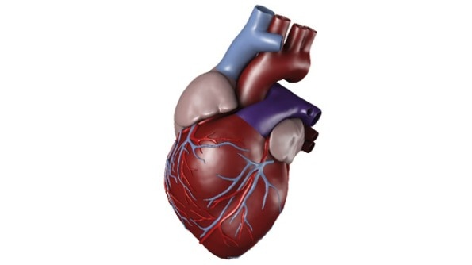
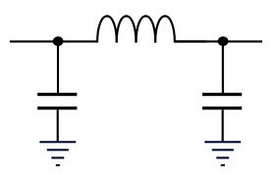
Example: Physiological Signal Filter
L = 75μH
EP Amplifier
C = 1600 pF
C = 1600 pF
f_{c} = 680 kHz
-85 dB @ 64 MHz

Slide 20
Example: Physiological Signal Filter
L = 75μH
EP Amplifier
C = 1600 pF
C = 1600 pF
f_{c} = 680 kHz
-85 dB @ 64 MHz

Slide 21
Example: Physiological Signal Filter
I_{leak}
L = 75μH
EP Amplifier
C = 1600 pF
C = 1600 pF
f_{c} = 680 kHz
-85 dB @ 64 MHz

Slide 22
Example: Physiological Signal Filter
C_{total} < ~100 pF
L = 75μH
EP Amplifier
C = 1600 pF
C = 1600 pF
f_{c} = 680 kHz
-85 dB @ 64 MHz

Slide 23
Where are the iCMR devices?
They are coming, but slowly
Part of the problem:
People tend to underestimate the challenge

Slide 24
We need to help each other.¹
Researchers shouldn’t necessarily be experts in regulation and standards
But experts in regulation and standards do exist
We are happy to help
We are not selling a test service, but we can offer a bit of guidance
We can help you:
Understand the safety issues
Do the right tests the right way
Properly scope out what yet needs to be done
¹ Lederman R., Schaeffter T., Email to SCMR iCMR Workshop speakers, 2015

Slide 25
Regulatory Approval of New Devices
SCMR 2015 Interventional CMR Workshop
Technology for Interventional cMRI
Steve Wedan (CEO): steve.wedan@imricor.com
Tom Lloyd (VP Research): tom.lloyd@imricor.com

