Slide 1
HeartVista Interventional Platform
(RTHawk)

Slide 2
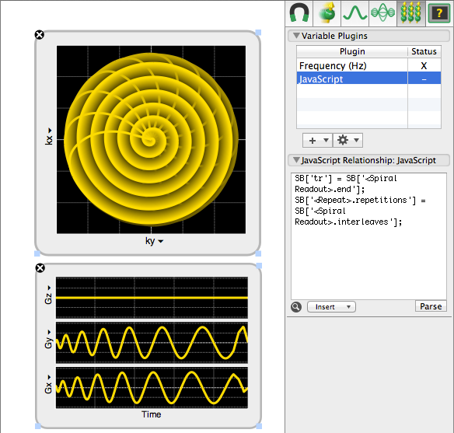
Open Architecture MRI OS
Simplified application development

Slide 3
Open Architecture MRI OS
Simplified application development
Real-Time acquisition and control

Slide 4
Open Architecture MRI OS
RT Color Flow
Simplified application development
Real-Time acquisition and control
On-the-fly sequence interchange
Real-Time
RT & CINE MR Doppler
High-Resolution
2D & 3D
Interventional MRI (tracking)
Interventional MRgFUS

Slide 5
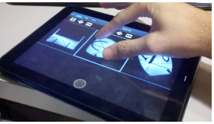
Open Architecture MRI OS
Simplified application development
Real-Time acquisition and control
On-the-fly sequence interchange
Customizable visualization
Courtesy: Andrew Holbrook, Ph.D.
Courtesy: Graham Wright, Ph.D.

Slide 6
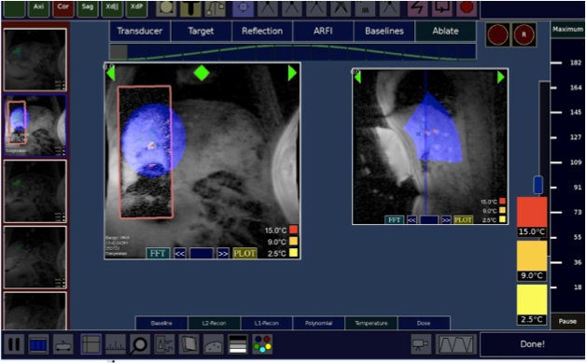
Open Architecture MRI OS
Simplified application development
Real-Time acquisition and control
On-the-fly sequence interchange
Customizable visualization
Device integration
HIFU Ablation in the Breathing Liver

Slide 7
Network of iMRI Collaboration
Various academic participants including: Sunnybrook, UCSF, Stanford, U. Dundee, U. Wisconsin, Robarts, Kinderspital Zurich, U. Virginia.
Project areas:
MR-guided EP
MR-guided Fus
MR-guided CED
Real-Time MRI & CMR
Advanced and high performance reconstruction

