Slide 1
Imaging the <Left Ventricular> Arrhythmic Substrate ‘How we do this…’
Daniel A. Herzka, PhD
Department of Biomedical Engineering
Johns Hopkins School of Medicine

Slide 2
Disclosure:
DA Herzka: Funding from Siemens Medical Systems
(unrelated project)
Notes:
TO DO : REMove red line (different master)

Slide 3
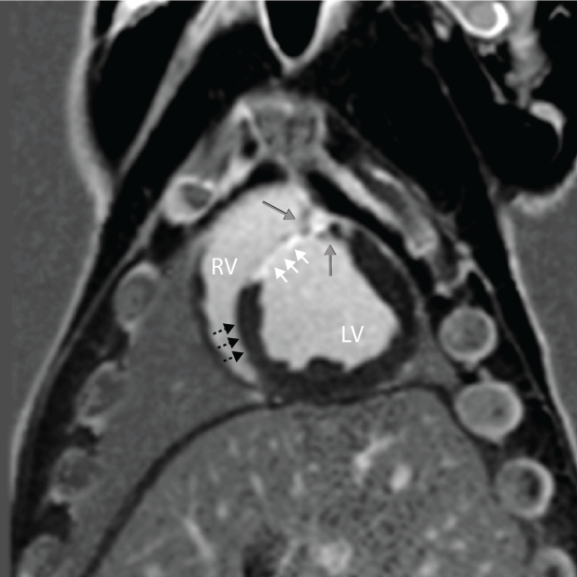
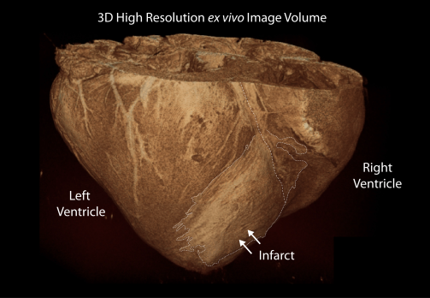
In vivo MR Tissue Viability Imaging (swine) Late Gadolinium Enhancement (LGE)
1.25x125x5.0 mm³
~ 30 second Breath-hold (untenable)

Slide 4
Why LGE? MRI & EP and electroanatomical mapping (EAM)
Ashikaga et al. showed that in swine 1) electrically defined scar may not reflect real scar distribution, and 2) scar has complex structure
(ex vivo, 3D, 400 um³ isotropic) [Circ Res. 2007;101]
Bogun et al. showed LGE-MRI can identify arrhythmogenic substrate
(in vivo, 2D, 1.4x1.4x8.0 mm³) [JACC 2009;53]
Estner et al. showed that in swine the critical isthmuses associated with VT are located within the heterogeneous zone (HZ)
(in vivo, 2D 1.25x1.25x5.0 mm³) [Heart Rhythm 2011;8]
Perez-David et al. demonstrated that in patients slow conduction channels on EAM are within the HZ on LGE-MRI
(in vivo, 2D 1.48x1.66x5.0 mm³) [JACC 2011;57]
Notes:
Show that channels in myocardium are of interest;

Slide 5
Why LGE? MRI & EP and electroanatomical mapping (EAM)
Andreau et al. showed that
1) LGE-MRI can be integrated into EAM platforms for procedure guidance
(in vivo, 3D, 1.4 mm³ isotropic) [Circ Arrhythm Electrophysiol 2011;4]
2) LGE –MRI can identify some of the ablation targets/substrate, as well as access (endo vs. epi) route
(in vivo, 2D, 1.4x1.4x10 mm³ ) [Eur Heart J 2014; 35]
Fernandez-Armienta et al. recently demonstrated that in patients with healed MI scar displays a complex 3D pattern, with significant epicardial scar
(in vivo, 3D, 1.4 mm³ isotropic) [Circ Arrhythm Electrophysiol. 2013;6]
Peters et al. showed that 3D LGE > 2D LGE for depiction of enhancement pattern including papillary involvement
(in vivo, 3D, 1.3x1.4x5.0 mm³) [JMRI 2009; 30]
Andreau et al. have shown that for LGE, 3D GRE > 2D GRE or 2D SSFP for detection of the HZ and identification of slow conduction channels (targets)
(in vivo, 3D, 1.4 mm³ isotropic) [Europace 2015: early view]
And many more…
Notes:
Show that channels in myocardium are of interest;

Slide 6
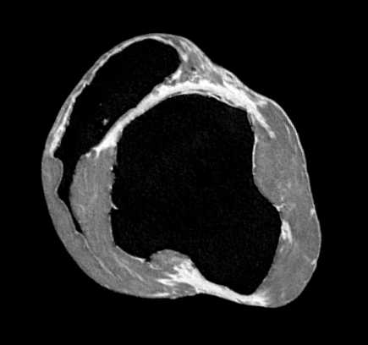
3D LGE-MRI in the LV
We know LGE is good at depicting complex scar/viable tissue and the <larger> slow conduction channels within or around scar
ex vivo resolution is what want...
~ 1 hr scan
Acq: 0.25x0.25x0.5 mm³
Rec: 0.25x0.25x0.25 mm³
Notes:
Swine; ~ 4 mo post MI

Slide 7
Our Approach High-resolution LGE-MRI
Target Resolution: ~ 1 mm³ isotropic
Amount of tissue needed for conduction (?)
Need: High quality, good SNR+CNR
Technique:
3D & 3T: increase SNR to support desired resolution
Free-breathing: respiratory navigators to remove breath-hold constraints
Use PSIR to increase SNR and reduce effects of time-varying inversion time (TI). No more worrying about nulled myocardium.
Assume long scan time (every minute of MR saves many minutes of fluoro)

Slide 8
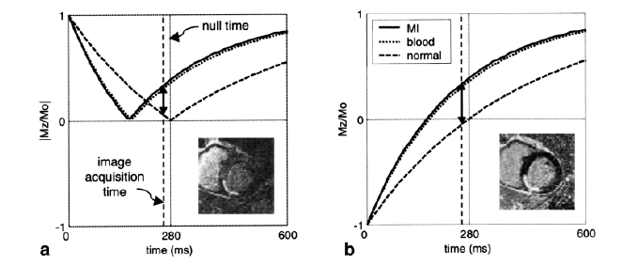
Breath-hold 2D PSIR-LGE¹ Pulse Sequence
2 Heartbeats per segment
First: IR-prepared Image (T1-weighted)
Second: Phase reference
Insensitive to TI
2nd heartbeat increases SNR (T1-recovery)
¹Kellman et al. MRM 2002

Slide 9
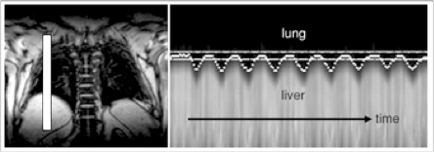
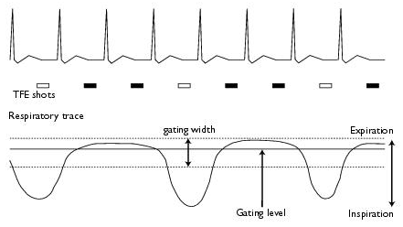
Motion Compensation Diaphragmatic Respiratory Navigators
http://media.wiley.com...
Navigator
Gating - Philips online help
Slide Courtesy of H. Ding

Slide 10
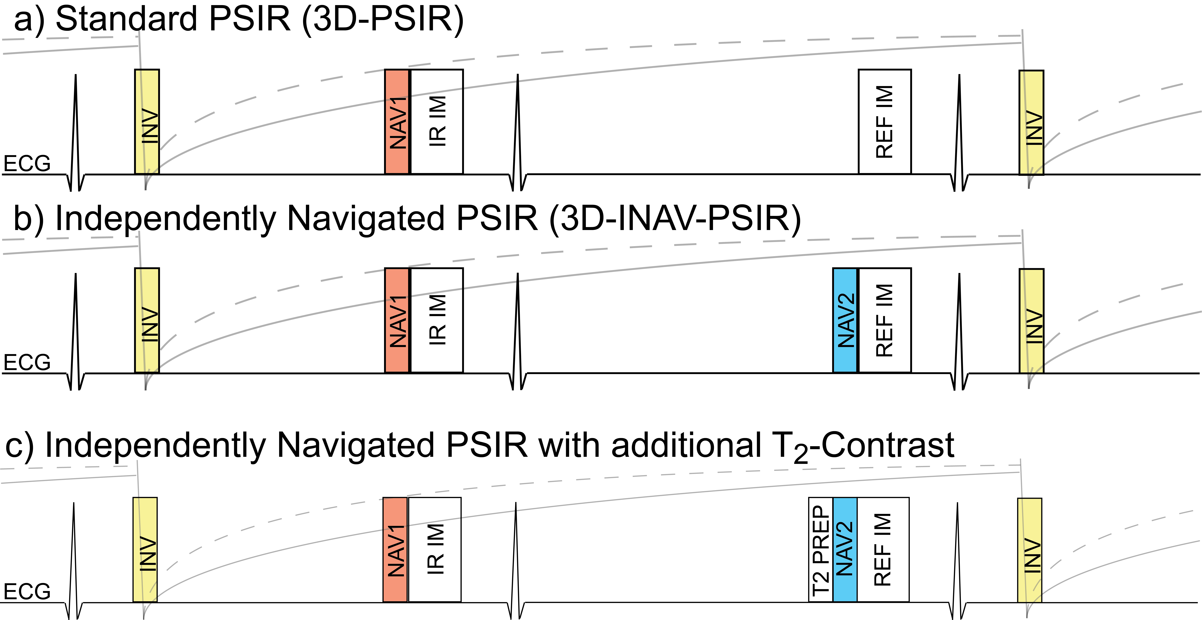
Free-breathing 3D PSIR-LGE Pulse Sequence
Independent Respiratory Navigators (INAV)¹
Current vendor implementations add 1 NAV for the IR-prepared volume. None for phase reference.
The lack of respiratory motion compensation in the reference volume in standard 3D PSIR leads to artifacts
The addition of a second independent NAV yields a clean phase reference volume
Each volume fills independently
Independent navigator templates may be used as contrast can vary
¹ S. Laurence Lee, ISMRM 2011

Slide 11
Free-breathing 3D PSIR-LGE Pulse Sequence Other details
Scan Duration (actual):
7-12 min (in swine) with nav. efficiency ~33-55%
Scan Start:
8-10 min post injection double dose Gd-based contrast agent
Acceleration: Rate 2 SENSE
Centric PE order
TI drift minimized
Diastolic acquisition window: 100 ms (max) – min temporal blur
No partial echo/partial Fourier - min spatial blur
Orientation: SAX
Readout: Spoiled gradient echo (SPGR)
NAV acceptance window: 2-4 mm – min spatial blur
Notes:
In humans, with lower efficiencies these scans would take ~ 15-18 min.

Slide 12
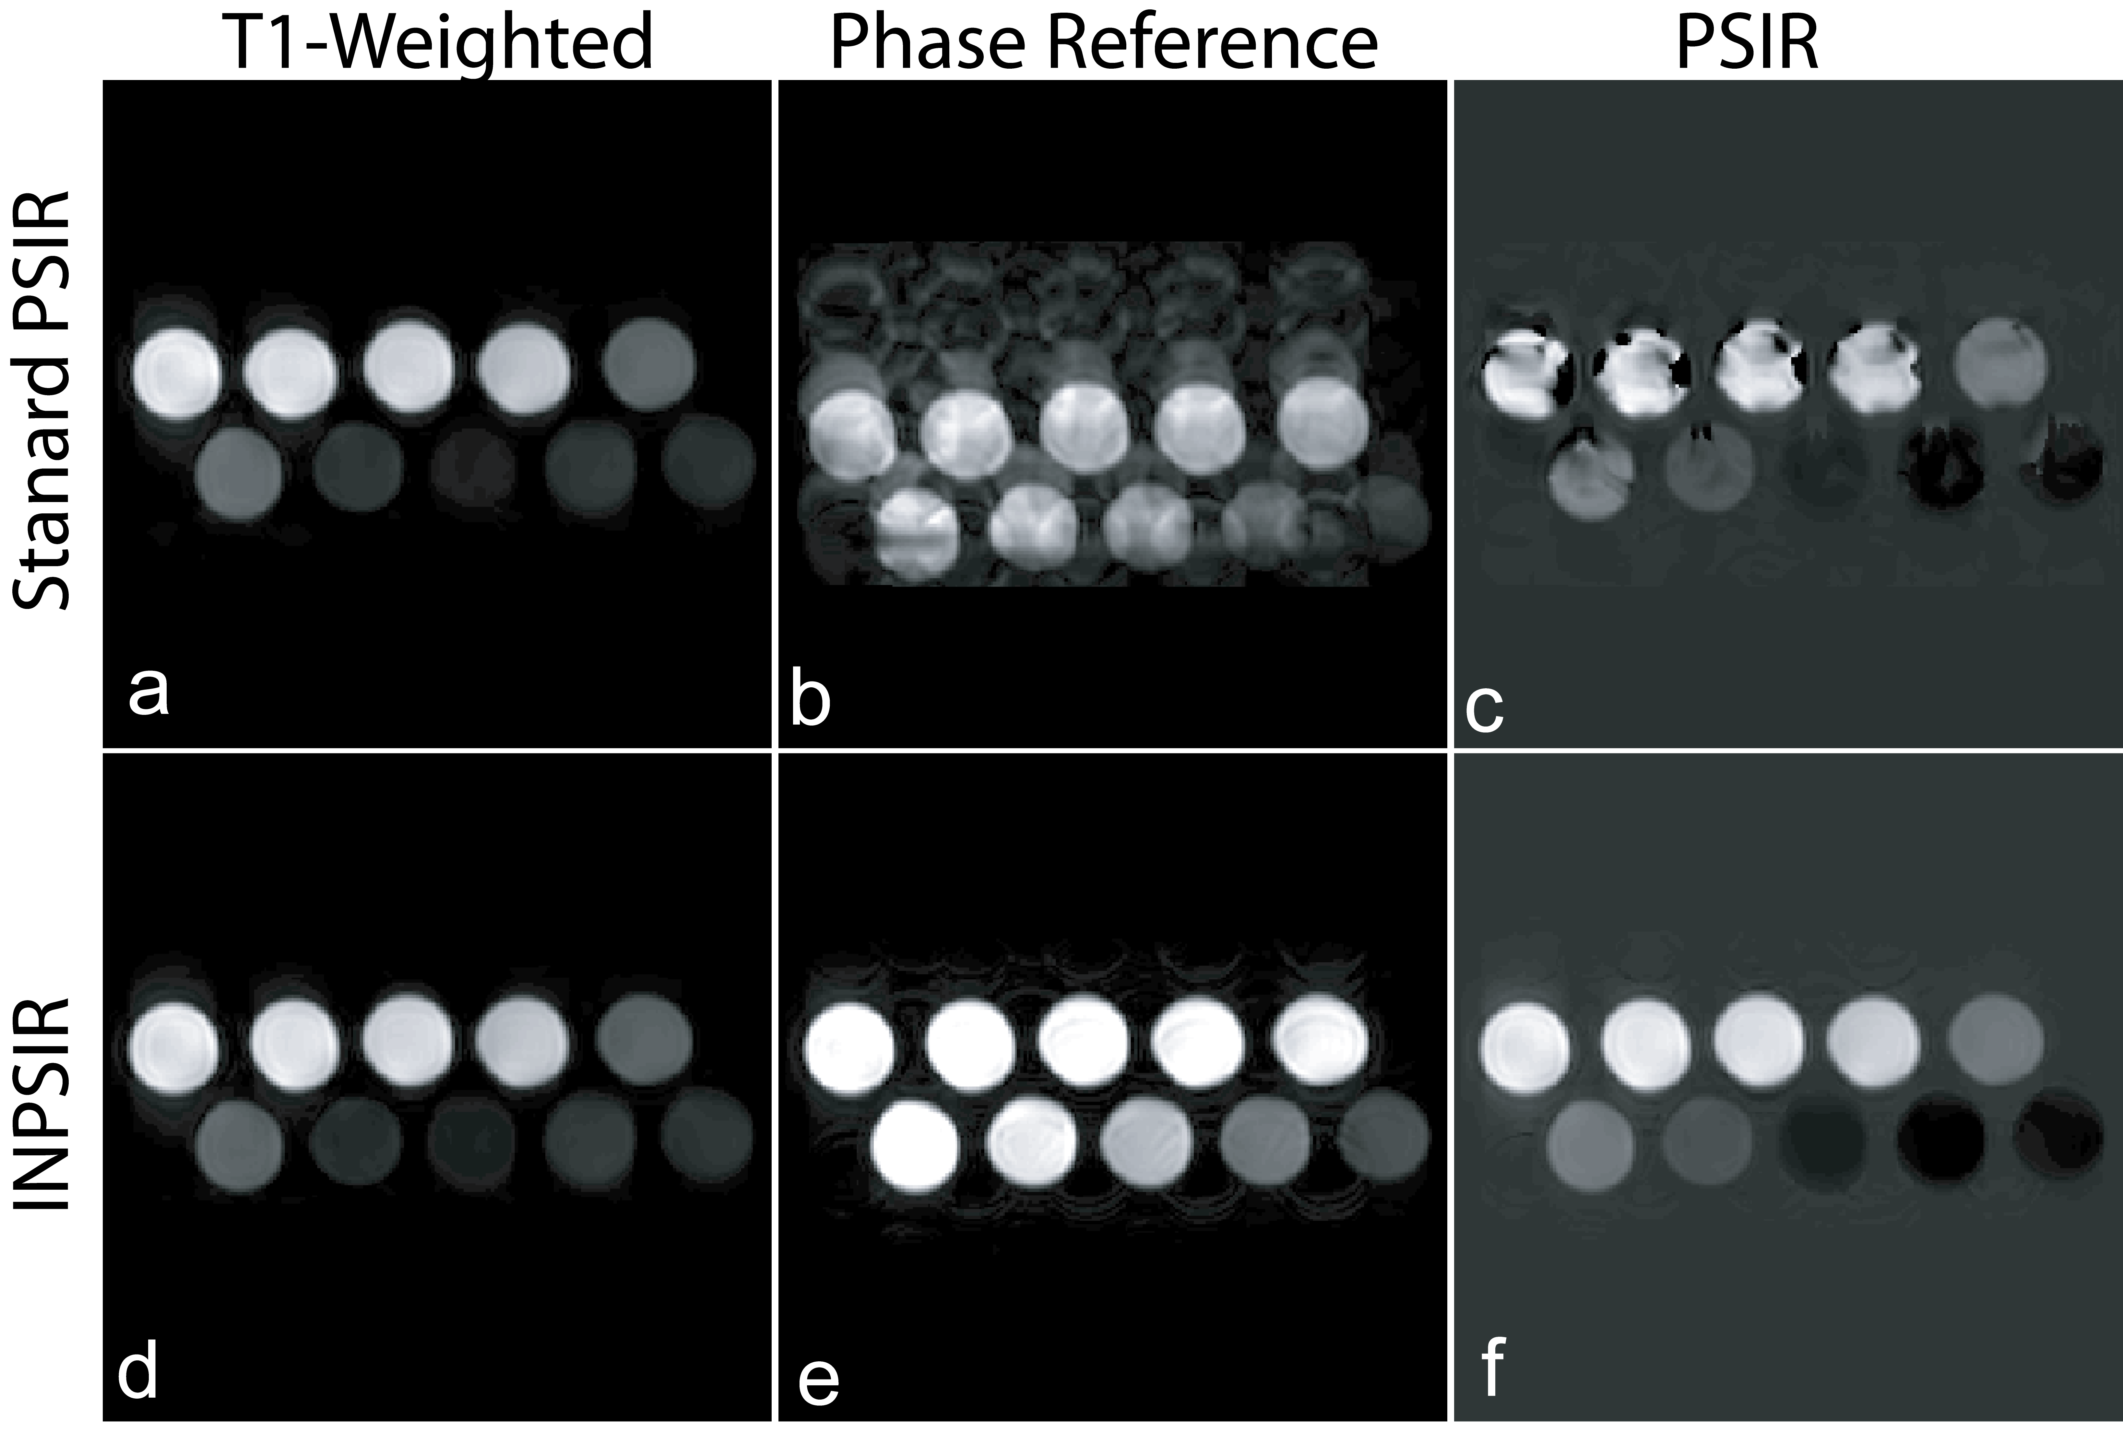
Respiratory Motion Compensation Independent Navigators - Phantoms
IR-Prepared
Volume
Reference
Volume
PSIR
Volume
3D-PSIR
3D-INAV-PSIR
¹ S. Laurence Lee, ISMRM 2011

Slide 13
3D Phase Sensitive Inversion Recovery w/ Independent Navigators (INAV)
Acq:1.0x1.25x3.00 mm³
Rec: 0.7x0.7x1.5 mm³
Notes:
Sample 3D PSIR-LGE (independently navigated volumes). Much better for scar delineation than 2D.
Animal with Chronic MI (11 Months post MI)

Slide 14
3D Phase Sensitive Inversion Recovery w/ Independent Navigators (INAV)
Acq:1.0x1.25x3.00 mm³
Rec: 0.75x0.75x1.5 mm³
Notes:
Sample 3D PSIR-LGE (independently navigated volumes). Much better for scar deliniation than 2D.
Animal with Chronic MI (~11 Months post MI) B706 – If there is time, repeat with videos that are in focus

Slide 15
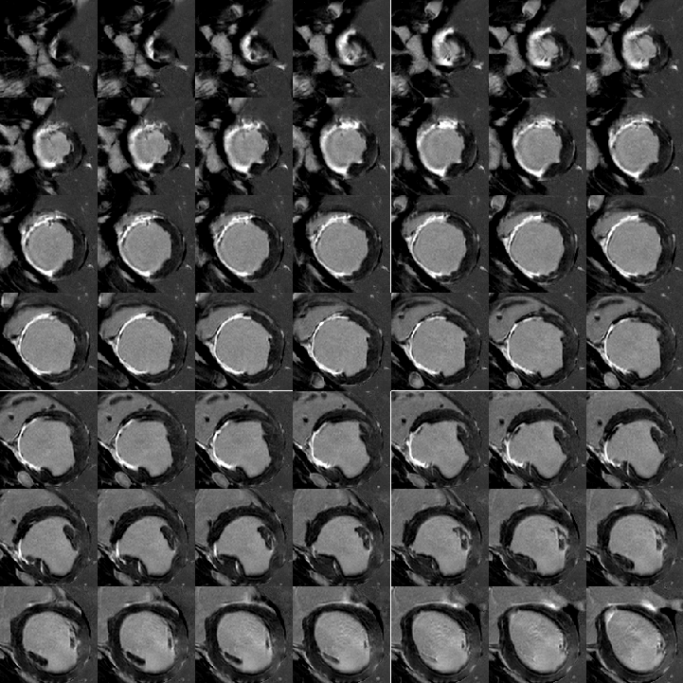
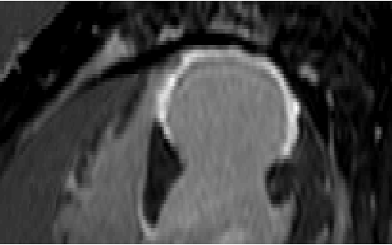
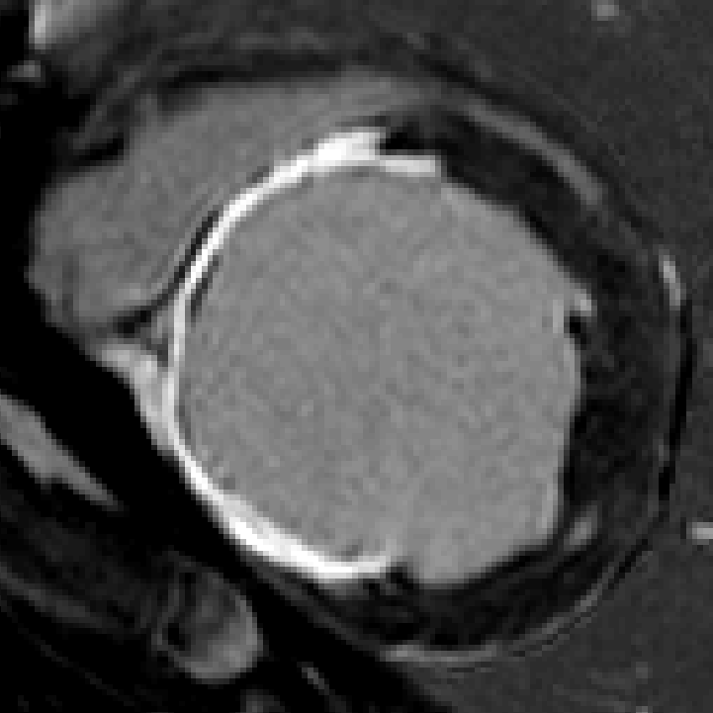
3D Phase Sensitive Inversion Recovery w/ Independent Navigators (INAV)
Acq:1.0x1.25x3.00 mm³
Rec: 0.7x0.7x1.5 mm³
Notes:
Sample 3D PSIR-LGE (independently navigated volumes). Much better for scar deliniation than 2D.
Animal with Chronic MI (4 Months post MI)

Slide 16
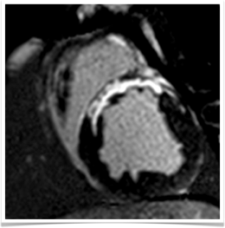
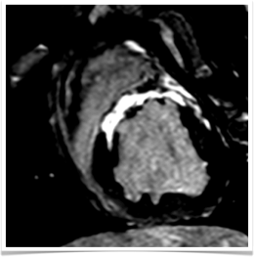
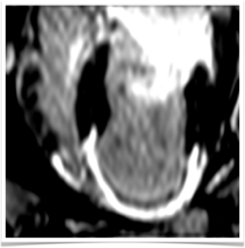
2D vs. 3D
2D Breath-hold PSIR
3D Free-breathing PSIR
SAX
30 sec BH per slice
LAX Reformat
1.25×1.25×5 mm³
1.0×1.25×3.0 mm³
ISMRM 2012, #3937
Notes:
Comparison of 2D vs 3D in chronic MI animals. Note breath-hold acquisition requires 30 second breath-hold!
High res is needed to plan a VT ablation procedure.
Contrast difference between 2D and 3D is a result solely of contrast kinetics – there is reduced partial volume averaging in 3D, but we always ran the 3D after the 2D.

Slide 17
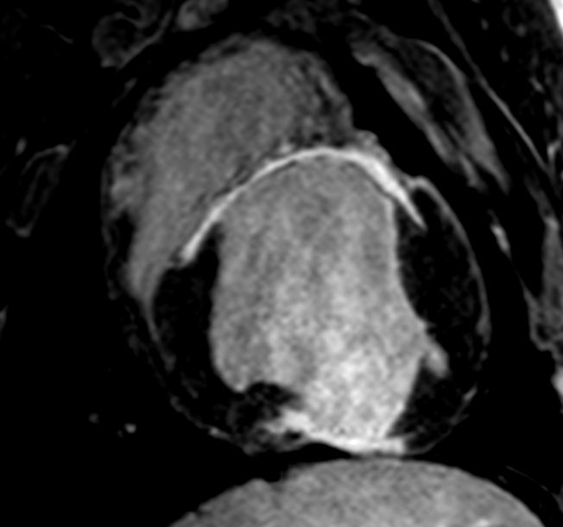
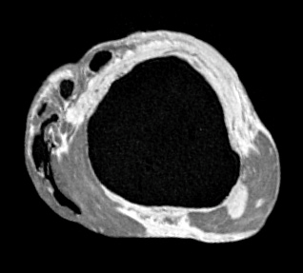
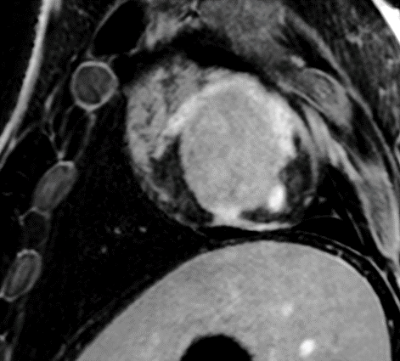
3D Phase Sensitive Inversion Recovery in vivo vs. ex vivo
Acq:0.75x1.0x2.0 mm³
Rec: 0.7x0.7x1.5 mm³
Acq:0.25x0.25x0.5 mm³
Rec: 0.25x0.25x0.25 mm³

Slide 18
Assessment of Arrhythmic Substrate Detection of channels/heterogeneity
Notes:
Visualization of live myocardium channel through heterogeneous scar visible with the high-res acquistition.

Slide 19
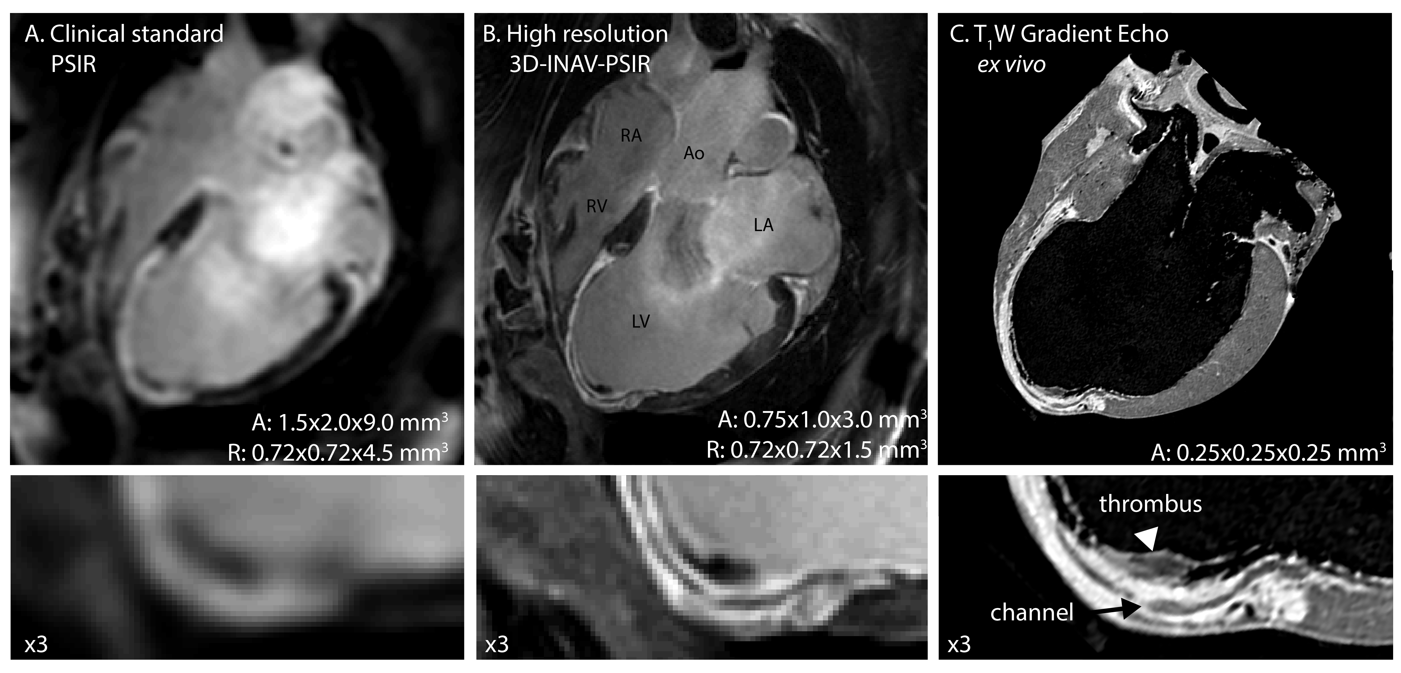
Assessment of Arrhythmic Substrate Detection of channels/heterogeneity
Notes:
Clinical resolution PSIR. B. High Res 3D PSIR LGE. C. Ex vivo SPGR reformat
Lowrest Row, magnifications
Animal had a 6 Mo chrnic MI. Shows channel in apical scar involved in a CT circuit, confirmed by EP induction study.
Lo res confuses a thrombus at the apex with a live myocardium and completely misses channel. High Res 3D is able to depict the channel.
(We now acquire at 0.75x1.0x1.5 Reconned to 0.75 isotropic). Looks very nice.

Slide 20
Segmentation / Target Selection
Notes:
Clinical resolution PSIR. B. High Res 3D PSIR LGE. C. Ex vivo SPGR reformat
Lowrest Row, magnifications
Animal had a 6 Mo chrnic MI. Shows channel in apical scar involved in a CT circuit, confirmed by EP induction study.
Lo res confuses a thrombus at the apex with a live myocardium and completely misses channel. High Res 3D is able to depict the channel.
(We now acquire at 0.75x1.0x1.5 Reconned to 0.75 isotropic). Looks very nice.

Slide 21
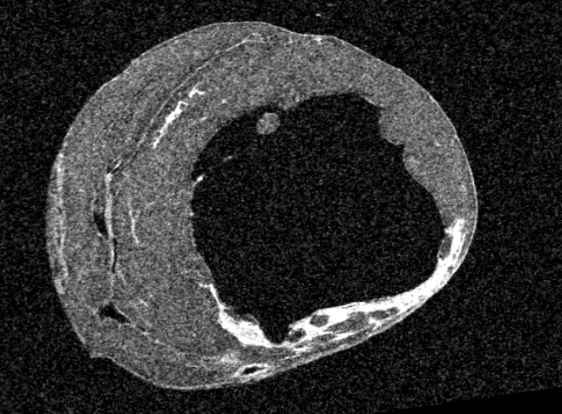
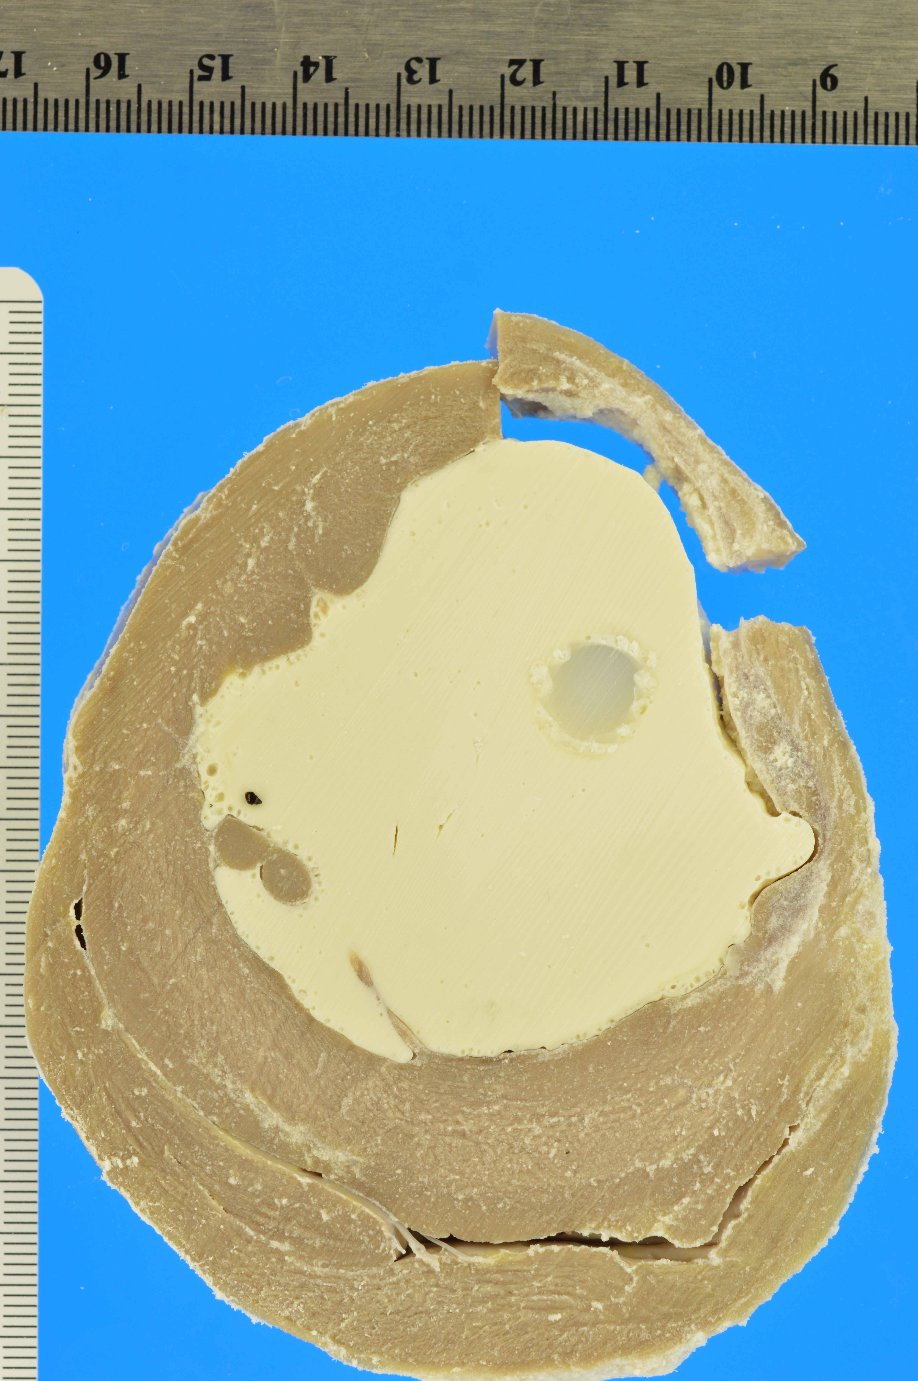
How far do we go?
ex vivo T1-W SPGR
Photography (pre-histology)
Acq: 0.25x0.25x0.5 mm³
Rec: 0.25x0.25x0.25 mm³
Notes:
Case C459 – Ex vivo MRI (lo res version as high res is much noisier than usual due to Siemens scan –bad head coil?)

Slide 22
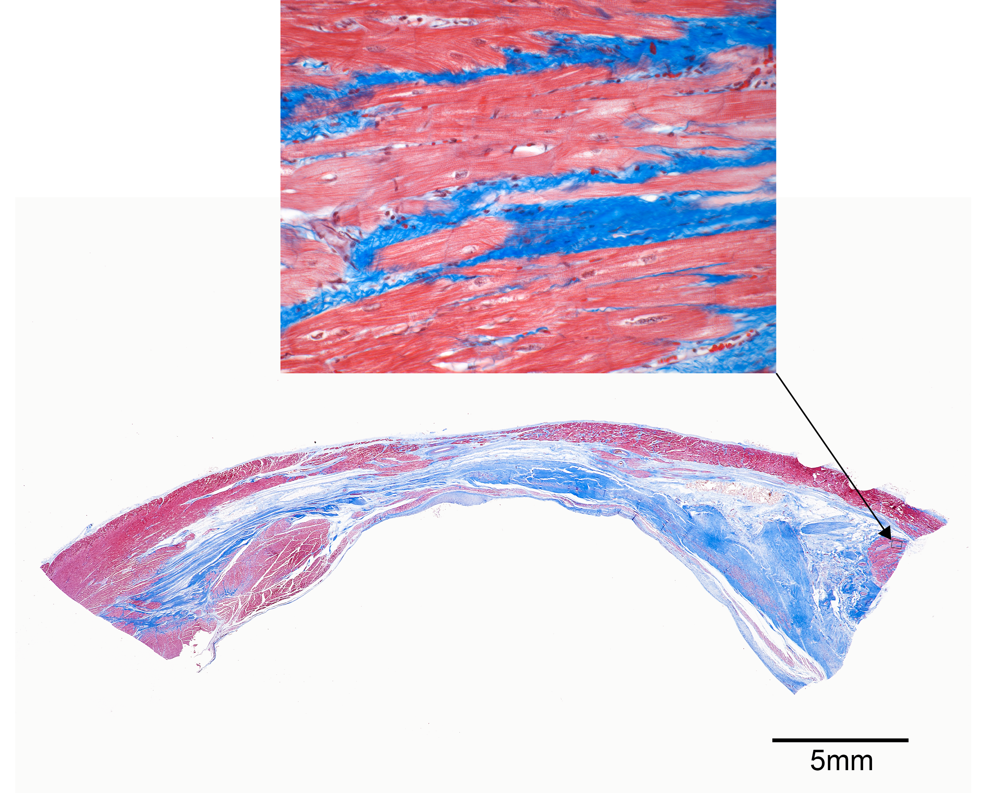
How far do we go?

Slide 23
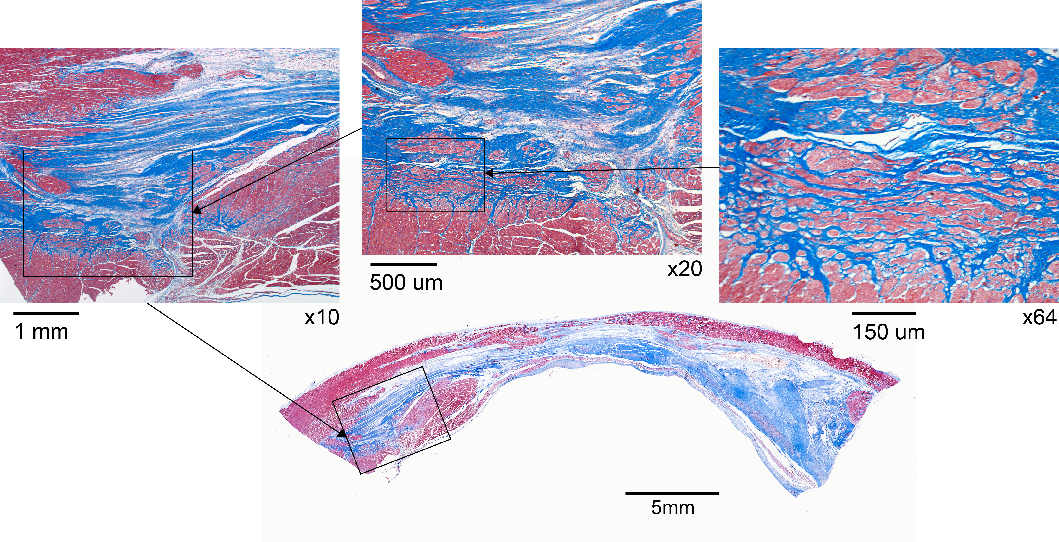
How far do we go?
Not too far…

Slide 24
Recommendations
For high-res imaging: 3T, 3D, PSIR
PSIR-LGE
Removes need for exact TI
Increases image SNR (longer T1 recovery)
Get INAVs (from your friendly vendor)
Imaging for EP guidance
Take the time to get high quality images (speed will come)
Quality means better segmentation
There are enough outstanding questions without adding doubt from MRI
Do the LGE scans first
Later means lower chance of success.
If viability is the priority, then scan immediately after localizers.

Slide 25
The Lab & Our Collaborators
Dynamic Imaging Lab, JHU
Haiyan Ding, Ph.D.
S. Laurence Lee, M.S.E.
JHU
Michael Schär, Ph.D.
Electrophysiology Lab (Cardiology)
Henry Halperin M.D. M.A.
Aravindan Kolandaivelu, M.D.
M. Muz Zviman, Ph.D.
Roy Beinart, M.D. (EP Fellow)
Heidi Estner, M.D. (EP Fellow)

Slide 26
Thank you for your attention.

