Slide 1
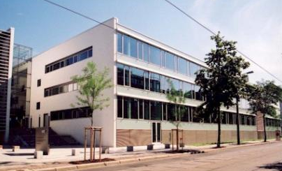

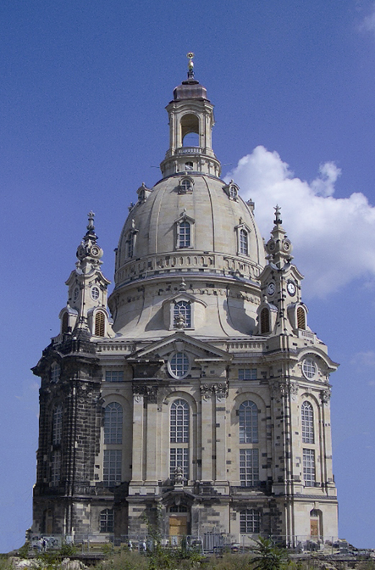

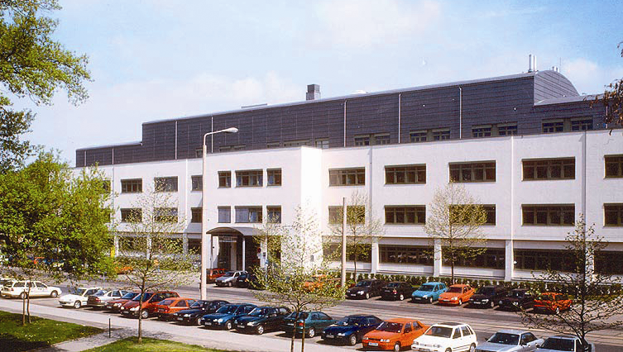
SCMR 2015
MR guided Treatment of the Arrhythmic Substrate
C. Piorkowski¹, M. Grothoff², T. Gaspar¹, G. Hindricks³, M. Gutberlet²
1 University of Dresden, Heart Center, Department of Electrophysiology
2 University of Leipzig, Heart Center, Department of Radiology
3 University of Leipzig, Heart Center, Department of Electrophysiology

Slide 2
SCMR 2015
Presenter Disclosure Information
C. Piorkowski has the following disclosures
Lecture honoraria: SJM, Biotronik, Medtronic, Siemens, Bayer, Pfizer
Advisory board member: SJM, Siemens, Biosense,
Research support: SJM, Biotronik, Imricor, Philips, Biosense

Slide 3
SCMR 2015
Why does EP wants to move into MR ?
Fluoroscopy free working environment
Three-dimensional real-time visualization of
  cardiac anatomy
  arrhythmia substrates
  neighboring structures
Description of lesion formation / gap formation
  direct tissue changes
  MR thermometry
Immediate detection of complications

Slide 4
Challenges for EP procedures in the MR scanner
SCMR 2015
Challenges for EP procedures in the MR
Completely different interventional working setup
  limited patient access, difficult patient monitoring, no 12 lead ECG
  communication issues, defibrillation issues, no in-room scanner control
Need for MR compatible/safe material (wires, sheaths, catheters)
Need for MR compatible/safe EP recording system, RF delivery
Issue of visualization/tracking of intracardiac tools in the scanner

Slide 5
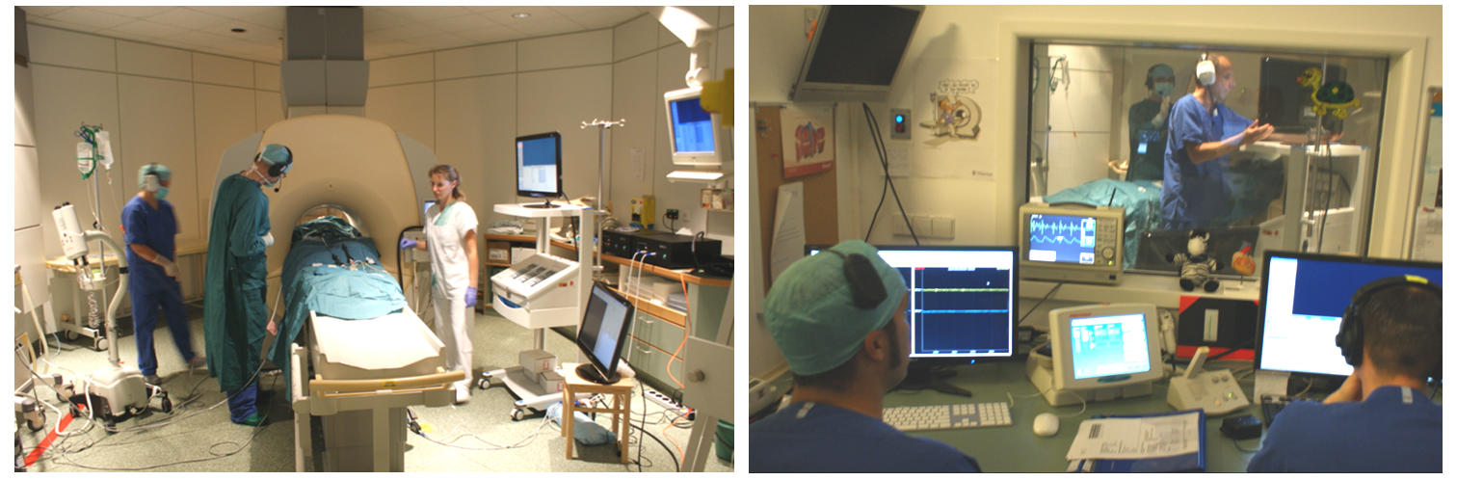
SCMR 2015
MR interventional EP: First steps
Problems solved:
sterile patient access, patient monitoring, communication,
MR compatible catheter technology / EP recording system
Eitel et al, EHJ 2012

Slide 6
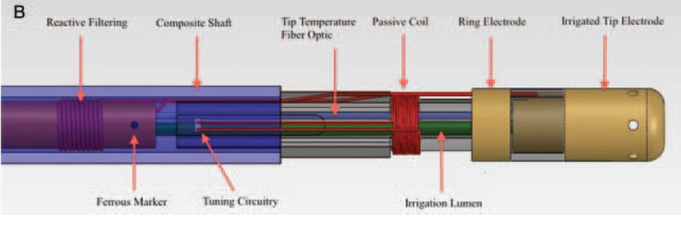
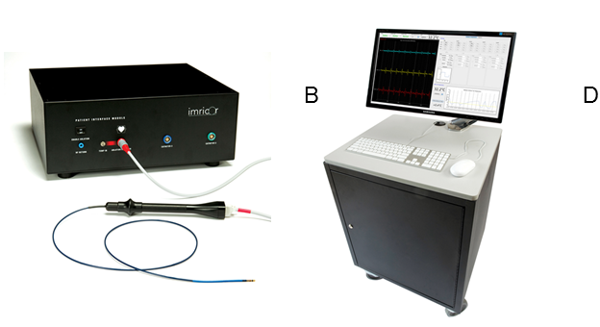
SCMR 2015
MR interventional EP: First steps
Piorkowski et al., CircAE 2013

Slide 7
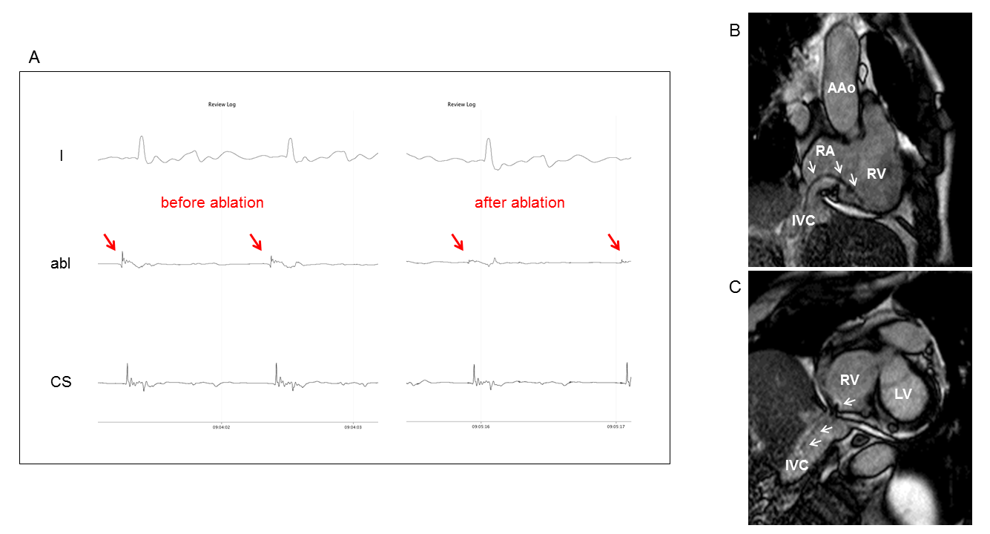
SCMR 2015
Real-time MRI guided isthmus ablation
Piorkowski et al., CircAE 2013

Slide 8
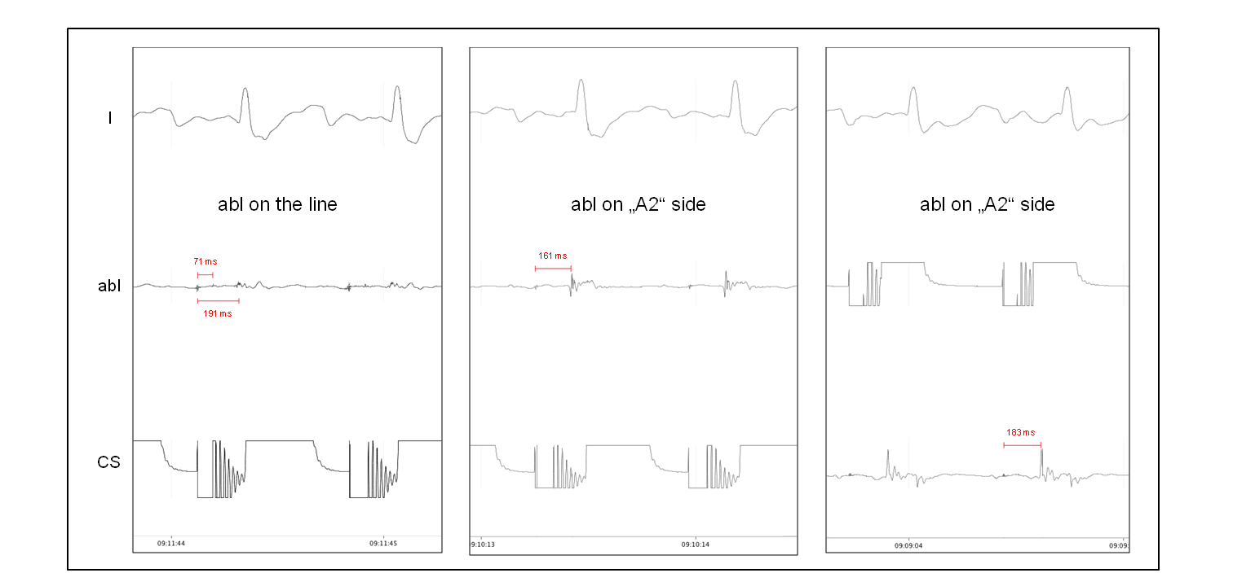
SCMR 2015
Proof of bidirectional isthmus block
Piorkowski et al., CircAE 2013

Slide 9
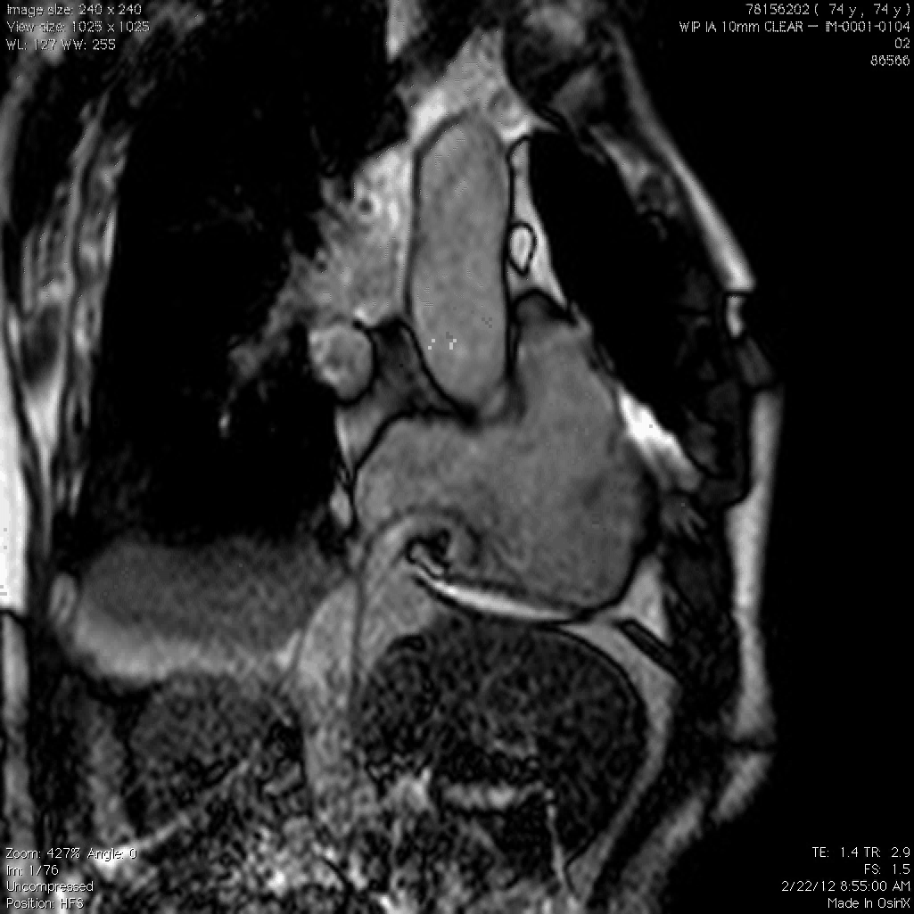
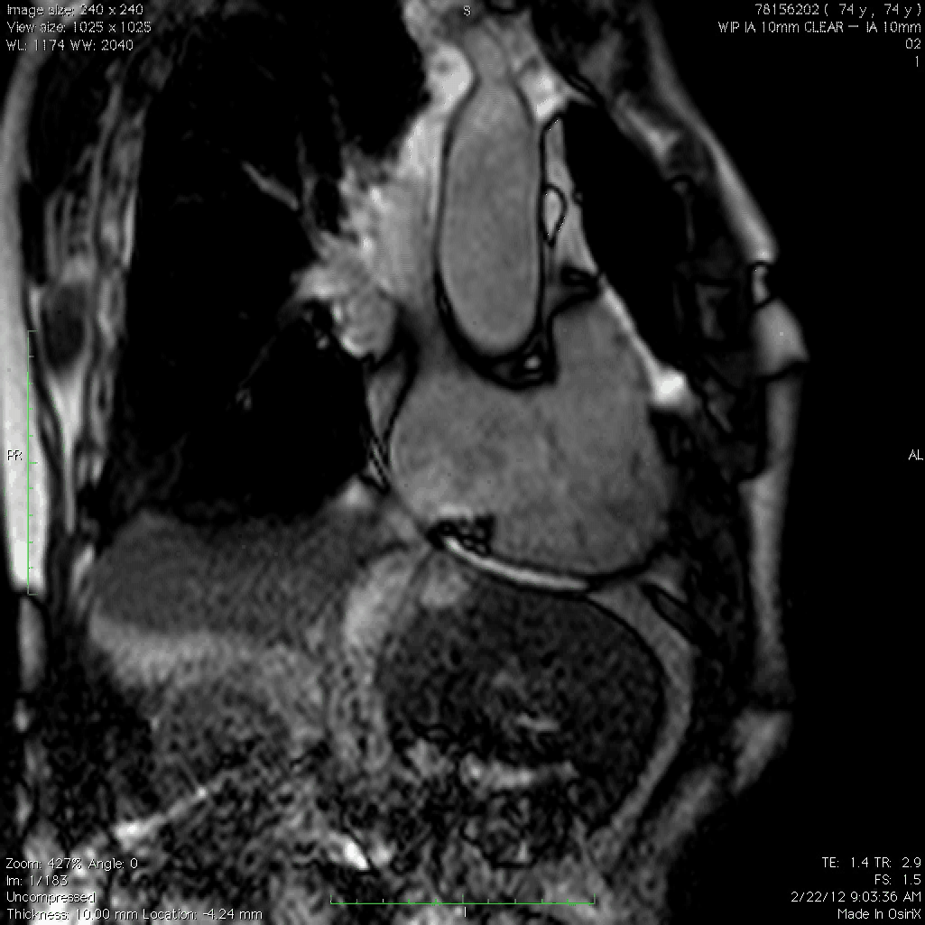
Challenges for EP procedures in the MR scanner
SCMR 2015
Passive catheter tracking
Piorkowski et al., CircAE 2013

Slide 10
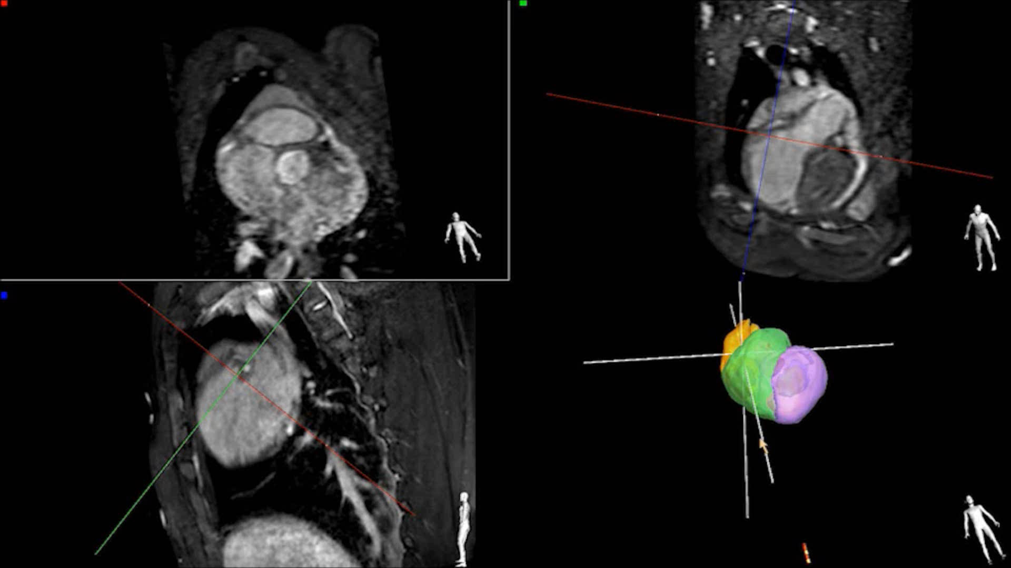
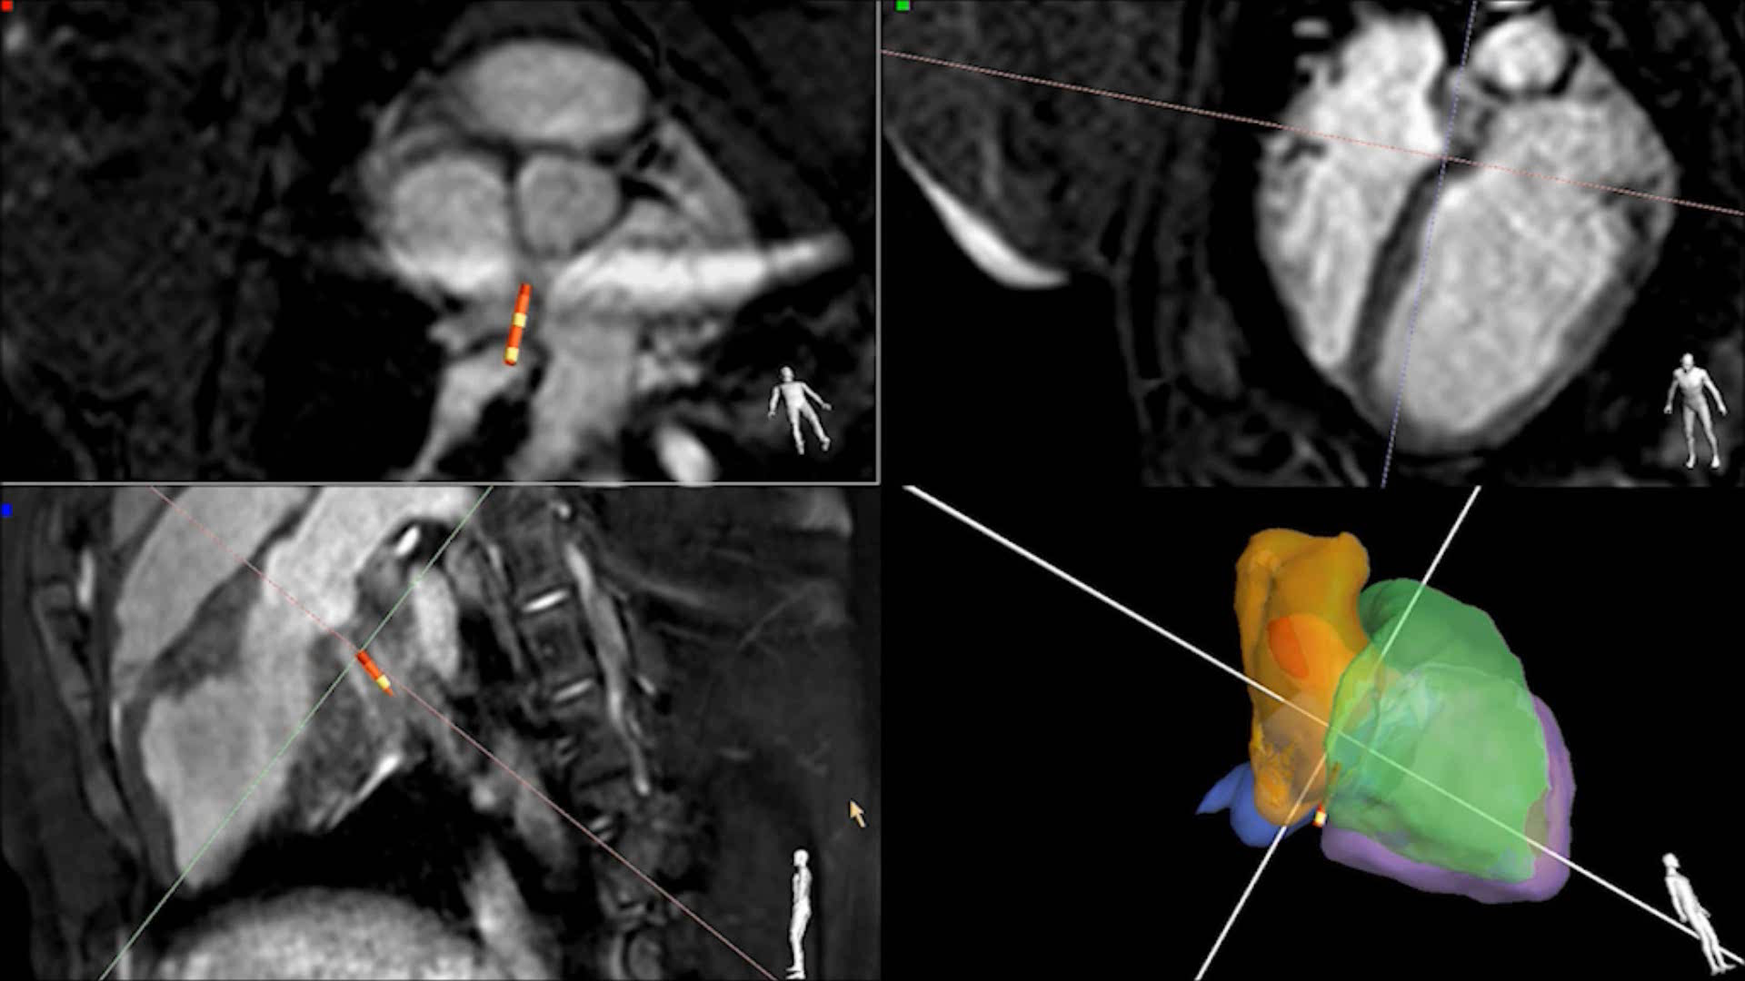
SCMR 2015
Active catheter tracking: Catheter introduction
Gaspar et al., EHJ 2014

Slide 11
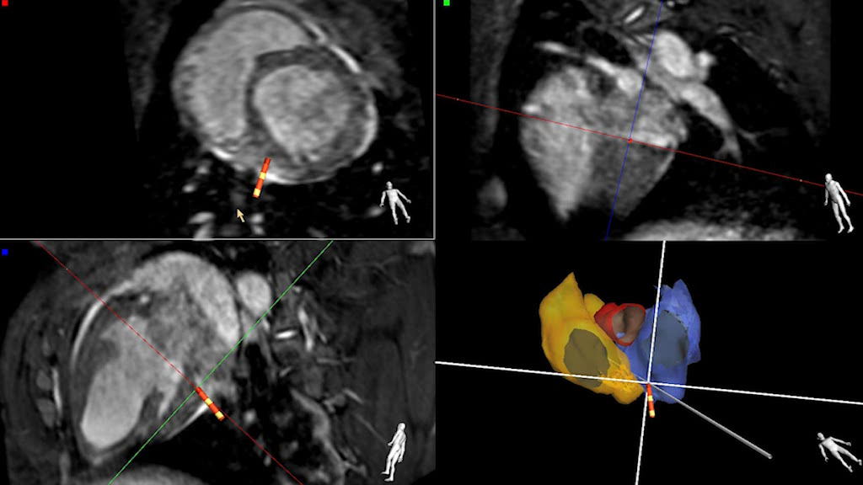
SCMR 2015
Active catheter tracking: CS intubation

Slide 12
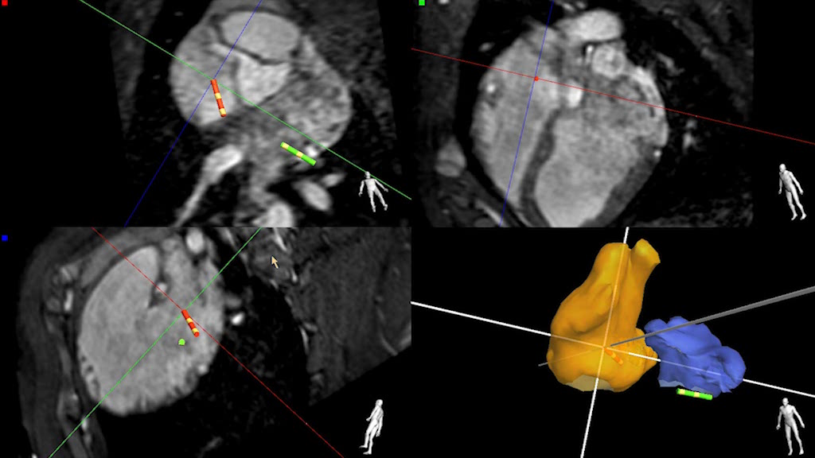
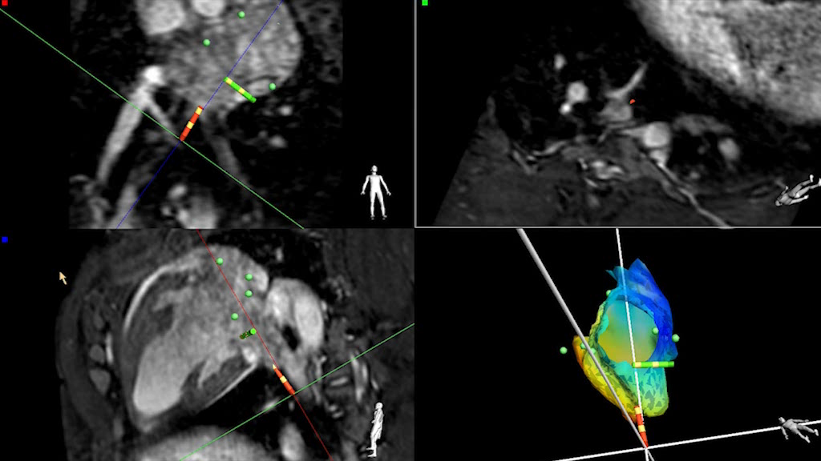
Challenges for EP procedures in the MR scanner
SCMR 2015
Active catheter tracking: TSP and PV intubation
Gaspar et al., EHJ 2014

Slide 13
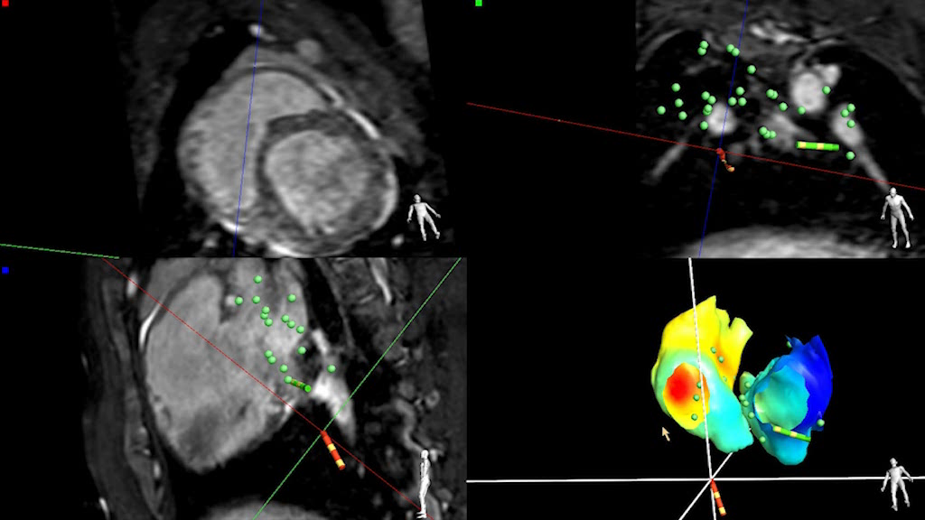
Challenges for EP procedures in the MR scanner
SCMR 2015
Active catheter tracking: Activation RA + LA

Slide 14
SCMR 2015
Conclusions
Potential advantages of MR interventional EP procedures relate to the combination of anatomical, functional and substrate informations.
To evaluate those in a clinical meaningful way, a concise „MR-only“ workflow for all clinically relevant EP procedures is needed.
Challenges are various, however, initial diagnostic EP studies and ablation procedures have safely been performed.
A first irrigated ablation catheter and EP recording system are safety tested and ready for clinical use – even with active tracking
Wider clinical application requires 12-lead ECGs and numerous catheters, wires, needles and other interventional tools.

