Slide 1
MiRTLE Medical, LLC. 12-Lead ECG During MRI Jay Ward Executive Vice-President
iCMR February 5, 2015
Notes:
1

Slide 2
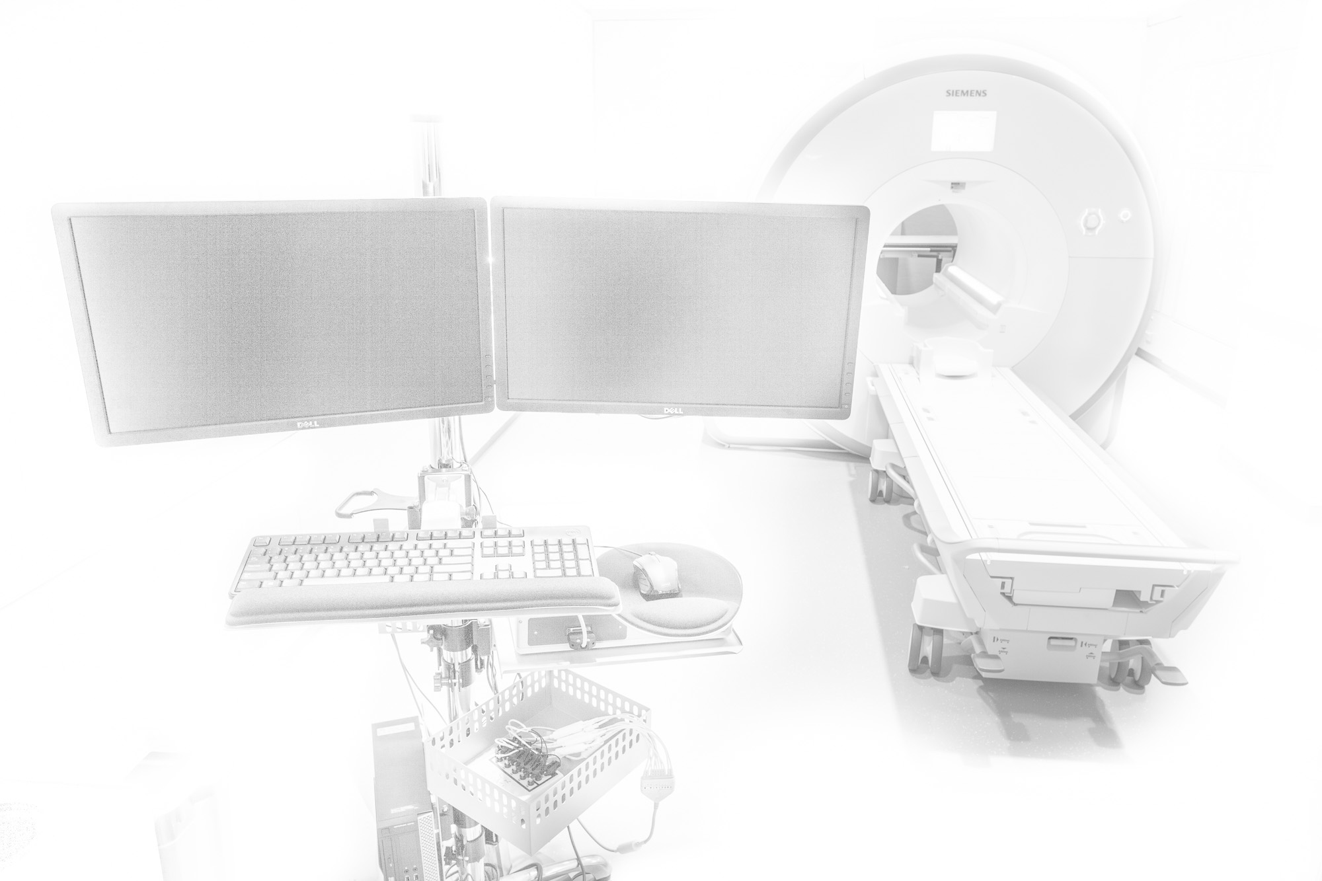
12-Lead ECG During MRI
MiRTLE Medical, LLC.
Initial work October 2010
Founded December 2012, privately held
Majority owned by E-TROLZ, Inc.
Intellectual Property
Brigham & Women’s Hospital, Boston, MA
Acquiring patient physiological information during MRI scan
E-TROLZ, Inc.
Electrophysiological acquisition & signal processing device
Product Development
Validation complete through third-generation prototype device
Building final design Beta device

Slide 3
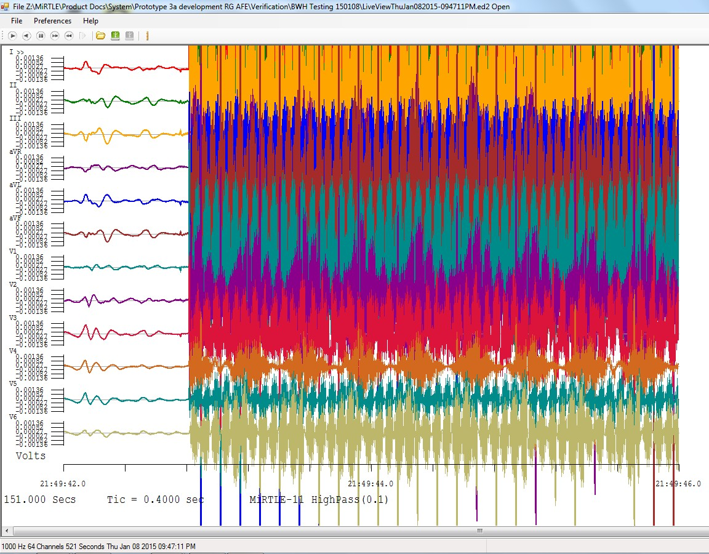
Typical ECG Recording
ECG signal obliterated by gradient induced interference during an SSFP sequence

Slide 4
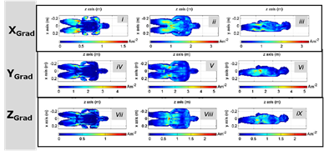
Theoretical Induced Voltages
Martin Bencsik, Richard Bowtell and Roger Bowley, Physics in Medicine & Biology 52 2007

Slide 5
Measured Induced Voltages
Sequence Iso-center location | Lead-I Heart (mV p-p / µs) | Lead-II Heart (mV p-p / µs) | Lead-II Nose (mV p-p / µs)
SSFP | 1340 / 62.5-156 | 1800 / 62.5-156 | 2850 / 125-281
GRE 1 slice | 640 / 62.5-219 | 1860 / 62.5-156 | 3140-3400 / 219-250
GRE 20 slice | 535 / 125 – 188 | 1580-2150 / 62.5-125 | Not Recorded
TSE | 700-3470 / 62.5-156 | Not Recorded | Not Recorded
EPI | 1560 / 156-1400 | 2380 / 94-188 | 3440 / 62.5-219
Localizer | 970 / 62.5-125 | Not Recorded | 3245-3610 / 125-250
Table 1: 32 KSPS Pulse amplitude (mV p-p) / duration (µs)
Data recorded on a Siemens Skyra 221L-3T

Slide 6
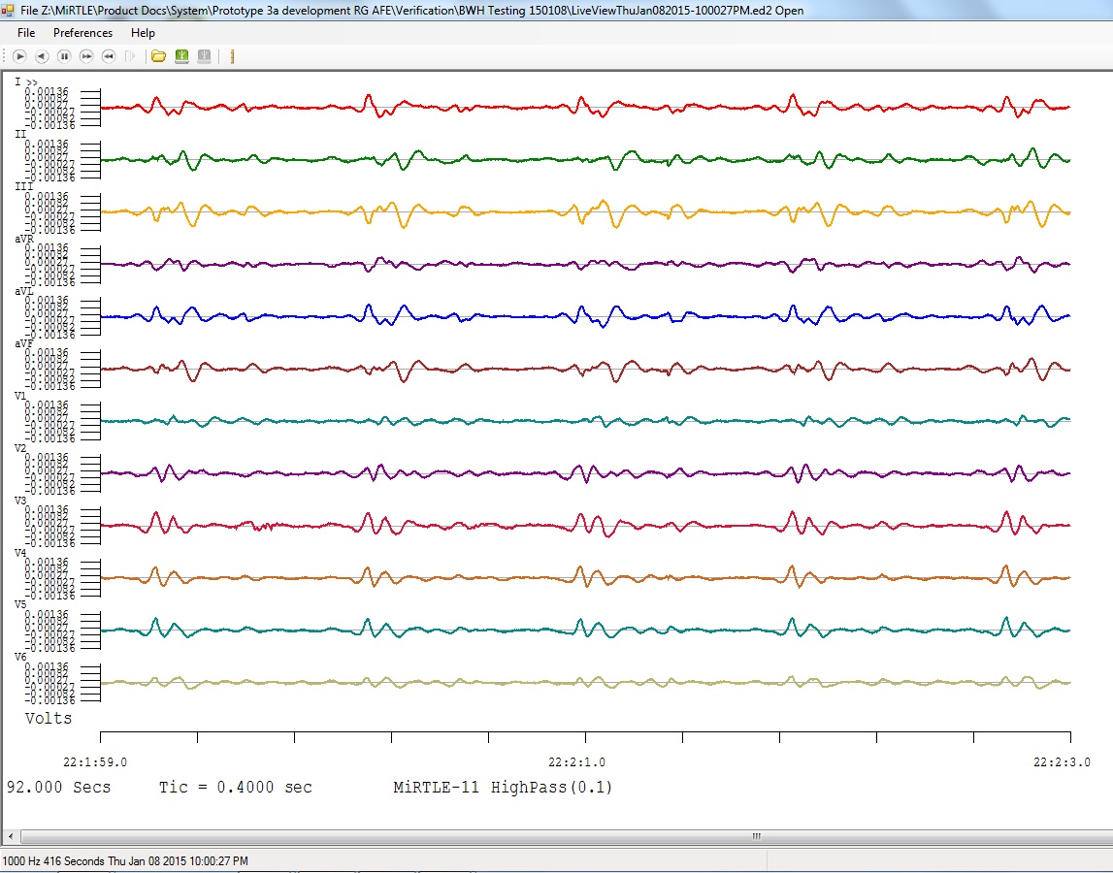
MiRTLE ECG Performance – GRE
I
II
III
aVR
aVL
aVF
V1
V2
V3
V4
V5
V6
Near perfect gradient induced interference removal

Slide 7
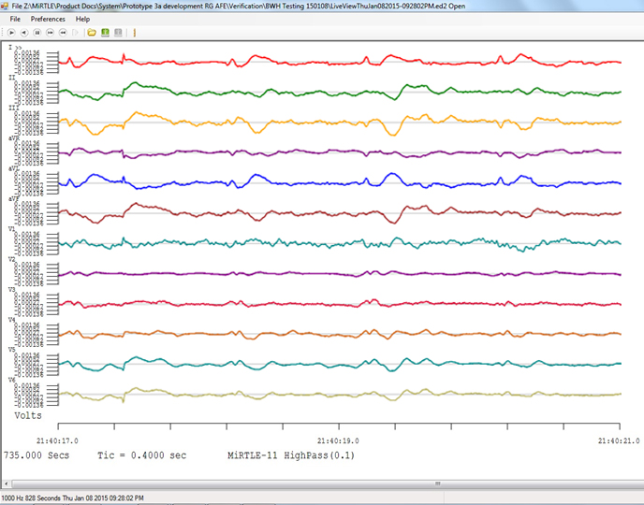
MiRTLE ECG Performance – SSFP
I
II
III
aVR
aVL
aVF
V1
V2
V3
V4
V5
V6
Sequence used for Interventional MRI due to imaging speed

Slide 8
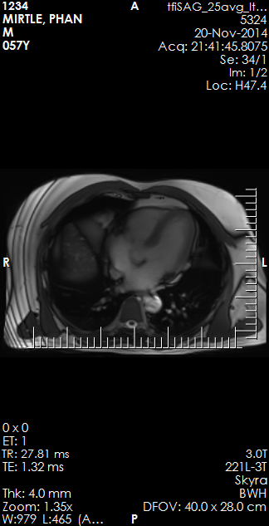
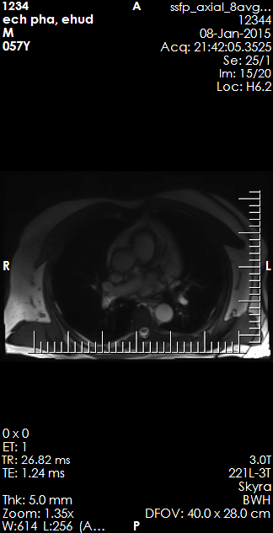
Imaging During ECG Acquisition

Slide 9
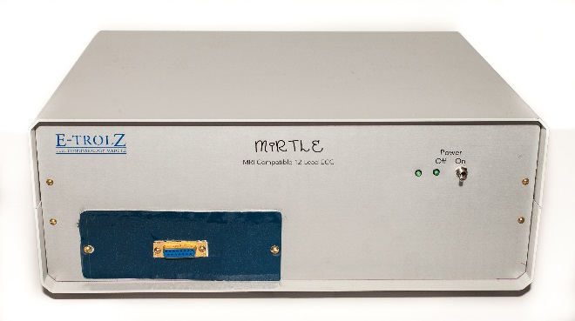
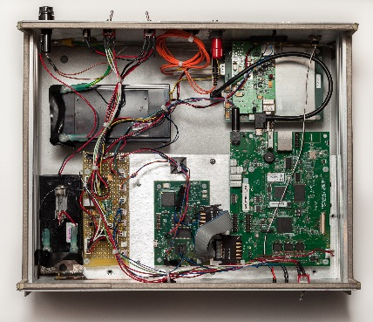
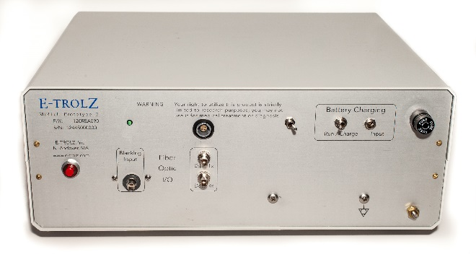
Device Road Map
Feature | Proto3 | Next Generation | FDA Device
 | Now | Q4’2015 | 2017
ECG 12-Lead, diagnostic grade | P | P | P
Patient safety | P | P | P
Beat detection at 3T | P | P | P
Scanner gating | P | P | P
Diagnostic quality ECG during scan | P | P | P
SSFP, GRE, TSE, EPI sequences cleansed | 3 of 4 | P | P
MHD real-time removal |  | P | P
Dual imaging modalities with uninterrupted monitoring |  | P | P
Stroke volume estimation |  | P | P
Continuous comparison with baseline ECG morphology |  | P | P
SPO2 |  |  | P
Dual Invasive Blood Pressure |  |  | P

Slide 10
Jay Ward
978.688.8825 x13
jay.ward@e-trolz.com
Dr. Ehud Schmidt
ESCHMIDT3@PARTNERS.ORG
Dr. Zion Tse
ziontse@uga.edu

