Slide 1
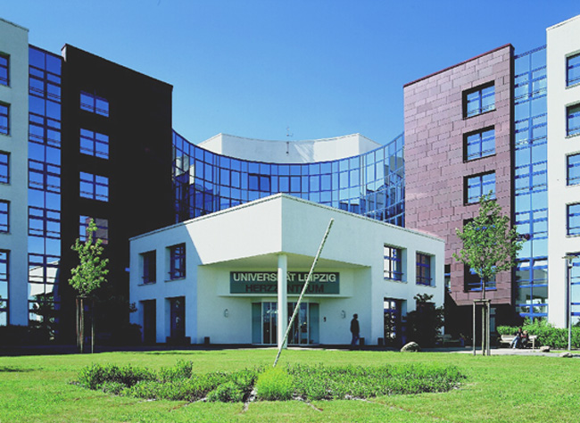
SCMR pre-conference workshop 28.1.2016 Los Angeles
How to start an
Electrophysiology iCMR program
Philipp Sommer, M.D., FHRS, FESC
Heart Center University Leipzig
Dept. of electrophysiology
Notes:
1

Slide 2
How to start an Electrophysiology iCMR program
Disclosures:
Lecture fees and/or travel grants within the last 12 months by
St. Jude Medical, Biosense Webster
Siemens Healthcare, Abbott Medical
Biotronik, Imricor
Boehringer Ingelheim/Bayer/Pfizer/BMS/Daiichi Sankyo.
Member of advisory board or consultant for
St. Jude Medical
Boehringer Ingelheim
Daiichi Sankyo
Research grants from
St. Jude Medical
Imricor
Notes:
2

Slide 3
How to start an Electrophysiology iCMR program
What do you need?
1.) Objective
2.) Scanner
3.) EP equipment
4.) Patients
5.) Patience
Notes:
3

Slide 4
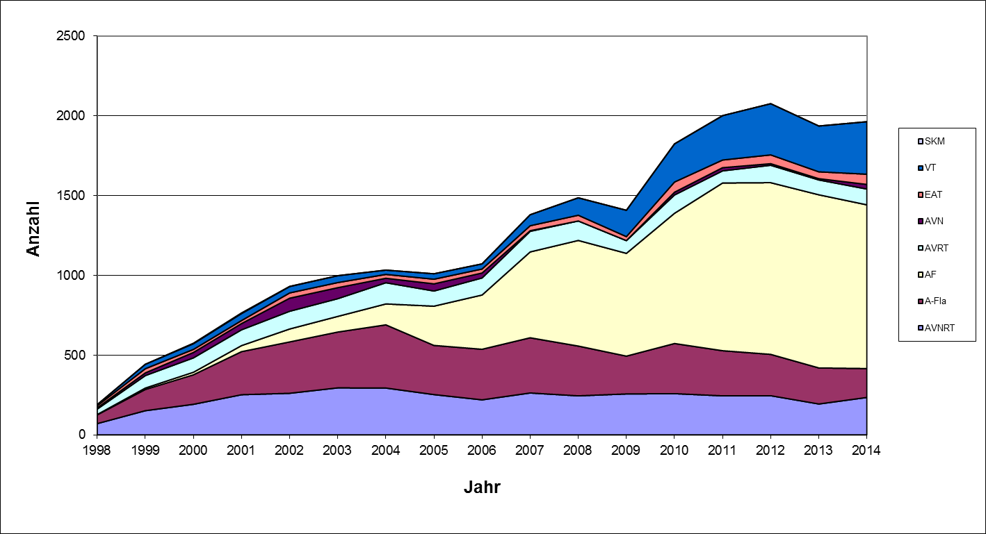
How to start an Electrophysiology iCMR program
„Substrat-based“ interventions @ HCL

Slide 5
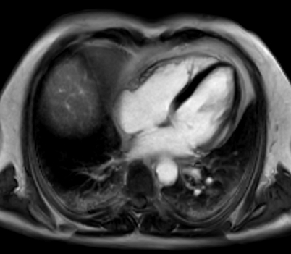
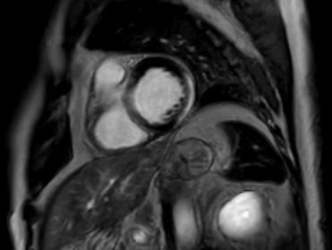
How to start an Electrophysiology iCMR program
CMR can target the procedure
Images:
iCMR Heart Center Leipzig
Notes:
„max.“ T1 Wichtung…

Slide 6
How to start an Electrophysiology iCMR program
CMR pre-ablation: epicardial scar
cine
scar
cine: normal wall motion
scar: epicardial lateral scar
T1: no myocardial fat
T2: no edema
T1
T2
Images:
iCMR Heart Center Leipzig
Notes:
In T2 „kein Wasser“- daher keine –itis.

Slide 7
How to start an Electrophysiology iCMR program
CMR pre-ablation: epicardial scar
© by A. Berruezo & Lluis Serra, Galgo Medical
Notes:
Nur Reko auswärts !! Software bald bei uns !

Slide 8
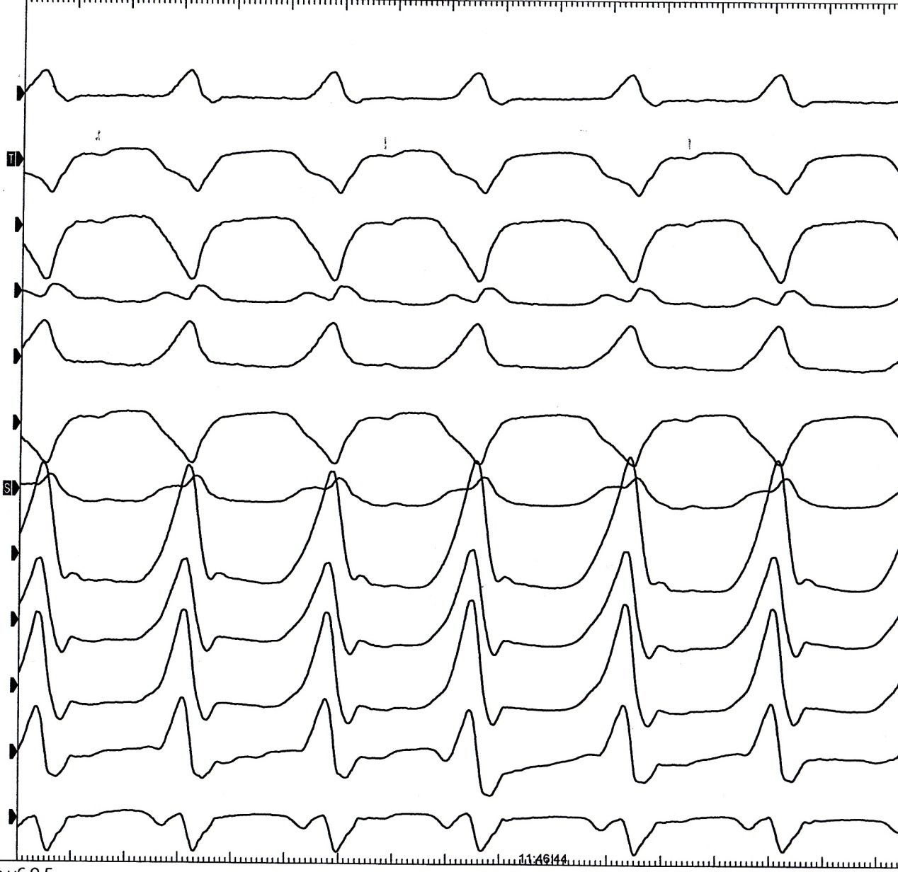
How to start an Electrophysiology iCMR program
Induction of clinical VT with epicardial origin
EP study:
-> Programmed RVA stimulation (500 S2), reproducible induction of clinical VT
I
II
III
aVR
aVL
aVF
V1
V2
V3
V4
V5
V6

Slide 9
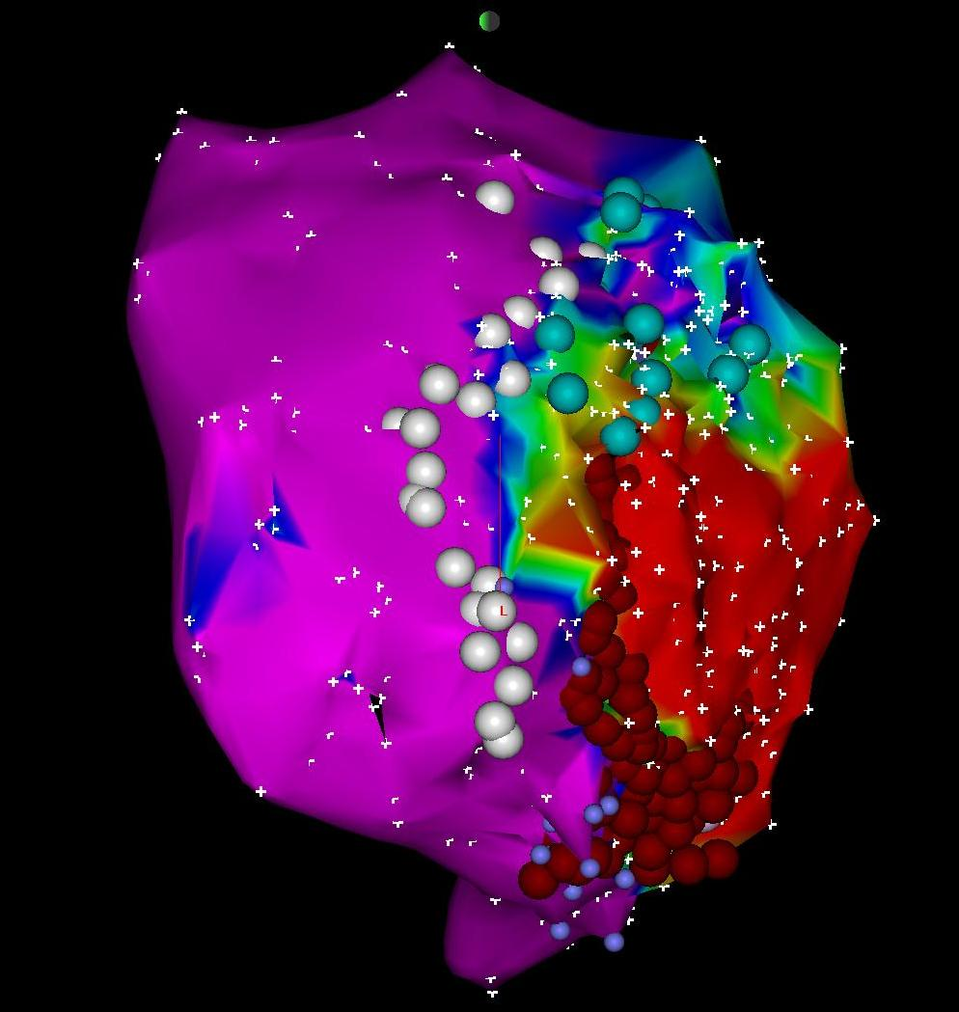
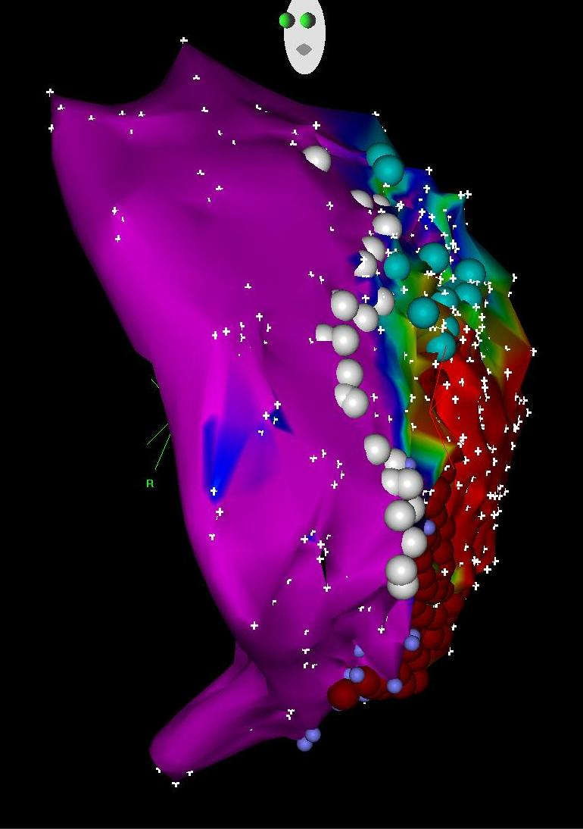
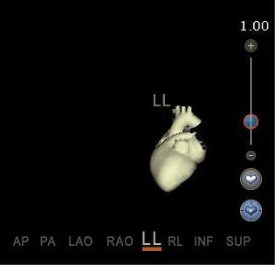
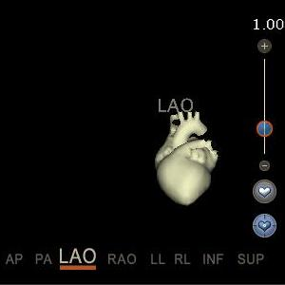
How to start an Electrophysiology iCMR program
Vision: bringing the intervention “to the image”
epicardial
epicardial
LL
LAO

Slide 10
How to start an Electrophysiology iCMR program
CMR post-ablation: microvascular obstruction
cine
EGE
scar
cine: lateral hypokinesis
EGE: focal microvascular obstruction
scar: nearly transmural lateral scar
EGE: early gadolinium enhancement
Images:
iCMR Heart Center Leipzig
Notes:
EGE: 2-3min nach KM Gabe

Slide 11
How to start an Electrophysiology iCMR program
What do you need?
1.) Objective
2.) Scanner
3.) EP equipment
4.) Patients
5.) Patience
Notes:
11

Slide 12
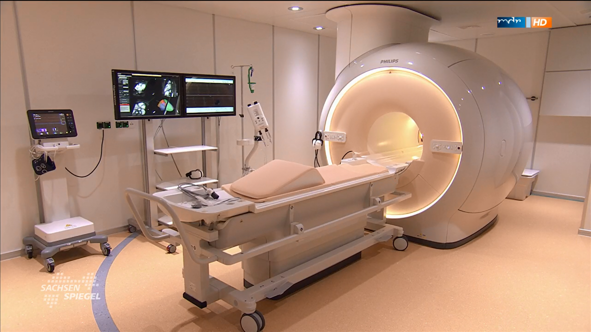
How to start an Electrophysiology iCMR program
Setup for EP interventions in Leipzig

Slide 13
How to start an Electrophysiology iCMR program
What do you need?
1.) Objective
2.) Scanner
3.) EP equipment
4.) Patients
5.) Patience
Notes:
13

Slide 14
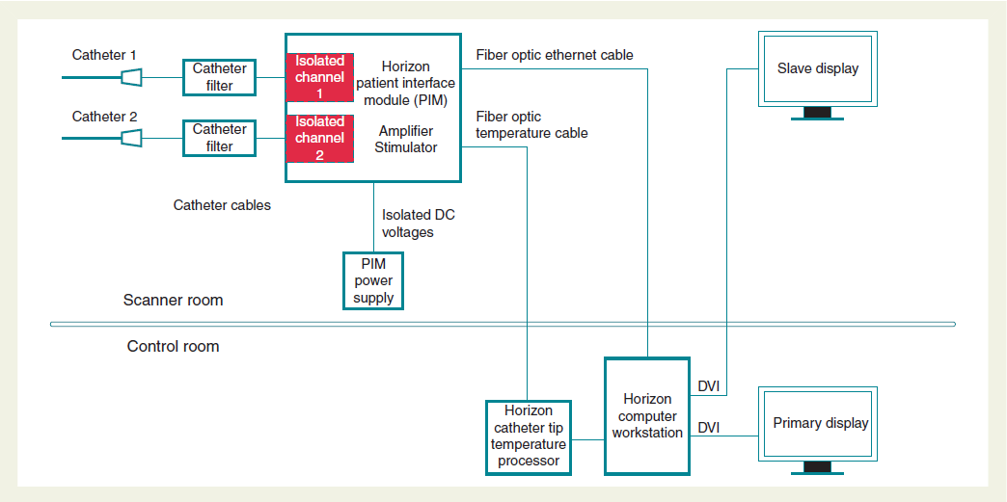
How to start an Electrophysiology iCMR program
Setup for EP interventions in Leipzig
Hilbert, Sommer. Europace Aug. 2015

Slide 15
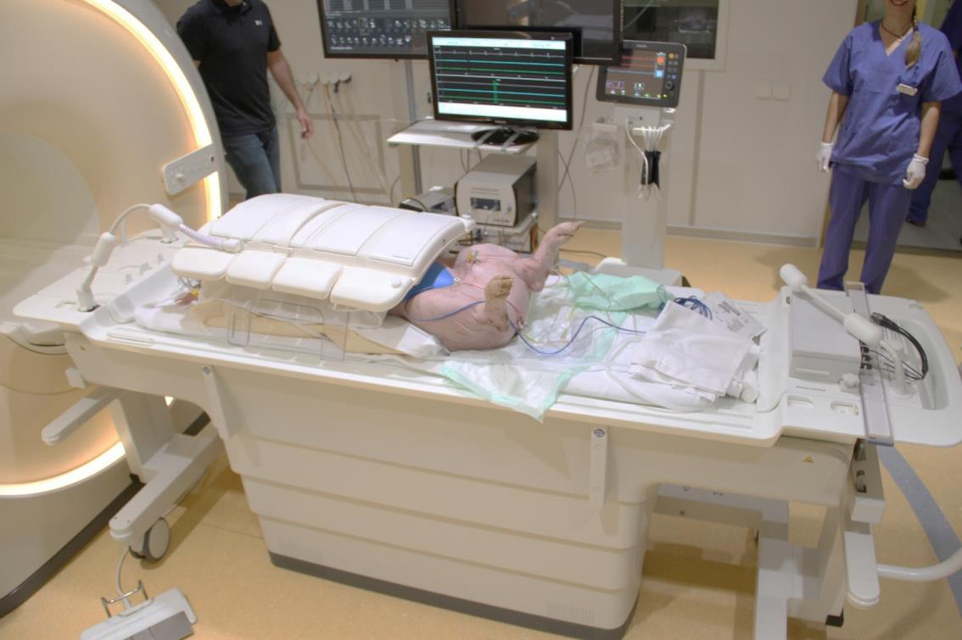
How to start an Electrophysiology iCMR program
Setup for EP interventions in Leipzig
Intracardiac ECG
iCMR monitor (iSuite display)
dStream interface
for active catheters
footpedal (iSuite)

Slide 16
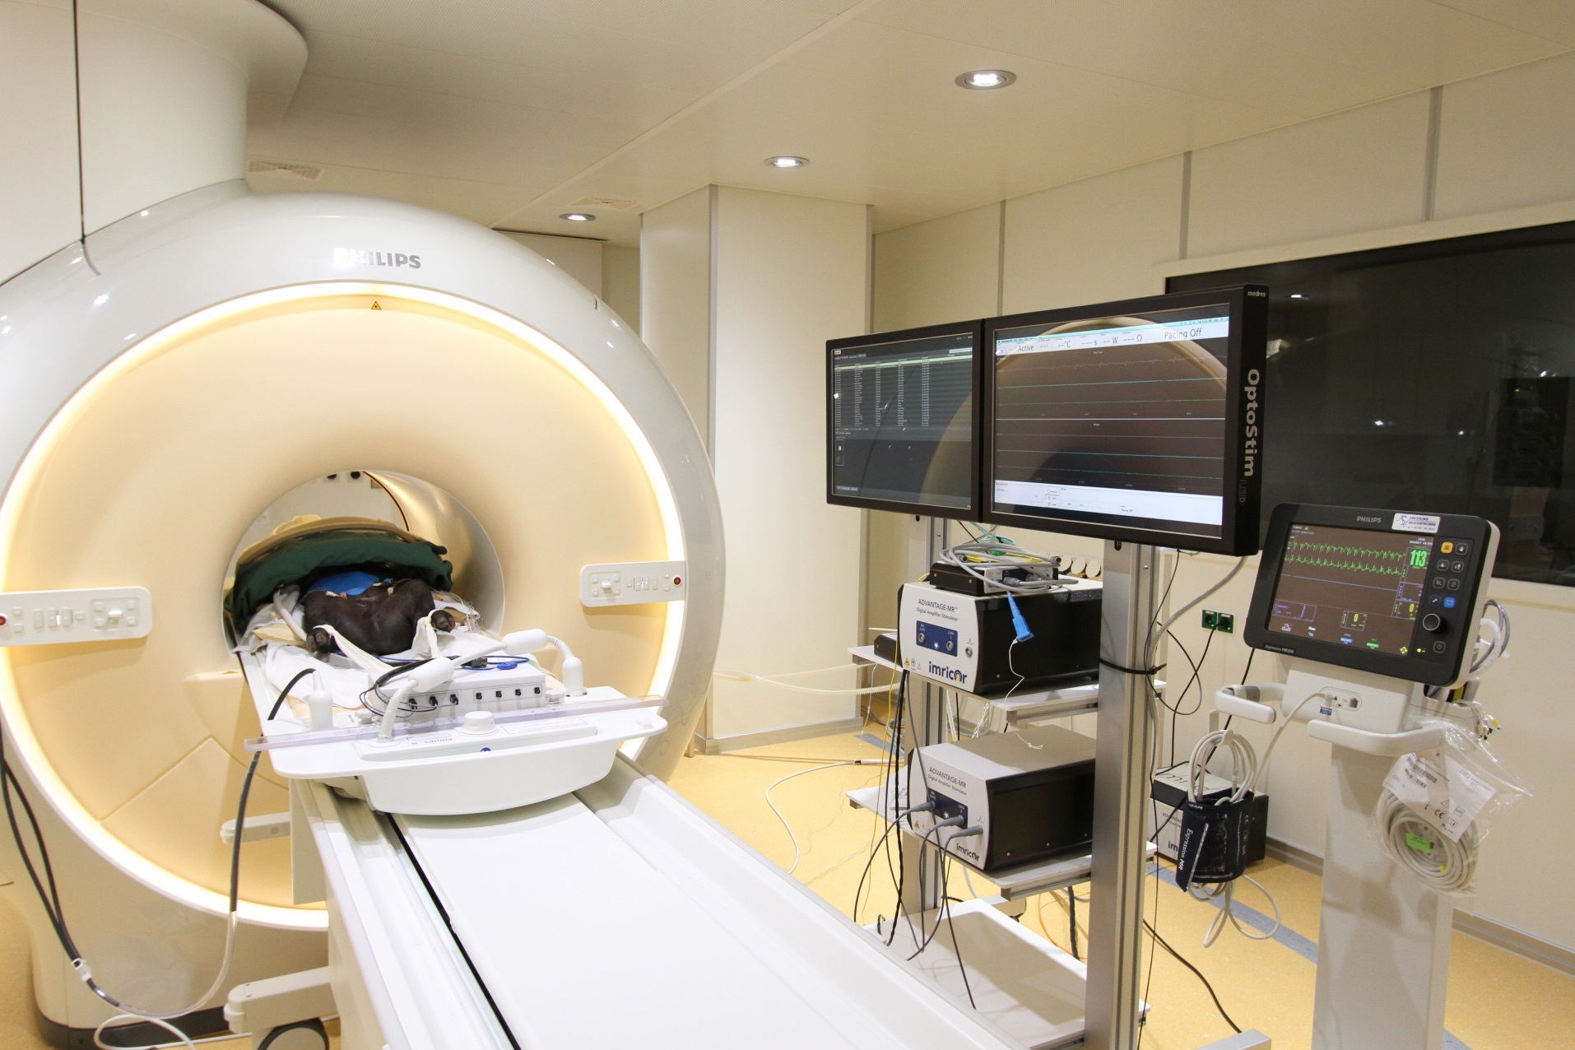
How to start an Electrophysiology iCMR program
Setup for EP interventions in Leipzig

Slide 17
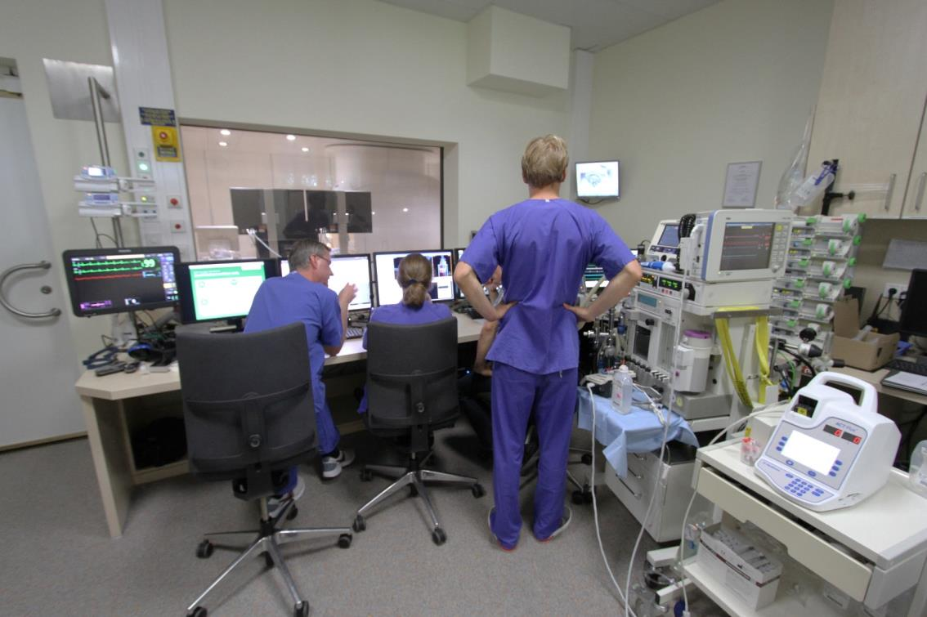
How to start an Electrophysiology iCMR program
Setup for EP interventions in Leipzig
CMR Operator
Respirator
EKG Monitoring
Infusions

Slide 18
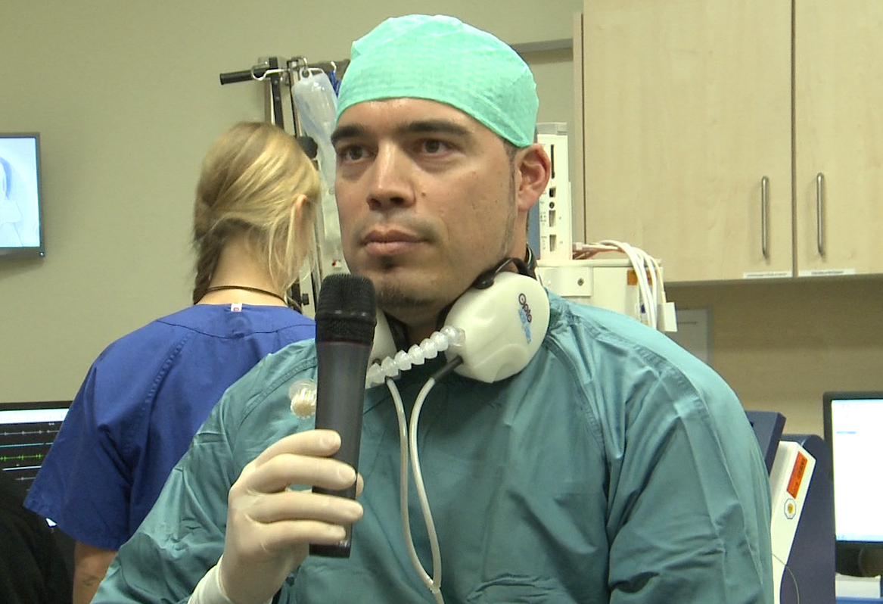
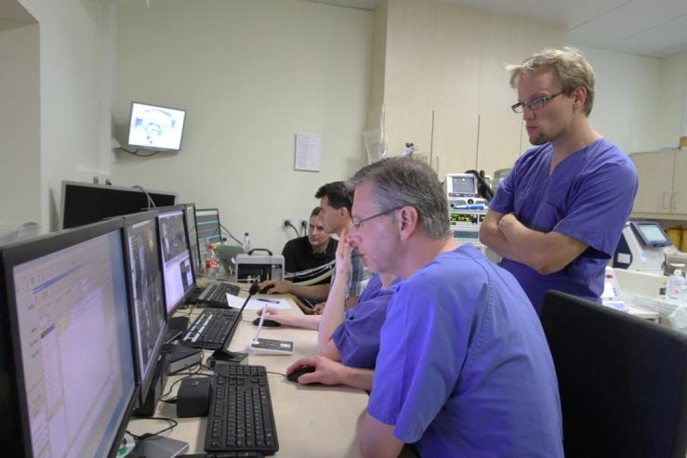
How to start an Electrophysiology iCMR program
Setup for EP interventions in Leipzig
Optoaccust. Headsets
External Microphone
IMROC™ optical fiber-based communication system
Field-proven reliability @ 1.5 Tesla
Crisp, clear speech with very low latency
Automatic noise reduction/noise cancellation

Slide 19
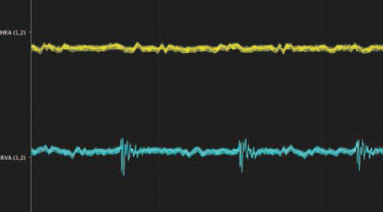
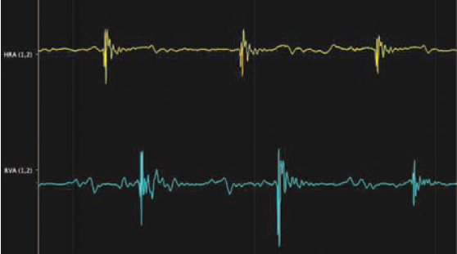
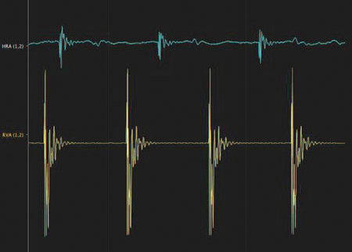
How to start an Electrophysiology iCMR program
Initial signal quality in CMR procedures
No filter
With filter
HRA
HRA
RVA
RVA
During RV pacing
HRA
RVA
Sommer. Europace 2012
Notes:
As I have already demonstrated the importance of signal quality for EP procedures I´d like to show you examples of initial signals we dealt with and the improvement with filtering.
On both catheters (upper tracing, yellow: right atrium and lower tracing, blue: right ventricle) noise is detected limiting signal quality during magnetic resonance imaging activity (A). With noise reduction algorithms there are clear signals from both catheters (B). Both recordings were performed during magnetic resonance imaging scanning.
Pacing maneuvers from RVA (blue) catheter; during incremental ventricular pacing there was no conduction from the ventricular pacing site to the atrium: VA-block. RVA, right
ventricular apex; VA block, ventriculo-atrial block.
The signal quality (see Figures 5 and 6) does not yet allow interpretation of small potentials like HIS-electrograms in all patients; further improvements must be made in order to suppress noise and to enhance small potential electrograms registered by MRI compatible EP catheters.

Slide 20
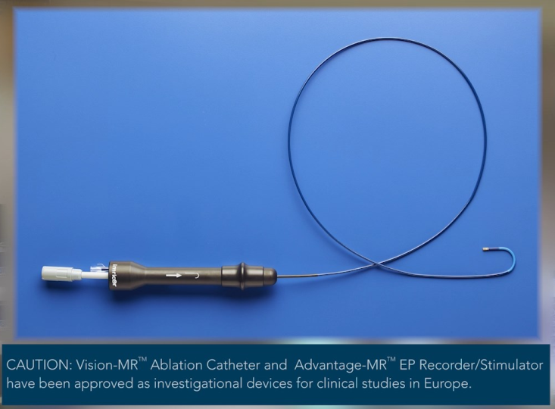
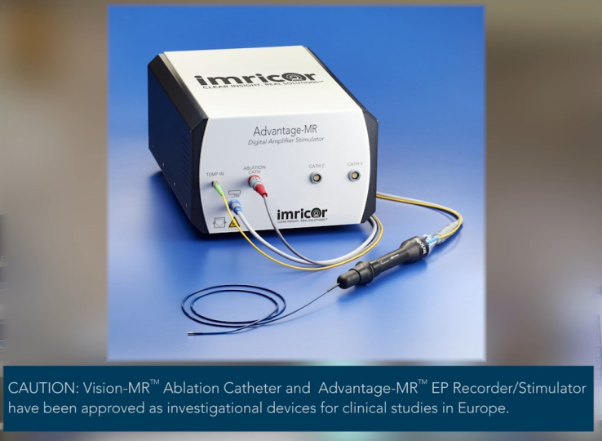
CMR Compatible EP Devices
How to start an Electrophysiology iCMR program
Vision MRTM Ablation Catheter
Advantage MRTM EP Recorder/Stimulator
Approved for investigational use in Europe only

Slide 21
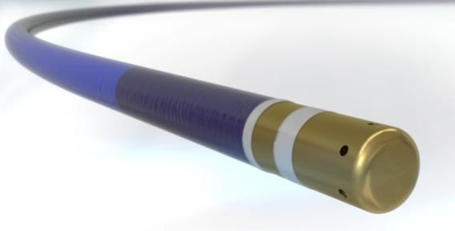
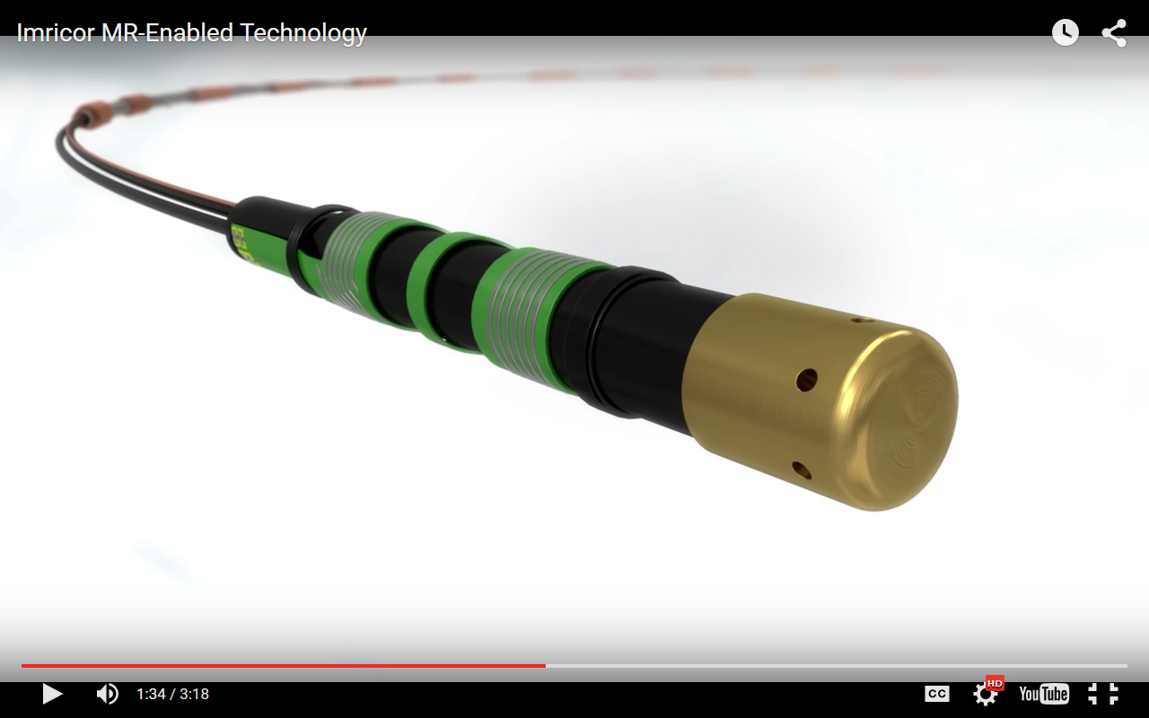
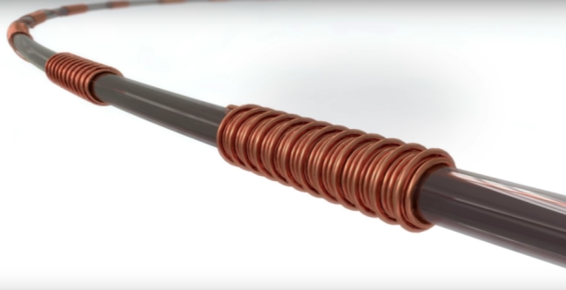
Imricor catheter design ("Microcoils")
How to start an Electrophysiology iCMR program

Slide 22
How to start an Electrophysiology iCMR program
What do you need?
1.) Objective
2.) Scanner
3.) EP equipment
4.) Patients
5.) Patience
Notes:
22

Slide 23
How to start an Electrophysiology iCMR program
„Substrat-based“ interventions @ HCL

Slide 24
How to start an Electrophysiology iCMR program
What do you need?
1.) Objective
2.) Scanner
3.) EP equipment
4.) Patients
5.) Patience
Notes:
24

Slide 25
Passive Tracking - Interactive RealTime CMR
How to start an Electrophysiology iCMR program
Passive Catheter Visualization
RealTime CMR ("fluoroscopy")
High Resolution Cine CMR ("confirmation scan")
Images:
iCMR Heart Center Leipzig

Slide 26
Passive Tracking RA & transseptal LA
How to start an Electrophysiology iCMR program
Images:
iCMR Heart Center Leipzig

Slide 27
Passive und active tracking in RV
How to start an Electrophysiology iCMR program
Images:
iCMR Heart Center Leipzig

Slide 28
How to start an Electrophysiology iCMR program
Conclusion:
Today, CMR is a very helpful and radiation-free imaging modality that supports complex ablation procedures, especially the „substrate based ablations“ (AF&VT).
First steps have been made to preform easy procedures completely MR-guided. These procedures have proven to be safe, but not yet as efficious as in conventional EP labs.
Technological innovations are needed to make further steps (defibrillators, catheters, mapping systems etc.)
The potential advantages of CMR technology are so attractive that it‘s worth going on pioneering…
Notes:
In conclusion Pre- an postinterventional MRI is routinely performed in clinical practice as it provides significant additional informations especially with respect to substrate analysis.
For better passive tracking of the Vision catheter the ferrous marker will replace the inductive coil as tip marker in the future. In addition it is interesting to experiment with much thicker imaging planes or even real-time MIP in order to produce summation images (like fluoroscopy). However, ultimately active tracking is likely to be needed and can be achieved two ways: (i) using scanner algorithms together with MR tracking coils on the Vision catheter, or (ii) bringing MR compatible versions of existing EP tracking technologies (Carto, NavX) into the magnet room.

Slide 29
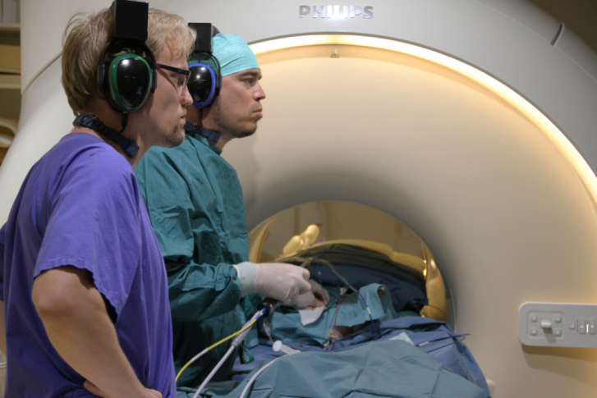
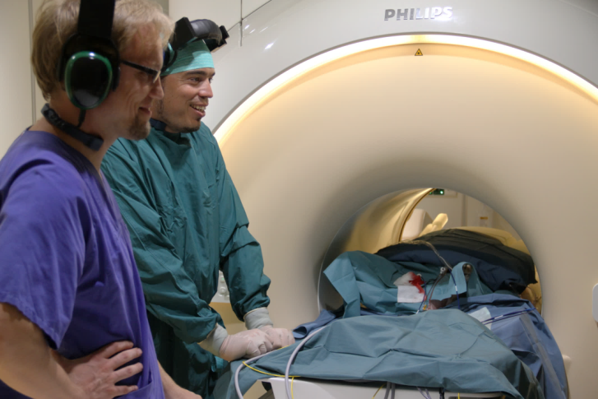
CMR procedures can be very satisfying…
How to start an Electrophysiology iCMR program
During intervention….
After successful intervention…

Slide 30
How to start an Electrophysiology iCMR program
Voting question:
Where do you see CMR imaging in EP 2026?
1.) Preprocedural imaging in all complex arrhythmia cases
2.) Mostly CT, few CMR.
3.) CMR will have disappeared.
4.) Simple ablations will be performed in iCMR.
5.) All ablation procedures will be performed in iCMR.
Notes:
30

Slide 31
MRI interventional suites: far away?
Thank you!
philipp.sommer@helios-kliniken.de
Notes:
In conclusion Pre- an postinterventional MRI is routinely performed in clinical practice as it provides significant additional informations especially with respect to substrate analysis.
For better passive tracking of the Vision catheter the ferrous marker will replace the inductive coil as tip marker in the future. In addition it is interesting to experiment with much thicker imaging planes or even real-time MIP in order to produce summation images (like fluoroscopy). However, ultimately active tracking is likely to be needed and can be achieved two ways: (i) using scanner algorithms together with MR tracking coils on the Vision catheter, or (ii) bringing MR compatible versions of existing EP tracking technologies (Carto, NavX) into the magnet room.

