Slide 1
iCMR January 28, 2016
by Deerfield Imaging, Inc.
Meir Dahan
Executive Vice President R&D / CTO

Slide 2
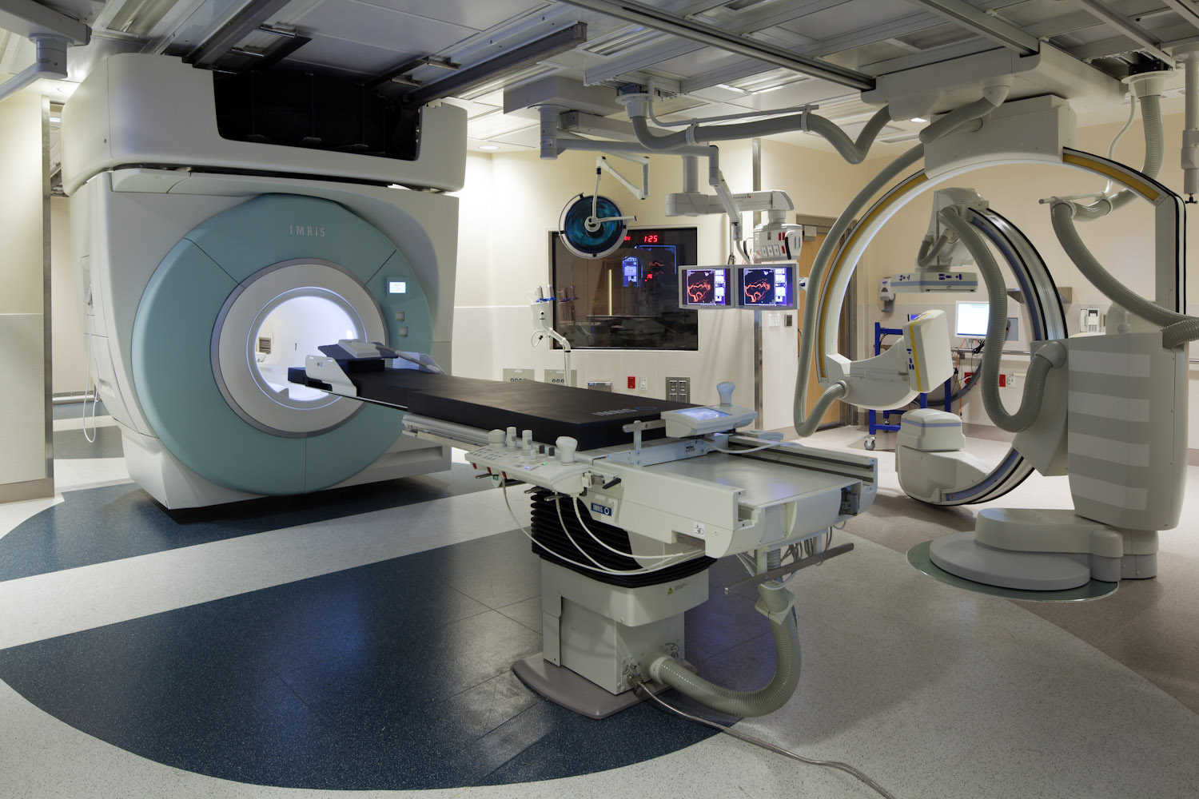
Combined MRI and X-ray Angiography System
Espree / Verio
Artis Zee

Slide 3
Technical and Clinical Challenges
Preserve all existing Angio system functionality and performance
Angio system needs to be RF quiet during MR imaging
Angio components near the magnet must be MR conditional or safe
For cardiac MR imaging, need a mechanism to install posterior RF coil and removal for X-ray imaging without affecting the patient
Emergency bailout imaging; rapid transition from MR imaging to intervention without patient transport
MR safe Hemodynamic monitoring and recording devices

Slide 4
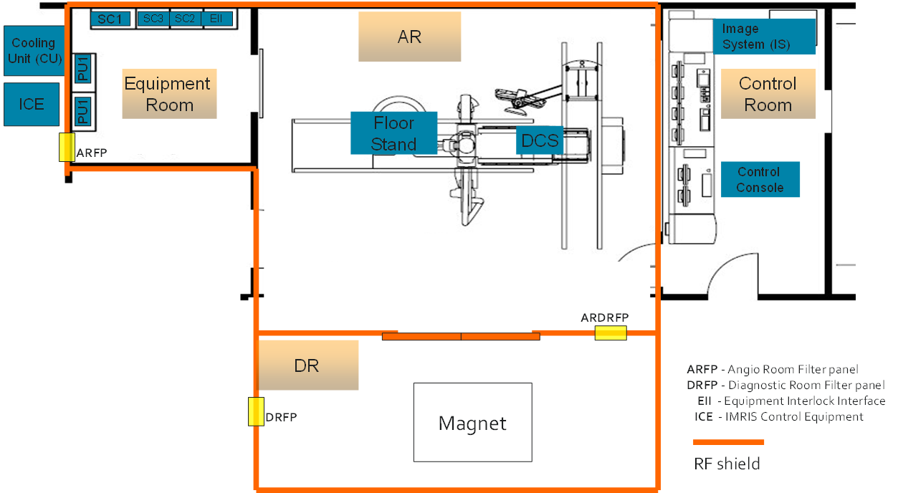
Typical System Layout

Slide 5
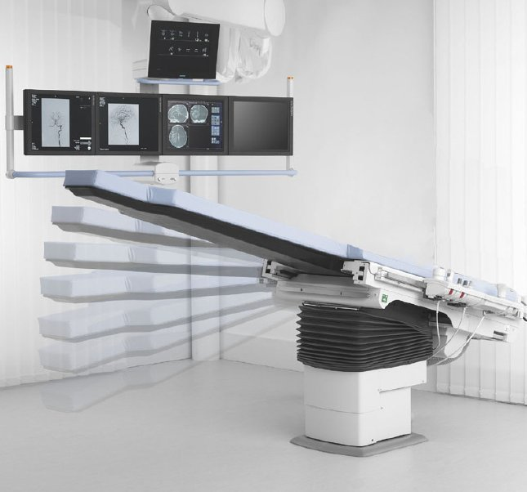
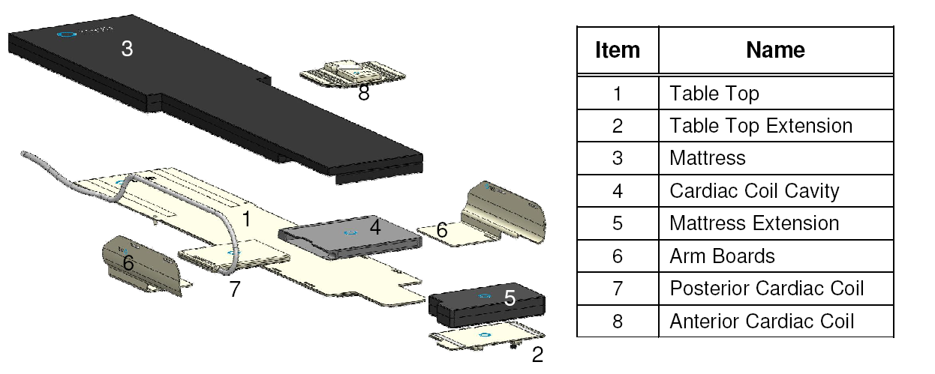
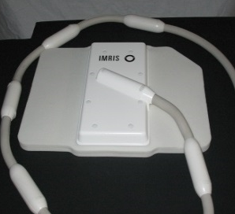
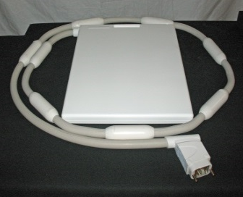
Cardiovascular Configuration
Designed MR and X-ray compatible components
Designed a cardiac coil “cavity” to allow insertion and removal of the cardiac coil for MR imaging
Designed MR conditional patient table

Slide 6
Angio Power Up/Down
When the magnet moves past the Patient Safety Check Point (PSCP), all components in the Angio room automatically power down/up (including the Angio system)
Magnet
PSCP

Slide 7
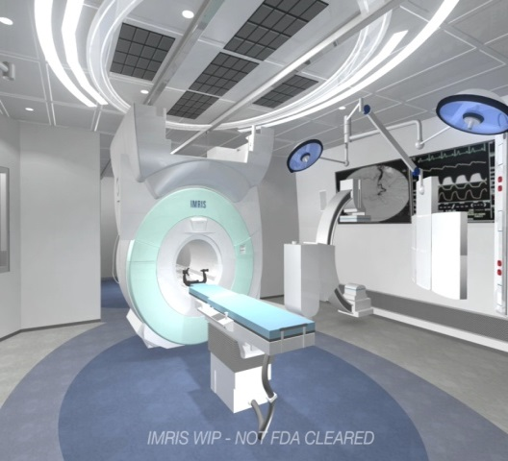
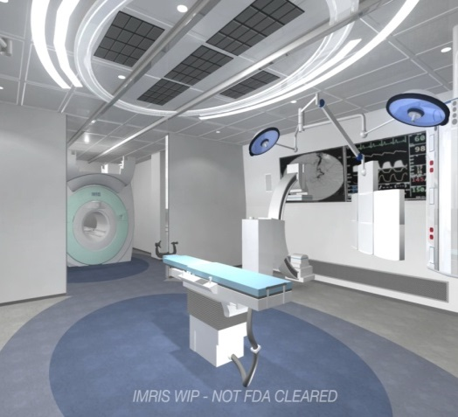
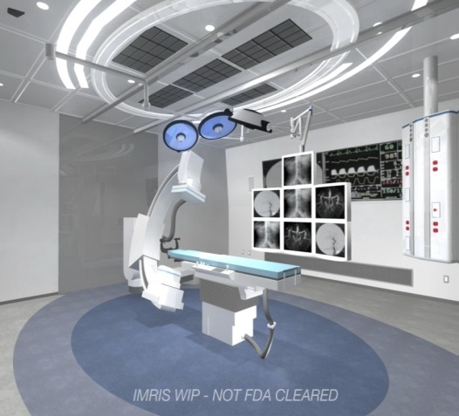
Treating patients with Atrial Fibrillation Recurrence After Prior AF Ablation (N=10)
IMRIS solution to patient handling No patient motion between OR and MRI
Perform MRI Imaging
to find gaps in ablation lesions
Remove MRI. Prepare OR
for EP Intervention
MRI data transferred to EAM station. X-ray, ULS & EAM -guided intervention performed.
Perform MRI. Validate Lesion Gap Closure
Prepare Room, Bring MRI back in
OR Room (EAM, ULS, X-ray)
MRI Room

Slide 8
Acute MRI Contributions after EP ablation Lumen Imaging, Scar Imaging, Edema Imaging
RIPV
LA
LIPV
RSPV
LSPV
Schmidt/ BWH

Slide 9
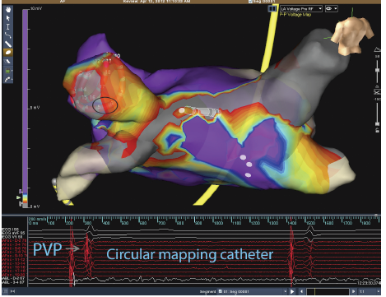
Human MR-Guided Left Atrial Radio-Frequency
Repair Ablations
No recurrences (N=10) 3+ yrs. post-ablation
LSPV
RIPV
RSPV
LIPV
LSPV
Late Gad Enhancement
Pre-ablation
Detect Scar Gaps
LIPV
RIPV
EAM Mapping (St. Jude) Pre-ablation
Confirms Ablation Lesion Gaps
RSPV
LSPV
IMRIS MRI
Room
Grey: Scar Circles : gaps detected with MRI
LIPV
Ablate Gaps
Late Gad Enhancement post-ablation
Confirm gap closure
IMRIS OR Room
Schmidt/ BWH

Slide 10
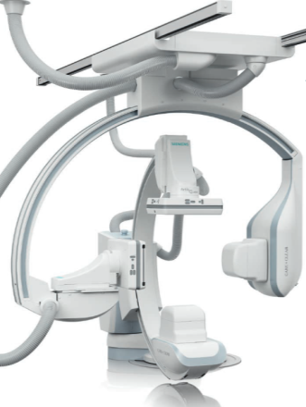
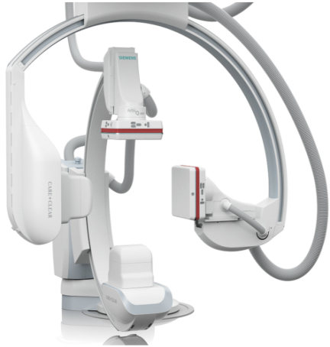
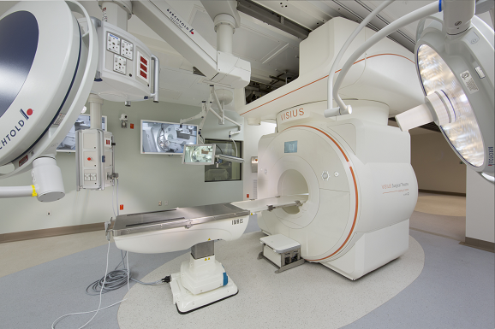
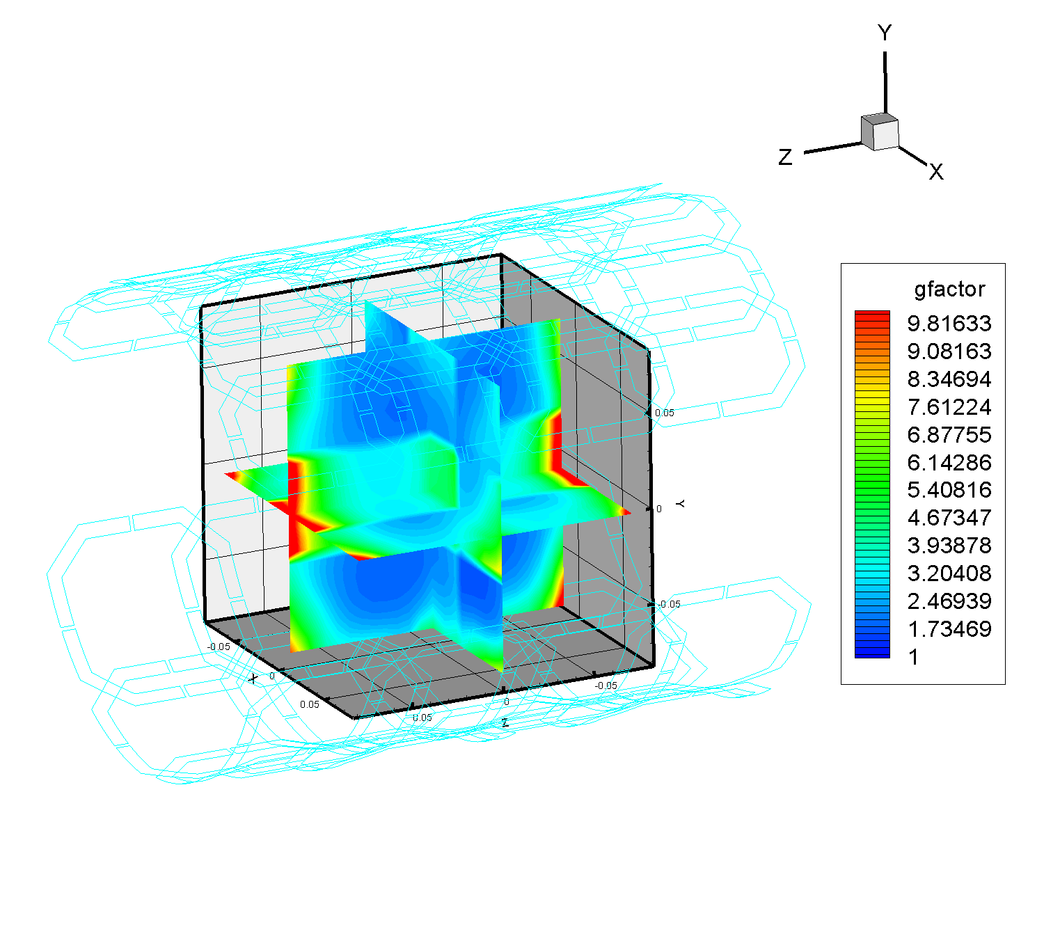
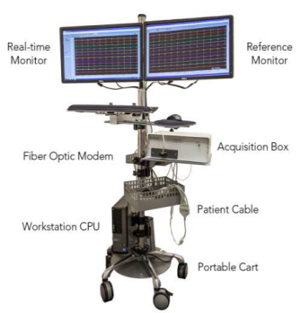
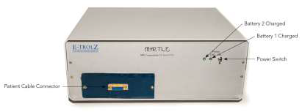
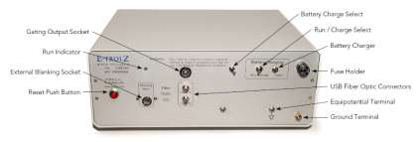
Future Technology Development
Artis Q
Artis Q Zen
Aera/Skyra
New X-ray Tube
(GIGALIX X-ray tube)
New X-ray flat panel detector (HDR detector)
Same X-ray Tube
as Artis Q
New X-ray flat panel detector for low dose
(Crystalline silicon detector)

