Slide 1
DSIR Plus MRI
Series 3 Software

Slide 2
INOMAX® (nitric oxide for inhalation)
INDICATIONS AND USAGE:
  INOmax is a vasodilator, which, in conjunction with ventilatory support and other appropriate agents, is indicated for the treatment of term and near-term (>34 weeks gestation) neonates with hypoxic respiratory failure associated with clinical or echocardiographic evidence of pulmonary hypertension, where it improves oxygenation and reduces the need for extracorporeal membrane oxygenation
CONTRAINDICATIONS:
  Neonates known to be dependent on right-to-left shunting of blood
WARNINGS AND PRECAUTIONS:
  Rebound: Abrupt discontinuation of INOmax may lead to worsening oxygenation and increasing pulmonary artery pressure
  Heart Failure: In patients with pre-existing left ventricular dysfunction, INOmax may increase pulmonary capillary wedge pressure leading to pulmonary edema
  Elevated NO2 Levels: Monitor NO2 levels continuously with a suitable Nitric Oxide Delivery System
  Methemoglobinemia: Methemoglobin increases with the dose of nitric oxide; following discontinuation or reduction of nitric oxide, methemoglobin levels return to baseline over a period of hours

Slide 3
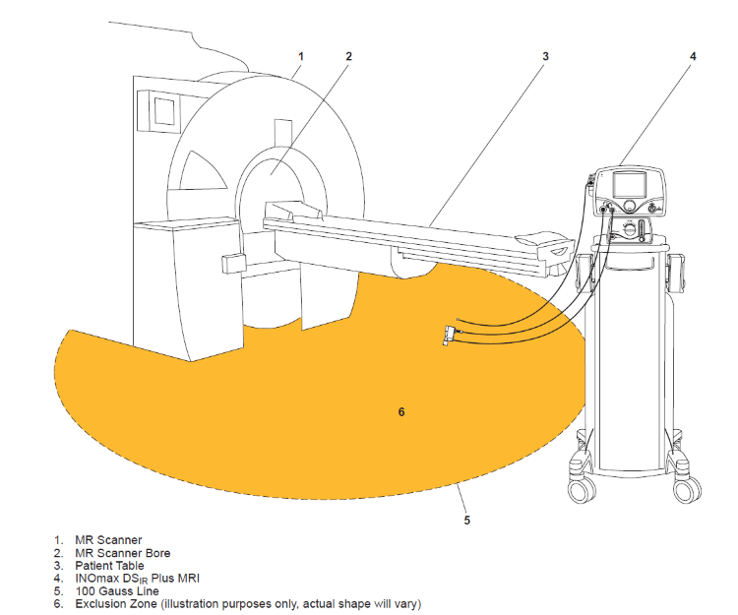
  WARNING: This device contains ferromagnetic components and hence will experience strong attraction close to the magnet. It should be operated at a fringe field of less than 100 gauss.

Slide 4
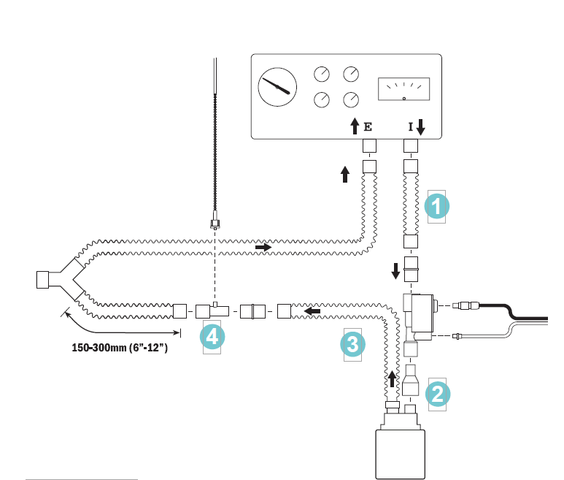
Injector Module and Disposables

Slide 5
Hardware - Safety Features

Slide 6
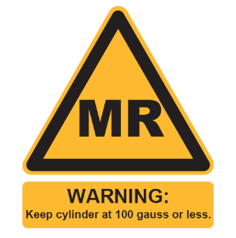
Drug Cylinders
Only use a size “88” (1,963 liters) with the DSIR Plus MRI while in the scanner room. Use of any other cylinder may create a projectile hazard.

Slide 7
Software - Safety Features

Slide 8
MRI Testing Ventilator Validation
Servo-I
Biomed MVP-10
Pulmonetics LTV-1200 MRI
* Nasal Cannula

