Slide 1
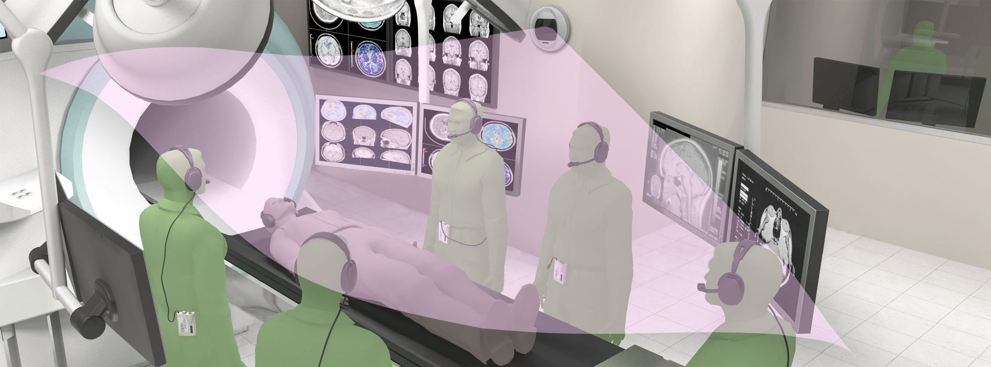
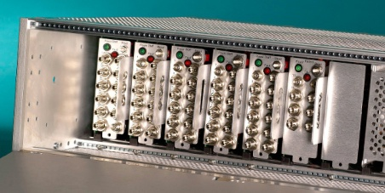
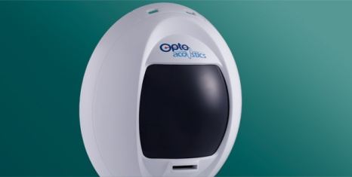
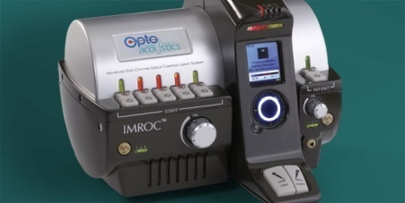
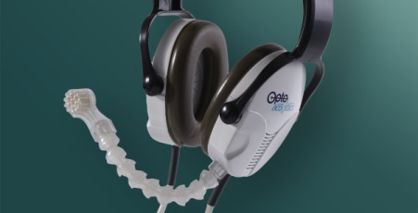
IMROC™ Wireless Multi-Channel Communication System
Interactive MRI Communications
Yuvi@optoacoustics.com

Slide 2
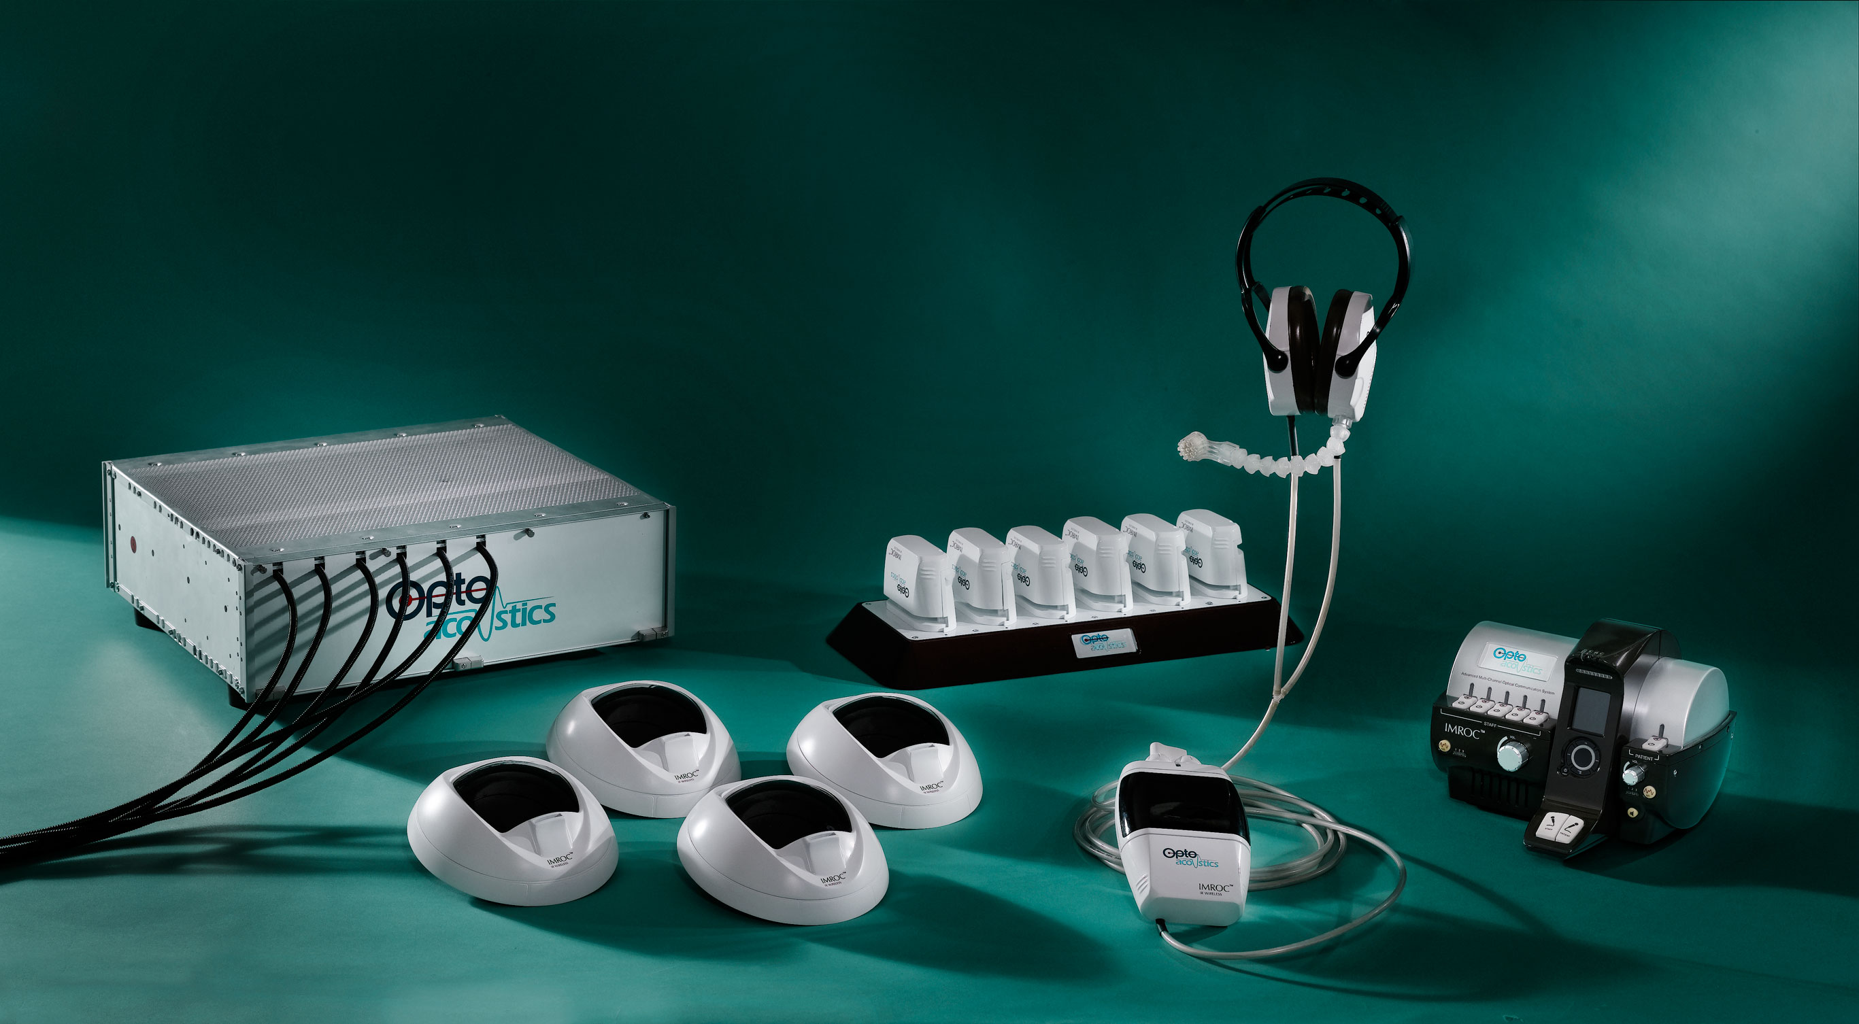
IMROC™ Wireless: Complete Freedom and Flexibility
x 6
Hands free MRI noise cancelation communications system

Slide 3
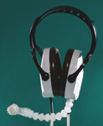
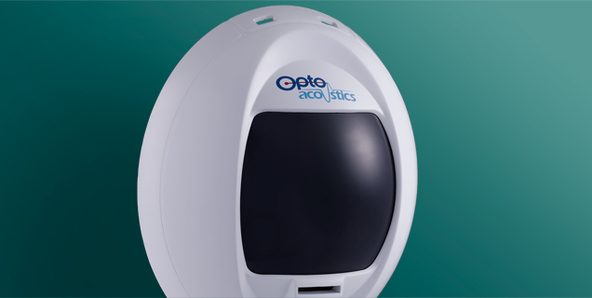
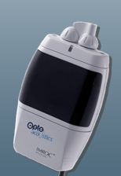
IMROC™ installed in 1.5T and 3T at
Interactive MRI Communications
NIH / NHLBI and NIH / Children hospital
JHU (4 systems)
MDACC
BWH
Utah
Emory, Atlanta
Cobourg, Germany
Leipzig, Germany
Gottingen, Germany
ICAN, Paris, France
✗
NO RF
IMROC™: Enables 8 Concurrent Dialogs During Scan

Slide 4
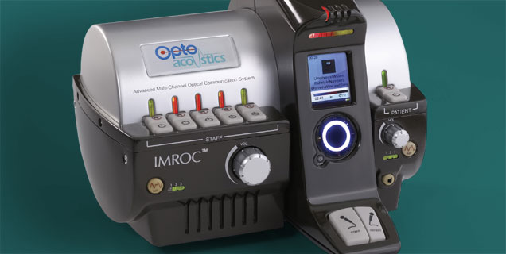
Interactive MRI Communications
IMROC™: Enables 8 Concurrent Dialogs During Scan
Up to 5 staff and 1 patient in scanner room, 2 users in control room
Hands Free, Crisp, clear speech with very low latency
Selectable DSP-based adaptive noise reduction filters out MR gradient noise for excellent sound quality
Total control over configuration, headset and microphone operations
Completely safe
Doctors can work smoothly and quietly, speaking freely with technicians and patients in any MRI environment even during scan.

Slide 5
IMROC™ Wireless: Complete Freedom and Flexibility
Interactive MRI Communications
Our acclaimed interactive MRI communications system, built on a a breakthrough diffused IR (DIR^{™)} wireless platform
Wall-mounted transceivers in both MRI suite and control room support up to 8 concurrent users
Outstanding audio performance with ultra-low latency and no RF footprint
Wearable, rechargeable personal audio control units
Eliminates need for fiber optical cables in the MR suite
✗
NO RF
IMROC Wireless brings the ultimate level of freedom and flexibility to doctors, technicians and patients in any MRI environment.

Slide 6
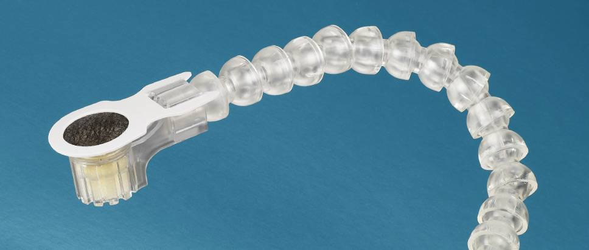
IMROC™: Most Advanced Dual-Channel Microphone
Interactive MRI Communications
FOMRI-III™ adaptive noise cancelling microphone is the gold standard for speech recording in MRI
Crisp, clear speech with very low latency (10 msec)
Inherent low self noise, wide bandwidth, a high dynamic range, and high directivity
Automatic noise reduction
Includes our industry-standard microphone for MRI research and clinical settings, now in its third generation.

Slide 7
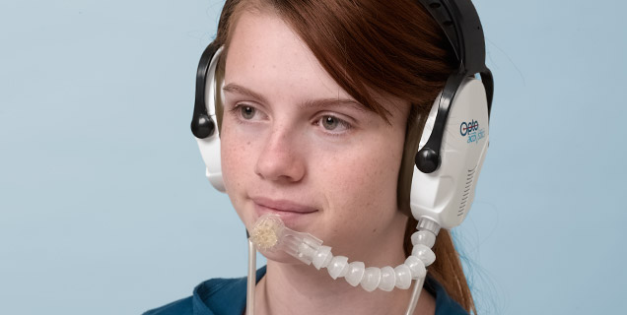
IMROC™: Patient Noise Reduction Headset
Interactive MRI Communications
Fiber optic patient headset for ultimate comfort and high fidelity audio
Provides optimal passive noise reduction
Slim design – suitable for children and adults, wireless module is located on MRI scanner outer shell (4 meters of cable connecting headset and switch unit)
Revolutionary clear sound with optimal passive noise reduction.
7

Slide 8
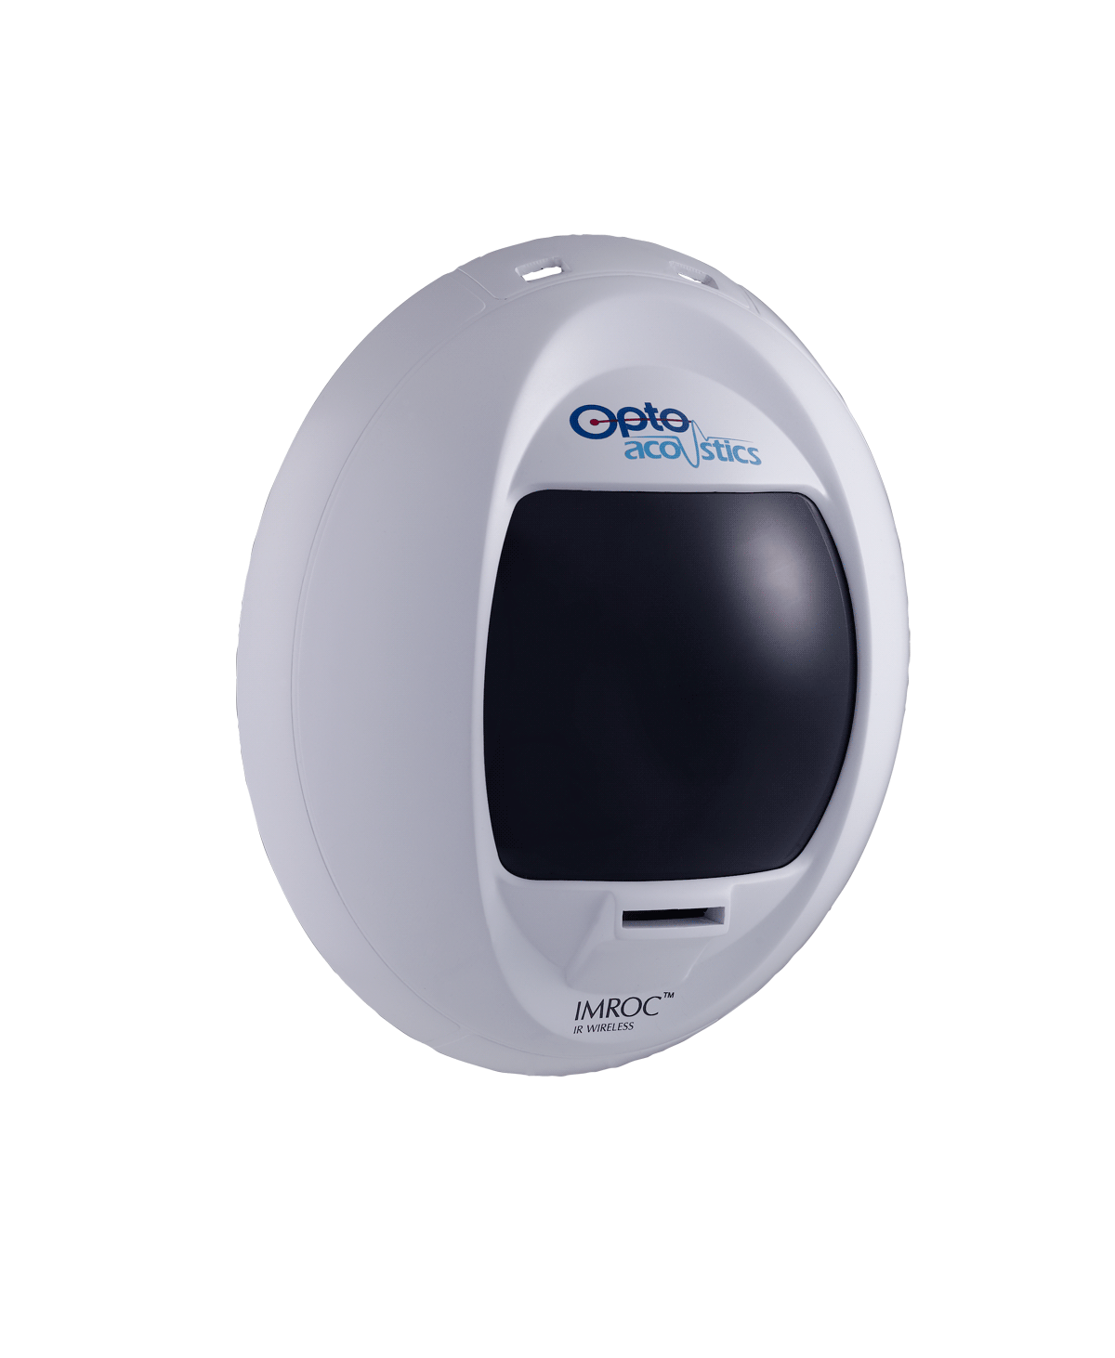
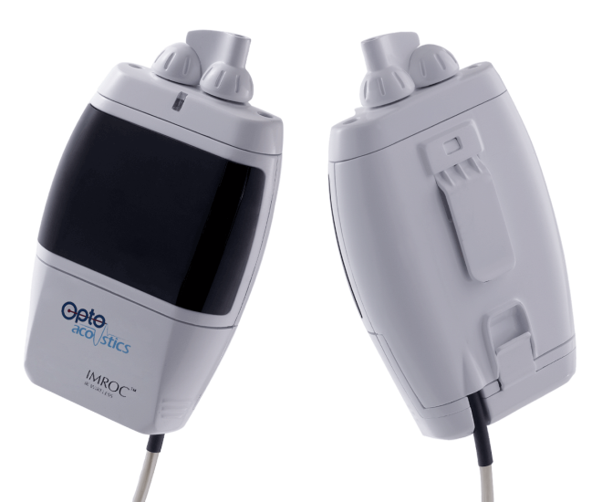
Interactive MRI Communications
IMROC™ Wireless Main Components
Wall Unit
Uses diffused, non-directional IR transmission -- no need for direct line-of-sight
Supports multiple transceivers for ideal coverage
Reception range of 10 m
110/220V AC/DC power
Personal Audio Control Unit
Complete switching and audio control
Wireless communication device
Customized 7.4V rechargeable battery
Attached to optical fiber headset
IMROC Wireless is the first full duplex, light-based multi-channel two way communications system, suitable for any MRI environment.
www.optoacoustics.com/medical
8

Slide 9
Interactive MRI Communications
IMROC™ Wireless Diffused IR (DIR™) Technology
Optical, non-RF operation with no line-of-sight required
High immunity to RF interference
High bit rate – 5 Mbps, 16-bit resolution
Ultra low latency (< 2 msec), ideal for for real time applications
Congestion-free, secured link
No bandwidth regulation required
IR does not penetrate body – no health issues (Greentooth)
www.optoacoustics.com/medical
9

Slide 10
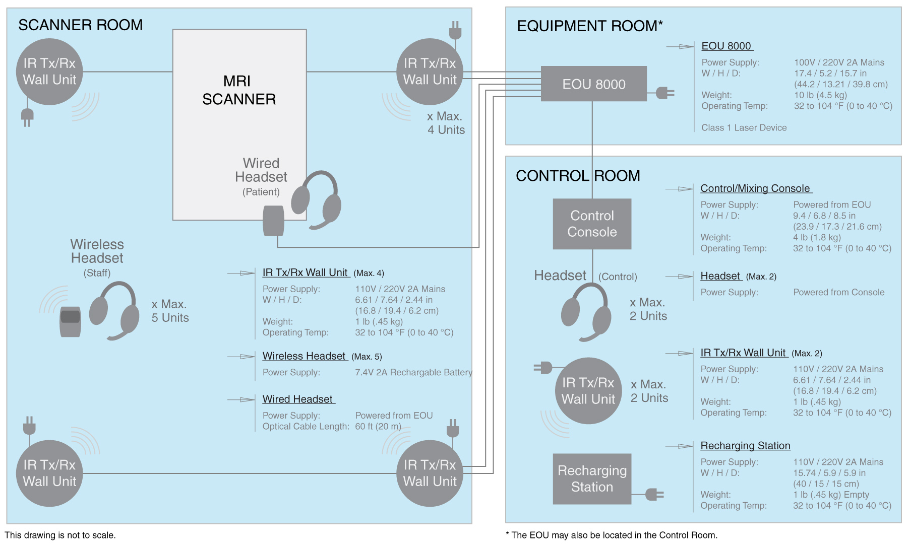
Interactive MRI Communications
IMROC™ Wireless Site Configuration Layout
www.optoacoustics.com/medical
10

Slide 11
Interactive MRI Communications
IMROC™ Wireless Site Configuration Details
MRI Scanning Suite:
Control Room:
Up to 5 wireless headsets for staff and 1 wired for patient, each with FOMRI-III fiber optical microphone
Personal audio control unit for each staff member (belt-worn)
Up to 4 wall-mounted wireless IR transceivers
IMROC control and mixing console with built-in MP4 player
Up to 2 lightweight headsets for control room staff
Up to 2 wall-mounted wireless IR transceivers
Recharging station for up to 5 personal audio control unit batteries
Equipment Room:
IMROC electro-optical unit (EOU)
A professional wireless optical communication system, bringing complete flexibility with a rich and robust feature set for MR applications.
www.optoacoustics.com/medical
11

Slide 12
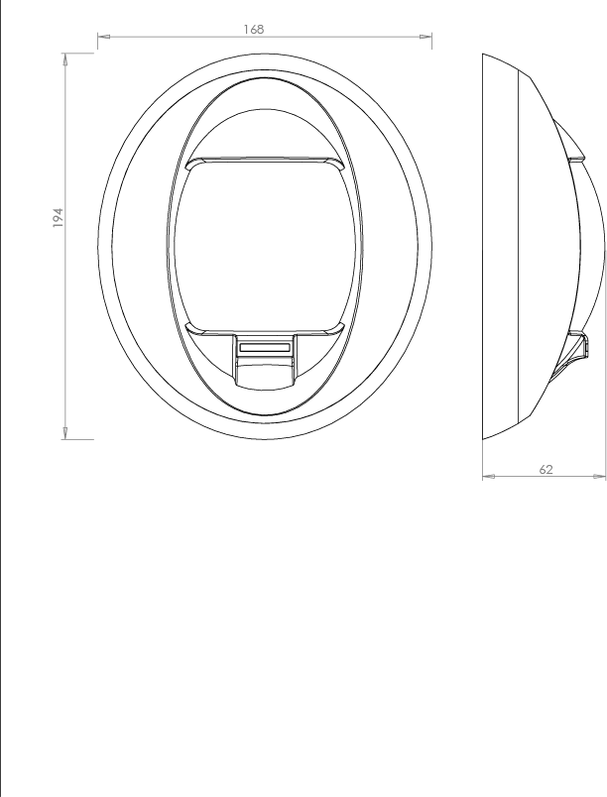
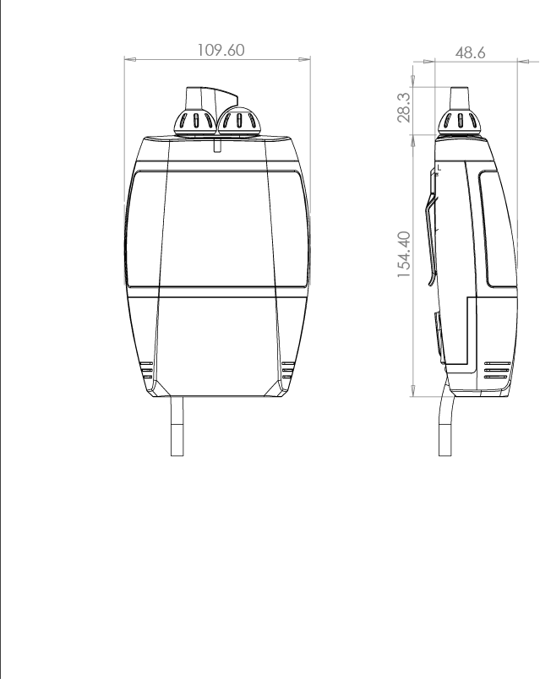
Interactive MRI Communications
IMROC™ Wireless Main Component Dimensions
Personal Audio Control Unit Worn on waist belt; rechargeable power
Units in mm
IR Transceiver Unit Uses up to 6 wall-mounted units – for multiple rooms
www.optoacoustics.com/medical
12

Slide 13
IMROC™ Wireless Transceiver Configuration
Fiber optic connector to EOU 8000 in Equipment Room Cable length up to 30 m (98.4 ft)
EOU 8000
IR Tx/Rx Transceiver Unit
Mount near scanner room corners;
Wall height 1.5 to 2.5 m (5 to 8 feet)
Note: Generally, 2 transceivers are sufficient for complete room coverage.
Standard 110/120 plug to electrical mains socket; Unit cord length up to 2m (6.5 ft)
www.optoacoustics.com/medical
13

Slide 14
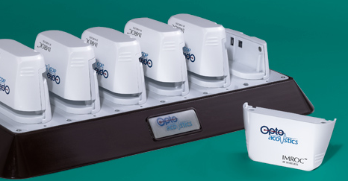
IMROC™ Wireless Personal Control Unit Battery Details
Custom 7.4V 2600 mAh Polymer-Lithium battery
Fully MRI compatible
Continuous use up to 5 hours
Green/Red LED charge indicator
12 batteries supplied with full configuration
Resides in Control Room
Recharges 6 batteries at a time (6-in, 6-out)
Green/Red LED charge indicator
Personal Audio Control Unit
Recharging Station
www.optoacoustics.com/medical
14

Slide 15
IMROC™ Wireless: Complete and Easy Control
Interactive MRI Communications
Total interactive control over channel configurations, headset and microphone operation in real-time
Control room mixing console supports full duplex communication and enables control over: muting participants, adjusting noise reduction, adjusting a patient’s music volum, and other features.
Up to 2 additional headsets can connect directly to the console for observers
Control room recharging station for up to 5 personal audio control units
Built-in MP4 stereo entertainment system
A professional wireless optical communication system, bringing complete flexibility with a rich and robust feature set for MR applications.

Slide 16
Summary – IMROC-IR
Multi-channel advanced noise cancellation communication system developed specifically for iMRI
5 staff +1 patient +2 in the control room for concurrent dialog even during scan
Siemens certified, CE, FDA-510k
Can be installed in multiple rooms for continuous communication
Unique, diffuse IR technology, no RF
Price 50k$-68k$ (# of staff headsets, # IR wall transceivers, etc)
Contact: Dr. Yuvi Kahana (yuvi@optoacoustics.com)

