Slide 1
PRiME (Physiological Recording in MRI Environment)
John Kakareka
Signal Processing and Instrumentation Section,
Division of Computational Bioscience, Center for Information Technology
NIH
Conflict of Interest Statement
I have no financial relationships regarding the PRiME system
NIH does not have any patents or licenses on the PRiME system
NIH does not officially recommend or endorse any company or product mentioned

Slide 2
PRiME Overview
Supports physiological recording of 6-lead ECG and 2 invasive blood pressure (IBP) channels
This is not a marketed system, but rather design documents on how sites can assemble a non-significant risk medical device.
Please adhere to local clinical and research standards if you plan to use these devices on patients.
Benchmarks
>24 pediatric patients at Children’s National Medical Center in Washington, D.C.
>6 adult patients at NIH
numerous animal studies at NIH

Slide 3
PRiME 1st Generation System Components
Physiological Signal Acquisition – resides on patient table
Designed specifically to reduce noise (i.e., gradient, RF pulse sequence) generated in an MRI environment
Uses fiber optic cables to transfer digitized signals to control room
Control System and Adaptive Filtering – resides in control room
Uses gradient control signals from MRI to adaptively cancel gradient induced noise
Real-time FPGA-based system designed using National Instruments Labview programming software
Allows for display of signals; user control of system settings
Provides trigger based on ECG or IBP signals which can output to MRI system
Can be used for gated MRI sequences
Physiological Signal Converter – resides in either control room or X-ray room
Outputs transducer-level analog signals for integration with commercial recording systems (e.g., Siemens SENSIS, GE Maclab)

Slide 4
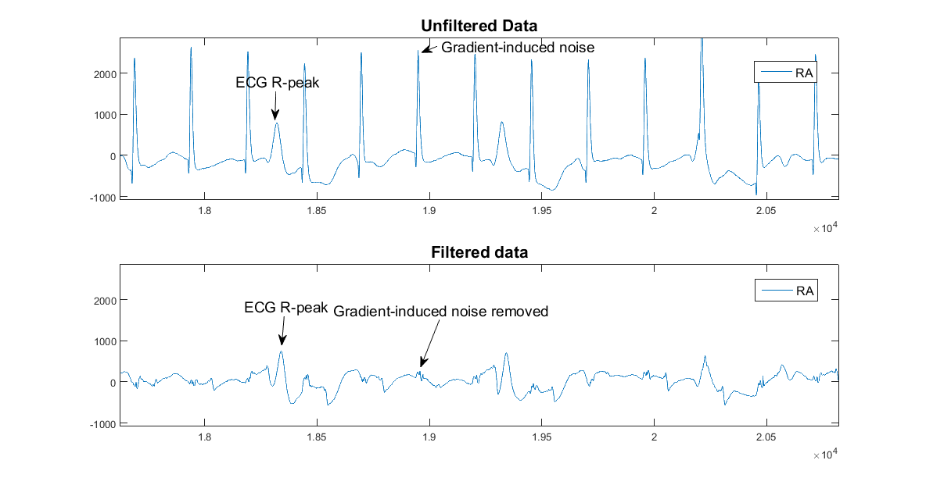
PRiME Example of Gradient Noise Removal
Figure 1. Example of removal of MRI gradient-induced noise in a volunteer during a real-time imaging sequence. The top plot is the right arm electrode after acquisition and the bottom plot is same signal after the adaptive filter

Slide 5
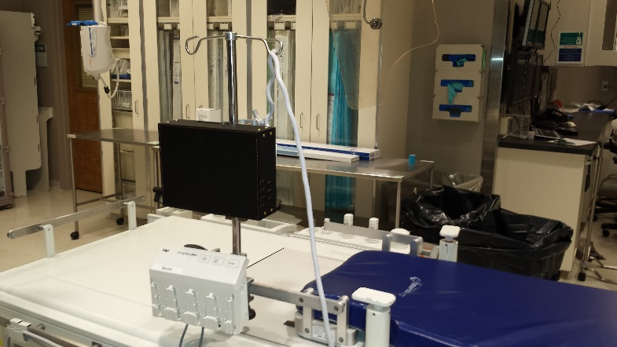
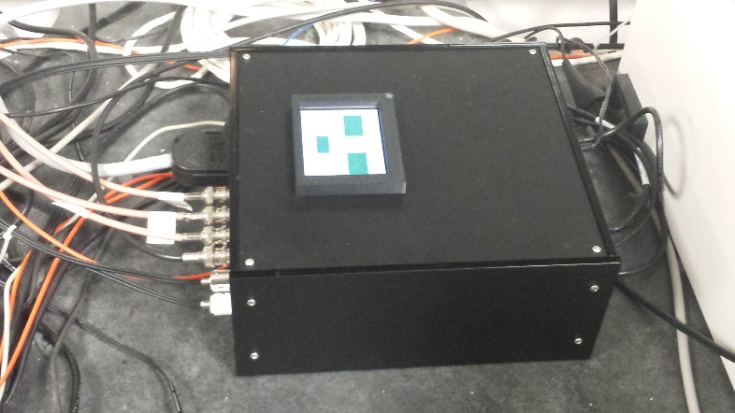
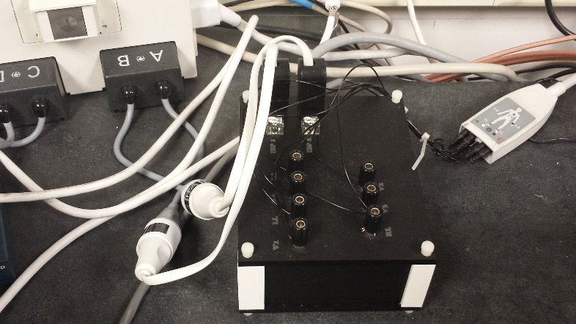
PRiME Technology Transfer for Early Adopters
All schematics, printed circuit board layouts, mechanical designs, bill of materials and software code will be made available at no cost with no licenses required
Guidelines on how to assemble and test a system will be provided
Information enabling an electronics assembly house to assemble all three components
http://nhlbi-mr.github.io/PRiME/
Total estimated cost (including all hardware and software): $20,000
Figure 1. Physiological Acquisition System (black box) on IV Pole
Figure 2. Control System and Adaptive Filter System located in the MRI control room
Figure 3. Physiological Converter System located in MRI control room

Slide 6
PRiME Acknowledgements
NHLBI, Cardiovascular Intervention Program
Dr. Tony Faranesh
Dr. Robert Lederman
Children’s National Medical Center
Dr. Kanishka Ratnayaka
CIT, Signal Processing and Instrumentation Section
Tom Pohida
Randy Pursley
Jessica Crouch

