Slide 1
SCMR 2016 - iCMR Workshop
Vendor Panel 3: EP
Steve Wedan
Imricor Medical Systems
Disclosure: Employee of Imricor Medical Systems

Slide 3
Vision-MR Ablation Catheter
9 Fr
Open irrigated
Gold electrodes
Tip temperature sensing
Active tracking
Active Tracking Coils

Slide 4
CAUTION: None of the following devices have been approved for use in humans.

Slide 5
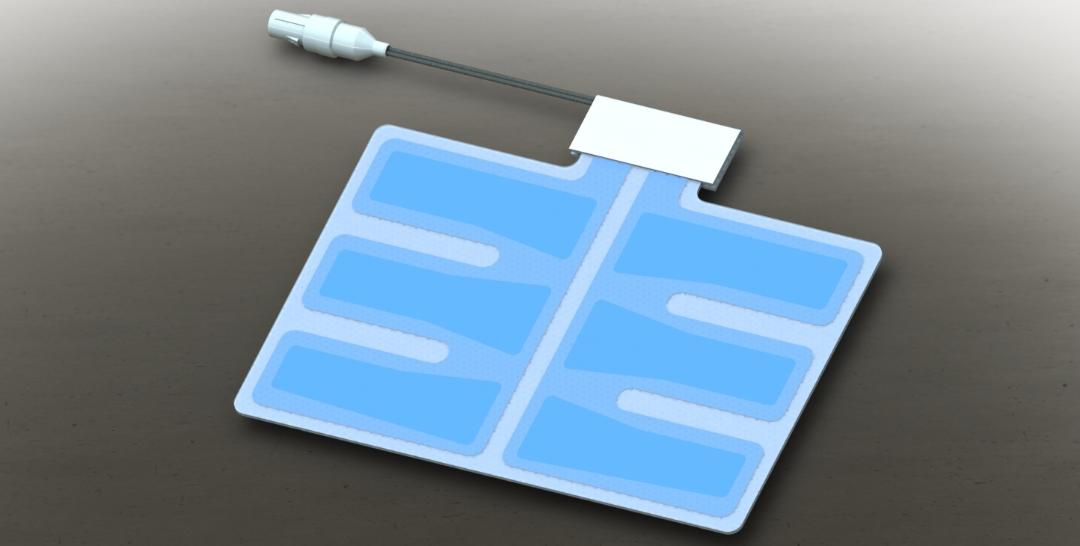
Vision-MR Ablation Return Electrode

Slide 6
Vision-MR Introducer Kit

Slide 7
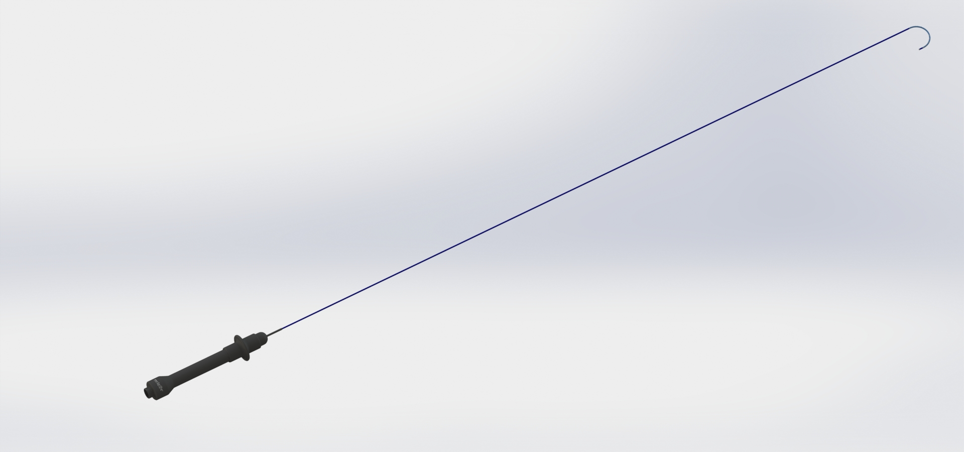
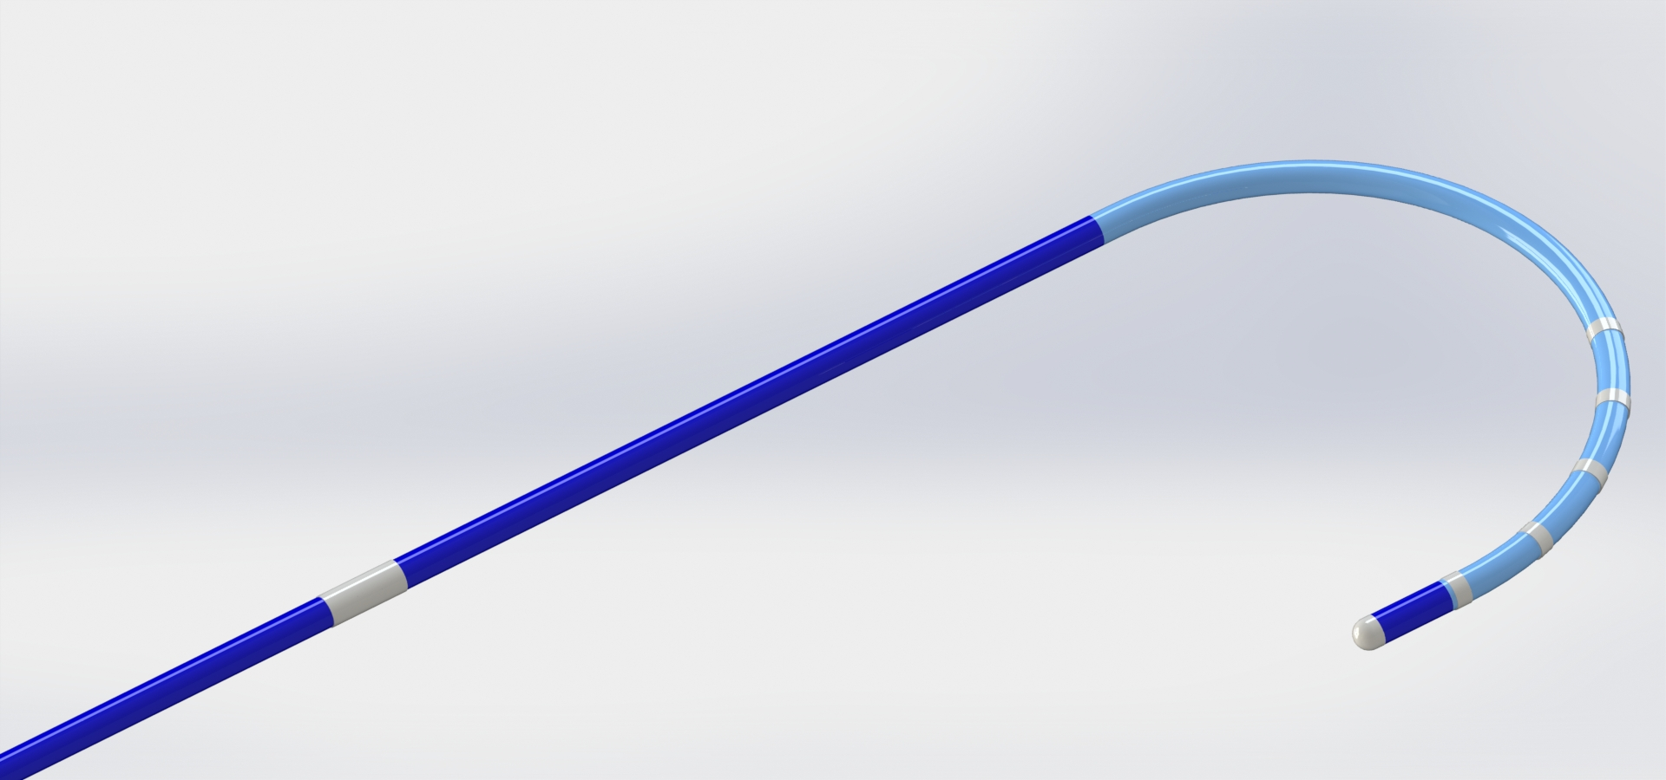
Vision-MR Diagnostic Catheter
6 Fr
7 Electrodes
Passive tracking

Slide 8
Vision-MR Dual-Deflect Sheath
11 Fr
Passive tracking

Slide 9
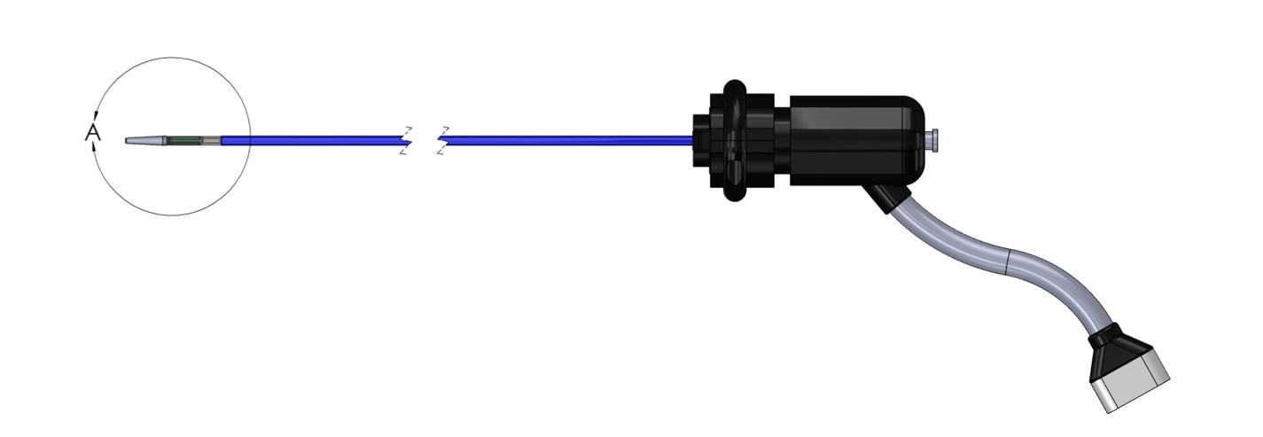
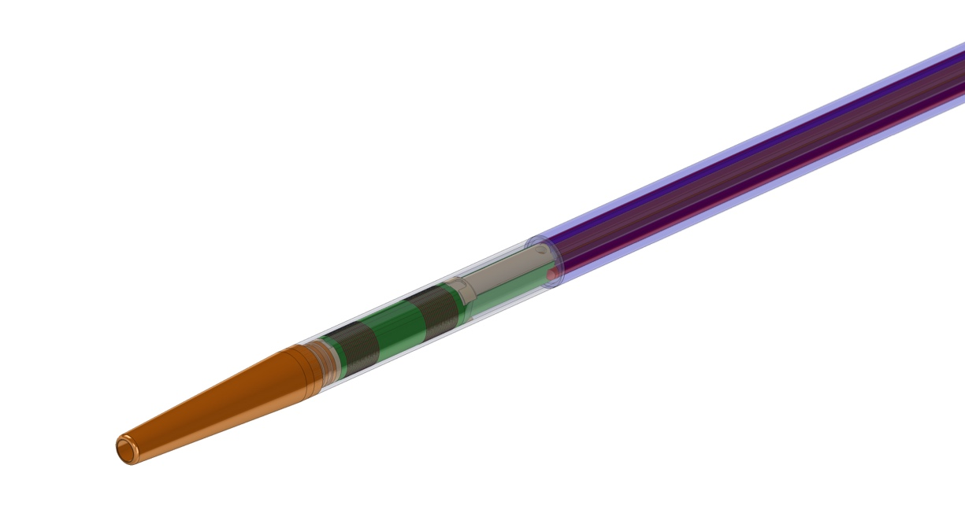
Vision-MR AT Dilator
Active
Tracking Coils
DETAIL A

Slide 10
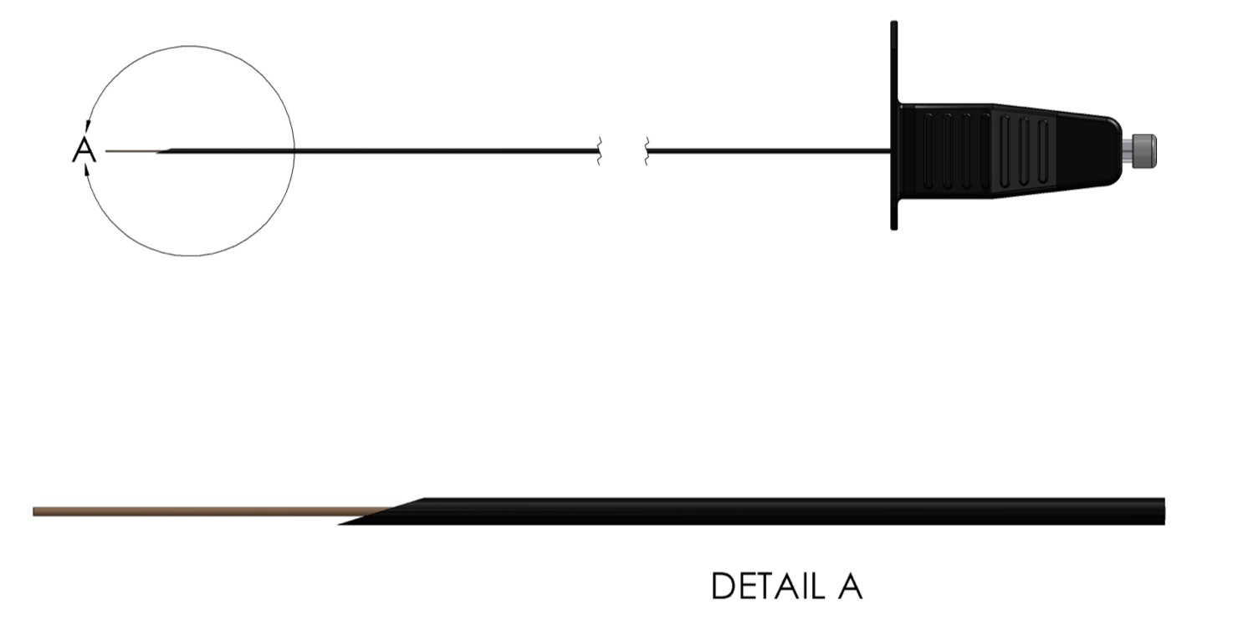
Vision-MR Transseptal Needle

Slide 11
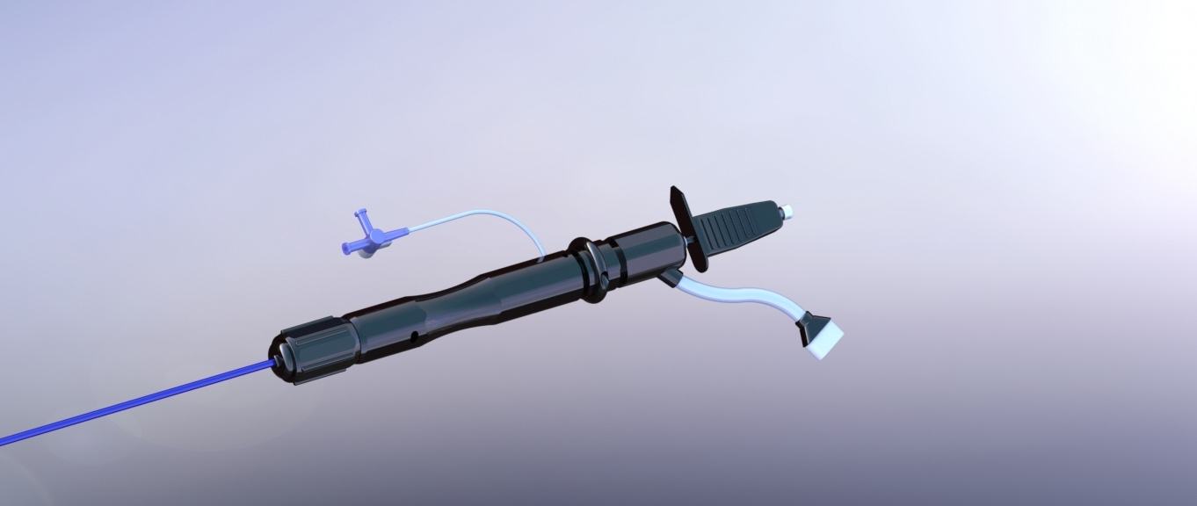
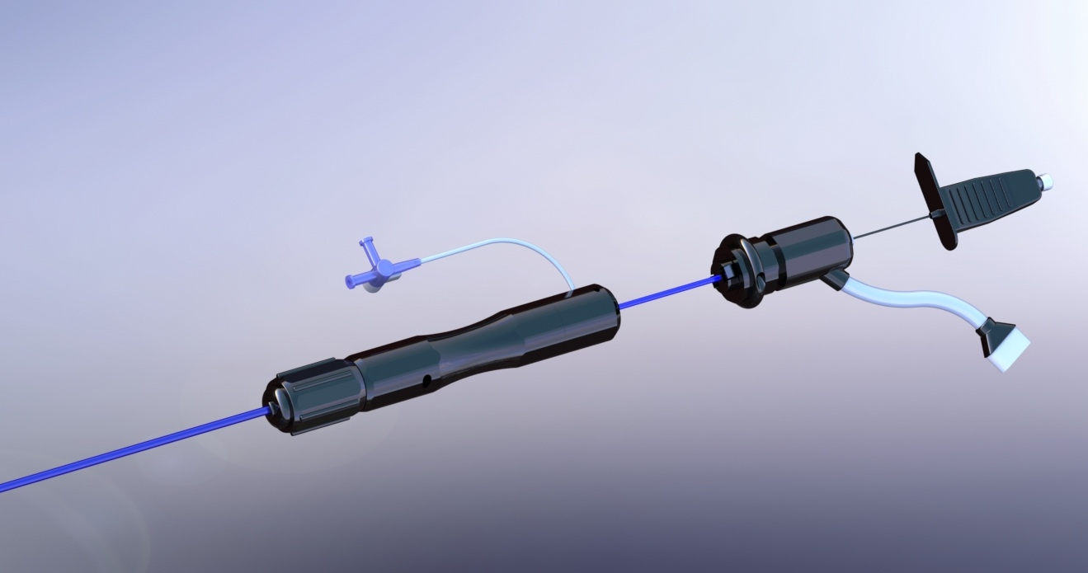
Transseptal Puncture Kit

Slide 12
Beyond EP

Slide 13
Vision-MR Injection Catheter

Slide 14
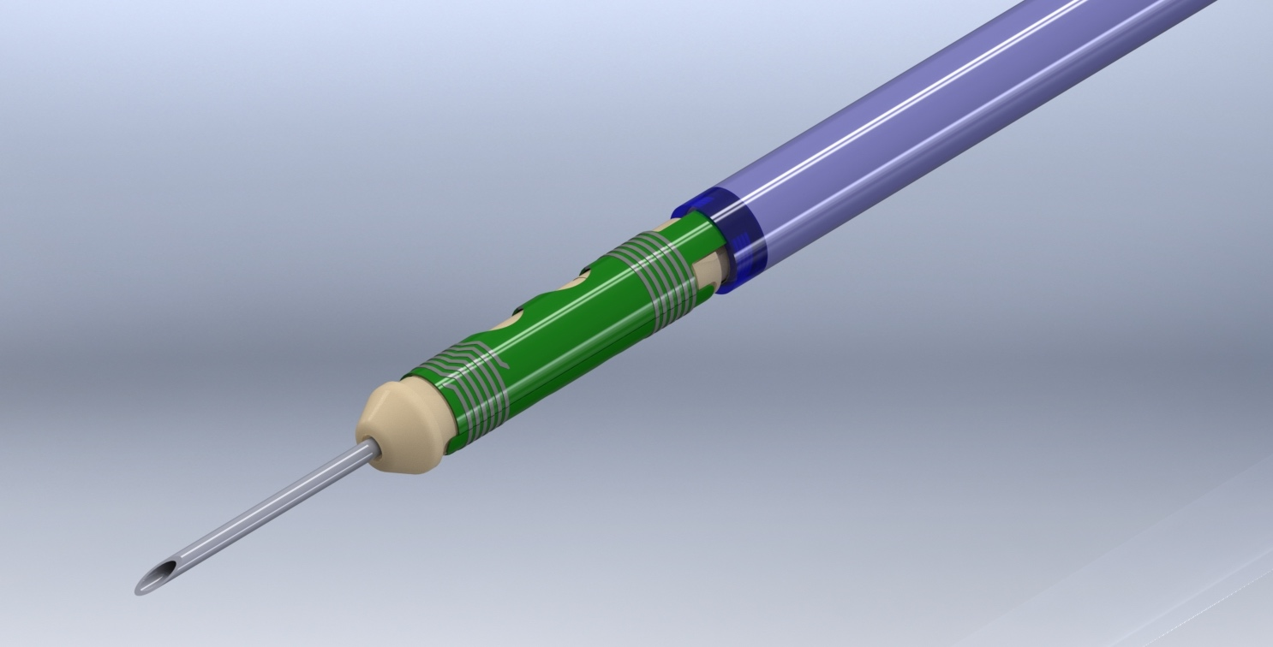
Vision-MR Injection Catheter
Active Tracking Coils

Slide 15
Vision-MR Biopsy Catheter

Slide 16
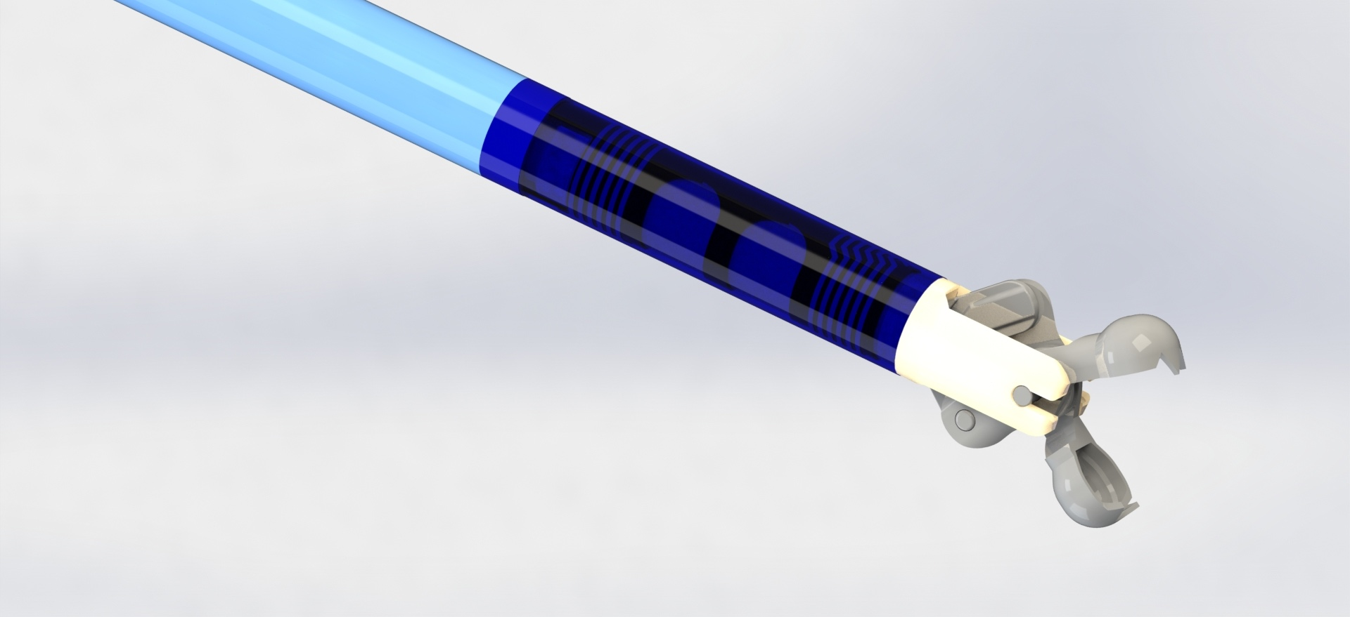
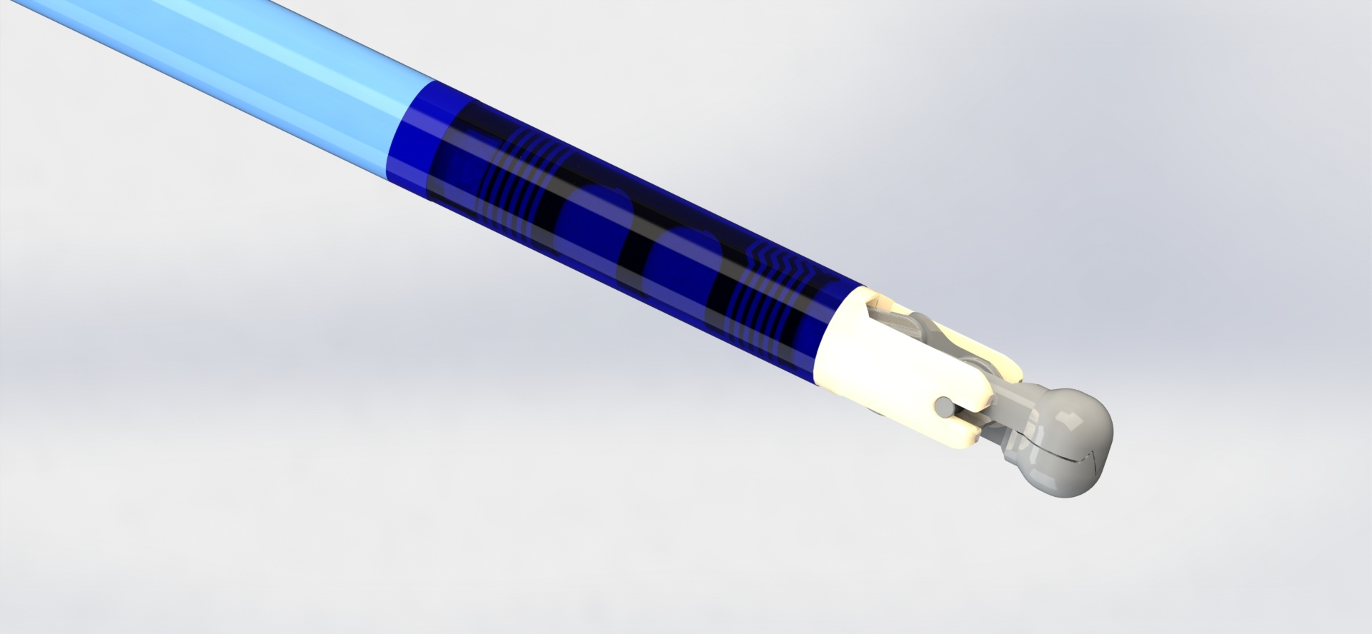
Vision-MR Biopsy Catheter
Active Tracking Coils

Slide 17
What’s next…
You tell us.

