Slide 1
VISION by Outsider: What I need to do?
Howaida El-Said, MD
Professor Pediatrics, Division of Cardiology
Director of Cardiac Cath lab,
Rady Children's Hospital,
UCSD, San Diego

Slide 2
I have no disclosures

Slide 4
Both
Dark & Light side techniques
Negotiator Guardian
Dark side

Slide 5
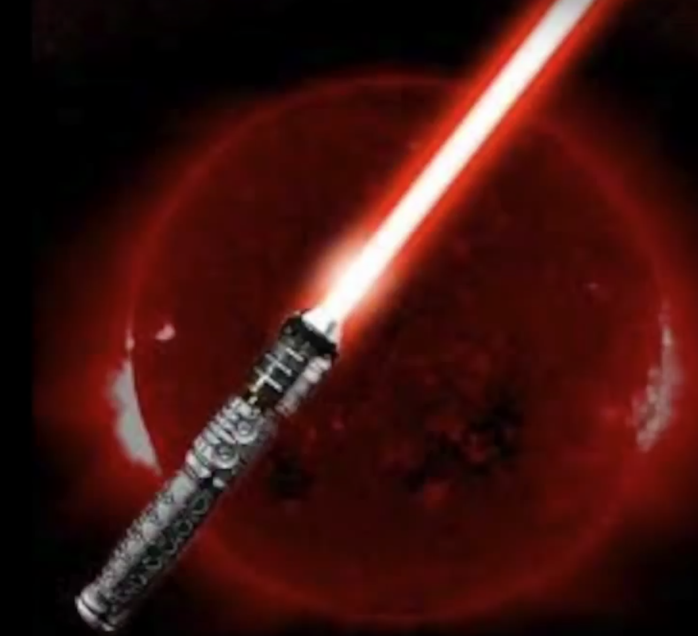
Radiation
Dark side

Slide 6
Radiation
Cancer
Left brain hemisphere tumors
Cataract
DNA damage

Slide 7
“Internationalist Disc Disease”
Back, neck, hip problems
Physicians with more than 20 years of experience have a very high rate of back pain (60%)

Slide 8
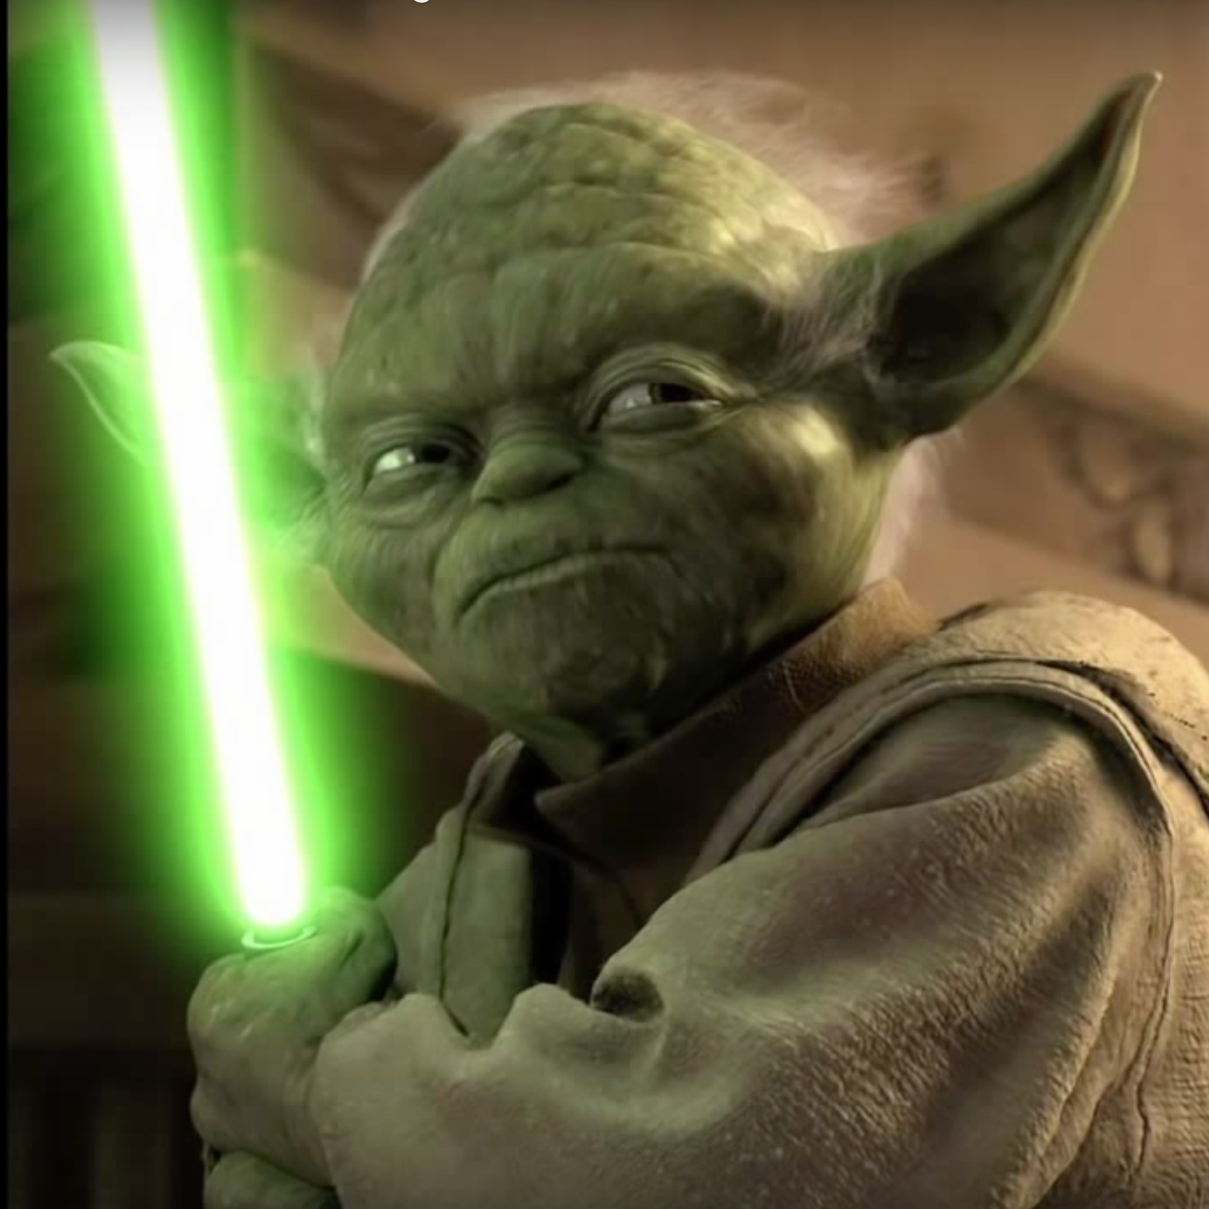
MRI
Negotiator Guardian

Slide 9
Advantages of MRI
No ionizing radiation
High resolution and 3D images of the cardiac chambers and thoracic vessels.
MRI is also less operator dependant than echocardiography.
SSFP techniques can be used to assess global and regional ventricular contractile function, including the more difficult to assess right ventricle.
Measure blood flow.
MRI does not have the weakness of geometric assumptions (as do angiography and 2-D echocardiography) in assessing ventricular volumes.

Slide 10
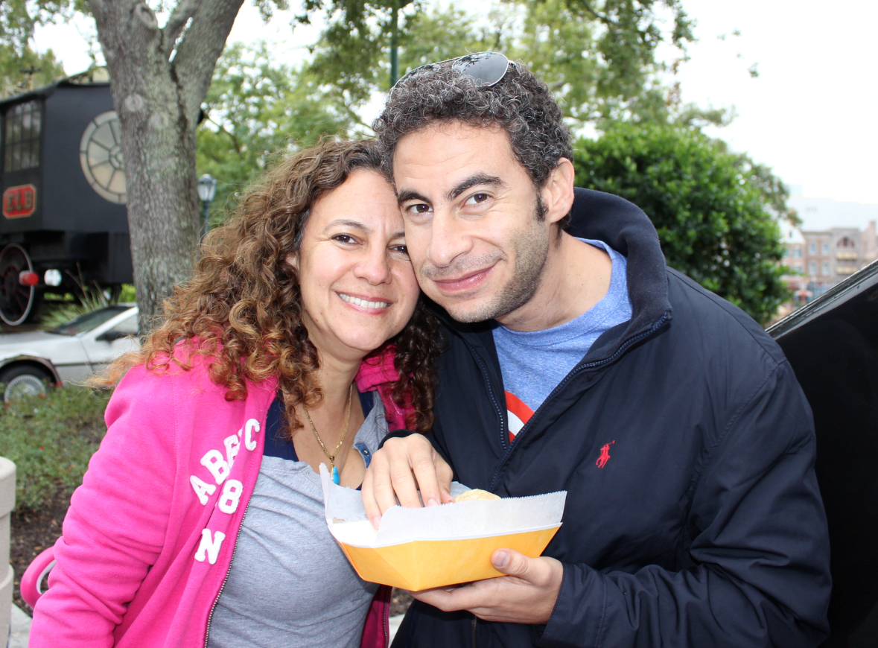
Master’s of Engineering
Khaled
El-Said
2002

Slide 11
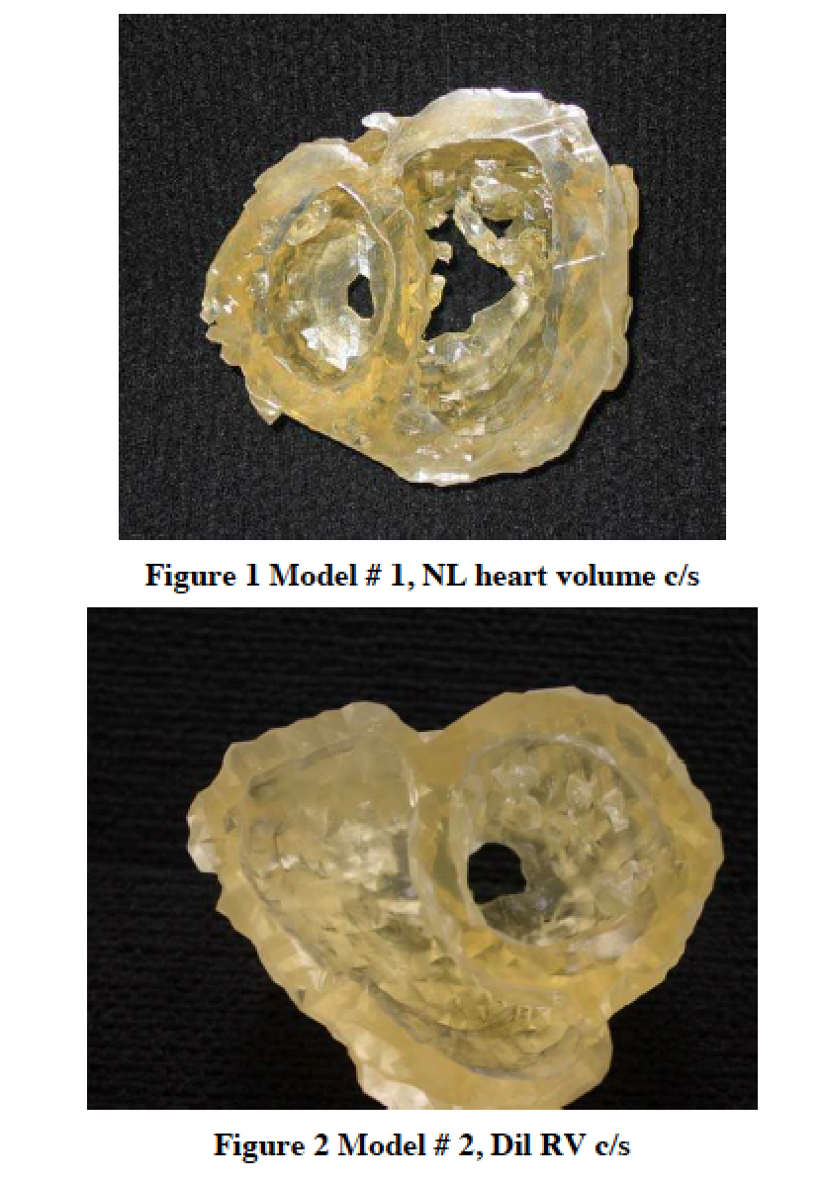
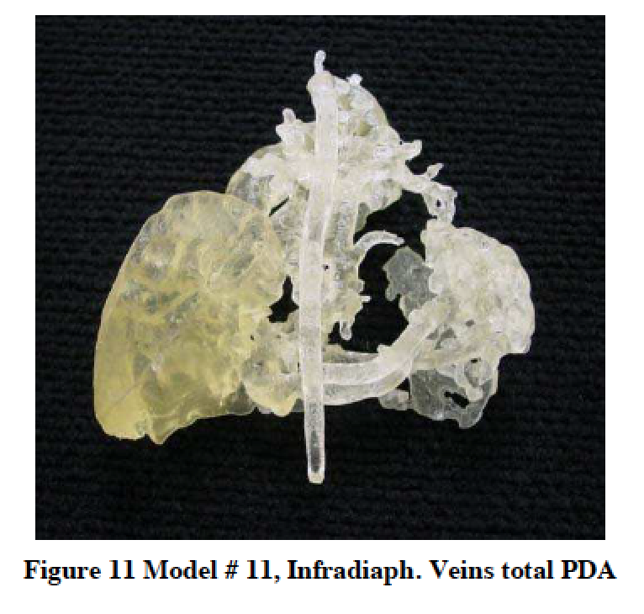
Stereolithographic modeling from MRI

Slide 12
Adjacent structures!!

Slide 14
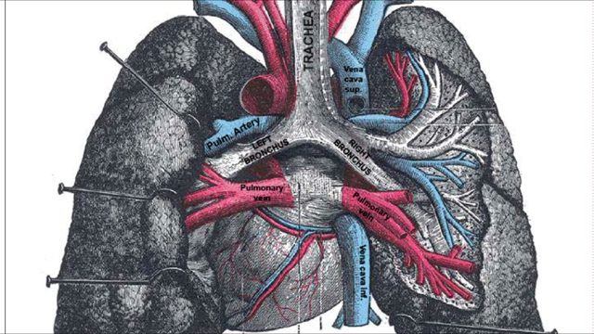
Bronchial Compression

Slide 17
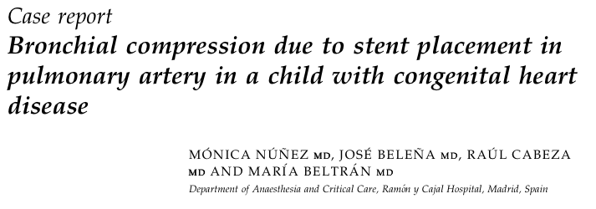
First report
Pediatric Anesthesia 2005

Slide 18
Cardiovascular Interventions 2009

Slide 19
Review of stents placed from August 2005 until November 2007
120 pts who received 147 stents
Those who had CT angiography (CTA) were analyzed

Slide 20
Indications for post-stent CTA imaging
Inability to wean from ventilator support
Persistent coughing episodes
Continued hypoxia
Follow-up study after complex repairs
Notes:
Indications for post-stent CTA imaging included inability to wean from ventilator support, persistent coughing episodes, continued hypoxia, and follow-up study after complex repairs.

Slide 21
21/120 pts underwent post-stent CTA
Age: median 10 m (1 d-17 y)
Wt: median 7.3 kg (2.7-80 kg)
22 stents were implanted in 21 pts
Stent length (8-38 mm)
Diameter (6-18 mm)
Notes:
21 of 120 patients underwent post-stent placement CTA.
There were 11 males and 10 females with an age range of 1 day to 17 years (median 10.5 months, mean 5 years 6 months), and a weight range of 2.7 to 80 kg (median 7.3 kg, mean 19.4 kg).
22 stents were implanted in the 21 patients, including 20 Palmaz Genesis Stents, 1 eV3 Max LD stent, and 1 Atrium Covered Stent
Unexpanded stent lengths ranged from 8 to 38 mm and inflation diameters ranged from 6 to 18 mm.

Slide 22
6/21 (29%) had bronchial compression
5/21 (23%) had significant, clinically apparent adverse events from stent bronchial compression, one patient was asymptomatic
At least 5% (6/120) of all stented pts had bronchial compression

Slide 23
2/6 pts expired as a result of this complication
Of the 4 surviving pts
1 required a tracheostomy
1 was asymptomatic
2 required slow weaning from mechanical ventilation (9,16 days)

Slide 24
Results

Slide 25
5/6 (83%) had aortic arch anomalies and subsequent arch reconstruction or hybrid interventions

Slide 26
The geometry
LPA
Br

Slide 27
The geometry
LPA
Br

Slide 28
The geometry
LPA
Br
Dome
Peak

Slide 29
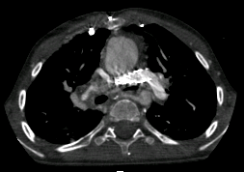
Stent in proximal LPA compresses Left bronchus

Slide 30
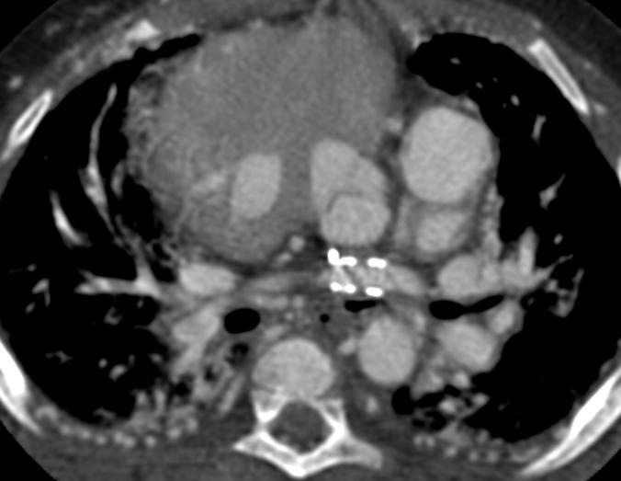
Stent in distal LPA compresses Left bronchus

Slide 31
Stent in RPA compresses Left bronchus

Slide 32
Stent CoA

Slide 33
Worst Scenario!
Arch repair (geometry change)
Stent of CoA
Stent of branch PA (especially the left)

Slide 34
Dilated aortic root
LPA
Br

Slide 35
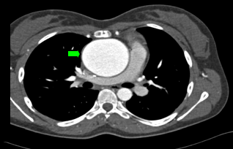

Slide 36
What did we find?
Unexpected incidence of clinically significant bronchial compression (Br comp) from stents
29% of pts with stents who had a CTA had Br comp
At least 5% of all stented pts have Br comp
More likely with arch re-construction
Notes:
This review revealed an unexpected incidence of clinically significant bronchial compression: 29% among patients who obtained a CTA, and 5% among all patients who received stents. This finding suggests that airway compression by implanted stents may be more common than previously thought. Five of the six patients with documented airway compression had respiratory symptoms. In one patient, airway compression was an incidental finding as the patient was asymptomatic and underwent CTA as a part of a preoperative workup.

Slide 37
Decided to do something about it!!

Slide 38
Warning!
Arch reconstruction

Slide 39
Better visualization

Slide 43
Goal
To limit airway narrowing by endovascular
stenting, by using simultaneous flexible
bronchoscopy and graduated balloon stent
dilation

Slide 44
Two Scenarios
Denovo stenting
Re-dilation of pre-existing stent

Slide 45
Denovo Stenting:

Slide 50
Re-dilation Of Pre-existing Stent

Slide 51
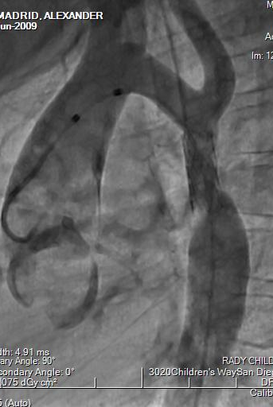

Slide 54
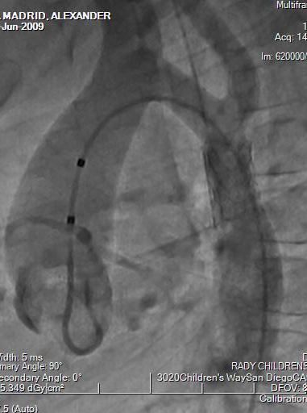

Slide 58
Conclusion
In cases at risk for airway compromise, flexible bronchoscopy is a useful tool to guide endovascular stenting.
Maximum safe stent diameter can be determined without risking catastrophic airway compression.

Slide 59
Both
Dark & Light side techniques

Slide 60
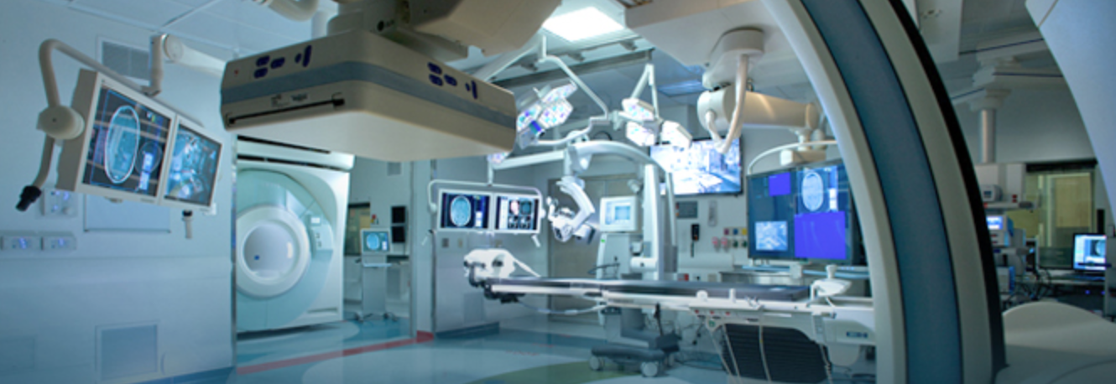

Slide 61
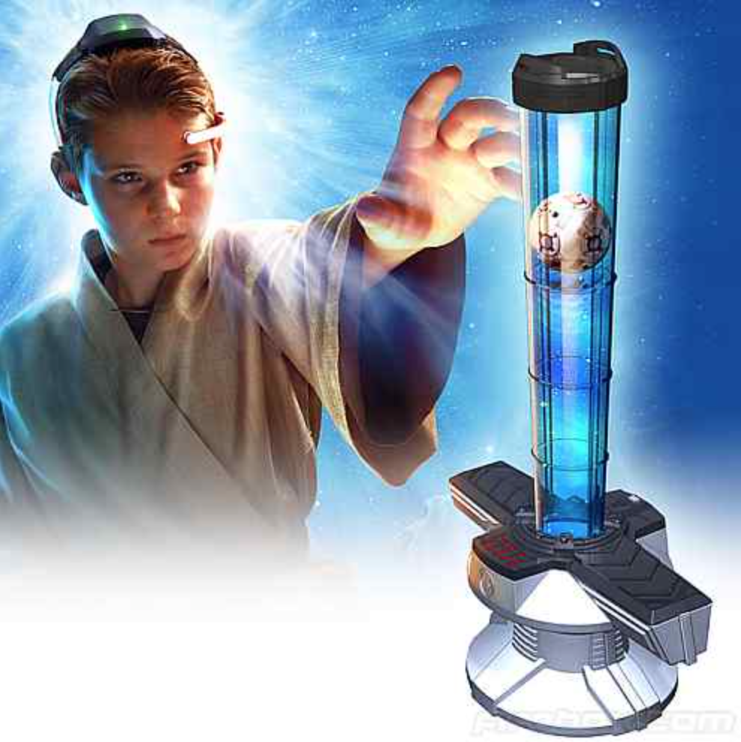

Slide 62
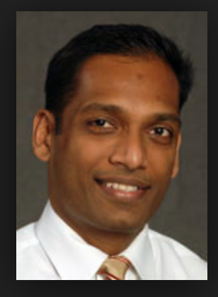
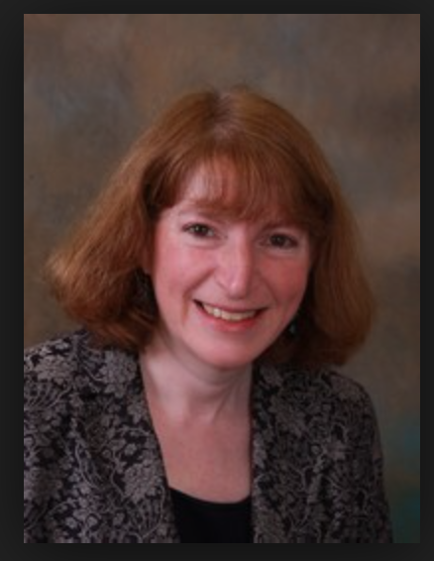
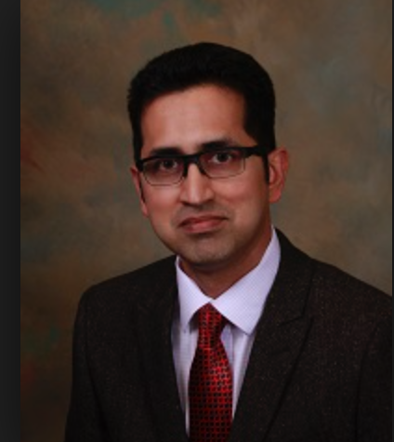
Dream Team!
“Dream Until Your Dreams Come True”

Slide 63
Thank You

