Slide 1
Real-Time Image-Based Motion Compensation
Graham Wright
Sunnybrook Health Sciences Centre, University of Toronto
SCMR Interventional Workshop
Jan. 28, 2016
University of Toronto

Slide 2
Disclosures
Graham Wright, PhD
I have the following conflicts of interest to disclose with regard to the subject matter of this presentation:
GE Healthcare – Research Support
HeartVista – Research Support

Slide 3
Image Registration for Motion Compensation
Context:
Current clinical tools merging prior CT/MR roadmaps with electroanatomic maps via landmarks and overlay on x-ray to guide ablation procedures yield positional error as much as 2.1±1.1 cm, primarily due to motion¹
Model-based motion compensation misses intra-procedural variability
Realtime imaging offers limited depiction of target anatomy (poor contrast, 2D)²
Motion correction with realtime imaging can yield most accurate target position
H. Zhong et al. Heart Rhythm, 2007
A.C. Lardo et al. Pediatr Cardiol, 2000

Slide 4
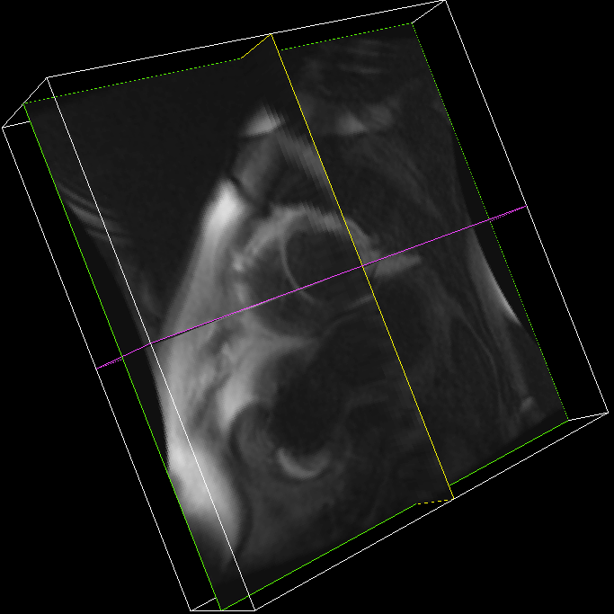
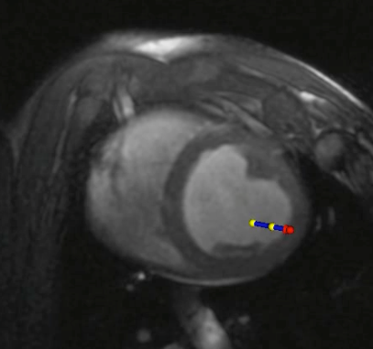
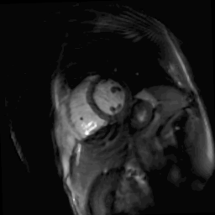
Direct Motion Correction in Heart using Realtime MRI
Registering 3D prior volume to 2D RT image should improve the anatomical localization of the interventional catheter.
Approach: Use an edge-sensitive multi-scale registration algorithm to achieve the desired accuracy
Catheter Position
Realtime 2D MRI
Prior Volume
Register
+
Notes:
…leading to improved RF ablation targeting accuracy.

Slide 5
Edge-Preserving Denoising with Weighted Total Variation
prior
t
real-time
P. Athavale et al. Medical Image Analysis 2015
Notes:
-de-noising and edge preserving algorithm…

Slide 6
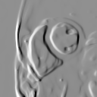
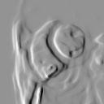
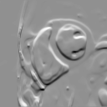
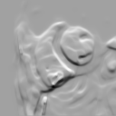
Edge Sensitive Registration
Evaluated a number of registration metrics. The best results were achieved by using an edge sensitive metric - normalized gradient fields (NGF)¹
prior
RT
align
1. E. Haber and J. Modersitzki MICCAI 2006

Slide 7
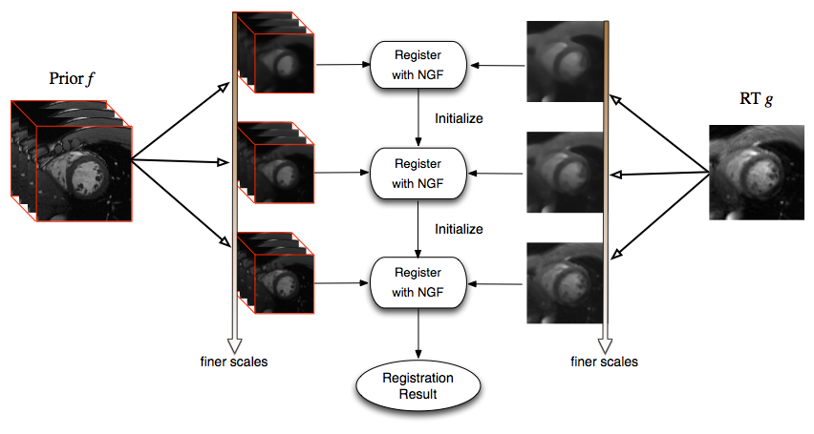
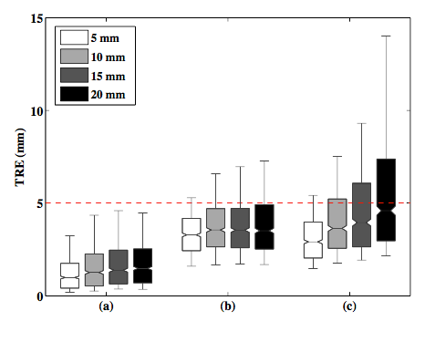
Registration Framework and Results
(a)
(b)
(c)
Normalized Gradient Fields
Normalized Cross Correlation
Mutual Information
R. Xu et al. IEEE TBME 2014
Notes:
multiscale registration motivation
robustness
speed

Slide 8
Realtime Motion Correction
R-R interval: 1000 ms
Heart Rate: 60 BPM
200 ms
diastolic window
Ideally image registration should be complete in < 200 ms; this is challenging (MATLAB implementation is ~30s).
Alternatively, a rapidly updated (<1000ms) motion model can be used to predict motion.
Notes:
-actually < 200 ms due to time required for data acquisition/reconstruction -> RT image

Slide 9
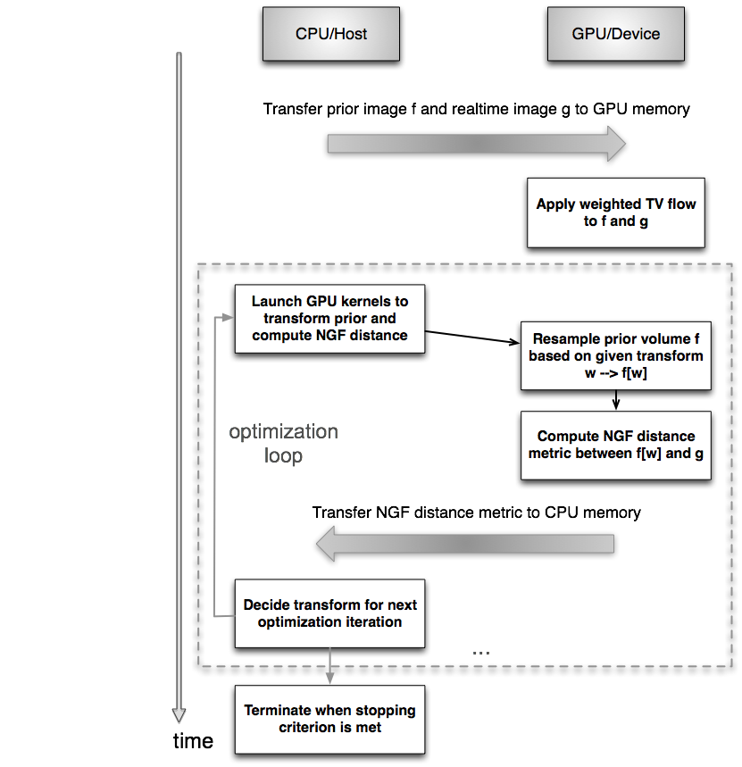
GPU Based Image Registration
This GPU registration framework reduces image registration time from ~30s to ~200ms.
Operation | Time
CPU-to-GPU Memory Transfer | 1.45 ms
Weighted TV processing / slice | 25 ms
Multiscale optimization loop | 176 ms
Total | 202.45 ms
Notes:
NGF distance transfer takes approximately 0.01 ms (measurement resolution ~0.05us)

Slide 10
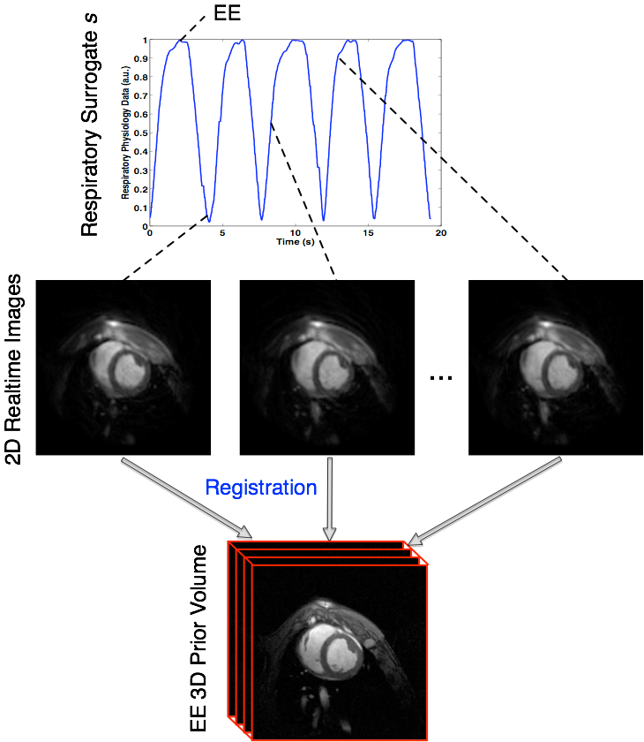
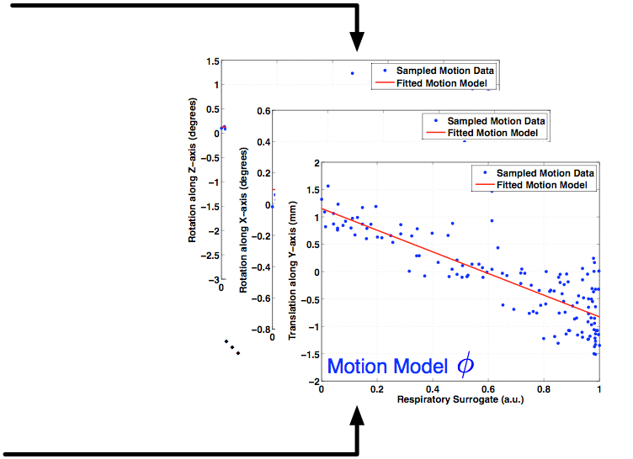
Realtime Registration for Dynamic Motion Modeling
R. Xu et al. IEEE TBME 2015

Slide 11
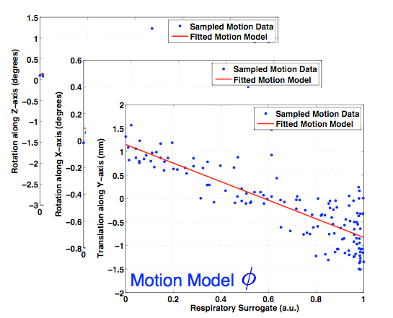
Respiratory Motion Model
R. Xu et al. IEEE TBME 2015

Slide 12
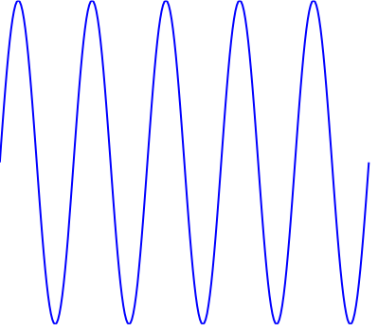
Dynamically Updated Motion Model
Build Motion Model
Predict Motion
Estimate
Notes:
-Model building itself requires ~8 ms
-fast because linear least squares fitting has a closed-form solution.
- x = inv(A^{T}A) A^{T}b (solution to Ax = b) or min x ||b-AX||²

Slide 13
Dynamically Updated Motion Model
Build Motion Model
Predict Motion
Estimate

Slide 14
Dynamically Updated Motion Model
Build Motion Model
Predict Motion
Estimate

Slide 15
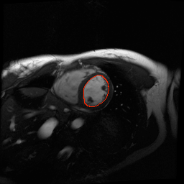
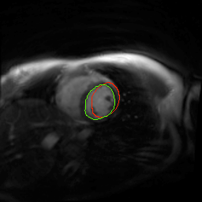
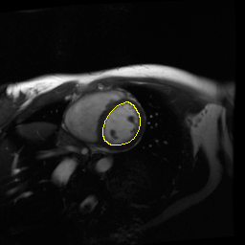
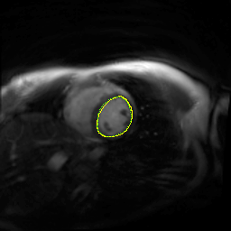
Evaluation
prior
real-time
Before
Motion Model
Correction
A
B
DSC = 2 (A & B) / (A + B)
A
After
Motion Model
Correction
B
APD
Notes:
DSC = 2 (A & B) / (A + B)

Slide 16
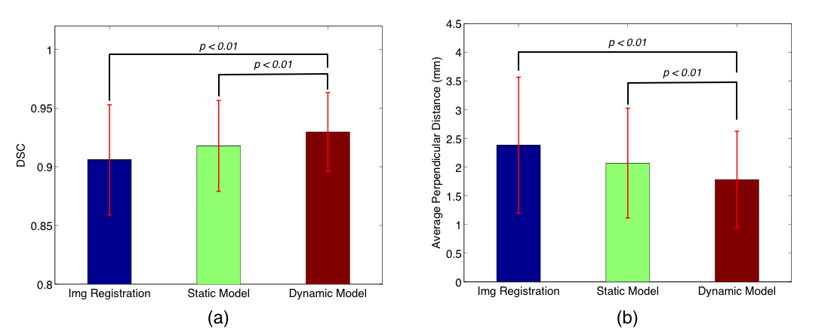
Results
Overall motion correction results from all 8 volunteers studies. Mean ± SD for (a) DSC and (b) APD after image registration (1 heart cycle delay), static model correction, and dynamic correction respectively.

Slide 17
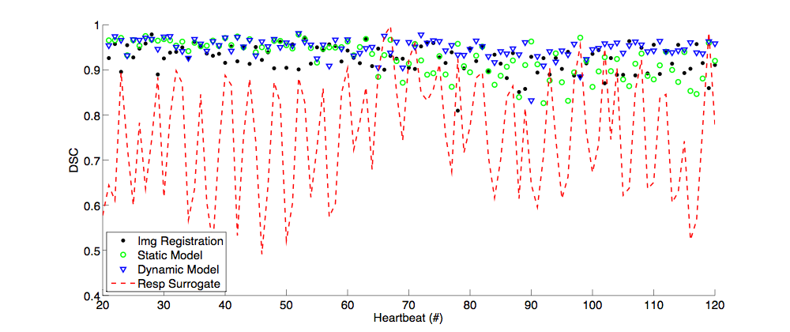
Results
breathing
variations
begin
Representative volunteer case study, comparing the 3 different motion correction approaches.

Slide 18
Summary
Realtime image registration for motion compensation holds potential for more accurate intervention guidance
GPU accelerated multi-scale edge-based LV registration of realtime MR and prior 3D MR volumes achievable within 200ms
This registration, with adaptive motion model, yields robust motion correction in volunteers

Slide 19
Acknowledgements
Robert Xu
Prashant Athavale
Kevan Anderson
Bonny Biswas
Venkat Ramanan
Rhonda Walcarius
Kawal Rhode, KCL
Canadian Institutes of Health Research
Federal Development Agency of Canada
Ontario Research Fund

