Slide 1
New Designs & Sequences for
Device Tracking
Ehud J Schmidt¹
With Contributions from: Wei Wang¹, Charles L Dumoulin² , Barret Daniels², Zion TH Tse³, Israel Byrd⁴, Jeffrey Schweitzer⁴, Ronald Watkins⁵, Raymond Y Kwong⁶, William G Stevenson⁶ , Ravi Seethamraju⁷, Henry Halperin⁸, Kamal Vij⁹, Charles Cunningham¹⁰ Graham Wright¹⁰
¹Radiology & ⁶Cardiology, Brigham and Women’s Hospital, Boston, MA
²Radiology, Cincinnati Children’s Hospital Medical Center
³Engineering, The University of Georgia
⁴Cardiovascular & Ablation Technologies, St Jude Medical Inc.
⁵Radiology, Stanford University, Stanford, CA
⁷Siemens Healthcare R&D, Boston, MA
⁸Johns Hopkins University, Baltimore, MD
⁹MRI Interventions, Irvine, CA
¹⁰Sunnybrook Health Sciences, Toronto, ON

Slide 2
Declaration of Relevant Financial Interests or Relationships
Speaker Name: Ehud J Schmidt
Presented MR-tracking and MRI-compatible VDT-tracking systems are not FDA Regulatory Cleared.
Patents submitted for (1) MR Tracking on Metal surfaces and (2) MRI-compatible Electro-Anatomic Mapping Systems
Jeff Schweitzer and Israel Byrd are employees of St. Jude Medical Inc.
Ravi Seethamraju is a Siemens Healthcare employee
Kamal Vij is an employee of MRI Interventions Inc.
Ehud Schmidt receives grant support from St. Jude Medical, E-TROLZ
Research Support: NIH U41-RR019703,NIH R43-HL110427-01, AHA 10SDG261039, NIH U54-HL119145, NIH-R21CA167800
Notes:
2

Slide 3
Topics
New developments in MR-Tracking
Phase Dithering
Tracking on Metallic Surfaces
Micro-transmit
Directionality detection using phase
Voltage Device Tracking
Technique
First implementations in MRI
Imaging while tracking
3

Slide 4
MR-Tracking with Phase Dithering
Reduce the effect of
Coupling of surrounding coils or catheters
B₁ in-homogeneities
Large Structure
Micro-coil
RF
pulse
Freq. Encoding
Gradient
Combine the data acquired over the cycle
Dephasing Grad.
Acquisition
Dephasing Gradient
Freq. Encoding Grad.
Improved peak, robust MR tracking
Dumoulin et al. Magn Reson Med 2010;63:1398-1403;

Slide 5
Cardiac EP using active MR-Tracking
3 MRI Devices Tracked
Simultaneously
Deflectable Sheath
Deflectable RF Ablation catheter
Non-deflectable Coronary Sinus catheter
Application of Phase Dithering reduces device coupling & flow artifacts
SR Dukkipati et al. Circulation 2008;118: 853-862
EJ Schmidt et al. Circ. Arrhythmia Electrophysiol. 2009;2:695-704

Slide 6
MR-Tracking of Metallic Devices
Most clinical intv’l devices (guidewires, catheter, sheathes, needles)
are largely made of metal
Improved mechanical properties for narrow and long devices
(larger stiffness, higher yield point, reduced brittle or fluid behavior,
better torquability)
Current MRI-compatible devices use a minimum of metal
Weaker devices, larger diameter for equivalent performance.
Better tracking properties.
Can we make active metallic MRI-compatible devices?
Active Tracking on Metal is Challenging
Static Magnetic Field (B₀) In-homogeneities close to metal surface
RF Field (B₁) In-homogeneities
Possible RF heating of long devices

Slide 7
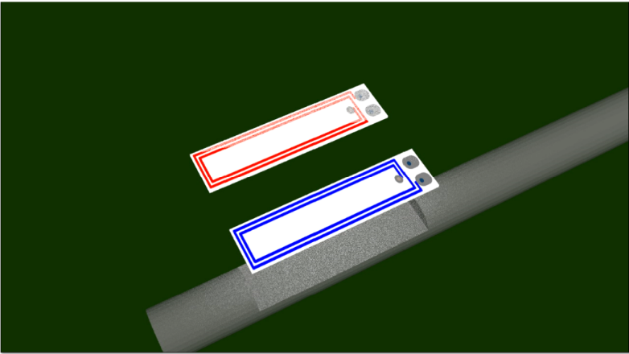
MR-Tracking of Metallic Devices
Multilayer Flexible printed circuit coils on
1.6 mm OD Tungsten needle
Simulation of RF (B₁ ) Field
2 mm
Sagittal MR image acquired by the micro-coil
W. Wang et al., Mag. Reson. Med. 2015; 73: 1803-11
W. Wang et al. , Medical Physics 2015; 42: 7114-7121

Slide 8
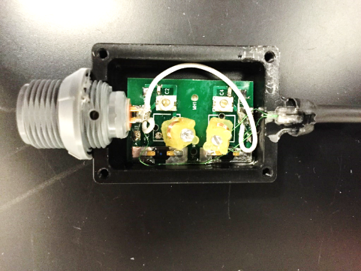
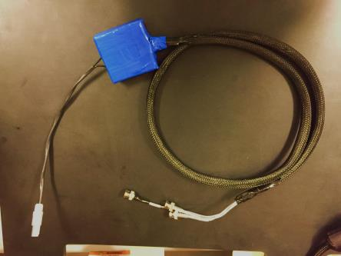
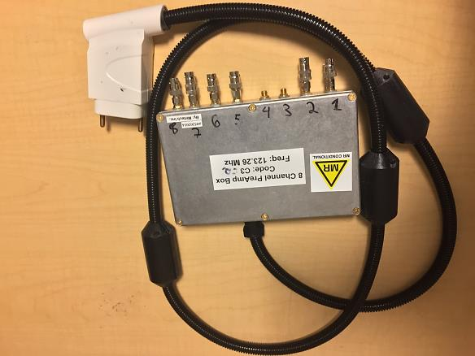
MR-Tracking Brachytherapy Stylets (N=10)
Active Tracked Metallic Stylet 33 cm length (MRI Interventions)
Tuning, matching, decoupling
1 cm
8-channel
MRI receiver
Patient Isolation
Unit
70 yr-old female
with cervical cancer

Slide 9
MicroTransmit (Tracking Transmit&Receive)
Body coil transmit / Tracking receive
Uniform RF excitation
High power (15KV)- device heating?
Large spin dephasing
Tracking coil transmit & Receive
Localized RF excitation
Low power (.2KV) - no device heating
Low spin dephasing
50% smaller location error
Requires hardware changes
Magnet
Transmit
Body RF coil
Receive
Tracking coil
Coils
Switch
Magnet
Body RF coil
Transmit
Tracking coil
Receive
Magnitude
Coils
Magnitude
0
12
24
36
48
0
12
24
36
48
Body coil
Transmit
Micro-
Transmit
BR Daniels et al. Mag. Reson. Imaging 2016;34: 289-297

Slide 10
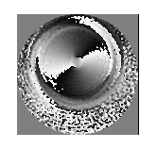
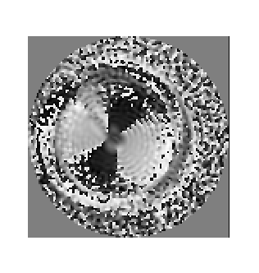
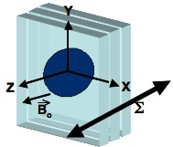
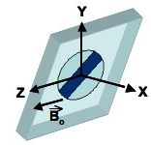
Directionality from Micro-coil Phase
MR-tracking projections do not give information on device orientation.
Two micro-coils are now required to determine direction
Phase images are unique to the position and orientation of the micro-coil.
Two low-resolution projection phase images in orthogonal planes can be used to determine device position and orientation.
Possible issues with magnetic susceptibility
Phase - plane 1 (x-z)
Phase - plane 2 (x-y)
Anderson et al. IEEE Trans. Med. Img. 31(6):1173, 2012
Notes:
-Phase images acquired in two orthogonal planes contains is unique to the position and orientation of a microcoil.
-Phase images can be therefore used to determine the position and orientation of a microcoil.

Slide 11
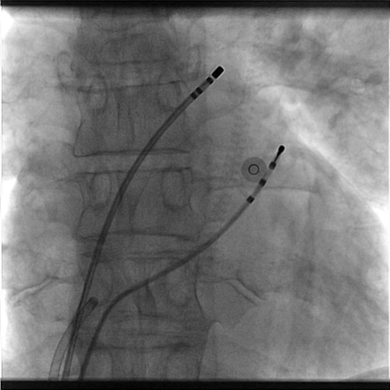
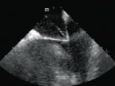
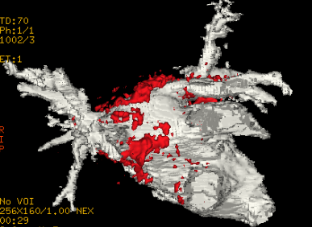
Tracking for Multi-modality EP Intervention
Foreseeable future
Cardiovascular Intervention performed using multiple modalities→X-ray, Intra Cardiac Echo (ICE), MRI
Existing Tracking Methods:
MRI-based tracking works only inside MRI.
Magnetic tracking works only outside MRI
Voltage device tracking (VDT) works outside MRI & inside MRI when scanner is not pulsing.
VDT used in >80% of EP sites (St. Jude NavX-VelocityTM & Biosense-Webster CarTo3TM)
X-Ray vascular navigation
RA
LA
ICE showing Foramin Ovalis tenting during Trans-septal puncture
Voltage-based SJM Velocity tracking system
MRI showing anatomy & RF ablation gaps

Slide 12
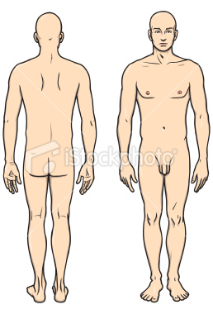
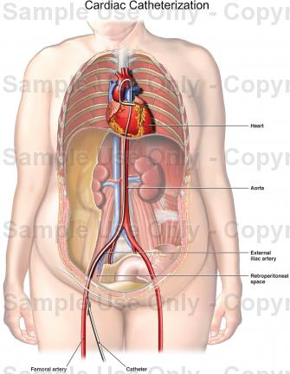
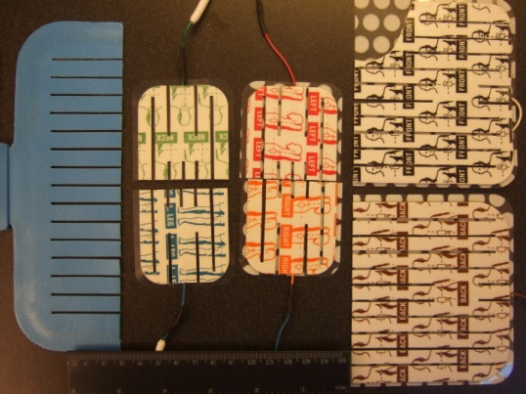
Voltage-Based Device Tracking: Principles*
8 kHz voltage bursts between 3 pairs of surface patches.
Ionic conduction through body
Localization based on voltage division across body impedance
Multiple catheters tracked @90 fps
Surface Patches Position
Body as voltage divider
Transmission between patches
Head
10 mV
Left
Right
SysRef
Back
Front
Left
Right
Feet
9 8 7 6 5 4 3 2 1
Slotted Surface Patches
Receive at catheter electrodes
*Wittkampf FHM et al. Circulation 1999, 99:1312-1317

Slide 13
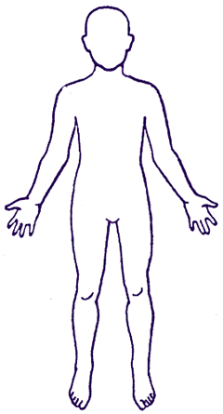
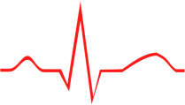
VDT Electro-Anatomic Mapping: MRI Setup
Control Room
Control Room
Transmit to 6 Patches
MRI Room
Received from catheter electrodes 1, 2,3,….N (N<64)
8 KHz Signal Bursts
20 MHz RF
Low-Pass Filters
TTL from
Grad & RF
Channel 1
. Front
Patches
Position (8KHz)
Delay
Switch
Intra-cardiac ECG
. Back
. Left
.Right
. Head
.
TTL from
Grad & RF
Channel 2
Position (8KHz)
Delay
Switch
Intra-cardiac ECG
. Foot
TTL from
Grad & RF
Channel 3
Delay
Switch
Position (8KHz)
Intra-cardiac ECG
.Channel 4
.Channel 5
.
Catheter
TTL from
Grad & RF
Channel N
Delay
Switch
Position (8KHz)
SysRef
Voltage Tracking
Ground
Intra-cardiac ECG
SysRef
Voltage-tracking Ground
Penetration Panel
Scanner Ground
Penetration Panel
Scanner Ground

Slide 14
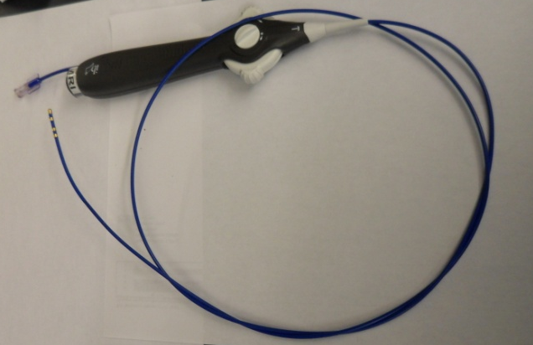
VDT Tracking in MRI during 3T imaging
Display on St. Jude NavX system
Three catheters tracked at 20 fps
Tracking & mapping simultaneously
Irrigated Deflectable EP catheter
Schmidt et al. Mag. Reson. Med 2014;71: 1197–1209

Slide 15
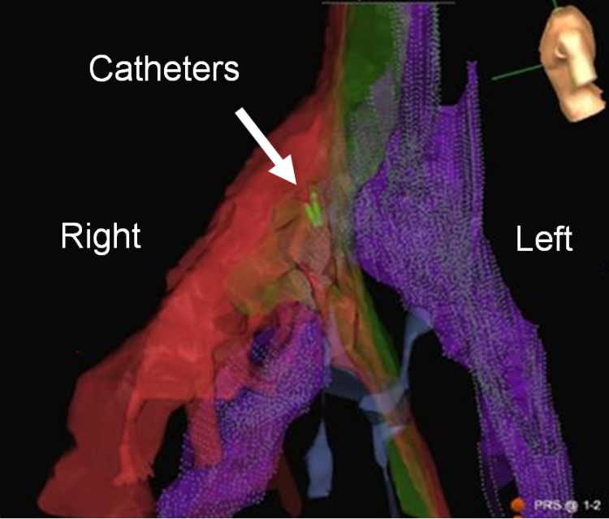
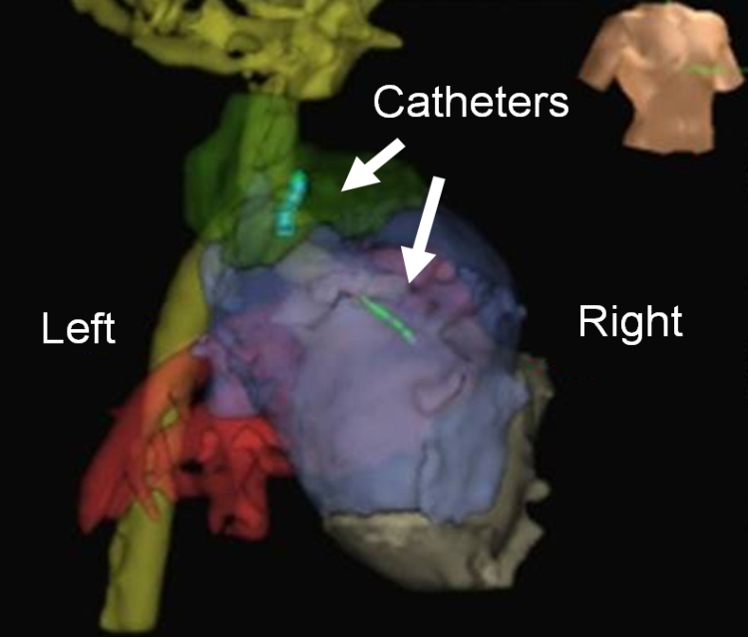
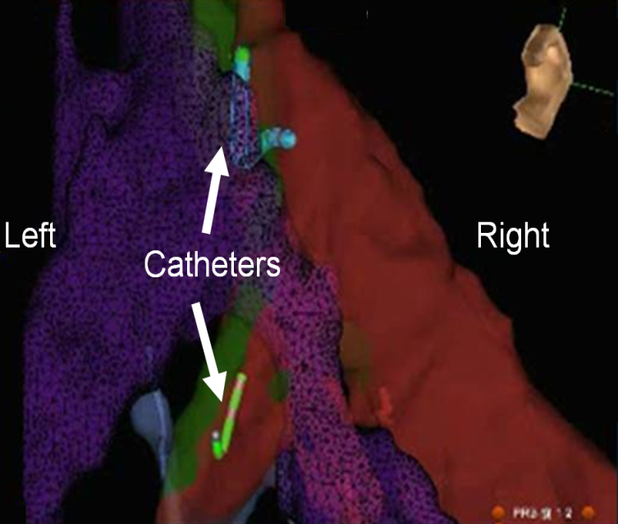
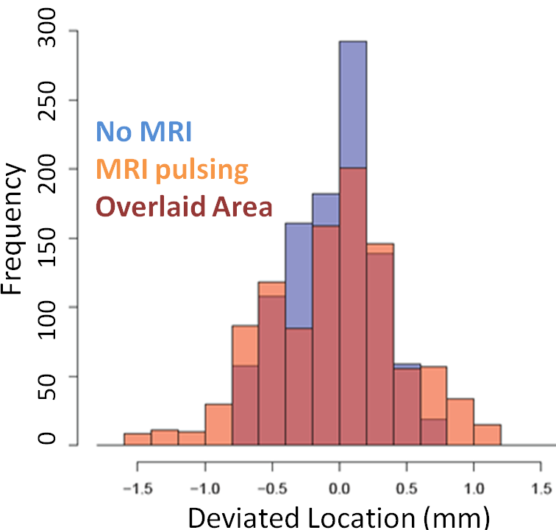
EAM During & Outside MRI: Comparison
EAM During MRI
EAM registered with MRA*
Catheter Tracking over 60-80% of sequence.
Locations
(i) Scan vs. No scan Mean: 0.33→ 0.37mm SD: 0.23 →0.45mm
(i) Inside vs Outside Mean deviation <0.6mm
Current Limitations: When TR<32msec (1) TR extension (2) imaging-pauses
EAM outside MRI
Location deviation
* West JJ, Cardiovasc Electrophysiol 2010; 21, 81-87
15

Slide 16
VDT Catheters during MRI Imaging un-gated axial SSFP
MR image quality reduction< 5%
Coronary
Sinus
RV
Coronary
Sinus
16

Slide 17
EAM Mapping in the Left Ventricle (JHU)

Slide 18
2 EPs Playing inside MRI using VDT
Display on St. Jude NavX system
Irrigated Deflectable EP catheter
Schmidt et al. Mag. Reson. Med 2014;71: 1197–1209

Slide 19
Conclusions
Conclusions
Precision & Robustness MR-Tracking improvements
Ability to use metallic tracked intv’l devices (heating-resolution limited)
Tracking with Voltage Device Tracking inside and outside MRI
Ability to track with VDT during limited MR imaging
Potential Benefits:
Multi-modality intervention (X-ray, ICE, MRI) using VDT-mounted devices without device co-registration for shorter & cheaper procedures
Dual MR-Tracking/Voltage Device Tracking catheters for greater geometric accuracy VDT-based electro-anatomic mapping & ablation
Easier MRI entry into clinical Electrophysiology (cheaper catheters, VDT hardware & software available at most EP sites)
19

