Slide 1
Real-time MRI guided endomyocardial biopsy
Toby Rogers¹, Kanishka Ratnayaka¹, Parag Karmarkar², Adrienne Campbell-Washburn¹, William H. Schenke¹, Jonathan R. Mazal¹, Ozgur Kocaturk^{1,3}, Anthony Z. Faranesh¹, Robert J. Lederman¹
¹National Heart, Lung and Blood Institute, National Institutes of Health, Bethesda, MD, United States
²MRI Interventions, Irvine, CA; currently Russell H. Morgan Department of Radiology and Radiological Sciences, Division of MRI Research, John’s Hopkins University, Baltimore, MD , United States ³Institute of Biomedical Engineering, Bogazici University, Istanbul, Turkey

Slide 2
Disclosures
Parag Karmarkar was an employee of MRI Interventions Inc., which supplied MRI-conditional bioptomes
All other authors report no disclosures.

Slide 3
X-ray guided endomyocardial biopsy
Cannot distinguish normal from abnormal myocardium
Cannot see vulnerable structures

Slide 4
MRI-conditional bioptome
6.5Fr
Titanium jaws
Kevlar activation cable
Shapeable distal tip
Active visualization

Slide 5
iCMR suite

Slide 6
MRI-conditional bioptome
Loopless antenna for shaft visualization
Passive artifact from bioptome jaws (arrow)

Slide 7
Real-time MRI during biopsy

Slide 8
MRI-guided biopsy specimens

Slide 9
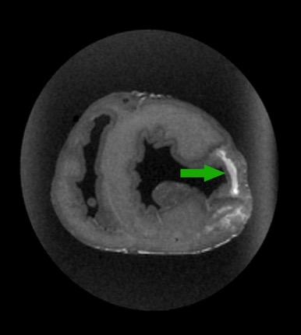
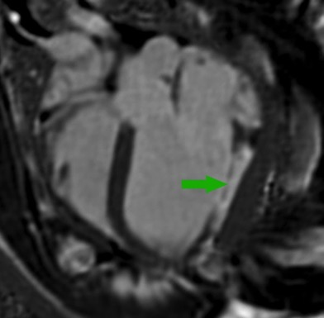
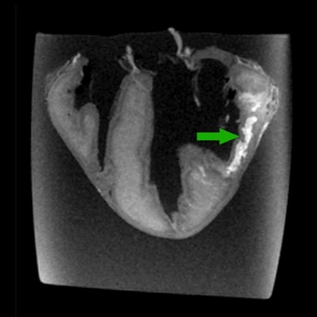
Animal model of focal disease
LGE
Ex-vivo
Branch coronary artery infarction
Ethanol and 15μm fluorescent microspheres
Animal survived for 14days

Slide 10
Inversion recovery real-time MRI
bSSFP
Inversion recovery

Slide 11
X-ray guided biopsy
MRI guided biopsy

Slide 12
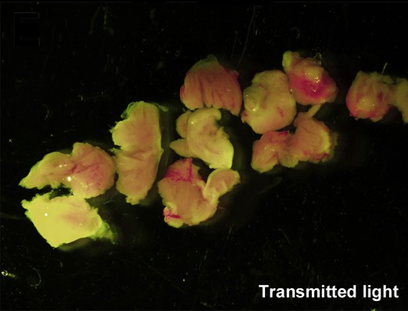
X-ray guided biopsy
MRI guided biopsy

Slide 13
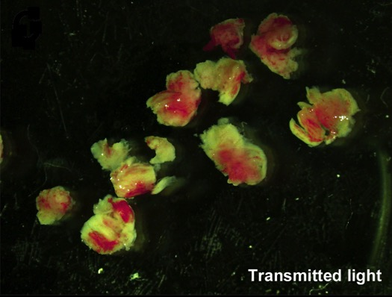
X-ray guided biopsy
MRI guided biopsy

Slide 14
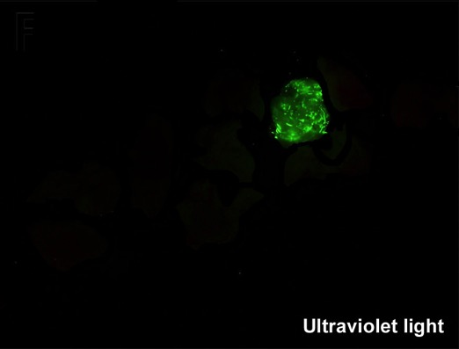
X-ray guided biopsy
MRI guided biopsy

Slide 15
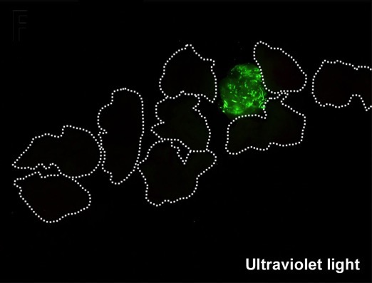
X-ray guided biopsy
MRI guided biopsy

Slide 16
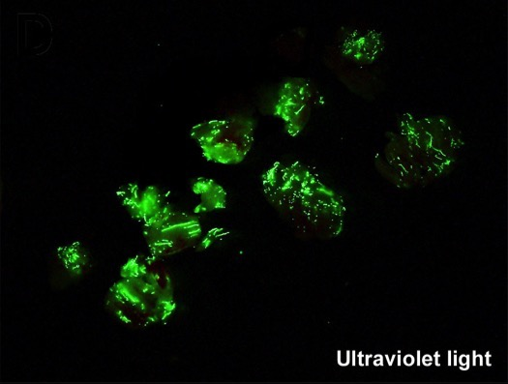
X-ray guided biopsy
MRI guided biopsy

Slide 17
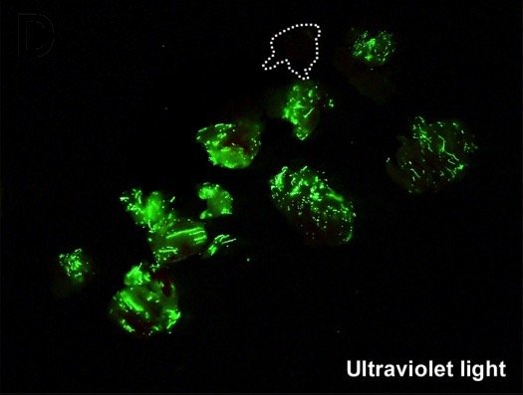
X-ray guided biopsy
MRI guided biopsy

Slide 18
Comparative yield

Slide 19
Comparative yield
82%
56%

Slide 20
Conclusions
Real-time MRI guided endomyocardial biopsy is feasible
MRI significantly improves the diagnostic yield compared to X-ray, despite smaller specimen volumes
MRI guided endomyocardial biopsy could be of particular value in disease processes that affect the myocardium in a non-uniform distribution

Slide 21
Acknowledgements
NHLBI, National Institutes of Health
Robert Lederman
Kanishka Ratnayaka
Anthony Faranesh
William Schenke
Jonathan Mazal
Jaffar Khan
Elena Grant
Adrienne Campbell-Washburn
Peter Kellman
Laurie Grant
Annette Stine
Merdim Sonmez
Ozgur Kocaturk
Michael Hansen
Marcus Chen
Burcu Basar
Collaborators
MRI Interventions Inc.
Parag Karmarkar

