Slide 1
iCMR in Cardio-Oncology
Juan C. Lopez-Mattei, M.D., FACC, FASE
Assistant Professor of Medicine and Radiology
Co-Director of MD Anderson Cardiac Radiology Services
jlopez9@mdanderson.org

Slide 2
Disclosures
None
I promise I will not talk about LV strain or anthracycline toxicity.

Slide 3
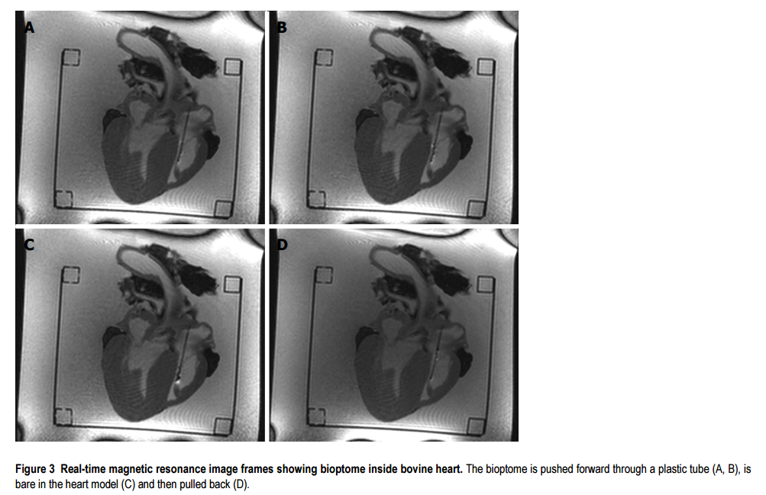
CMR guided biopsy is possible!
Lossnitzer D, et al. World J Cardiol. 2015 Jul 26;7(7):415-22.

Slide 4
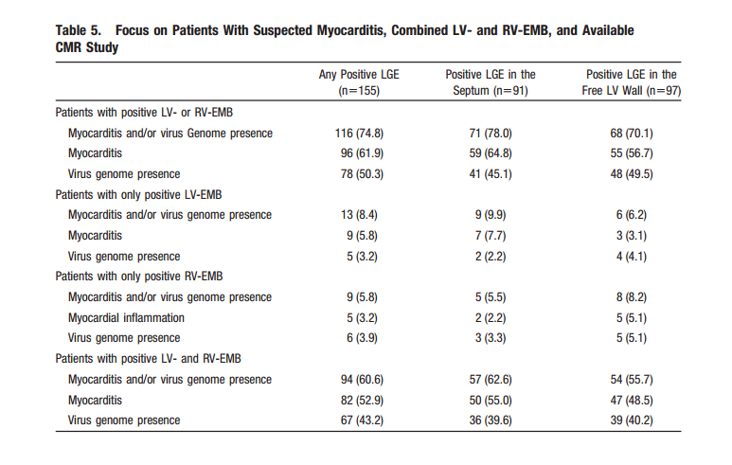
Is LGE directed EMB a good approach?
Yilmaz A, et al. Circulation. 2010 Aug 31;122(9):900-9.

Slide 5
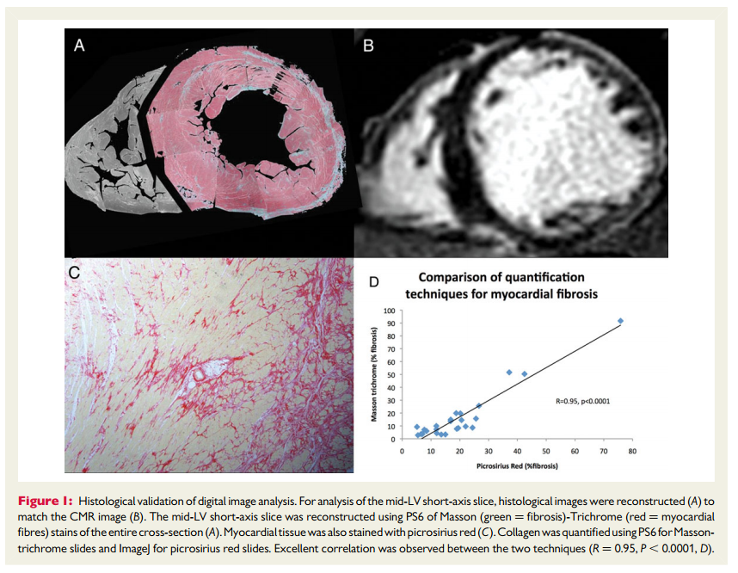
Replacement Fibrosis
Iles LM, et al. Eur Heart J Cardiovasc Imaging. 2015 Jan;16(1):14-22.

Slide 6
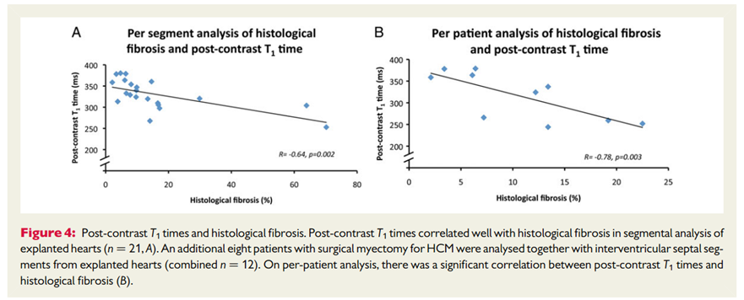
Diffuse Fibrosis
Iles LM, et al. Eur Heart J Cardiovasc Imaging. 2015 Jan;16(1):14-22.

Slide 7
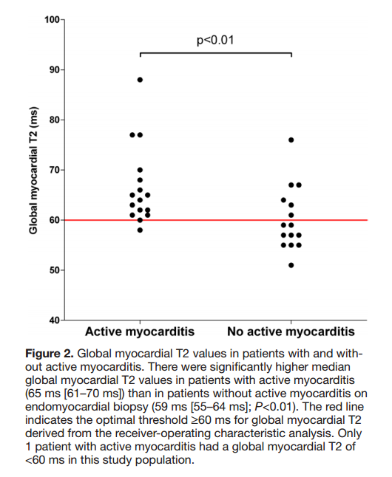
Diffuse inflammation
Bohnen S, et al. Circ Cardiovasc Imaging. 2015 Jun;8(6).

Slide 8
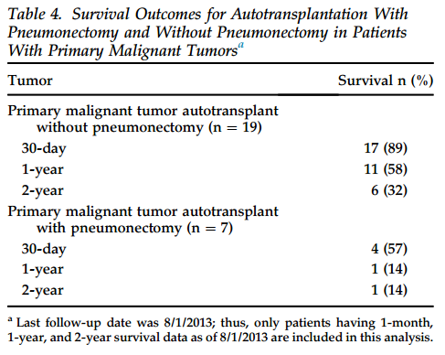
The Problem (median age 41 y.o.)
Ramlawi B, et al. Ann Thorac Surg. 2014 Sep;98(3):863-8.

Slide 9
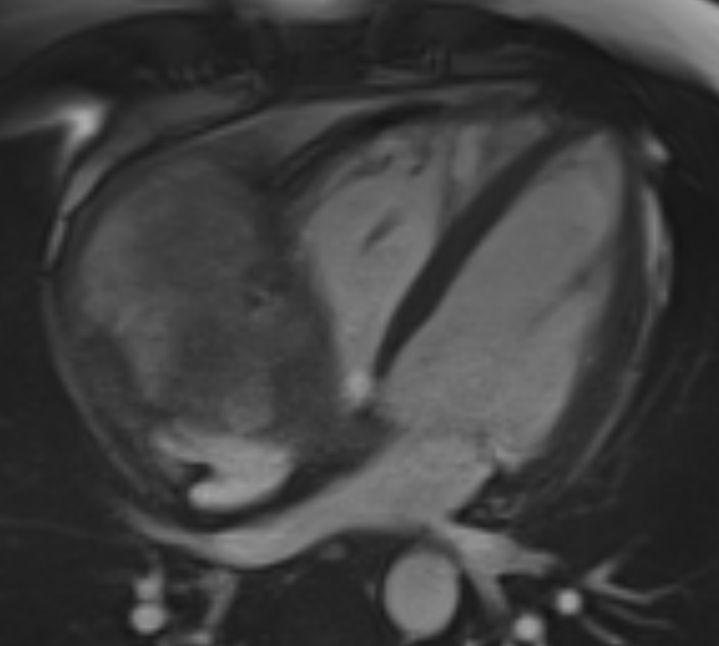
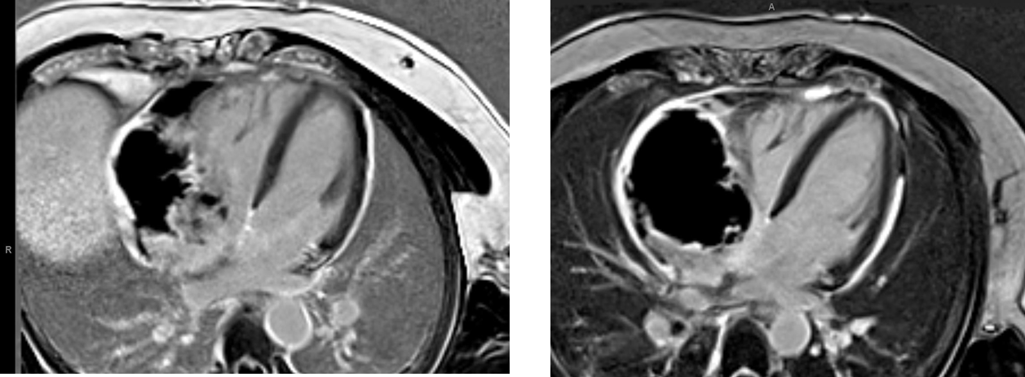
32 y.o. man with bx proven angiosarcoma
11/2/15
12/9/15
Doxorubicin + ifosfamide (1 cycle)

Slide 10
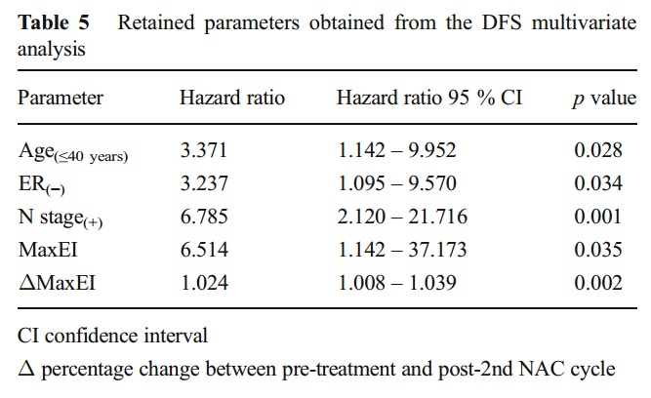
Prognosis of Breast CA in DCE-MRI
Pickles MD, et al. Eur Radiol. 2015 Apr;25(4):1097-106.

Slide 11
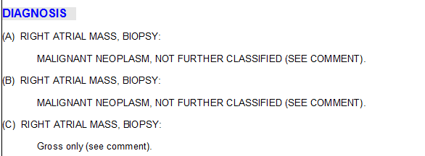
Fluoro and TEE guided tumor bx

Slide 12
Needs in cardio-oncology to manage cardiac tumors
Better diagnostic strategies
Less invasive approach
Better therapeutic options

Slide 13
Team Effort

Slide 14
Thank You
Juan C. Lopez-Mattei, M.D., FACC, FASE
jlopez9@mdanderson.org

