Slide 1
Transcatheter myocardial needle chemoablation during real-time MRI: a new approach to ablation therapy for rhythm disorders
Toby Rogers¹, Srijoy Mahapatra², Steven Kim², Michael Eckhaus³, William H Schenke¹, Jonathan R Mazal¹, Adrienne E Campbell-Washburn¹, Merdim Sonmez¹, Anthony Z Faranesh¹, Kanishka Ratnayaka¹, Robert J Lederman¹
¹National Heart, Lung and Blood Institute, National Institutes of Health, Bethesda, MD, United States; ²St Jude Medical, St Paul, MN; ³Division of Veterinary Resources, National Institutes of Health, Bethesda, MD

Slide 2
Disclosures
Srijoy Mahapatra and Steven Kim are employees of St Jude Medical
All other authors report no disclosures.

Slide 3
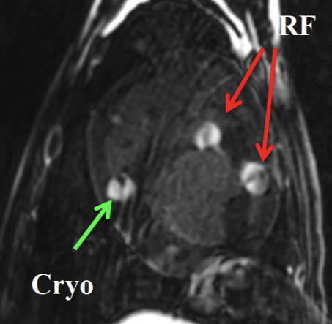
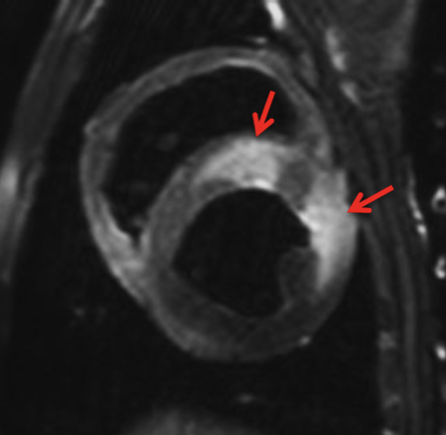
Limitations of RF ablation
Transmurality of ablation
Inability to visualize lesions
Edematous penumbra
Late gadolinium enhancement
Pre-contrast T2w
Kholmovski, ISMRM 2015

Slide 4
Real-time MRI guided chemoablation

Slide 5
Acute chemoablation lesions
Ethanol
Acetic Acid

Slide 6
Chronic acetic acid lesion
(20x)

Slide 7
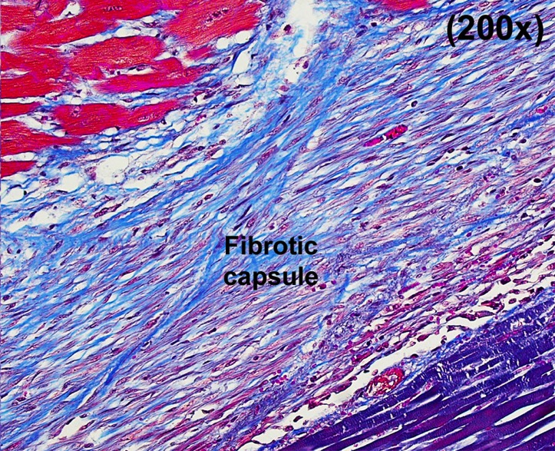
Chronic acetic acid lesion

Slide 8
Animal model of conductive isthmus
Two non-contiguous infarcts
Animals survived for 12(8-15) days
Late gadolinium enhancement

Slide 9
Isthmus chemoablation
Series of 0.6mL injections (max 5 per animal)
Macrocyclic gadolinium based contrast agent (Gadoterate) is stable at low pH
No change in serum pH or anion gap
Late gadolinium enhancement

Slide 10
Isthmus chemoablation
Ex-vivo
Masson trichrome

Slide 11
Isthmus chemoablation

Slide 12
Isthmus chemoablation

Slide 13
Epicardial voltage mapping (baseline)

Slide 14
Epicardial voltage mapping (post chemoablation)

Slide 15
Conclusions
Real-time MRI guided myocardial chemoablation:
Substrate guided targeted ablation
Instantaneous depiction of ablation lesions
Irreversible necrosis
Transmural ablation lesions
Anatomical lesion corresponds with functional ablation in an animal model

Slide 16
Acknowledgements
NHLBI, National Institutes of Health
Robert Lederman
Kanishka Ratnayaka
Anthony Faranesh
William Schenke
Jonathan Mazal
Jaffar Khan
Elena Grant
Adrienne Campbell-Washburn
Peter Kellman
Laurie Grant
Annette Stine
Merdim Sonmez
Ozgur Kocaturk
Michael Hansen
Marcus Chen
Burcu Basar
Collaborators
St Jude Medical
Srijoy Mahapatra
Steven Kim

