Slide 1

RFA for iCMR EP: MRI Assessment of VT Ablation Lesions in Pediatrics
Elena K. Grant, MBChB
Interventional Cardiac MRI, NHLBI/NIH
Interventional Pediatric Cardiology Fellow,
Children’s Healthcare of Atlanta / Emory University
grante@kidsheart.com / elena.grant@nih.gov
Disclosures: No Financial conflicts of interest
NHLBI and CNMC have independent research collaborations with Siemens

Slide 2
Potential for iCMR to enhance RFA
Procedure guidance
  Pre-existing scar mapping to predict successful ablation site
  MRI-3D EP map fusion
Lesion assessment
  Location
  Adequacy (e.g. depth)
  Gaps in ablation line
Real-time MRI-guided RF ablation
MRI-3D EP map fusion
D-TGA s/p Senning baffle
(CNMC clinical)

Slide 3
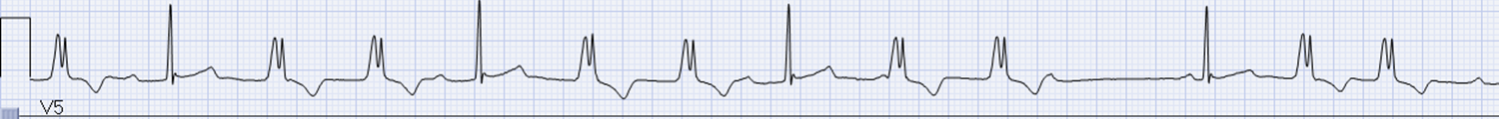
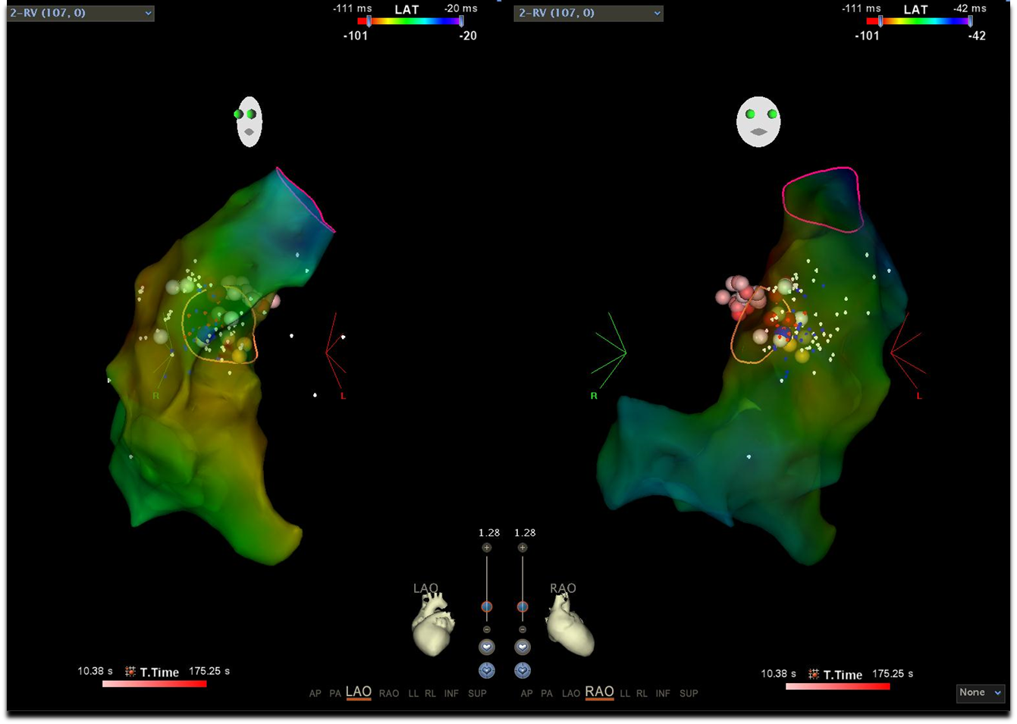
Ablation Lesion Assessment
Indirect measures of lesion creation
Arrhythmia recurrence risk
Can CMR do better?

Slide 4
CNMC Study: MRI Assessment of VT Ablation Lesions
Pilot study
Aim: To determine feasibility of acute visualization of ventricular ablation lesions by CMR in the pediatric age range
Preliminary data from 10 patients

Slide 5
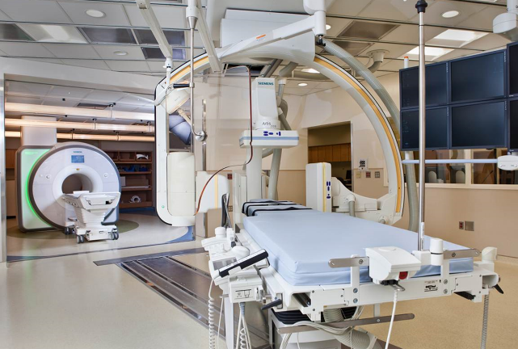
CNMC VT Ablation Study: Protocol
Baseline CMR (or review recent clinically indicated CMR)
Standard EP study & ablation
Post-ablation CMR
<30 min sedation limit
free breathing
LGE with MOCO PSIR +/- other sequences
CNMC-NHLBI Interventional Cardiac MRI (iCMR) Suite
Follow up for arrhythmia recurrence

Slide 6
CNMC Study: 10 Patients, age range 1.8 – 17 yrs
Age (years) | Cardiac anatomy | Site of VT ablation | Acute Ablation Success | CMR target LGE | Arrhythmia Recurrence
17 | s/p anomalous RCA unroofing | RVOT & right sinus of valsalva | Yes | Yes | No
1.8 | D-TGA s/p arterial switch | Anterior RVOT | Yes | Yes | No
5 | D-TGA s/p arterial switch | High septal RVOT | Yes | Yes | No
14 | Cardiac rhabdomyomas | Posterior septal LV | Yes | Yes | No
2 | Normal | LV mid-septum | Yes | Yes | No
11 | Normal | RV inflow | Yes | Yes | No
15 | Normal | RV anterior wall | Yes | Yes | No
16 | Normal | Septal RVOT | Yes | Yes | No
13 | Normal | RV anterior wall | Yes | No | Yes
16 | Normal | Inferior LV | Yes | Yes | Isolated PVCs

Slide 7
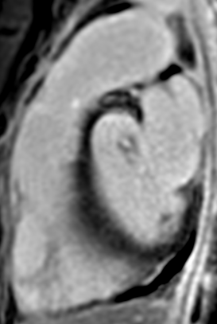
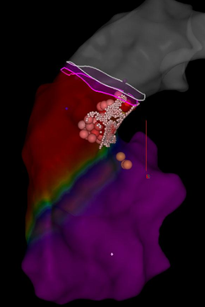
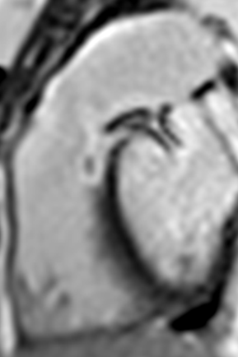
CNMC Results: Visible RVOT Lesion
16 yr old with VT, successful ablation, no recurrence
MPA
MPA
MPA
LV
LV
RV
RV
RV
Pre-ablation CMR MOCO PSIR LGE
CARTO RV activation
map with irrigated
tip RF ablation sites
(pink and red dots)
Post-ablation CMR
MOCO PSIR LGE

Slide 8
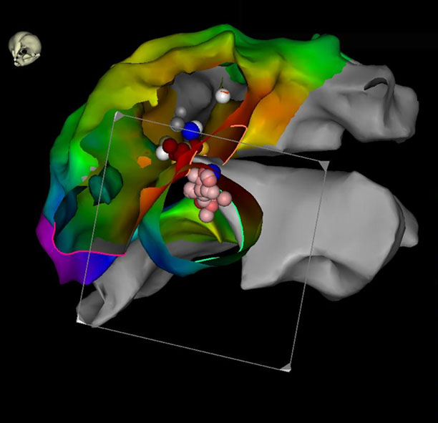
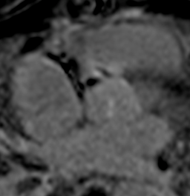
CNMC Results: RVOT & Aortic Cusp Ablation
14 yr old s/p anomalous RCA unroofing with frequent PVCs
RV
RV
Ao
Ao
LA
CARTO RV and aorta map with ablation sites (pink and red dots)
Post-ablation CMR, MOCO PSIR LGE with ablation lesion

Slide 9
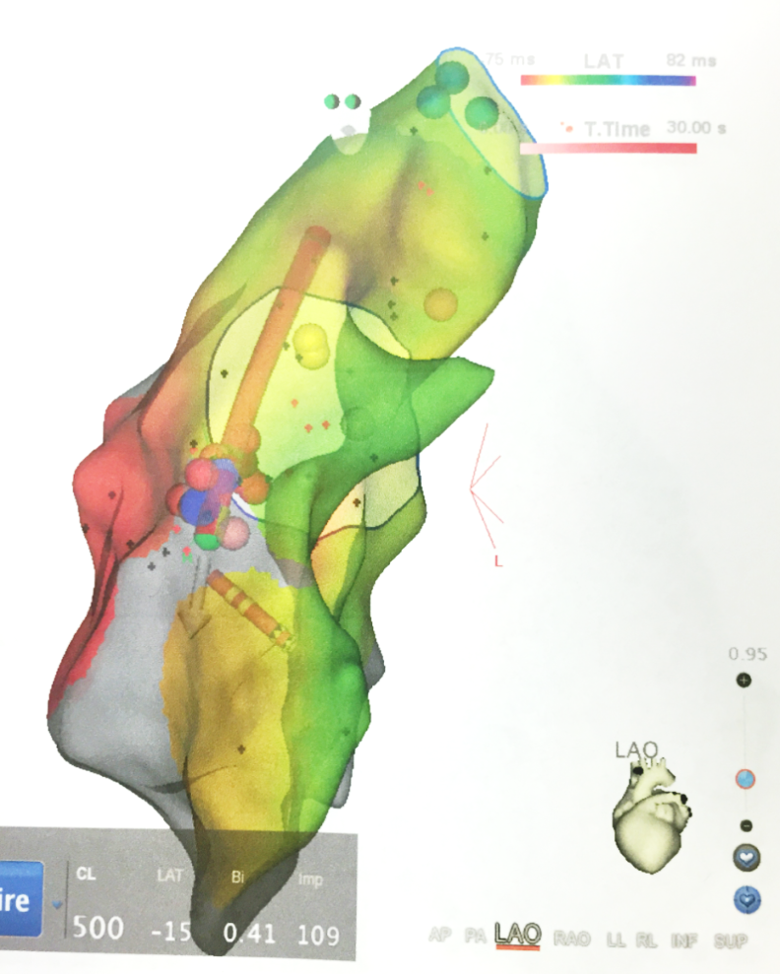
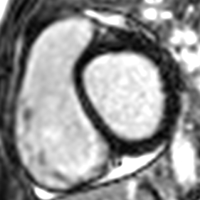
CNMC Study Results:
Arrhythmia Recurrence - ?Inadequate Lesion
13 yr old, ventricular tachycardia
RV anterior wall RF ablation
No lesion on post-procedure CMR
Post-ablation MOCO PSIR LGE

Slide 10
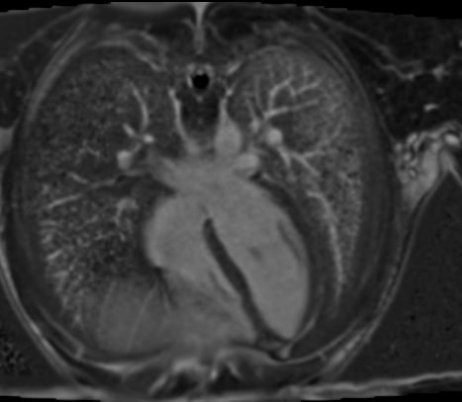
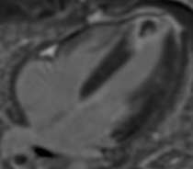
CNMC Study Results: PVCs Post-Ablation
16 yr old, non-sustained VT, unable to reproduce PVCs
RFA at site of abnormal signal. Recurrence of PVCs (diff morphology)
RV
RV
LV
RA
LV
RA
LA
LA
Pre-ablation
MOCO PSIR LGE
Post-ablation MOCO PSIR LGE Lesion at ablation site

Slide 11
CNMC Study: Next Steps
Analysis of ablation procedure variables and CMR lesion appearance
Optimize imaging protocols
  Improve lesion visibility via novel CMR techniques
  Determination between edema and ablation scar
Atrial ablation study

Slide 12
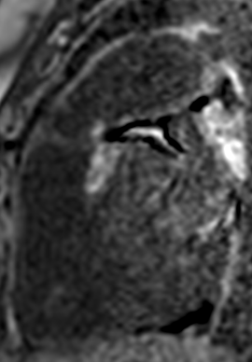
CNMC Study:
Dark blood LGE sequence
MPA
MPA
MPA
LV
LV
RV
RV
RV
RV
CARTO RV activation map with irrigated tip RF ablation sites (pink/red dots)
Post-ablation MOCO-PSIR bright-blood LGE imaging
Post-ablation
MOCO-PSIR
dark blood LGE imaging

Slide 13
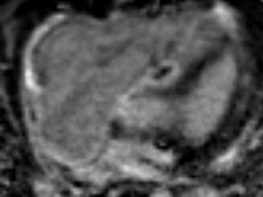
Conclusions
CMR can visualize acute ventricular ablation lesions
CMR lesion presence may correlate with clinical outcome
Clinical implications
  Decreased recurrence risk
  Targeted ablation of lesion gaps
  Real-time MRI guided ablation
LGE post septal RVOT ablation in a 5 yr old patient with D-TGA s/p arterial switch

Slide 14
Acknowledgements
  NIH/NHLBI MRI
  Peter Kellman, PhD
  Michael Hansen, PhD
  NIH/NHLBI Cardiovascular
  Intervention Program
  Robert J. Lederman, MD
  Anthony Faranesh, PhD
  Adrienne Campbell-Washburn, PhD
  Toby Robers, MB BCh
Children’s National Medical Center
Laura J. Olivieri, MD
Charles I. Berul, MD
Russell R. Cross, MD
Kanishka Ratnayaka, MD
Karin S. Hamann, RNC
Jeffrey P. Moak, MD
Kendall J. O’Brien, BA
Joshua Kanter, MD
Kohei Sumihara, RCIS
grante@kidsheart.com / elena.grant@nih.gov

