Slide 1
Human iCMR EP Update
Henry R. Halperin, M.D., M.A., F.H.R.S., F.A.H.A. David J Carver Professor of Medicine
Professor of Radiology and Biomedical Engineering
Johns Hopkins University School of Medicine Baltimore, MD USA

Slide 2
Presenter Disclosure Information
The following relationships exist related to this presentation:
Equity Interests: Lexmed, MRI Interventions
Royalty Interest: Imricor
(No support from these companies)
Grant Support: R01 HL094610, R01 HL064795,
Zoll Circulation
Consulting Fees: Zoll Circulation
Off label use: Imaging of patient with implanted devices, Gd for cardiac studies.

Slide 3
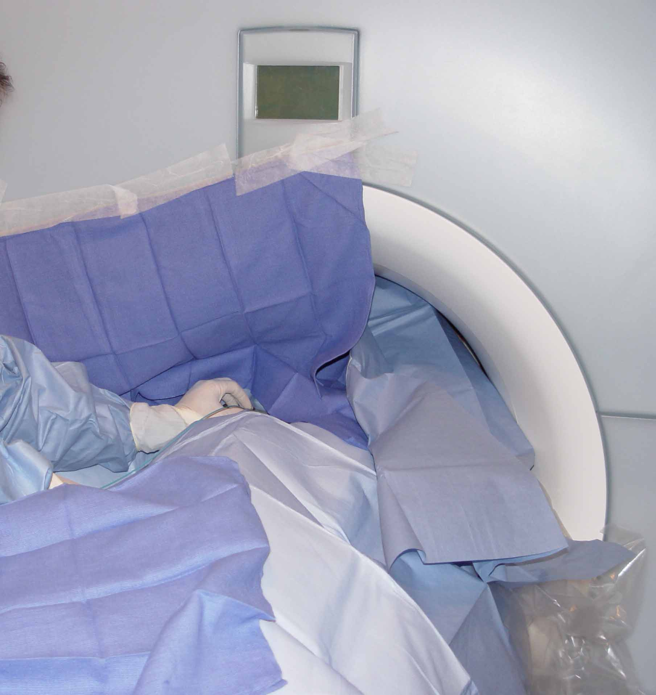
Initial Human Studies with Non-magnetic Catheters: No heat mitigation – Very Low SAR
Nazarian et al: Circulation.
2008 Jul 15;118(3):223-9

Slide 4
Objectives
Comparable (or better) capabilities as standard lab:
Catheter navigation (St Jude Ensite Navx + MRI))
Electrogram and ECG acquisition (Cardiolab, MiRTLE)
Pacing and Ablation (EP4, Micropace and IBI)
Defibrillation (in the MRI scanner)
Real time MRI thermography – lesion formation
Intraprocedural MR imaging for assessing:
Accuracy of navigation
Complications
Formation and completeness of ablation lesions

Slide 5
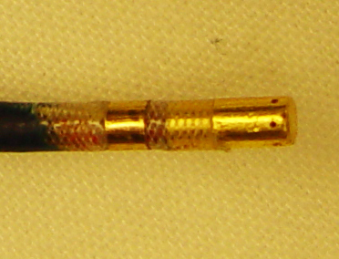
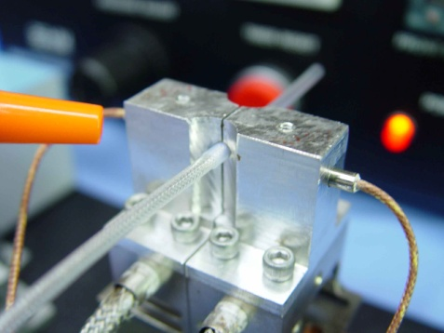
MRI Compatible Irrigated Ablation Catheter
MRI Compatibility
Non Magnetic Materials
Heating Suppression - filters
Irrigated Tip – Up to 60 ml/min
MRI Tracking coil
Standard Catheter Construction
Biocompatible Materials
Gold electrodes
PEBA catheter tubes
PTFE guides
Kevlar braid
Medical Grade Adhesives
Standard tube welding
Standard electrode attachment
Catheter tip
Tube Welding

Slide 6
MRI Compatible EP Equipment

Slide 7
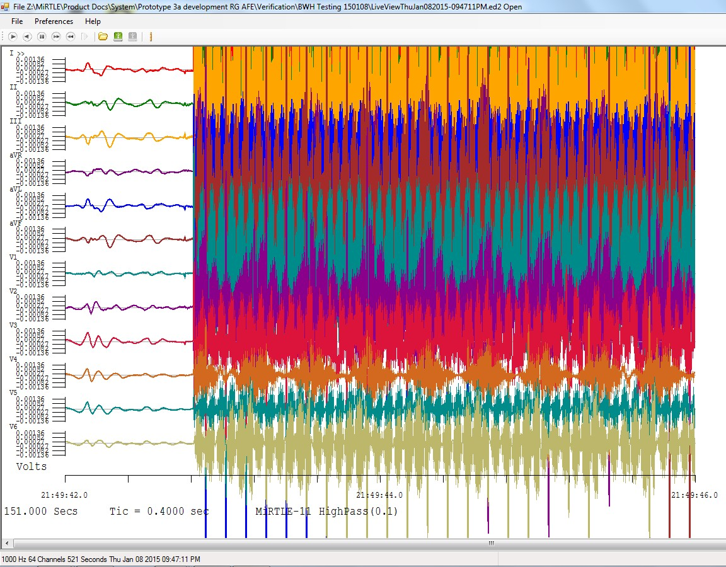
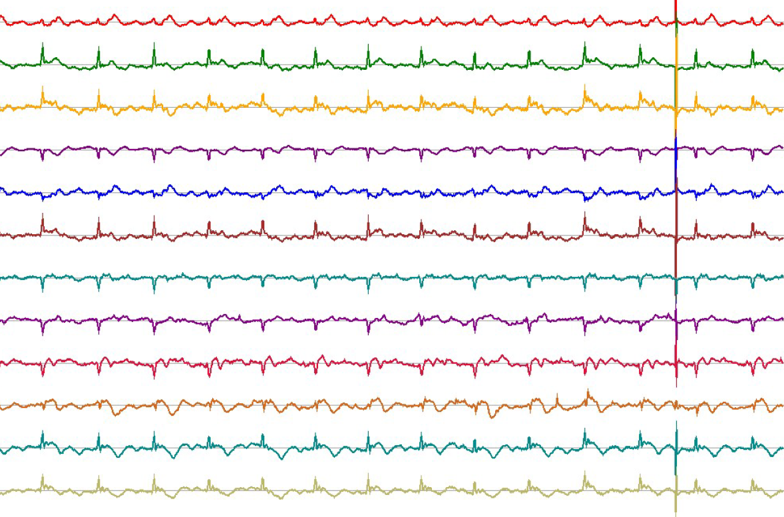
Artifact Suppression 12 lead ECG MiRTLE: Gates out the gradient induced noise using VCG
Jay Ward
Subject 3 - 38 year old male - SSFP - Skyra 221L-3T
I
II
III
aVR
aVL
aVF
V1
V2
V3
V4
V5
V6
MRI Operational
↑ MRI Operational
MiRTLE Off
MiRTLE On

Slide 8
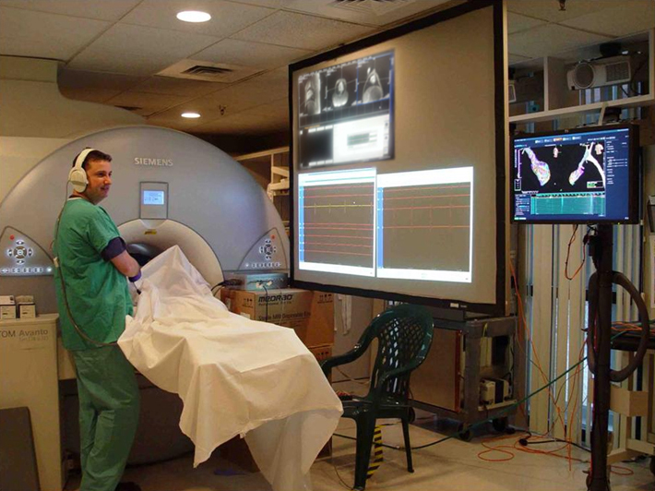
MRI Scanner Room

Slide 9
EGM Mapping: Inside MRI Scanner MRI Compatible Ensite Navx System

Slide 10
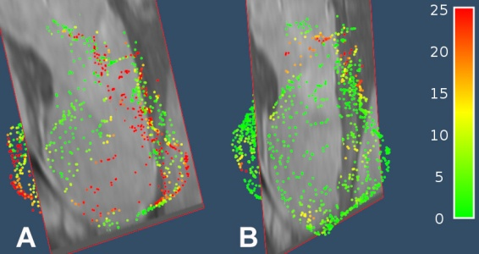
Navx Calibration
Coil
Tracking
Navx
Tracking
Pre
Calibration
Post
Calibration

Slide 11
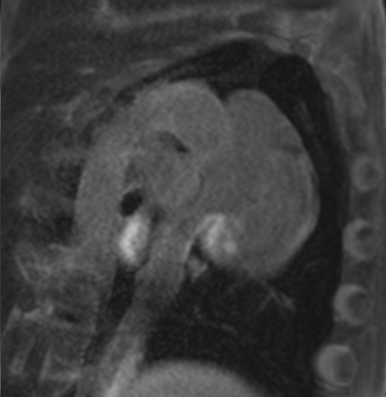
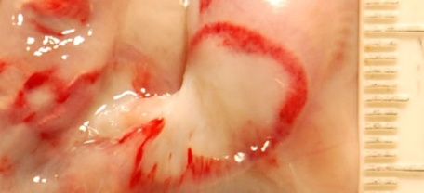
Ablation of TV–IVC Isthmus (Inside 1.5T MRI - validation with LGE and Gross)
LGE
Navx
Gross
RAO LAO
(Long Axis) (Short Axis)

Slide 12
MRI Thermography (Proton precession is temperature sensitive)
Temperature Evolution
DEMRI
Path
Kolandaivelu, Halperin et al: Circ A&E. 2010;3(5):521-9.

Slide 13
Transition to Routine Clinical Use
Dedicated 1.5T MRI interventional scanner
MRI compatibility of catheters and EP equipment completed – IEC60601 passed
Clinical grade catheter construction underway
Dedicated manufacturing facility on site
Validation with biocompatibility completed
Pre-IDE meetings: March 2011, March 2013:
15 issues noted by FDA
Issues resolved: IDE pending

Slide 14
Investigators
Hiroshi Ashikaga
Ergin Atalar
Roy Beinart
Ronald Berger
David Bluemke
Paul Bottomley
Hugh Calkins
Fady Daoud
Timm Dickfeld
Yoav Dori
Heidi Estner
Rob Evers
Owen Faris
Michael Guttman
Rozann Hansford
Daniel Herzka
Ritsushi Kato
Lars Lickfett
Aravindan Kolandaivelu
Jennifer LaCorte
Albert Lardo
Joao Lima
John McManigle
Elliot McVeigh
Glenn Meininger
Frank Miller
Saman Nazarian
Nael Osman
Ravi Ranjan
Ariel Roguin
Meiyappan Solaiyappan
Robert Susil
Natalia Trayanova
Menekhem Zviman
Ehud Schmidt
Jay Ward
Jared Miller
Susumu Tao
Jun Dong
Erez Nevo
Sandra Assaf
Diana McVeigh
Eric Meyer
Hassan Elahi
Sarah Fink
Valeria Weltin

