Slide 1
Gateway Drug: X-Ray fused with MRI
Brent M. Gordon, MD, FSCAI, FAAC
Assistant Professor, Division of Pediatric Cardiology
Director, Pediatric Cardiac Catheterization Laboratory
Loma Linda University Children’s Hospital
February 2nd, 2017

Slide 2
Disclosures
None relative to talk

Slide 3
Definition
Gateway drug theory states that the use of less deleterious drugs can lead to a future risk of using more dangerous hard drugs or crime.

Slide 4
DRUG ABUSE RESISTANCE EDUCATION
Notes:
Resistance AND Self Esteem were cornerstones of the DARE program

Slide 5
Task
When might XFM help you perform interventions you do now, but better, and potentially enable new interventions?

Slide 6
Case #1
5 month old ex 28 week twin (BW 1.3 kg) with Trisomy 21, G-tube, hypothyroidism, BPD/CLD, pulmonary hypertension
DORV and hypoplastic mitral valve
s/p repair of DORV with intraventricular baffle
Now 5.4 kg and with significant residual muscular VSD

Slide 7
Case #1 – VSD Closure

Slide 8
Case #1 – VSD Closure

Slide 9
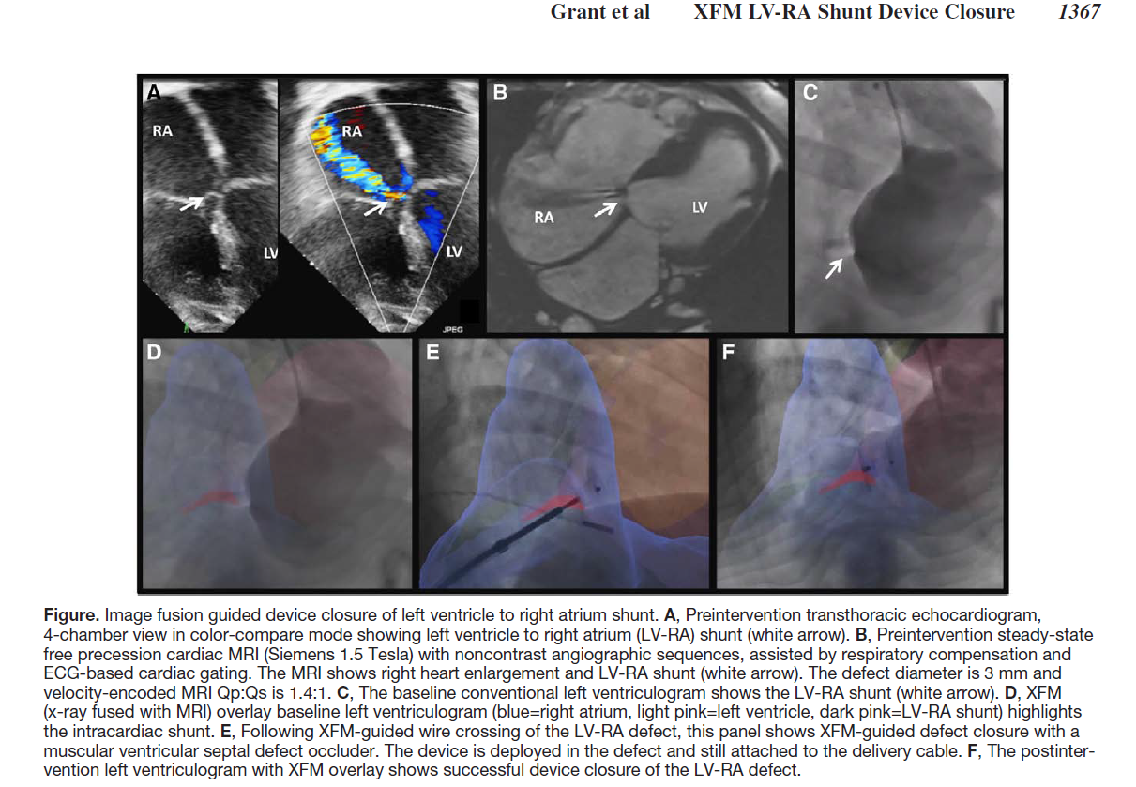
Circulation. 2015 Oct 6;132(14):1366-7

Slide 10
Case #2
3 year old 13 kg boy with Tetralogy of Fallot, severe pulmonary stenosis, quadricusp aortic valve.
s/p modified Blalock Taussig Shunt
s/p complete repair with transannular patch
Severe RV dilation with moderately reduced systolic function
Mild aortic insufficiency
Occluded bilateral femoral veins and right IJ

Slide 11
Case #2 – Hybrid Pulmonary Valve Implantation

Slide 12
Case #2 – Hybrid Pulmonary Valve Implantation

Slide 13
Case #2 – Hybrid Pulmonary Valve Implantation

Slide 14
Case #2 – Hybrid Pulmonary Valve Implantation

Slide 15
Case #3 – Anomalous origin of RCA
15 year old young woman c/o chest pain with exertion
Echocardiogram shows anomalous origin of RCA from left cusp
Treadmill test negative
Coronary CT angiogram shows possible intramural course of RCA

Slide 16
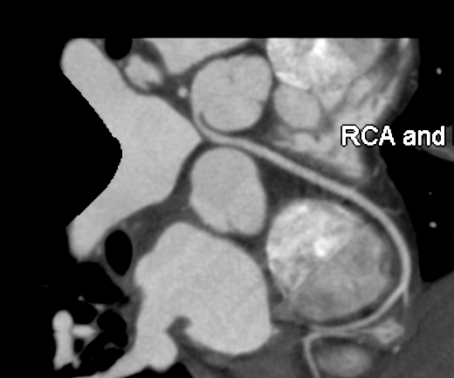
Case #3 – Anomalous origin of RCA

Slide 17
Case #3 – Anomalous origin of RCA
Abnormal FFR with adenosine challenge
Now what????

Slide 18
Why XFM?
Camera positioning
Radiation
Decreased procedure time

Slide 19
The Future
Pulmonary artery/valve interventions
Mitral valve repair/replacement
Perivalvar leaks
Complex aortic arch interventions
Device closure
????

Slide 20
DECREASE AMBIANT RADIATION EXPOSURE

Slide 21
Thank you!

