Slide 1
When I could have
really used ICMR!
Amish N. Raval MD
Associate Professor of Medicine
and Biomedical Engineering
U. Wisconsin School of Medicine and Public Health
anr@medicine.wisc.edu

Slide 2
Structural Heart Interventions
Para-valvular regurgitation
Valve
Replacement
Repair
Coronary artery – Coronary Sinus fistula
Vessels
Aortic coarctation repair
Aortic aneurysm repair
Pulmonary Embolectomy
Therapeutic Transendocardial Injection
Chambers
Left Atrial Appendage Exclusion
Ventricular remodeling therapy

Slide 3
Structural Heart Interventions
Para-valvular regurgitation
Valve
Replacement
Repair
Coronary artery – Coronary Sinus fistula
Vessels
Aortic coarctation repair
Aortic aneurysm repair
Pulmonary Embolectomy
Therapeutic Transendocardial Injection
Chambers
Left Atrial Appendage Exclusion
Ventricular remodeling therapy

Slide 4
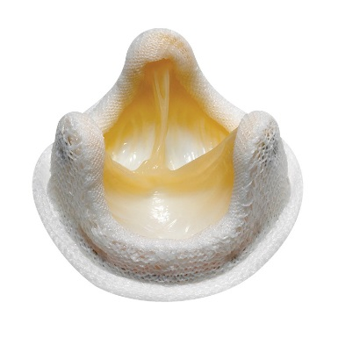
Case#1 Paravalvular leak closure of dehisced prosthetic aortic valve
78 yo man
2000 - CABG x 3
2012 - Aortic Valve Replacement
4/2014 - Bacterial Endocarditis
- Sinus of Valsalva Aneurysm
- dehisced valve + severe para-valvular leak
- NYHA class IV heart failure
27mm Hancock II

Slide 5
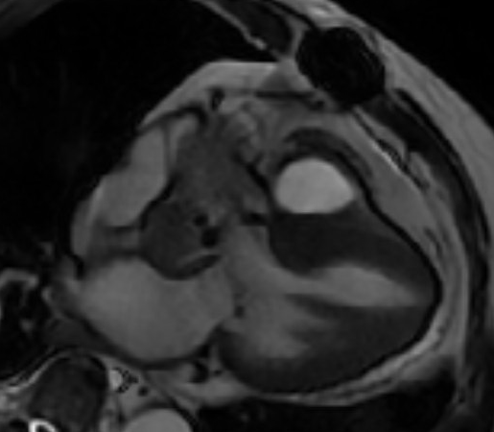
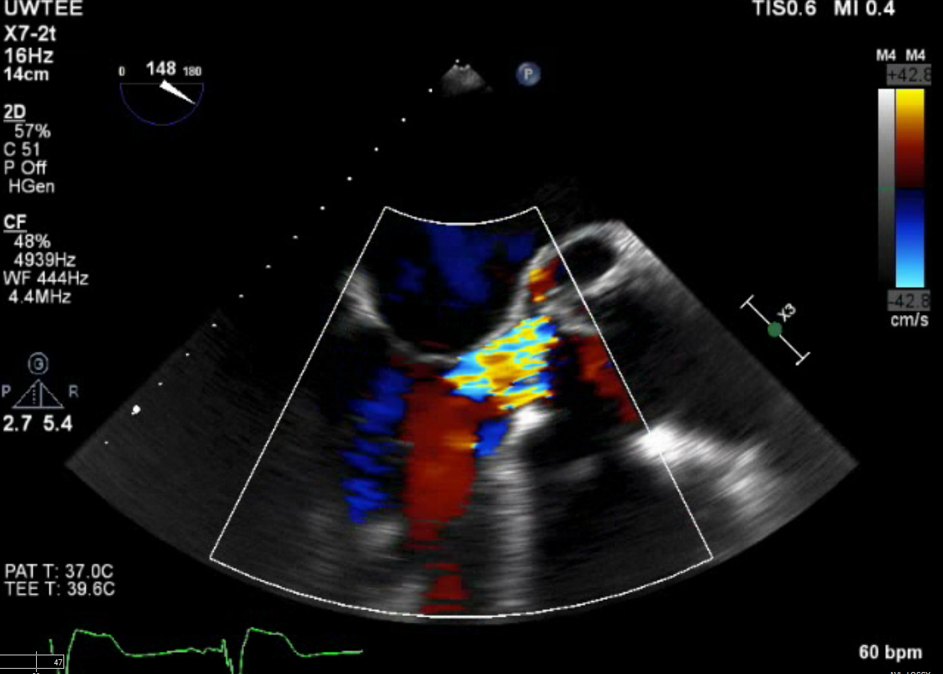
Case#1 Paravalvular leak closure of dehisced prosthetic aortic valve
Sinus of Valsalva
Aneurysm (NCC)
TEE
Hancock II
Aortic Valve
Prosthesis
Severe AI, dehisced valve
Systolic para-prosthetic jet
GE MR FFS 256x256x16
Flip 60, TR 3.21, TE 1.0

Slide 6
Severe para-valvular leak closure of dehisced prosthetic aortic valve
11/2014
Partial root reconstruction with synthetic patch (Aortic root “curtain”)

Slide 7
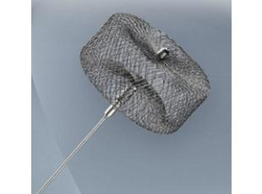
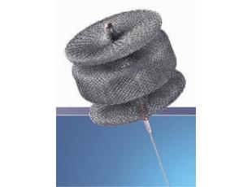
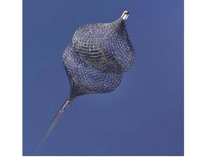
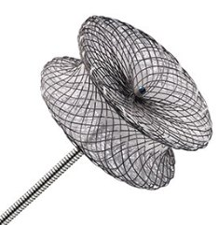
Case#1 Paravalvular leak closure of dehisced prosthetic aortic valve
Post op complete heart block – requiring a permanent pacemaker
Post op severe LVEF (25%)
Post op acute renal injury (GFR <25 mL/min)
Referred to UW for transcatheter closure of paravalvular leak

Slide 8
Case#1 Paravalvular leak closure of dehisced prosthetic aortic valve

Slide 9
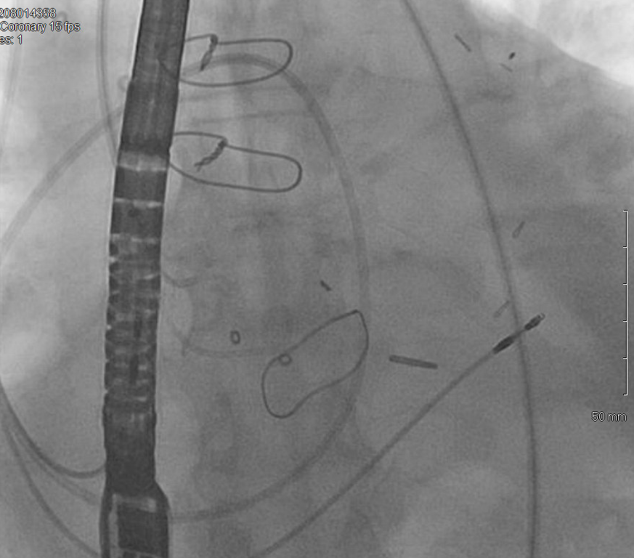
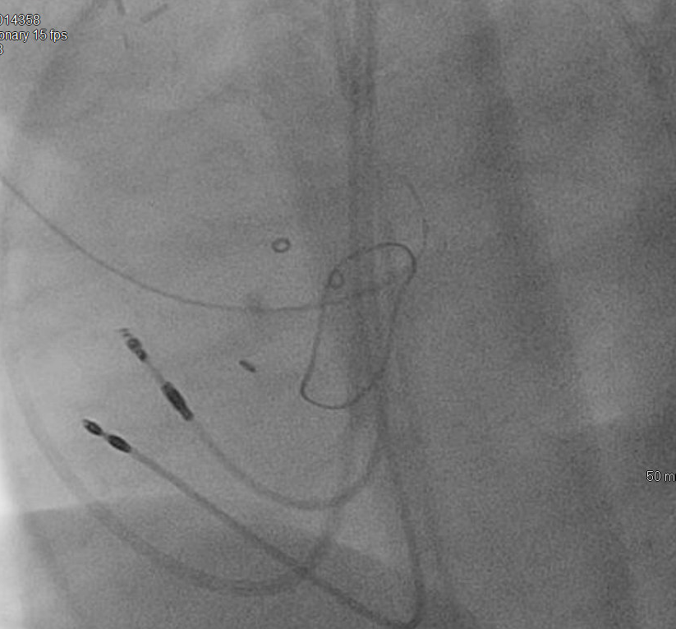
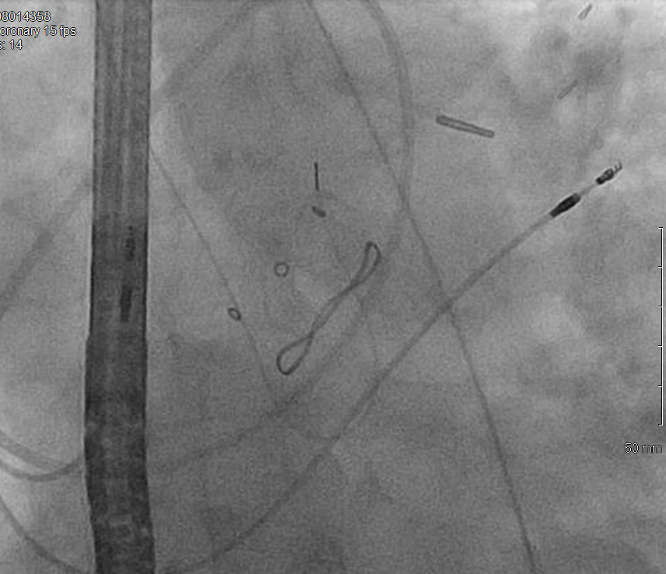
Case#1 Paravalvular leak closure of dehisced prosthetic aortic valve
2/23/2015
Procedure time: 3h 15 min
Fluoro time: 87 minutes
Skin dose: 748400 mGy/cm2
Contrast dose: 180 mL Iohexal

Slide 10
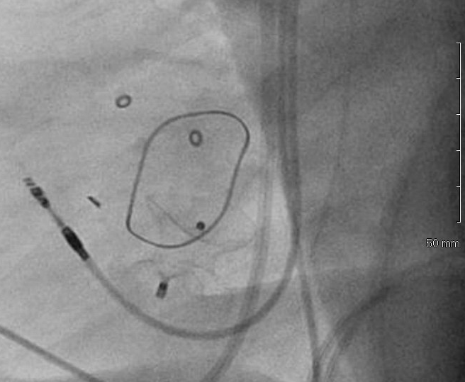
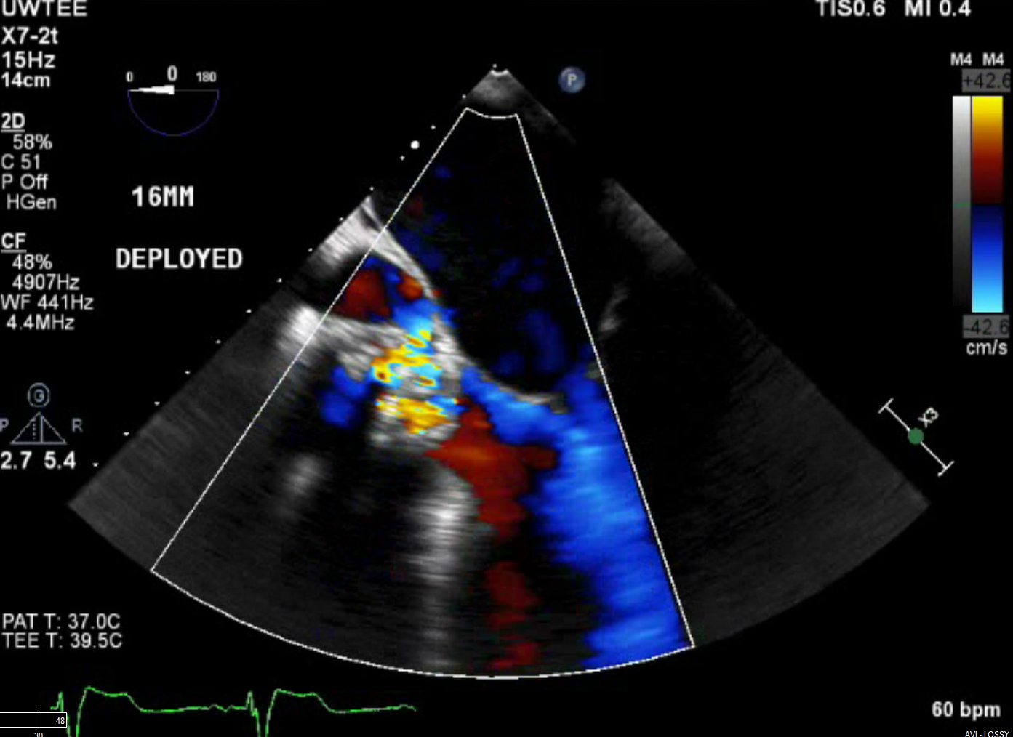
Case#1 Paravalvular leak closure of dehisced prosthetic aortic valve
2/23/2015
16mm Muscular VSD
Occluder
“Severe paravalvuvlar regurgitation”

Slide 11
Case#1 Paravalvular leak closure of dehisced prosthetic aortic valve

Slide 12
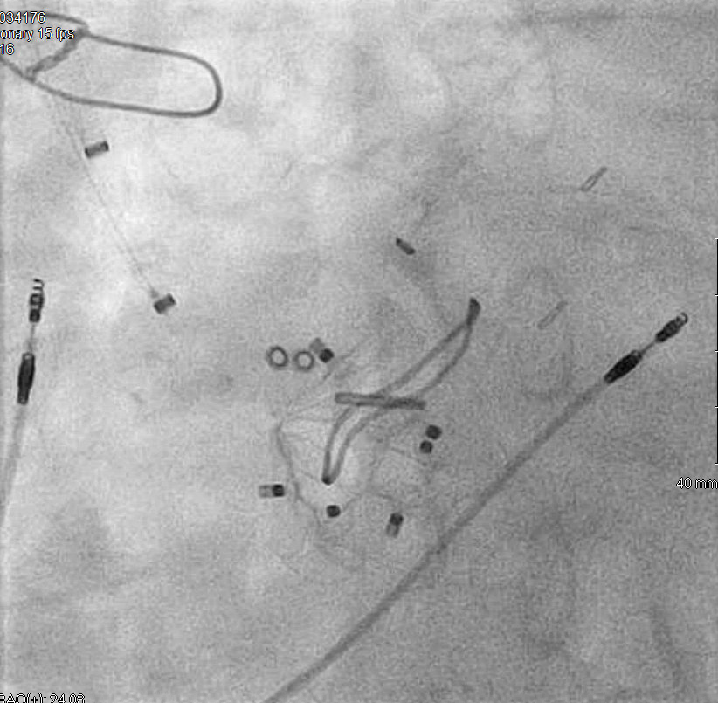
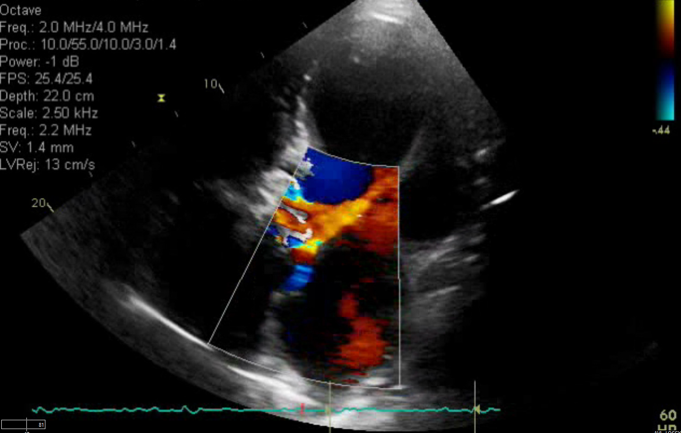
Case#1 Paravalvular leak closure of dehisced prosthetic aortic valve
3/10/2015 (moderate sedation – no TEE)
16 mm VSD
20 mm VP2
16 mm VP2
Procedure time: 2h 11 min
Fluoro time: 22 minutes
Skin dose: 191228 mGy/cm2
Contrast dose: 50 mL Omnipaque
“Moderate paravalvular regurgitation”

Slide 13
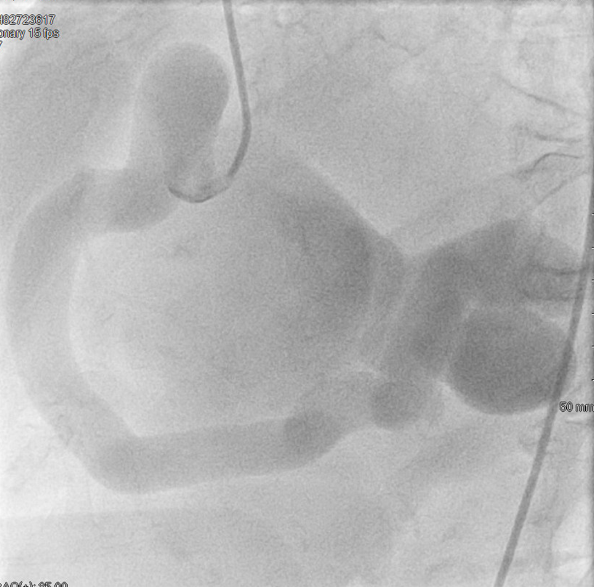
Case#2 RCA to Coronary Sinus Fistula causing Right sided heart failure
81 yo woman
Right sided heart failure
Severe RV enlargement
Recurrent pleural effusions
Not a surgical candidate

Slide 14
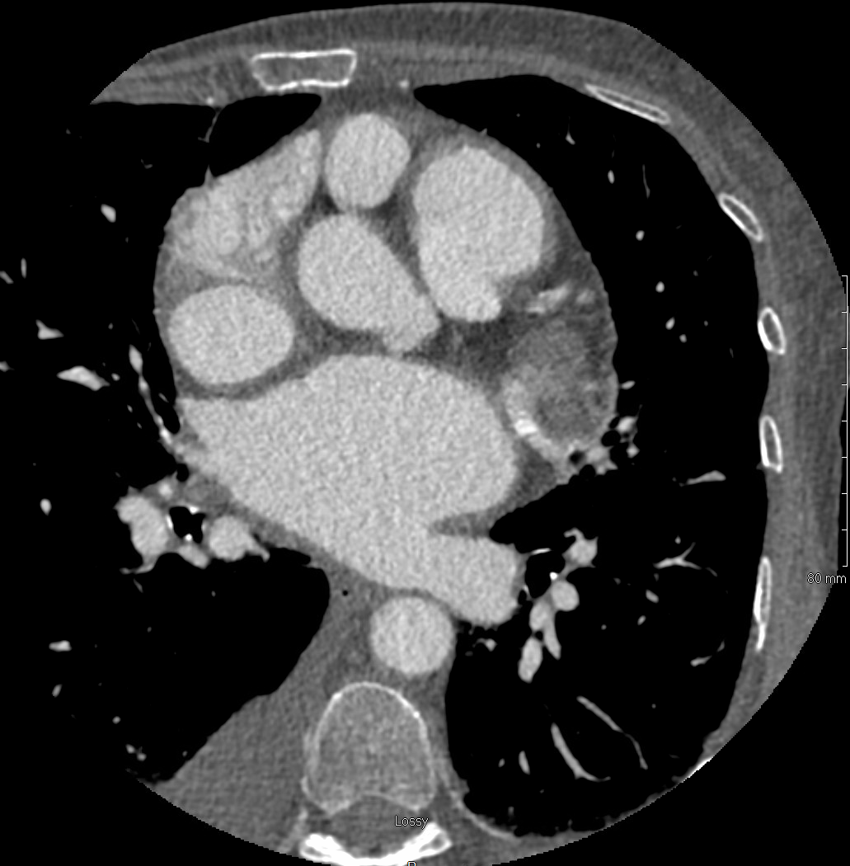
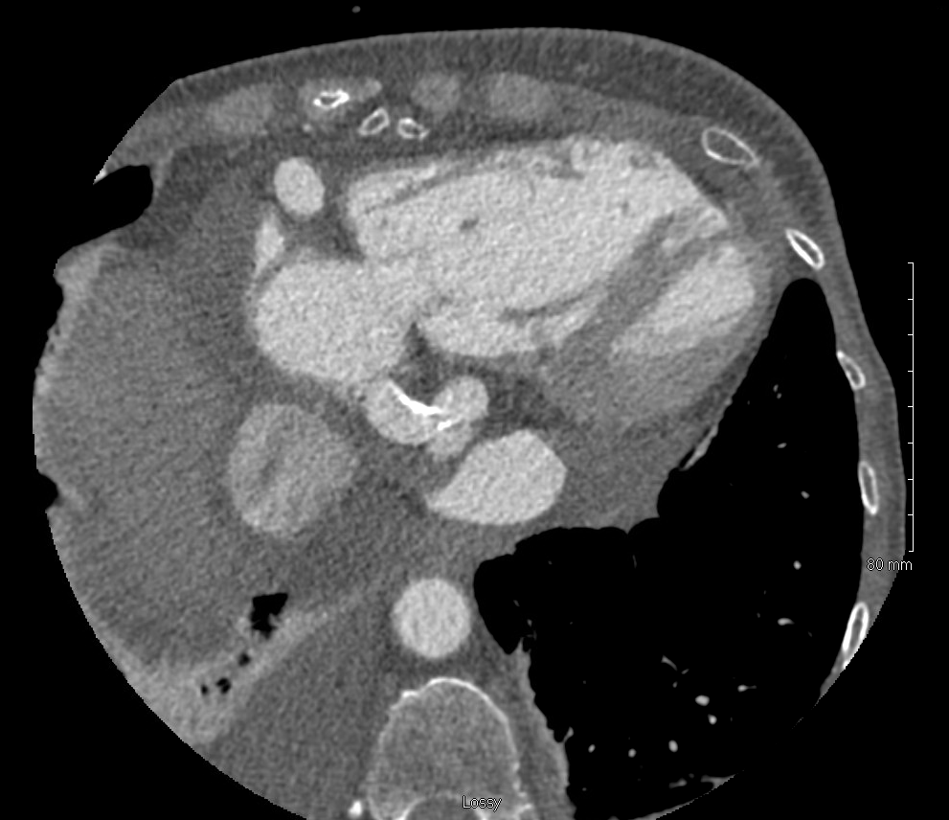
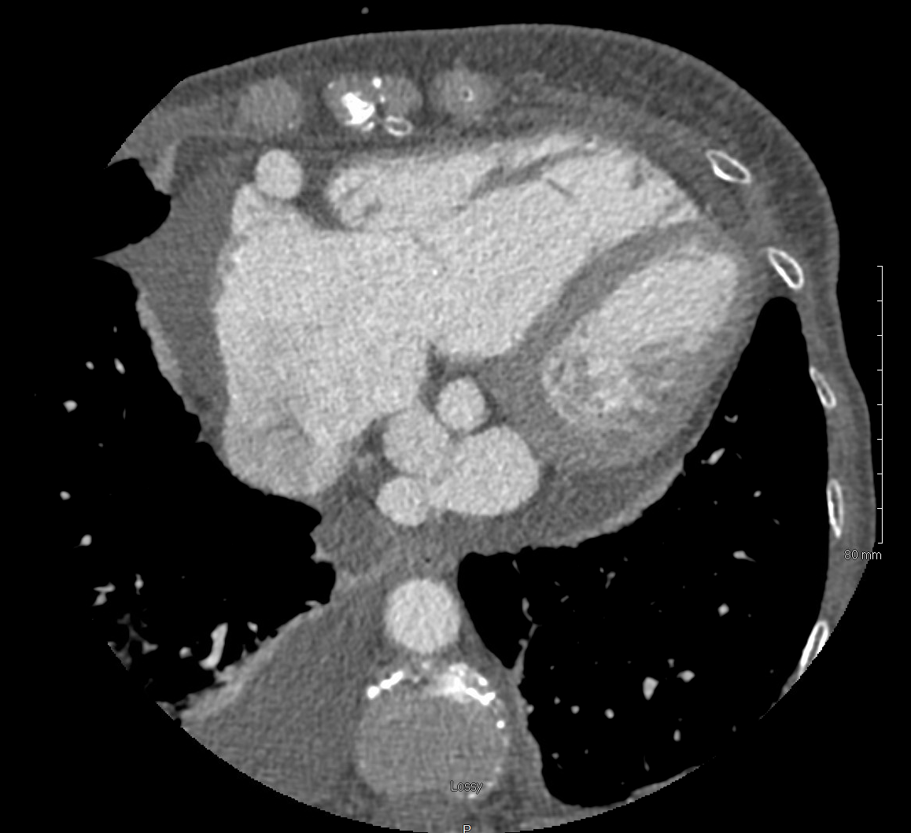
Case#2 RCA to Coronary Sinus Fistula causing Right sided heart failure
RCA
d
RCA
RV
RCA to CS connection
(measured diameter 4mm)
CS?
RCA?

Slide 15
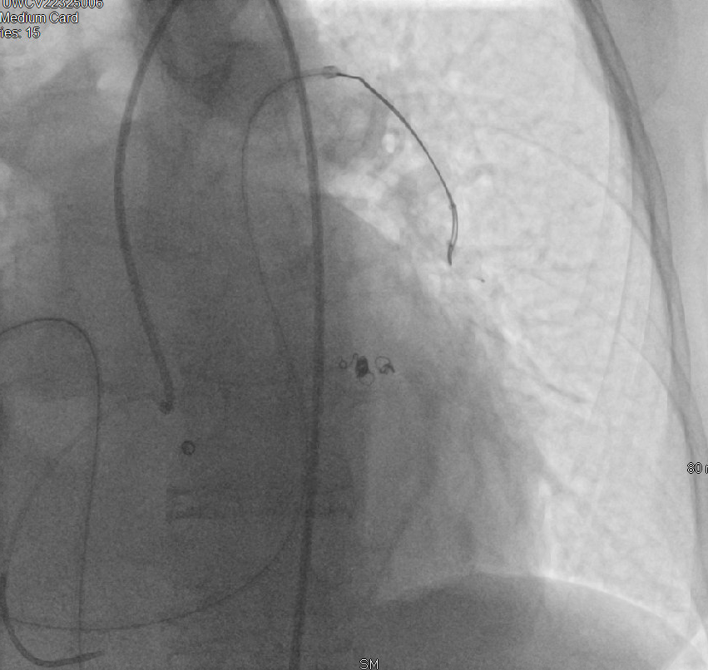
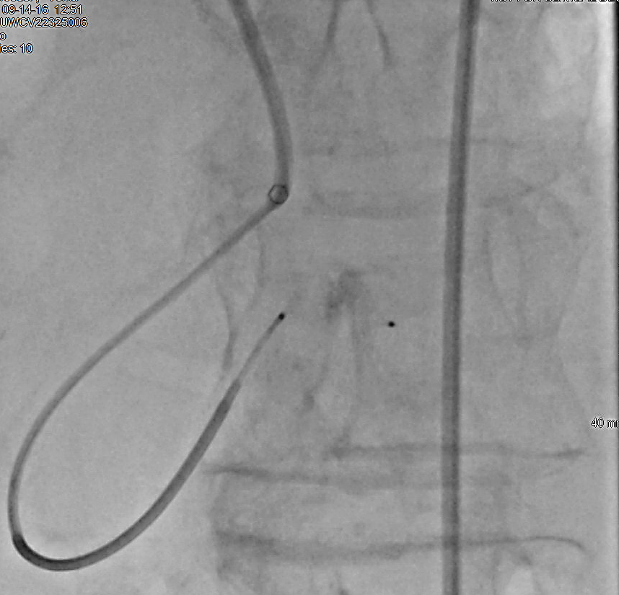
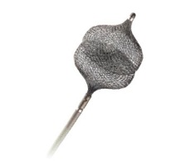
Case#2 RCA to Coronary Sinus Fistula causing Right sided heart failure
09/14/2016
Goose-neck Snare Retrieval
of Embolized VP4 from
L Pulm Artery
8 mm VP4
St. Jude Medical

Slide 16
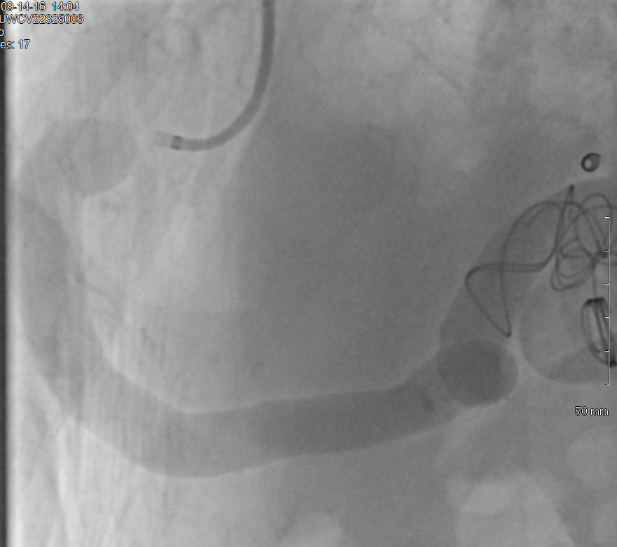
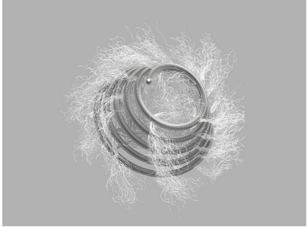
RCA to Coronary Sinus Fistula causing Right sided heart failure
09/14/2016
Tornado Coils (Cook Medical)
*platinum-based
20 mm
Procedure time: 2h 02 min
Fluoro time: 72 minutes
Skin dose: 33320 mGy/cm2
Contrast dose: 185 mL Iohexal

Slide 17
Case#2 RCA to Coronary Sinus Fistula causing Right sided heart failure
Barium Esophagram
09/19/2016
Next several days. . .
High flow through fistula
Severe hemolysis
Painful swallowing!!

Slide 18
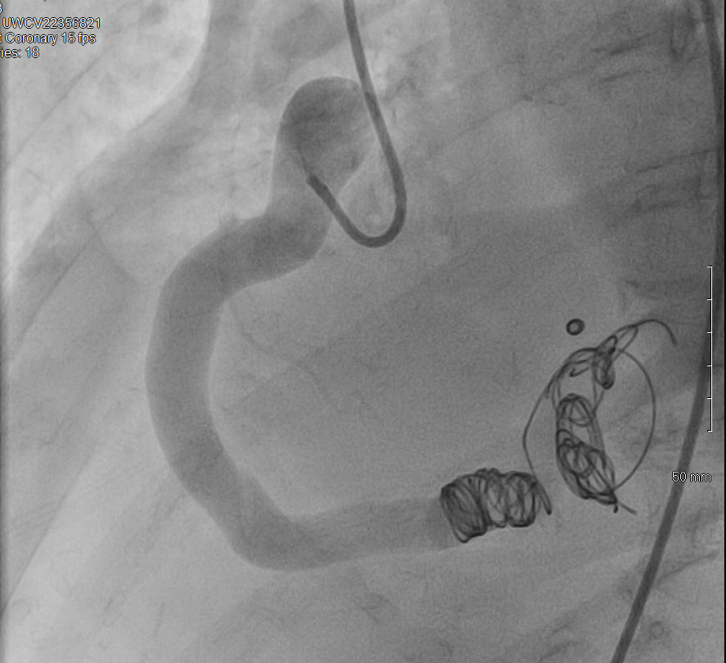
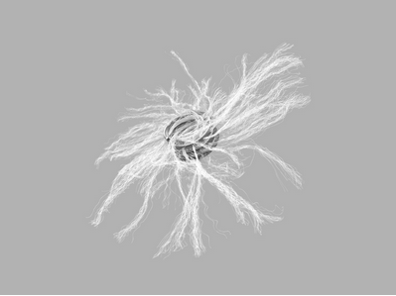
Case#2 RCA to Coronary Sinus Fistula causing Right sided heart failure
09/20/2016
Cook MReye Coils 20 mm (6)
*non-ferromagnetic
Procedure time: 3h 04 min
Fluoro time: 91 minutes
Skin dose: 288898 mGy/cm2
Contrast dose: 105 mL Iohexal

Slide 19
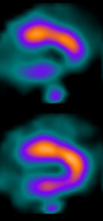
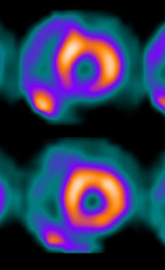
Case#3 Stem cell revascularization – Transendocardial Injection
SPECT
90 yo man
CCS class II refractory angina
Prior CABG/stents
Excellent medical therapy
No revascularization options
Enrolled in a stem cell therapy trial
stress
stress
rest
rest
Inferior ischemia

Slide 20
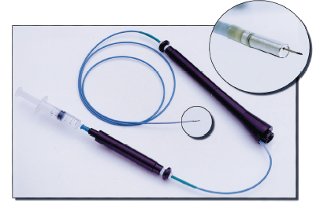
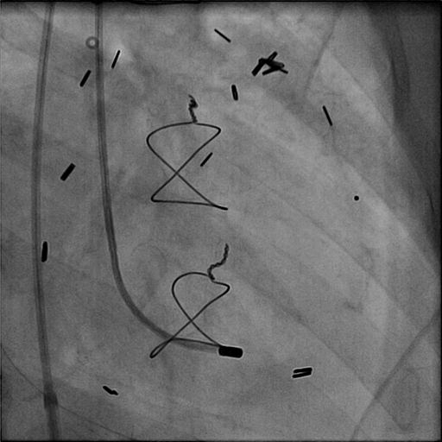
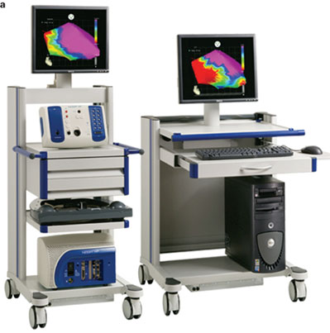
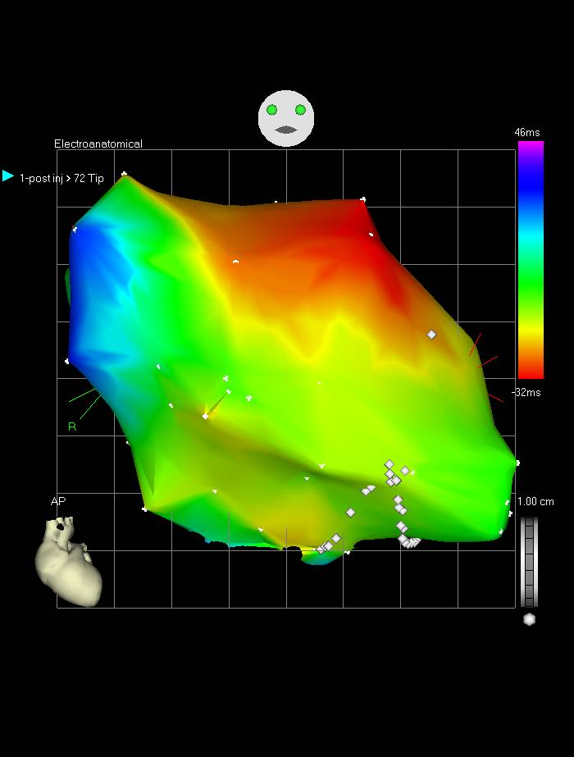
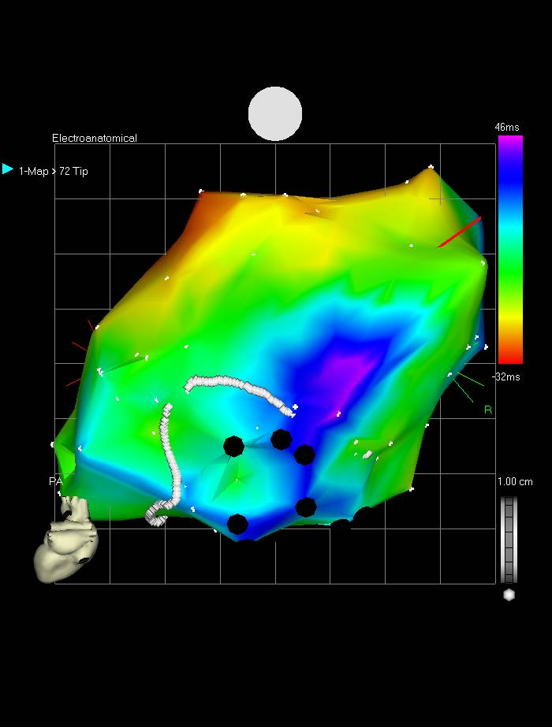
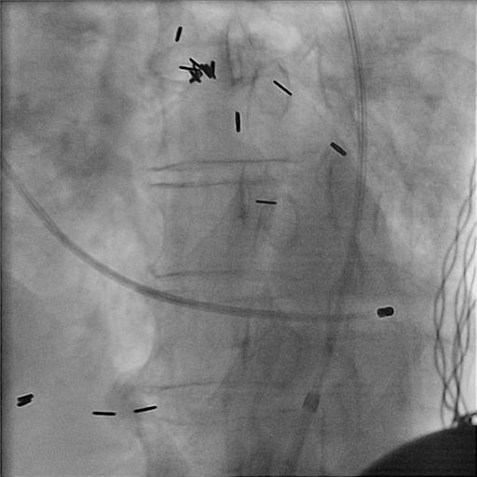
Case#3 Stem cell revascularization – Transendocardial Injection
Myostar
NOGA XP
RAO projection
LAO projection
1 hour to map – unstable arrhythmias
No PVC’s could be induced with needle deployment
No unipolar ST segment elevation with catheter tip engagement
Notes:
Advantages: prospectively tracks the catheter, voltage potential information, less radiation dose, extensive real world experience.
Disadvantages: time to create a map, no respiratory motion compension

Slide 21
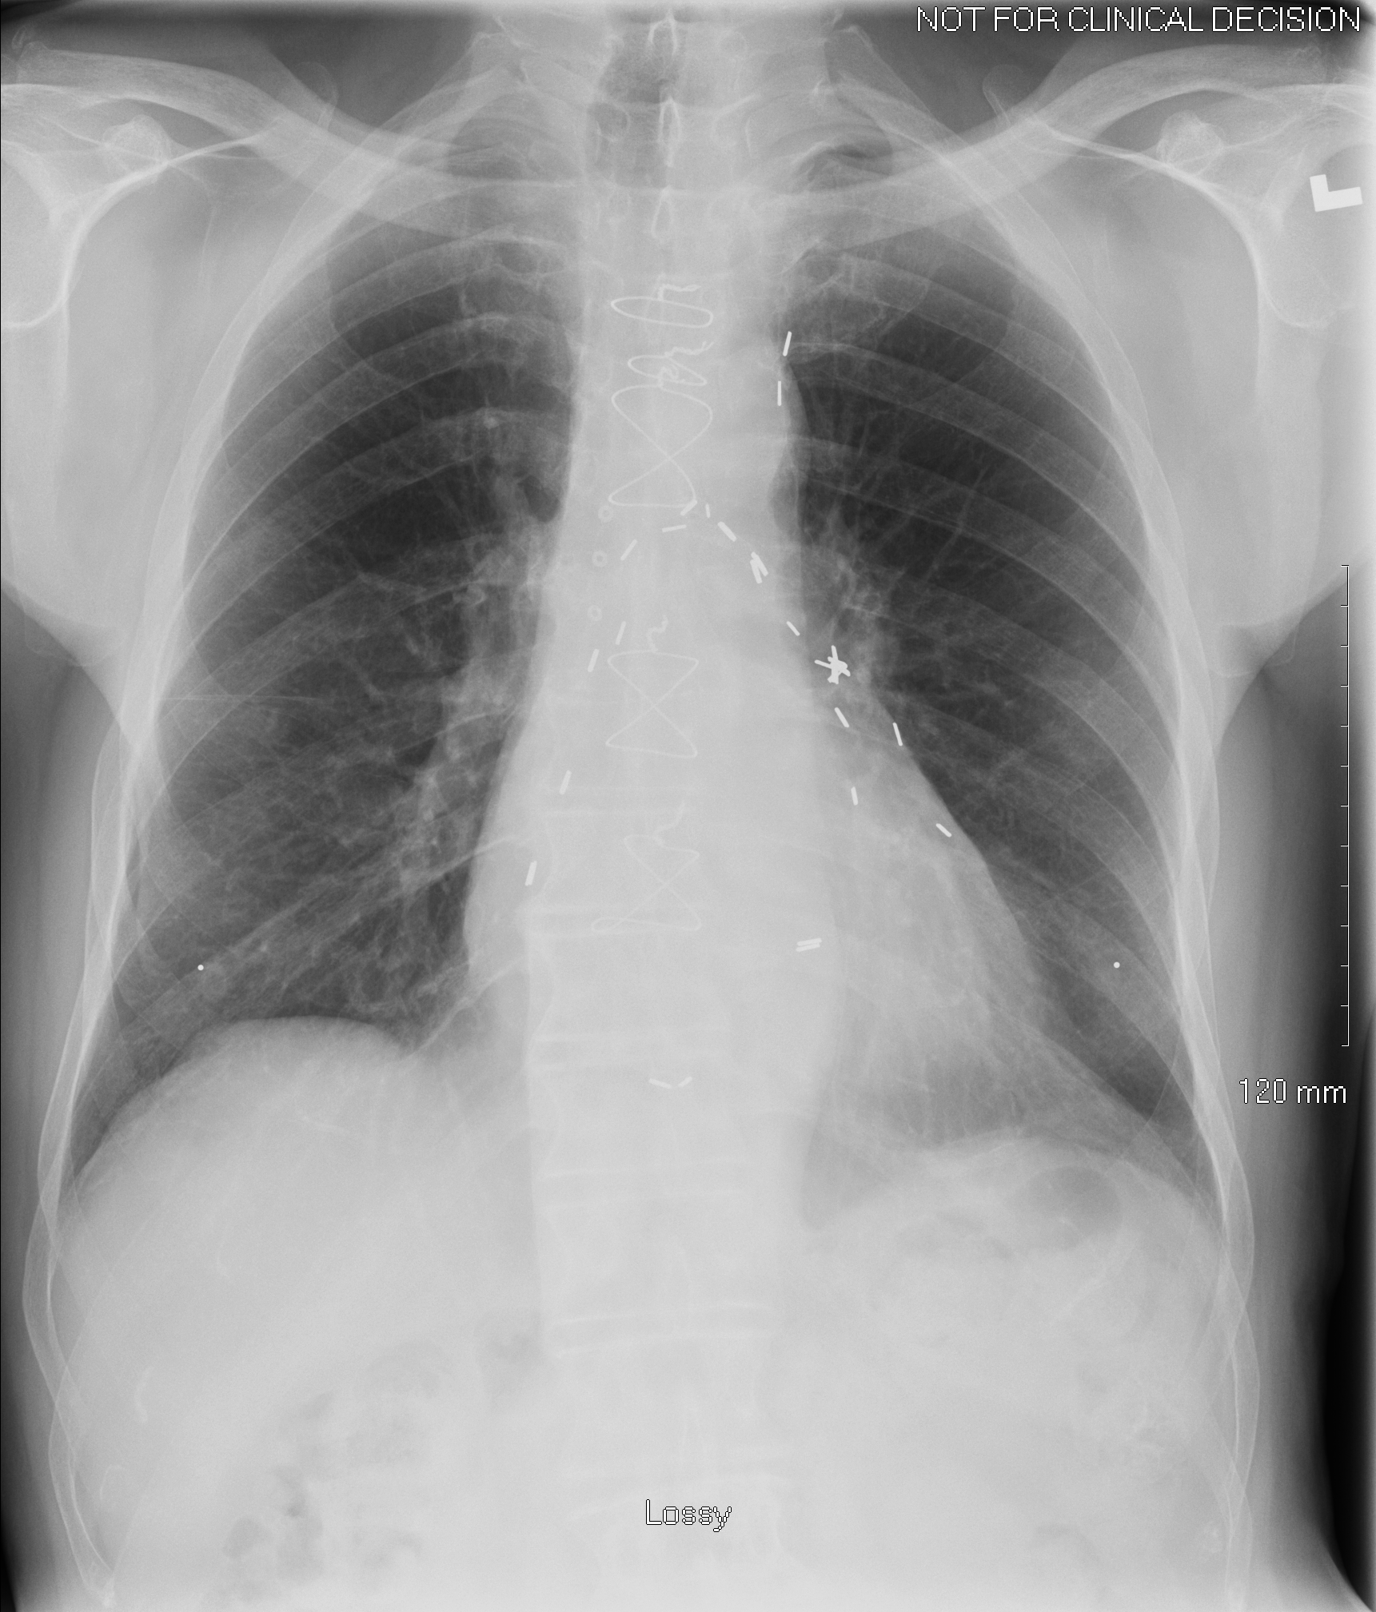
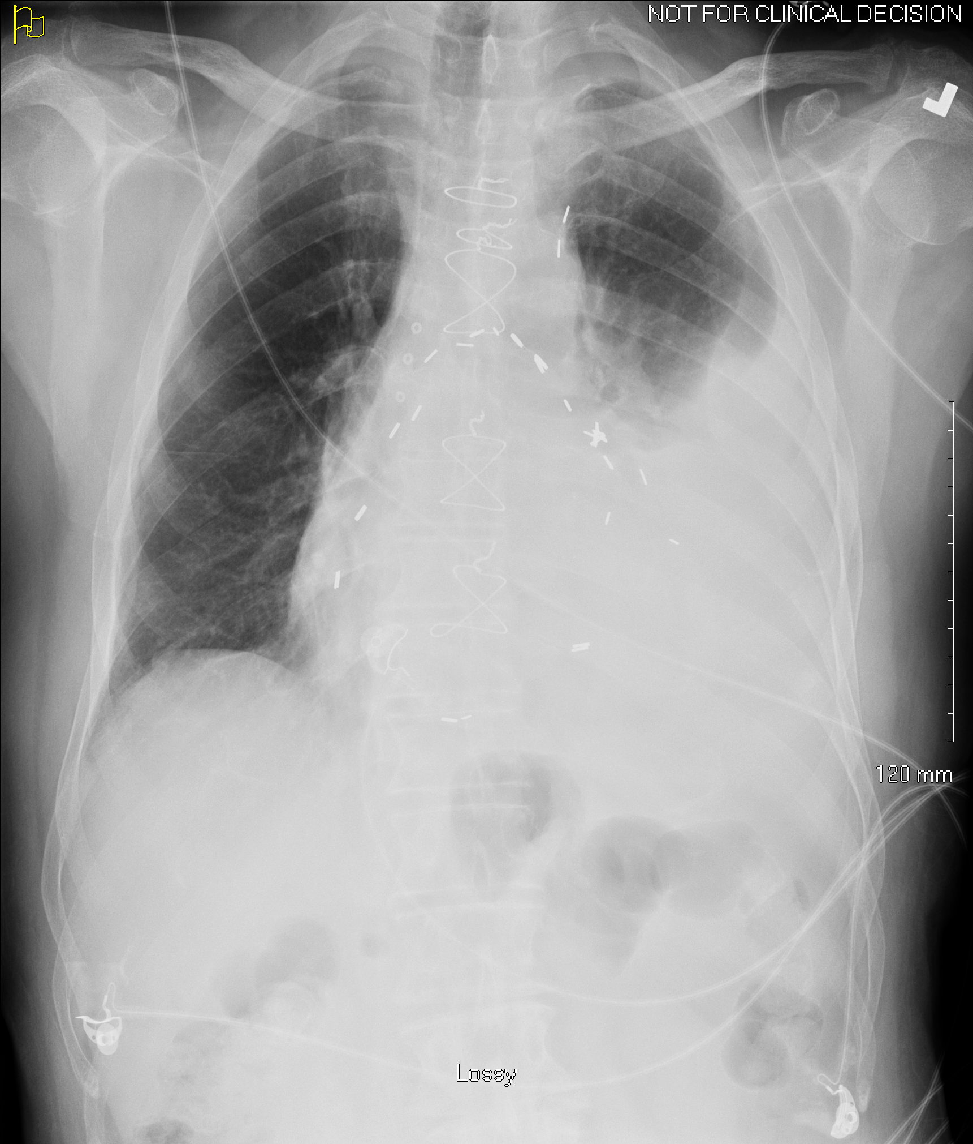
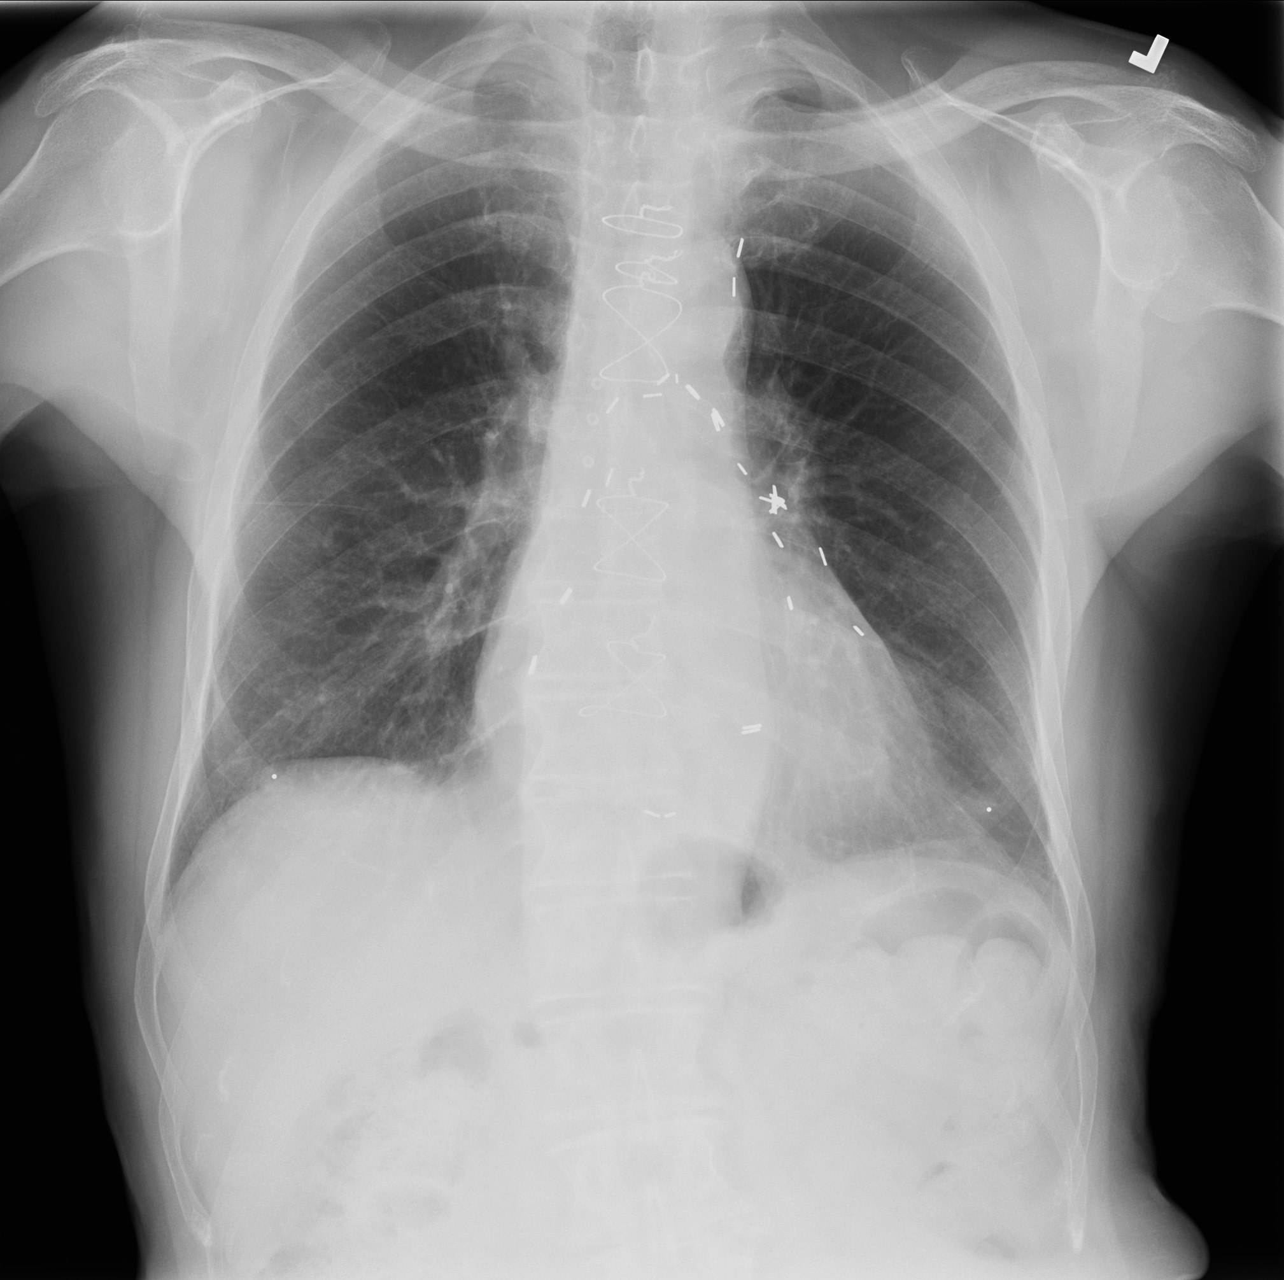
Case#3 Stem cell revascularization – Transendocardial Injection
Pre-procedure
6h Post Procedure
4d Post Procedure
Large Pleural
Effusion!!
Rx: Chest tube
and good as new!

Slide 22
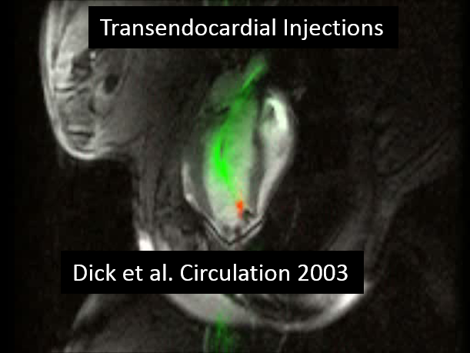
TAVR- Transapical
TAVR- Transfemoral
Valves
Horvath K.A. Eur J CT Surg 2011
Kahlert P et al. JCMR 2012
Cavo pulm shunt
Aortic Coarctation stenting
Vessels
Ratnayaka et al. JACC Card Int 2016
Raval et al. Circulation 2005
Atrial septal puncture and septostomy
Chambers
Raval et al. CCI 2006

Slide 23
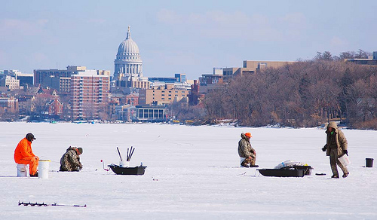
Thank you for your attention!
Madison, WI

