Slide 1
Saman Nazarian, MD, PhD Cardiac Electrophysiology University of Pennsylvania Perelman School of Medicine
MR Guided Interventional Electrophysiology
Initial Targets

Slide 2
Disclosures
Scientific Advisor
Biosense Webster, Inc
St Jude Medical, Inc
CardioSolv, Inc
Research Grants
NIH R01HL116280
Biosense Webster, Inc

Slide 3
Fluoroscopy
Advantages
Familiar views and landmarks for catheter positioning
No need for image registration
Disadvantages
Ionizing radiation
Lack of soft tissue resolution
Heart Rhythm. 2007 Dec;4(12):1582

Slide 4
Reentrant Arrhythmia Ablation
The substrate for reentry
Slowly conducting diseased myocardium
Perpetuates circuit reentry
The purpose of ablation
To destroy the diseased myocardial substrate necessary for reentry

Slide 5
The Arrhythmia Substrate is Not Directly Visualized
Point-by-point acquired intra-cardiac electrograms are used to identify scar
Time α complications
Papillary muscles, trabeculae, and fat
Choice of surface to map
Epicardial Mapping
Catheter
Endocardial Mapping
Catheter

Slide 6
Characterization of the Ventricular Substrate
Bipolar Voltage
Unipolar Voltage
EGM Duration
EGM Deflections
Non-Invasive 3D
Predicted Map
Invasive
Electro-anatomic
Map
Sasaki, Nazarian et al. Circulation A&E 2012;5:1081-1090

Slide 7
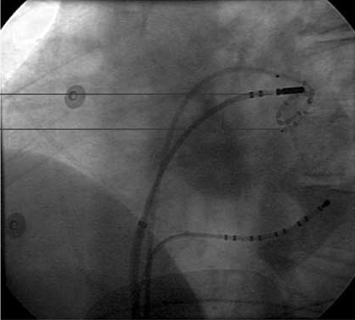
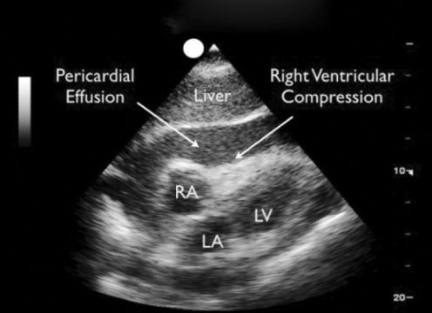
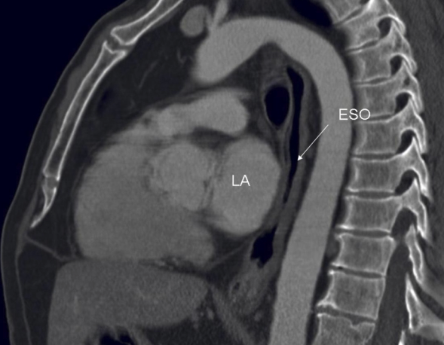
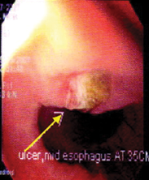
Monitoring for Complications
AF ablation
Trans atrial septal puncture
Circumferential ablation around pulmonary veins

Slide 8
Utility of MRI for EP Applications
No ionizing radiation
Accurate anatomic catheter guidance
No susceptibility to patient movement
Avoidance of ablation in thin walled regions
Real-time monitoring of adjacent organs and potential complications
Arrhythmia substrate identification

Slide 9
MR Catheter Guidance is a Reality
Real-time GRE sequence (repetition time, 10 ms; echo time, 4.4 ms; flipangle, 20°; field of view, 24 to 30 cm; slice thickness, 10 mm; matrix, 25696)
Circulation. 2008; 118: 223-229

Slide 10
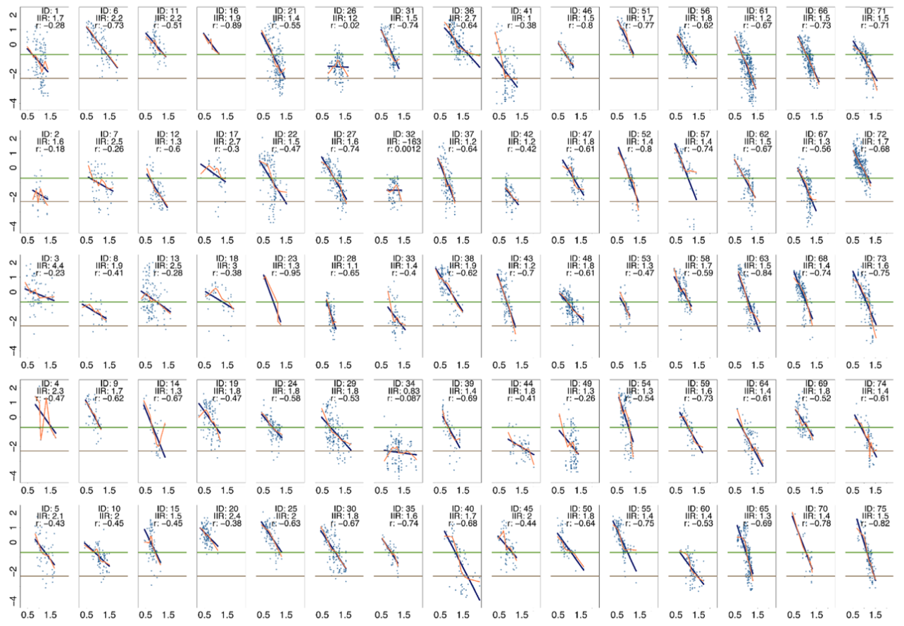
Next Target Characterization of the Atrial Substrate
Heart Rhythm. 2014 Jan;11(1):85-92

Slide 11
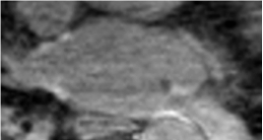
Real Time Lesion Visualization
Late Gadolinium
Enhancement
Blood Pool
Intensity
Normal
Scar
Time
10-20 minutes
Contrast
Injection
Khurram, Nazarian, et al. Pacing Clin Electrophysiol. 2015 Nov;38(11):1317-24

Slide 12
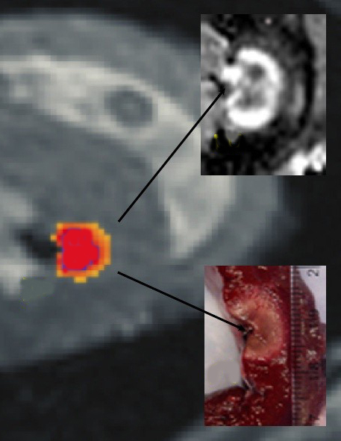
MRI Thermography
Proton precession rate is temperature sensitive
DEMRI
Path
Temperature Evolution
Kolandaivelu et al. Circ Arrhythm Electrophysiol. 2010 Oct;3(5):521-9

Slide 13
Summary
Initial targets
Catheter Guidance and ablation in flutter
Catheter Guidance and ablation in complex cases
Next Targets
Reliable characterization of thin walled tissues
Real-time lesion visualization and Thermometry

Slide 14
Acknowledgements
Fellows & Residents
Ali Habibi
Esra Gucuk Ipek
Eunis Yang
Irfan Khurram
Kotaro Fukumoto
Jonathan Chrispin
Sohail Zahid
Amir Rahsepar
Eunice Yang
Yuliya Mints
Research Coordinators
Nissi Saju
Rozann Hansford
Faculty
Stefan Zimmerman – Radiology JHU
Benoit Desjardin – Radiology Penn
Walter Witschey – Radiology Penn
Joao Lima – Cardiology JHU
David Bluemke – Radiology NIH CC
Frank Marchlinski – EP Penn
David allans – EP Penn
Henry Halperin – EP JHU
Hugh Calkins – EP JHU
Ron Berger – EP JHU
Natalia Trayanova – BME JHU
Vadim Zipunnikov – Biostatistics JHU
Funding
NIH - R01HL116280
PCORI – PATH and ADAPTABLE
Biosense Webster Inc.

