Slide 1
iCMR
‘One stop shop’
Dr. Toby Rogers, MA, BM BCh, PhD
Cardiovascular and Pulmonary Branch, Division of Intramural Research
National Heart, Lung, and Blood Institute
National Institutes of Health
Bethesda, Maryland, United States

Slide 2
Ionizing radiation avoidance is not the only reason to do iCMR cardiac catheterization

Slide 3
Case #1

Slide 4
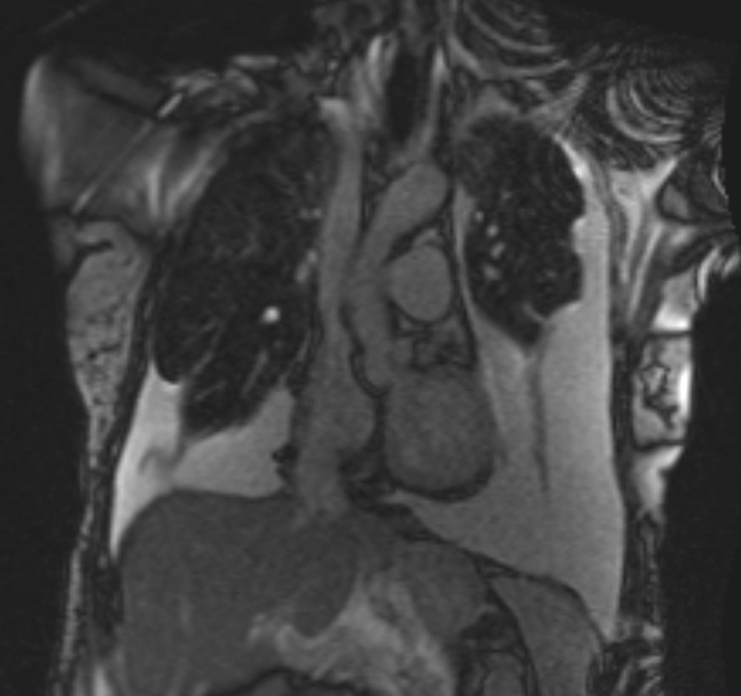
73 year old woman
Limited scleroderma (CREST)
Chronic pleural effusions
Suspected pulmonary hypertension
Recent increase in exertional dyspnea

Slide 5
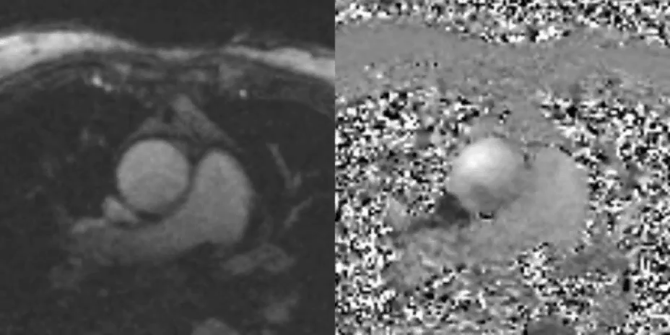
Hemodynamics
Room Air | Pressure (mmHg)
Right atrium | 11
Pulmonary artery | 50/20
Pulmonary artery mean | 30
Pulmonary artery wedge | 20
Transpulmonary gradient | 10
Aorta | 142/60
Left ventricular end-diastolic | 17
Cardiac index = 2.1 L/min/m²
Pulmonary vascular resistance index = 4.5 WU/m²

Slide 6
Hemodynamics
Room Air | Pressure (mmHg)
Right atrium | 11
Pulmonary artery | 50/20
Pulmonary artery mean | 30
Pulmonary artery wedge | 20
Transpulmonary gradient | 10
Aorta | 142/60
Left ventricular end-diastolic | 17
Cardiac index = 2.1 L/min/m²
Pulmonary vascular resistance index = 4.5 WU/m²

Slide 7
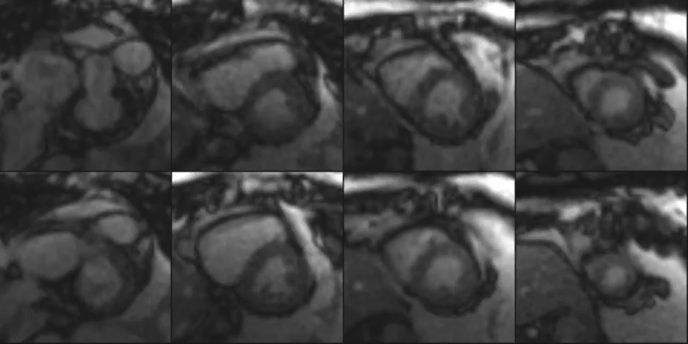
MRI anatomy and function

Slide 8
Supine ergometer exercise
 | Baseline | Peak exercise
Right ventricle end-diastolic volume index (mL/m²) | 58 | 63
Right ventricle end-systolic volume index (mL/m²) | 14 | 18
Right ventricle ejection fraction (%) | 77% | 72%
Pulmonary arterial vasoreactivity
 | Baseline | 100% O₂ and 40ppm NO
Mean pulmonary artery pressure (mmHg) | 30 | 30
Pulmonary vascular resistance index (WU/m²) | 4.5 | 4.5

Slide 9
Supine ergometer exercise
 | Baseline | Peak exercise
Right ventricle end-diastolic volume index (mL/m²) | 58 | 63
Right ventricle end-systolic volume index (mL/m²) | 14 | 18
Right ventricle ejection fraction (%) | 77% | 72%
Pulmonary arterial vasoreactivity
 | Baseline | 100% O₂ and 40ppm NO
Mean pulmonary artery pressure (mmHg) | 30 | 30
Pulmonary vascular resistance index (WU/m²) | 4.5 | 4.5

Slide 10
Supine ergometer exercise
 | Baseline | Peak exercise
Right ventricle end-diastolic volume index (mL/m²) | 58 | 63
Right ventricle end-systolic volume index (mL/m²) | 14 | 18
Right ventricle ejection fraction (%) | 77% | 72%
Pulmonary arterial vasoreactivity
 | Baseline | 100% O₂ and 40ppm NO
Mean pulmonary artery pressure (mmHg) | 30 | 30
Pulmonary vascular resistance index (WU/m²) | 4.5 | 4.5

Slide 11
Case #1 – Learning points
Pulmonary vascular resistance can be calculated with invasive pressures and MRI flow-derived cardiac output
Supine exercise in MRI can unmask RV dysfunction

Slide 12
Case #2

Slide 13
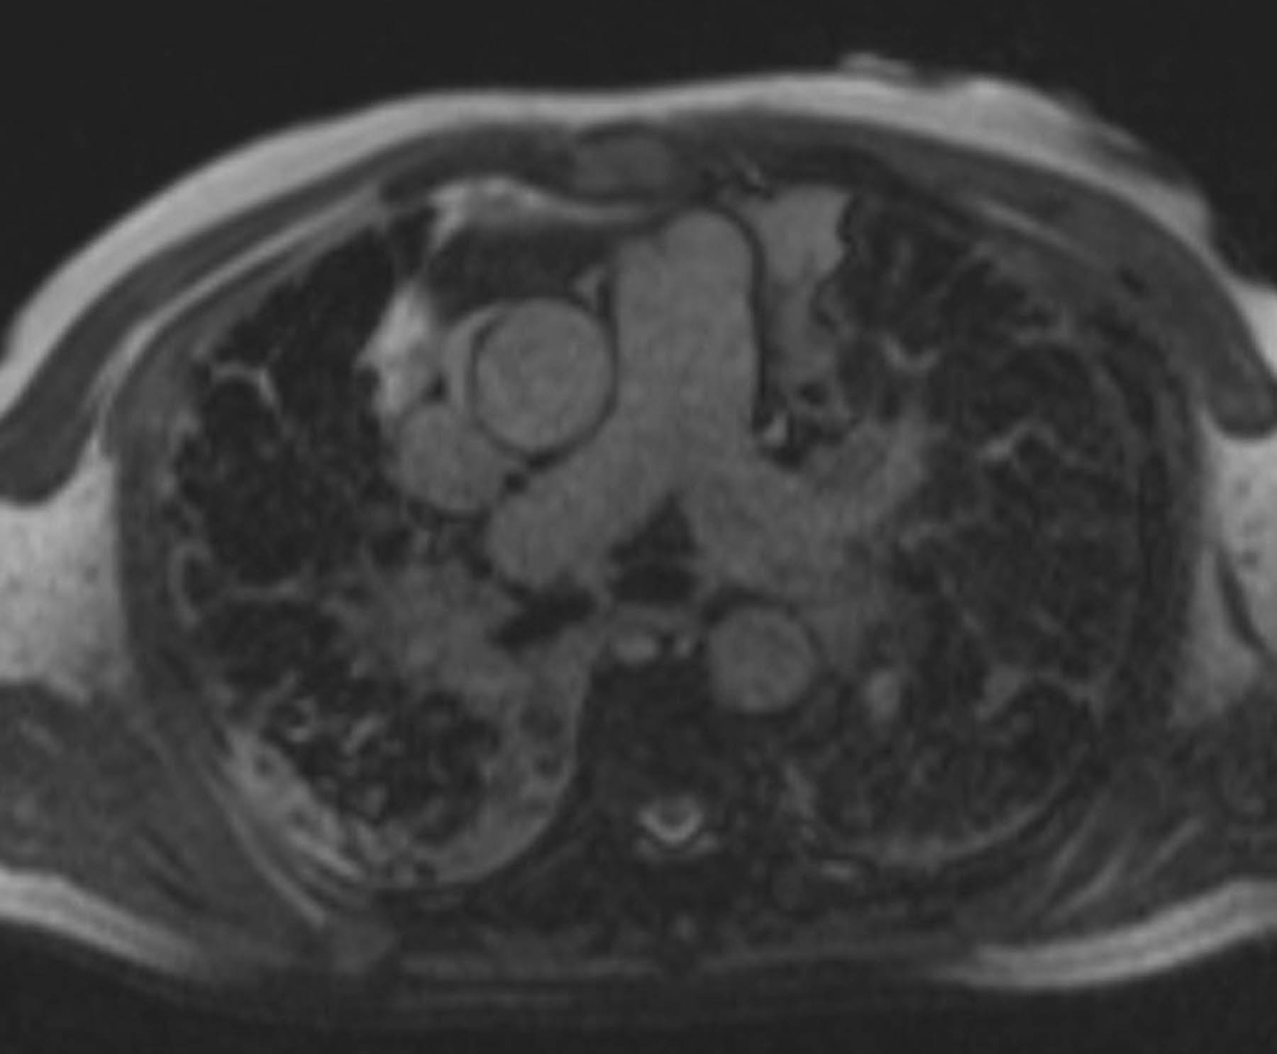
66 year old man
Sarcoidosis
Occupational exposure to coal dust
Chronic hypoxemia on home O₂
NYHA class IV

Slide 14
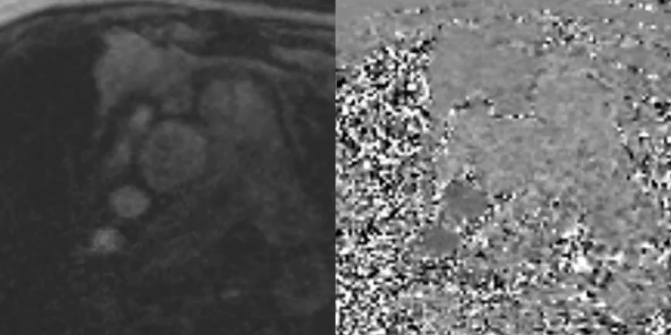
Hemodynamics
4L O₂ | Pressure (mmHg)
Right atrium | 1
Right ventricle | 65/6
Pulmonary artery | 65/25
Pulmonary artery mean | 40
Pulmonary artery wedge | 14
Transpulmonary gradient | 26
Aorta | 140/60
Left ventricular end-diastolic | 2
Cardiac index = 2.7 L/min/m²
Pulmonary vascular resistance index = 8.7 WU/m²

Slide 15
Hemodynamics
4L O₂ | Pressure (mmHg)
Right atrium | 1
Right ventricle | 65/6
Pulmonary artery | 65/25
Pulmonary artery mean | 40
Pulmonary artery wedge | 14
Transpulmonary gradient | 26
Aorta | 140/60
Left ventricular end-diastolic | 2
Cardiac index = 2.7 L/min/m²
Pulmonary vascular resistance index = 8.7 WU/m²

Slide 16
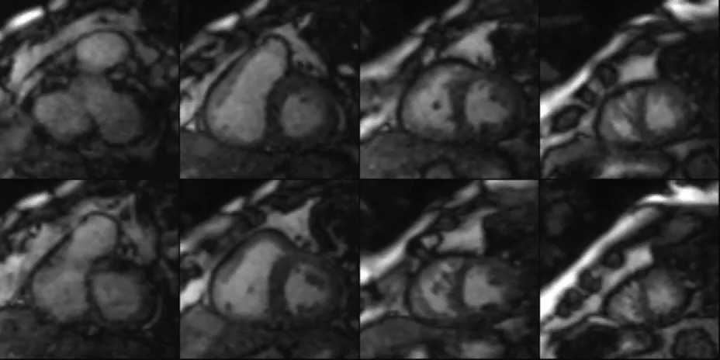
MRI anatomy and function

Slide 17
Pulmonary arterial vasoreactivity
 | 4L 0₂ | 100% O₂ + 40ppm NO
Mean pulmonary artery pressure (mmHg) | 40 | 28
Pulmonary vascular resistance index (WU/m²) | 8.7 | 7.4
 | 4L 0₂ | 100% O₂ + 40ppm NO
Right ventricle end-diastolic volume index (mL/m²) | 85 | 70
Right ventricle end-systolic volume index (mL/m²) | 48 | 39
Right ventricle ejection fraction (%) | 44% | 45%

Slide 18
Pulmonary arterial vasoreactivity
 | 4L 0₂ | 100% O₂ + 40ppm NO
Mean pulmonary artery pressure (mmHg) | 40 | 28
Pulmonary vascular resistance index (WU/m²) | 8.7 | 7.4
 | 4L 0₂ | 100% O₂ + 40ppm NO
Right ventricle end-diastolic volume index (mL/m²) | 85 | 70
Right ventricle end-systolic volume index (mL/m²) | 48 | 39
Right ventricle ejection fraction (%) | 44% | 45%

Slide 19
Pulmonary arterial vasoreactivity
 | 4L 0₂ | 100% O₂ + 40ppm NO
Mean pulmonary artery pressure (mmHg) | 40 | 28
Pulmonary vascular resistance index (WU/m²) | 8.7 | 7.4
 | 4L 0₂ | 100% O₂ + 40ppm NO
Right ventricle end-diastolic volume index (mL/m²) | 85 | 70
Right ventricle end-systolic volume index (mL/m²) | 48 | 39
Right ventricle ejection fraction (%) | 44% | 45%

Slide 20
Case #2 – Learning points
MRI is the best imaging modality to assess the right ventricle
iCMR catheterization can identify right ventricular response to pulmonary arterial vasodilators

Slide 21
Case #3

Slide 22
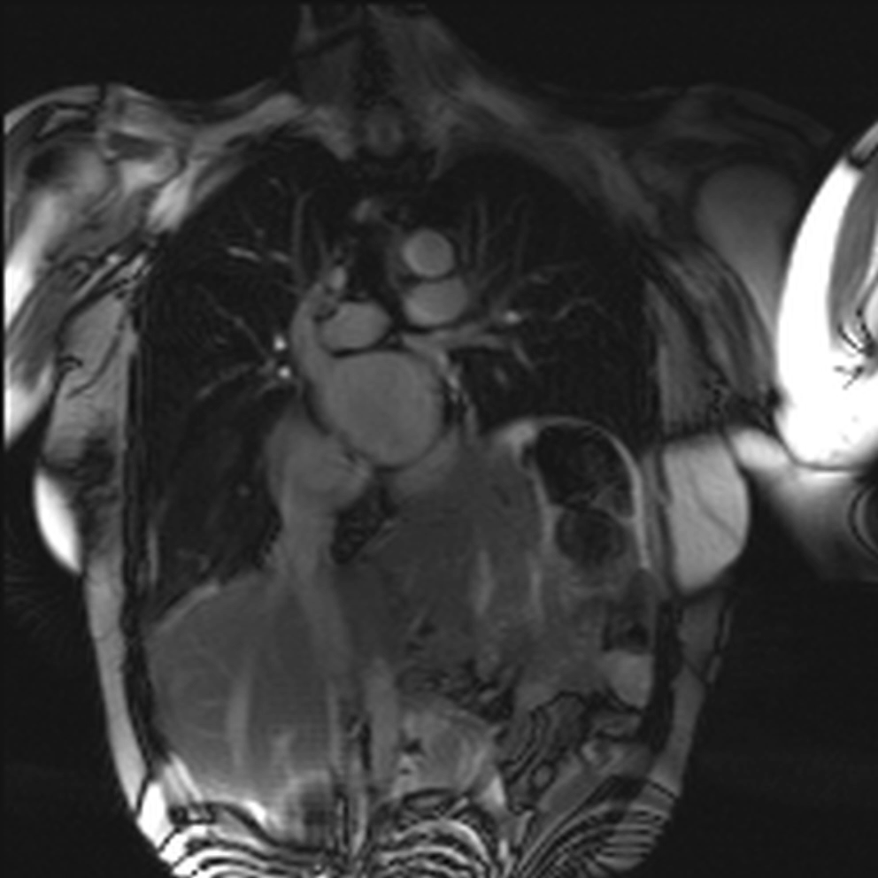
65 year old woman
Prior mediastinal surgery and phrenic nerve injury
Paralyzed hemidiaphragm
Recently increasing exertional dyspnea
NYHA class III
Echocardiography suggested pulmonary hypertension

Slide 23
Hemodynamics
Room Air | Pressure (mmHg)
Right atrium | 10
Right ventricle | 44/14
Pulmonary artery | 44/19
Pulmonary artery mean | 30
Pulmonary artery wedge | 20
Transpulmonary gradient | 10
Aorta | 121/57
Left ventricular end-diastolic | 12

Slide 24
Hemodynamics
Room Air | Pressure (mmHg)
Right atrium | 10
Right ventricle | 44/14
Pulmonary artery | 44/19
Pulmonary artery mean | 30
Pulmonary artery wedge | 20
Transpulmonary gradient | 10
Aorta | 121/57
Left ventricular end-diastolic | 12

Slide 25
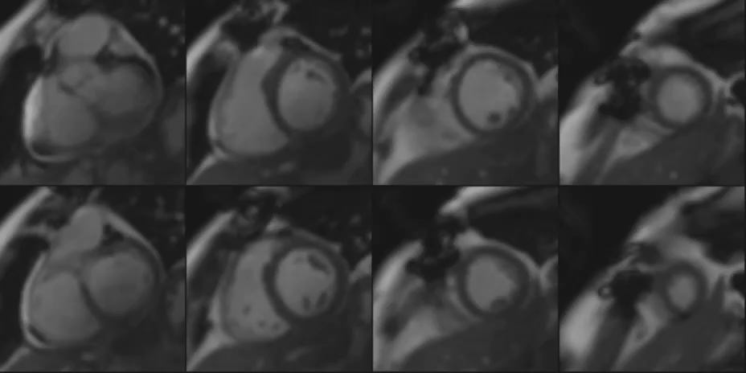
MRI anatomy and function

Slide 26
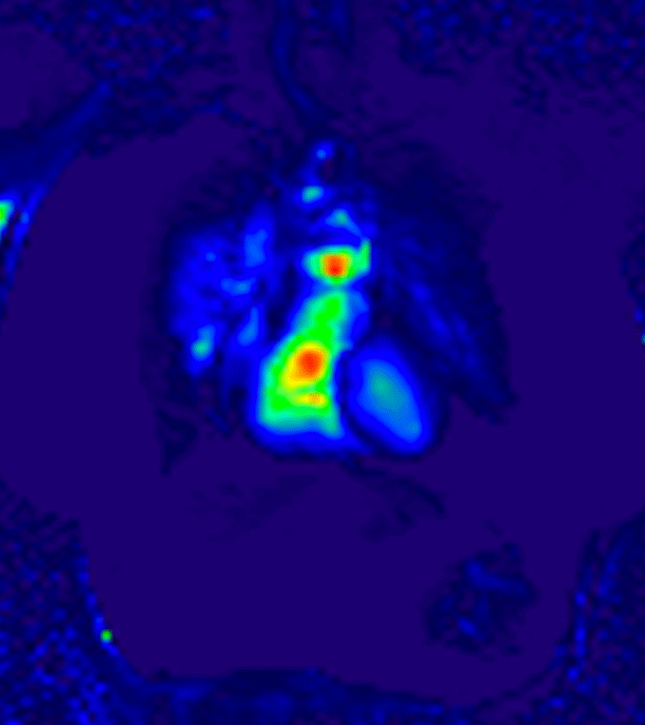
MRI lung perfusion
1mL gadobutrol followed by 20mL saline
Single breath hold

Slide 27
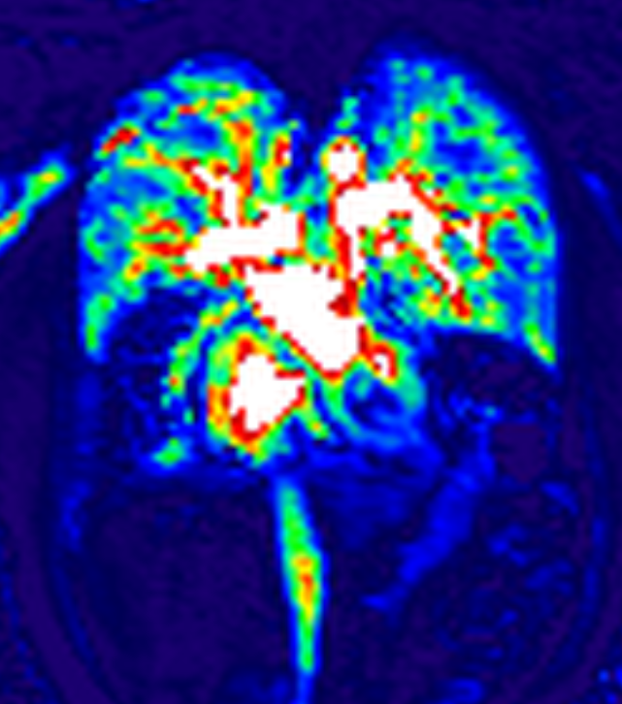
MRI lung perfusion
MRI lung perfusion imaging revealed large defect in right lower lobe

Slide 28
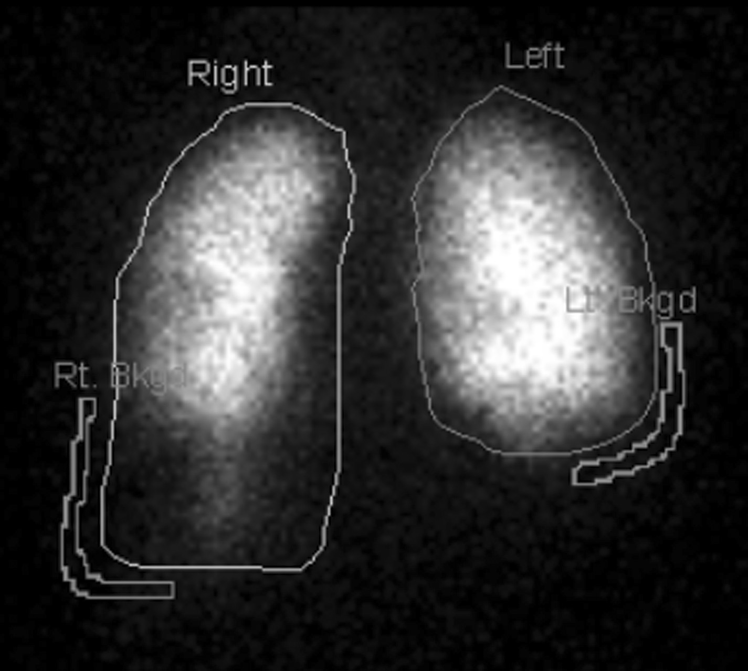
Nuclear ventilation/perfusion scan correlation

Slide 29
Case #3 – Learning points
Lung perfusion can be easily incorporated into iCMR catheterization protocol
1mL gadolinium contrast and a single breath hold sufficient

Slide 30
iCMR ’one stop shop’
Powerful diagnostic tool
Simultaneous function, anatomy and hemodynamics
Ideally suited for patients with pulmonary hypertension and right heart disease as well as patients with abnormal anatomy (e.g. congenital heart disease)

Slide 31
Acknowledgements
Robert Lederman, MD
Kanishka Ratnayaka, MD
Anthony Faranesh, PhD
William Schenke, BA
Jonathan Mazal, MA
Jaffar Khan, MD
Elena Grant, MD
Adrienne Campbell-Washburn, PhD
Raj Ramasawmy, PhD
Daniel Herzka, PhD
Peter Kellman, PhD
Laurie Grant, RN
Annette Stine, RN
Merdim Sonmez, PhD
Ozgur Kocaturk, PhD
Michael Hansen, PhD
Marcus Chen, MD
Burcu Basar, BS

