Slide 1
New Pediatric Cath Site:
Nationwide Children’s Hospital
Aimee K. Armstrong, MD, FAAP, FACC, FSCAI
Director, Cardiac Catheterization & Interventional Therapies
Nationwide Children’s Hospital
Associate Professor of Pediatrics
The Ohio State University

Slide 2
No Relevant Disclosures

Slide 3

Notes:
Serendipity led me to my interest in iCMR. It was several years ago at my former institution, the University of Michigan, when we were designing a hybrid cath lab and operating room. It just so happened that the only remaining space in the hospital to put this hybrid lab was in one of the two rooms adjacent to the IMRIS magnet.

Slide 4
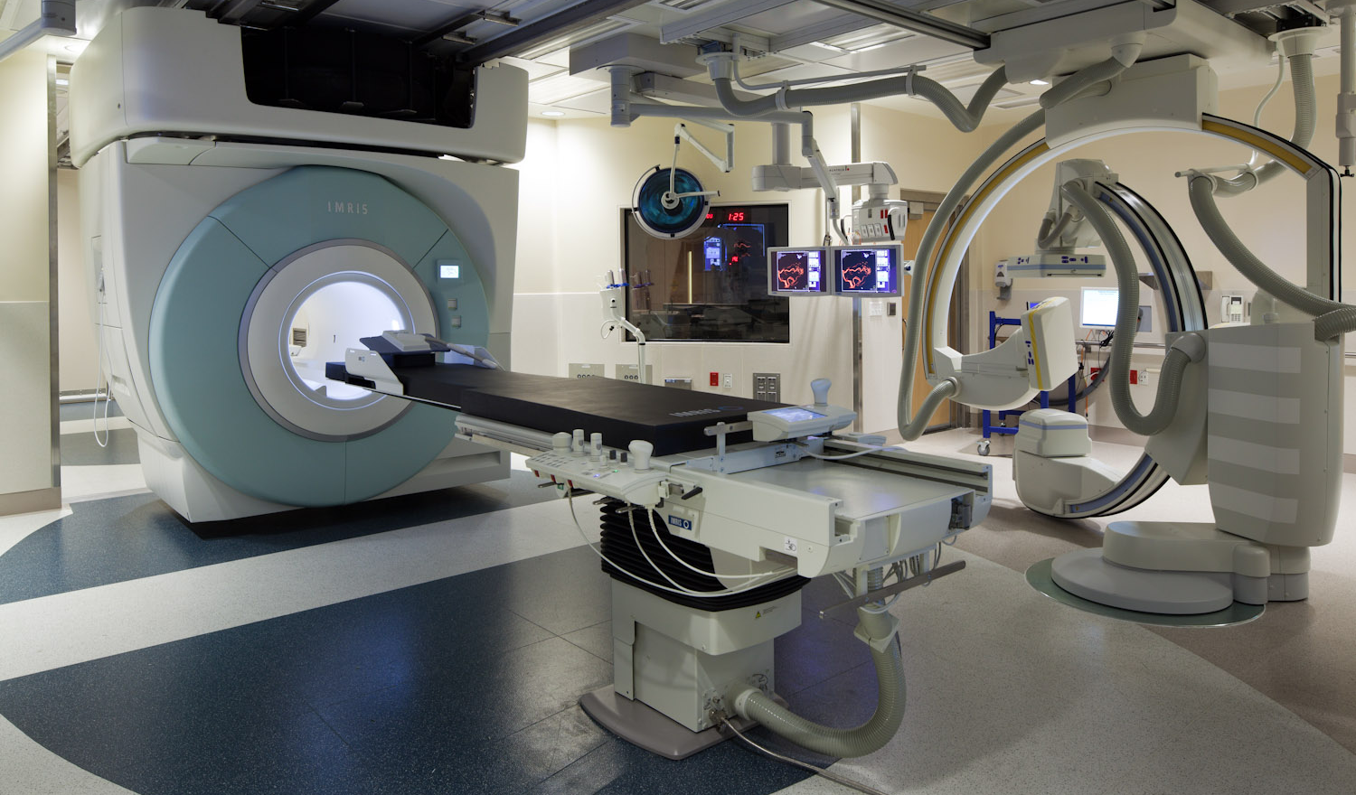
Notes:
IMRIS mounts an MR system on ceiling tracks for movement between two ORs or angio suites, as you see here with the magnet moving into the angio suite. The center room, also called a garage, can be used as a diagnostic scanning room. Having this space available, I immediately started thinking about all of the possibilities of combining MR with cath and even cathing with MR guidance, but I didn’t know anything about it. So in January of 2015, we had Dr. Robert Lederman come to the University of Michigan to educate us on iCMR and to evaluate our space. Robert and his team at the NIH have a mission to disseminate this iCMR technology to other centers and are more than willing to assist.

Slide 5
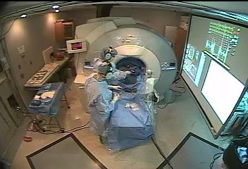
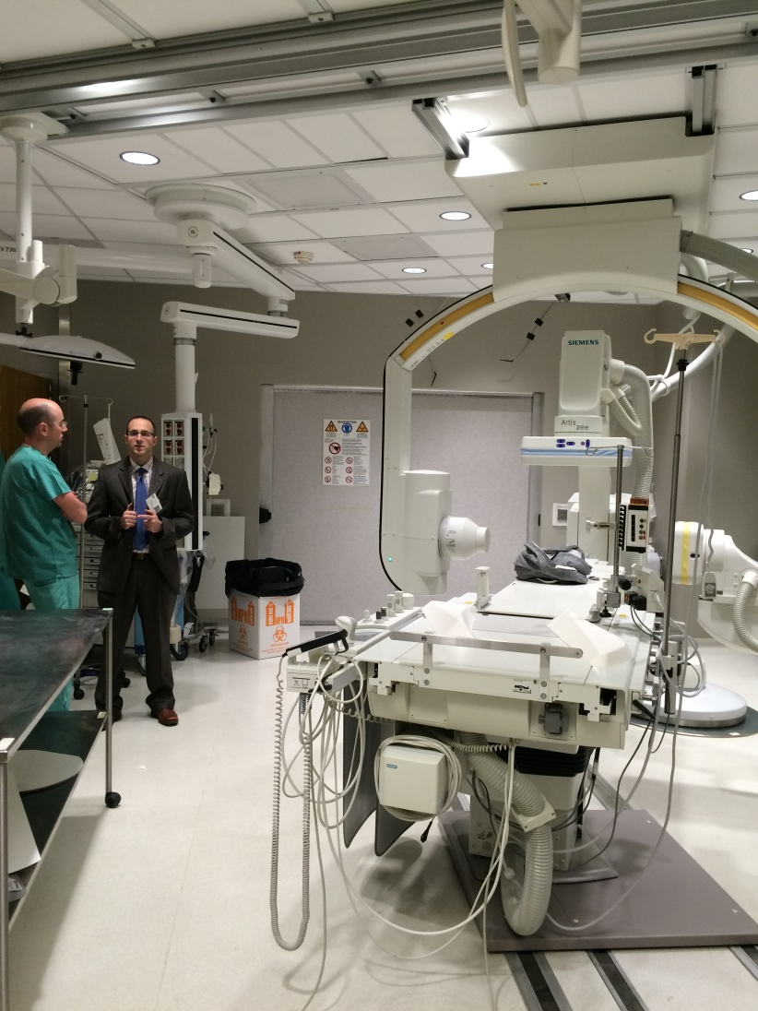
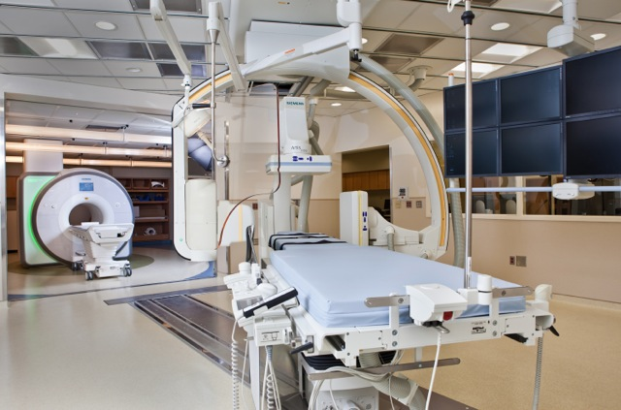
Notes:
In April of 2015, he invited our entire team to the NIH for a Hands-On session to learn about the construction of the lab, to actually perform MRI guided cath in an animal ourselves, and to visit the iCMR lab at Children’s National. This is truly in invaluable visit for anyone considering an iCMR program and I highly recommend it.

Slide 6
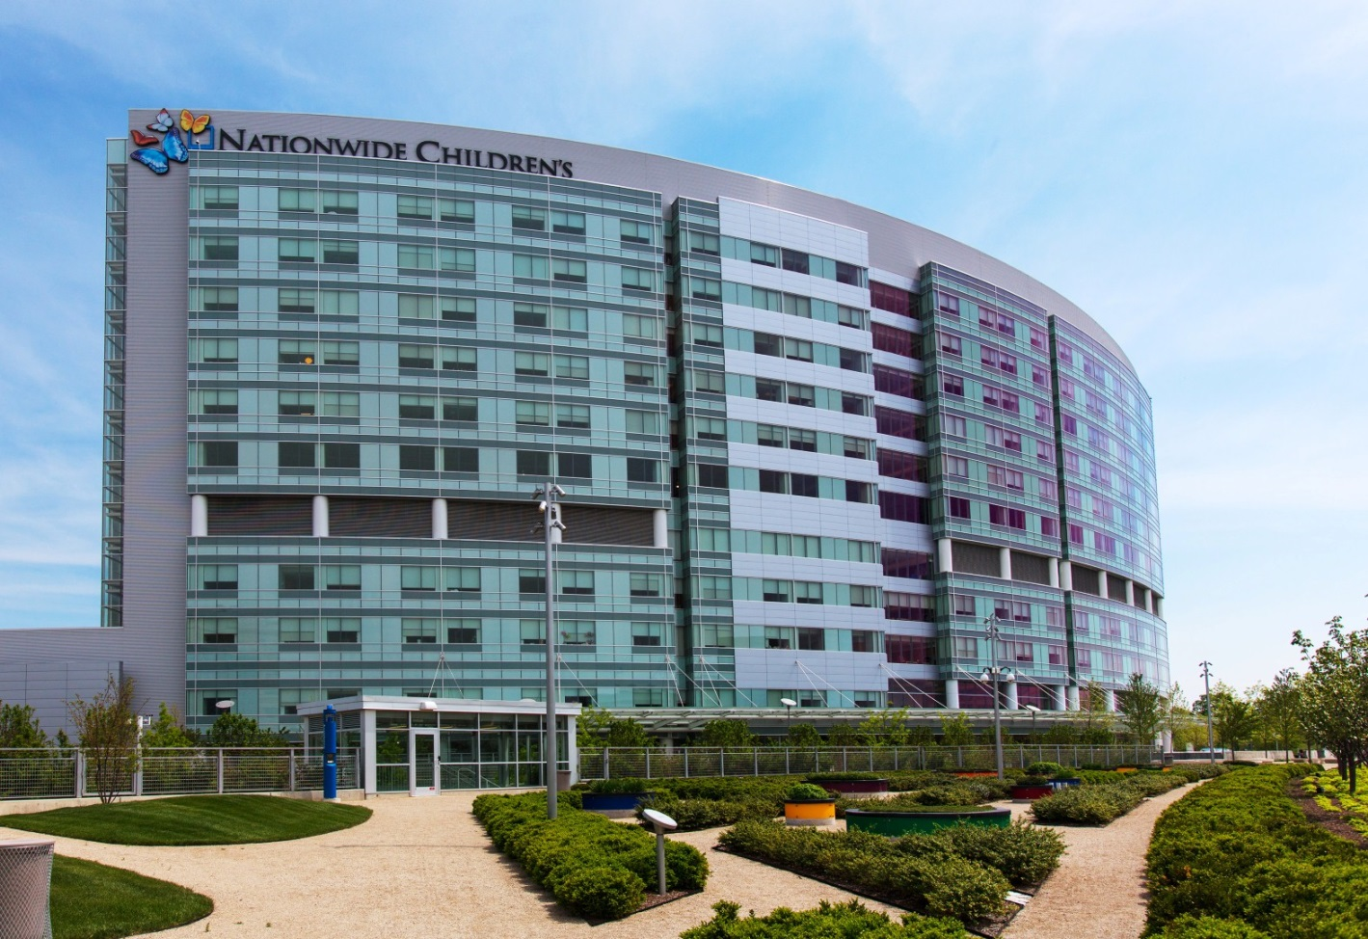
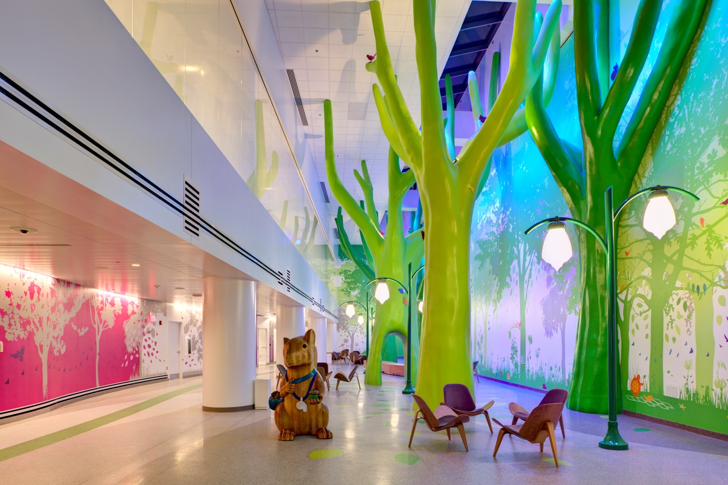
Notes:
In September of 2015, I moved to Nationwide Children’s Hospital, and the team there was also thinking about ICMR and possibilities of building an ICMR suite. So I was thankful that I’d be able to continue to pursue this interest. With the little bit of exposure I had gotten so far, I knew how important this technology could be to our field.

Slide 7
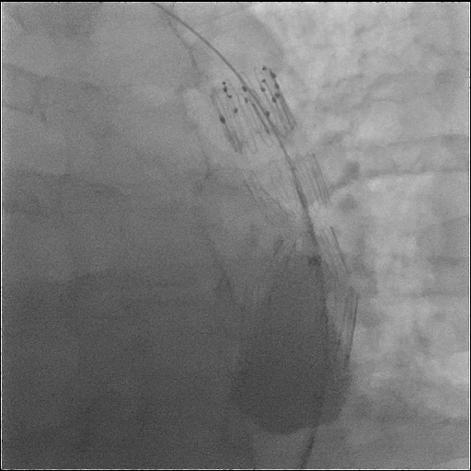
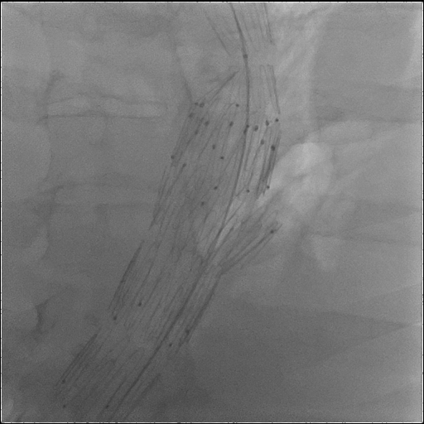
iCMR: Real-time Identification of Complications
Notes:
I know that MR will allow real-time identification of complications like this aortic rupture. When you see the balloon give like this, it’s most likely due to aortic rupture, but you have no imaging of it until you exchange this balloon for an angiographic catheter and hook up to a power injector, wasting valuable time that could be used to treat the problem.

Slide 8
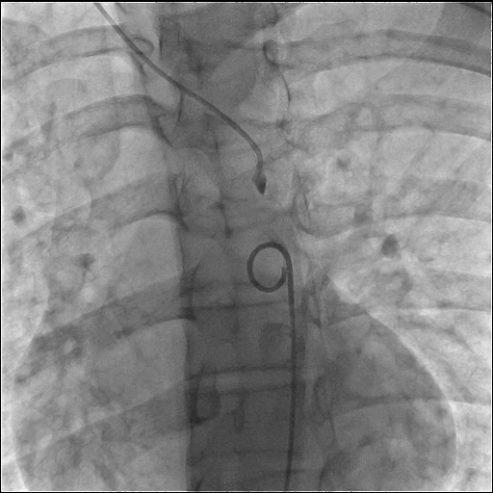
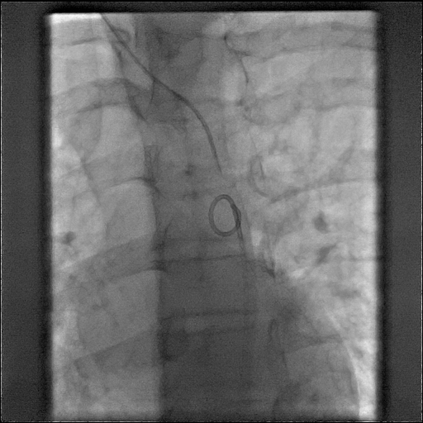
iCMR: Traversing Occluded Segments
Notes:
I know that MR will allow us to traverse chronic occlusions like this acquired interruption of the aortic arch with precision and not just blindly as you see us doing here.

Slide 9
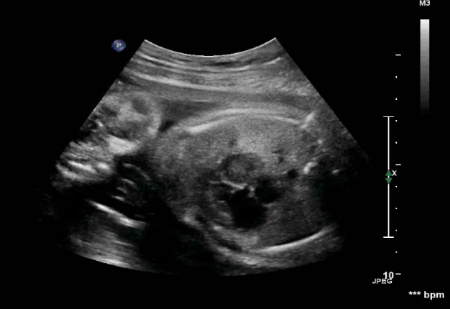
iCMR: Fetal Cardiac
Intervention
Notes:
And where I particularly want to use MR guidance is with fetal cardiac intervention. This is a fetus with HLHS and an intact atrial septum. You can see the needle enter the left atrium and then be placed up against the atrial septum.

Slide 10
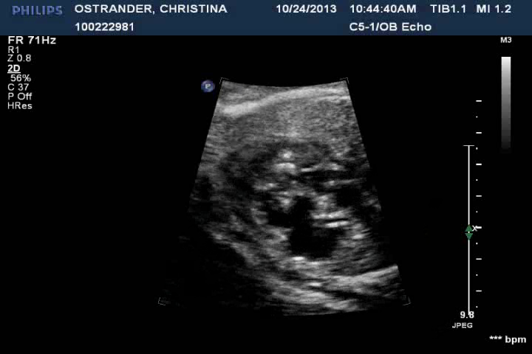
iCMR: Fetal Cardiac
Intervention
Notes:
Next we magnify the heart and start inflating the balloon with the stent on it. This is as good as the image quality gets in fetal intervention, and you can see how hard it is even with these great images to see the atrial septum during this stent implant.

Slide 11
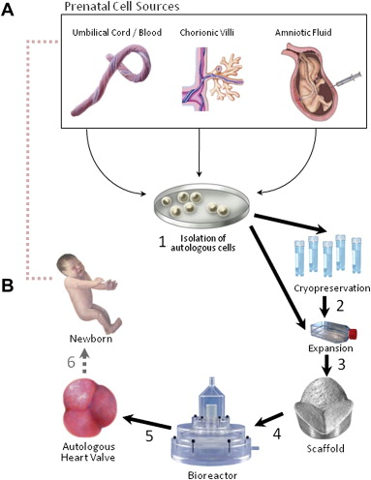
Tissue Engineered Valves For Fetuses
Weber et al. Placenta 32, 2011, S316-319
Courtesy of Christopher Breuer, MD and Simon Hoerstrup, MD
Notes:
Chris Breuer at NCH and Simon Hoerstrup in Zurich are working on tissue engineered valves for fetuses that will be deployed percutaneously on bioresorbable stents. The first valves to be implanted will be pulmonary valves.

Slide 12
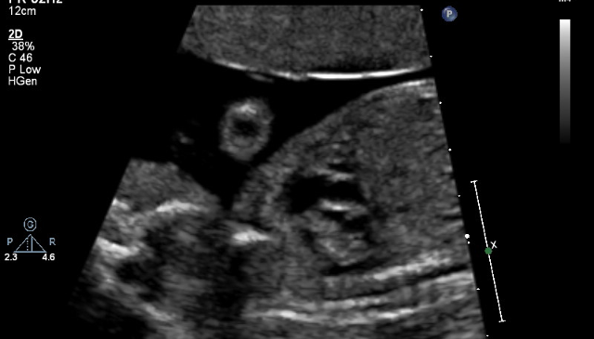
Tissue Engineered Valves For Fetuses
Notes:
Imaging the pulmonary valve in a fetus with pulmonary stenosis or atresia is even harder than imaging the atrial septum. So I think iCMR is going to be critical to many of the interventions that we do in fetuses in the future.

Slide 13
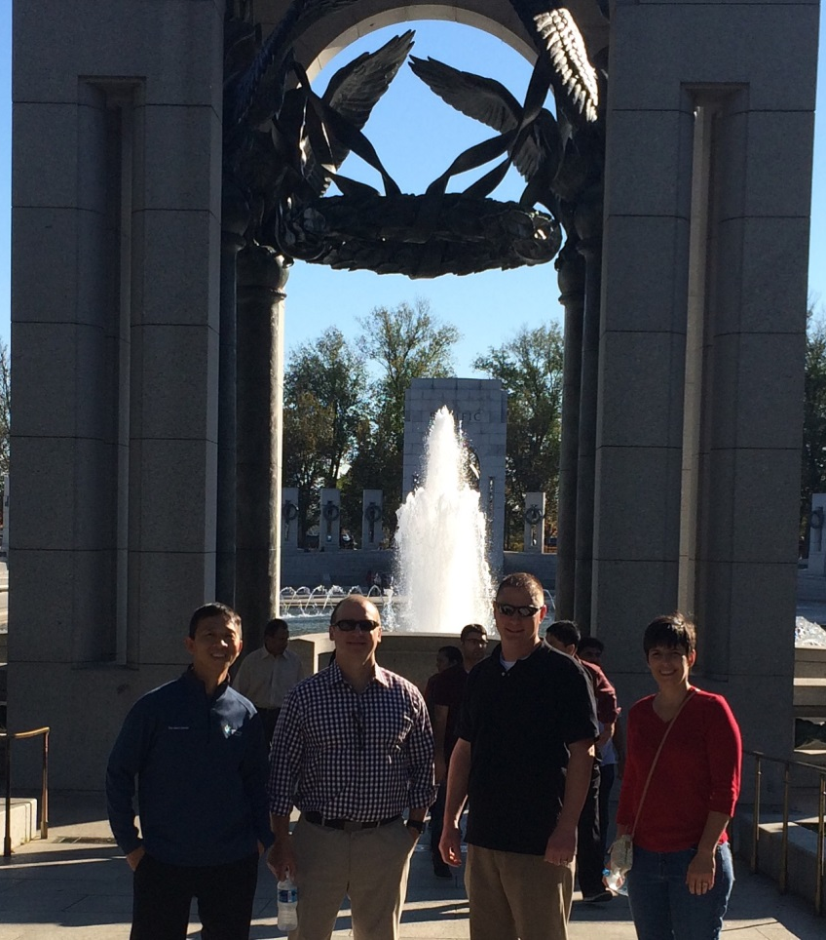
Notes:
Knowing how important this technology is and will be in the future, in November of 2015, I headed back to DC with the Nationwide team.

Slide 14
Notes:
Our team determined that we wanted to build an ICMR suite just like at Children’s National with a biplane angio system. This would allow this room to function as an independent diagnostic cardiac MR room and this room as an independent hybrid cath lab and OR. We needed to develop a business plan to present to the hospital, but from a volume standpoint we were not in need of another biplane cath lab at this time. We were, however, in need of a dedicated cardiac MR scanner.

Slide 15




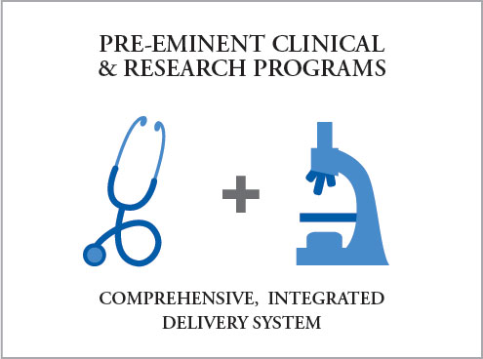
Notes:
So in May 2016 we presented the proposal and business plan to our hospital. We tied the ICMR program to the mission and vision of the hospital of developing pre-eminent clinical programs…

Slide 16
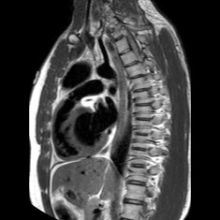
iCMR: World Class Program
Notes:
To achieve best outcomes for our patients.

Slide 17
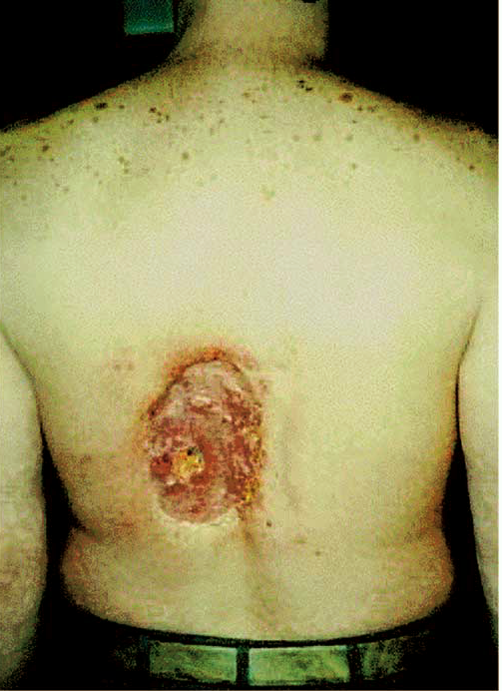
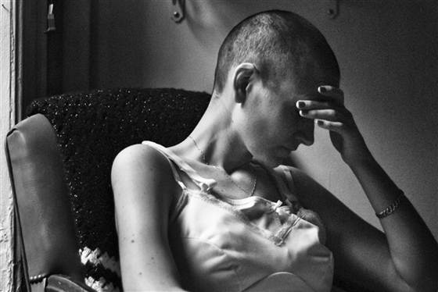
Radiation Exposure
Notes:
We discussed the negative effects of radiation exposure.

Slide 18
T.C. is a 13-year-old boy born extremely prematurely with a variant of HLHS who ultimately required a heart transplant at 3 years of age
Exams | Total Radiation Exposure (mSv)
194 x-rays | 19
7 CTs | 49
4 Lung Perfusion Scans | 9
19 Cardiac Catheterizations | 24,453
11 Misc IR and Fluoro Procedures | ?
TOTAL | >24,530
= >245,300 x-rays
Notes:
And to bring it close to home, we gave a real life example of one of our patients who is 13 years old and has had the radiation exposure equivalent to more then 234,000 x-rays.

Slide 19
Comparable Children’s Hospitals
27.2% CAGR
Dedicated Cardiac MR Scanners
Notes:
We showed how comparable Children’s Hospitals saw significant growth in cardiac MR volume when they got their own dedicated cardiac MR scanners.

Slide 20
ICMR Suite Functionality
MR immediately before or after interventional cath or surgery
MR overlay onto fluoroscopy
MRI-guided diagnostic catheterization (radiation-free)
MRI-guided interventional cath (radiation-free, still in animal studies)
Notes:
We described the myriad of ways you can use an ICMR suite with a biplane hybrid cath lab and OR. How each room can be used independently or in conjunction.

Slide 21
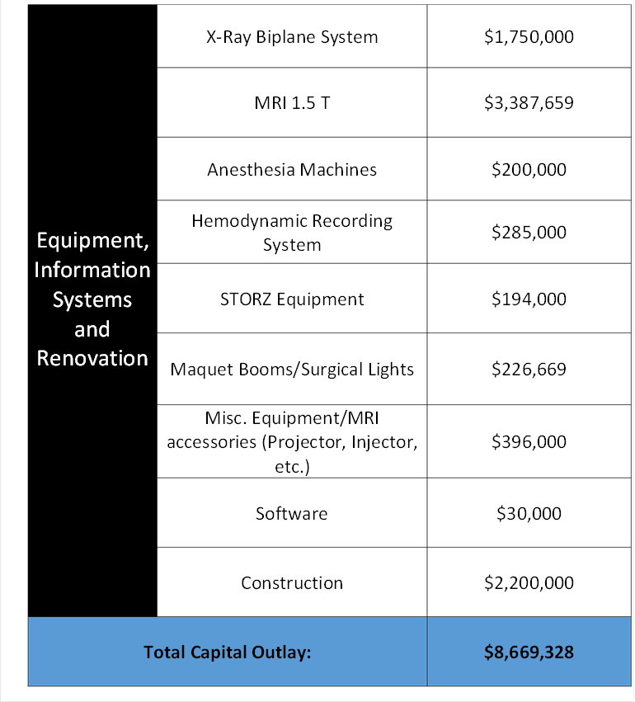
Capital Requirements
Notes:
The capital outlay for this suite came to just over $8.5 million, including 1.75 for a biplane angio system and 3.3 for a 1.5Tesla magnet.

Slide 22
Financial Scenario – Best Case
Financial Scenario – Conservative
Notes:
In the best case scenario, we assumed 65 incremental cath cases in the first year in addition to our usual cath volume…50 PAH cases transferred from our adult hospital and 15 cases recruited from other midwest centers because of the ability to perform radiation free catheterization. We also assumed 150 incremental cMRIs, looking at our current rate of growth and what was seen at Children’s National when the program was started. Despite this and assuming a $2 million philanthropic donation, we did not see a positive net margin until year 4.

Slide 23
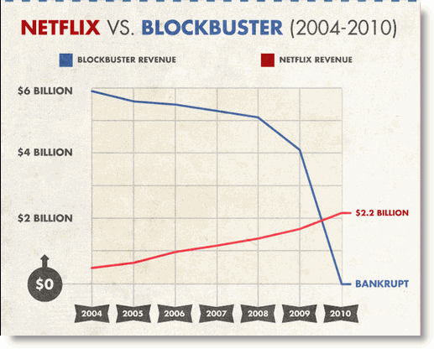
Notes:
But we focused on how we want to be the forward thinking, innovative Netflix and not the Blockbuster.

Slide 24
Hospital Leadership’s Response
Overall supportive of starting the program
Will not be funded in 2017
Want to see:
  Master Space Plan
  More progress on MR compatible guidewires and devices
Request presentation again for 2018 budget
Notes:
The hospital leadership’s response was that they were overall supportive of starting the program. But they did not fund it in 2017. Because our space request of ~2,000 square feet would take away 2 fully functioning operating rooms, they requested that we perform a master space plan to determine the best location of this suite, taking into account the plans of other services. They also expressed that they would like to see more progress on MR compatible guidewires and devices before approving the project. Nonetheless, they asked us to present the proposal again for the 2018 budget. Shortly after that response, we were very fortunate to have Dr. Raj Krishnamurthy join us as Chief of the Dept of Radiology at NCH. Raj also has a great interest in iCMR, and having a strong radiology partner and advocate for this program will only help to move it forward.

Slide 25
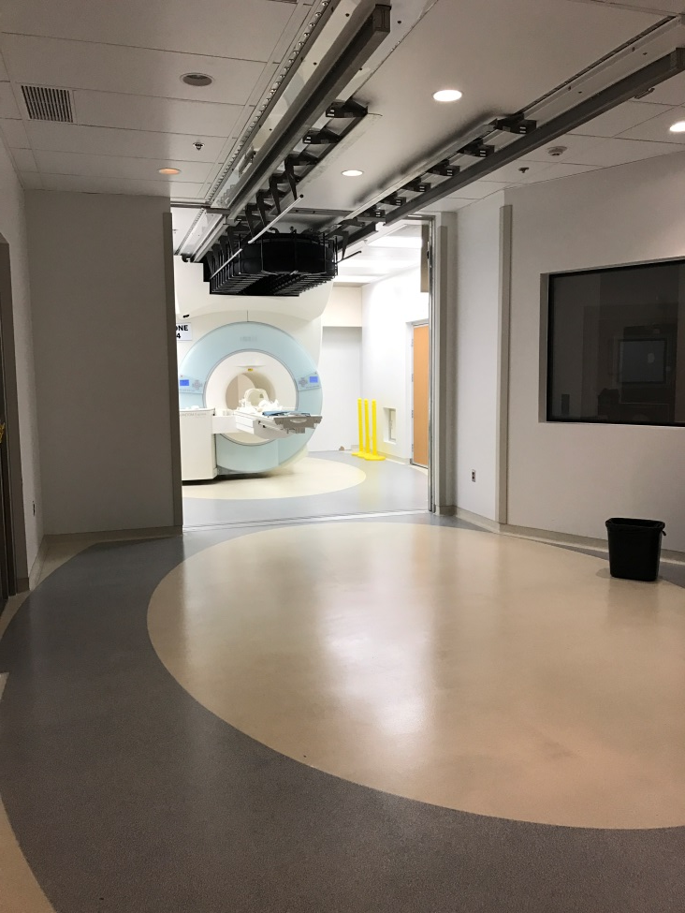
In The Meantime…
Notes:
In the meantime, while we’re doing the master space plan, Raj said, we do have a procedure room next to an IMRIS magnet…

Slide 26
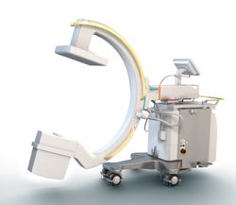

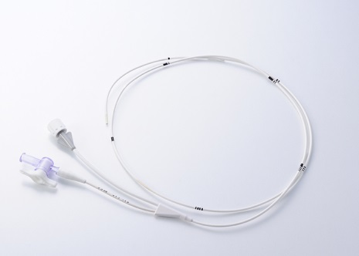
In The Meantime…
Notes:
What if we use a mobile C-arm to place a wedge catheter in the PA and move the patient into the scanner. Then we can use the pressure data and MR flows and functional data to replace the standard pulmonary hypertension cath. We could do that starting tomorrow.

Slide 27
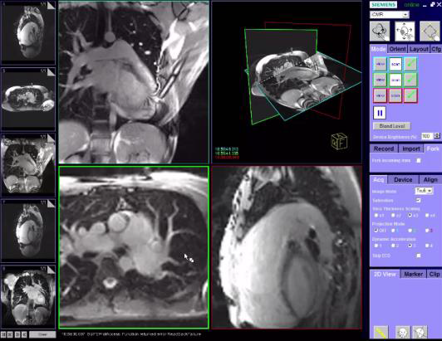
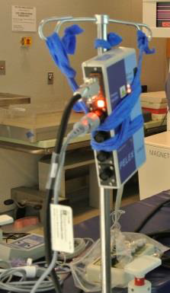
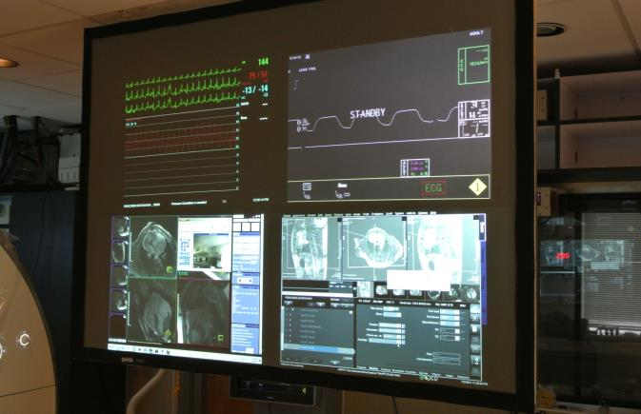
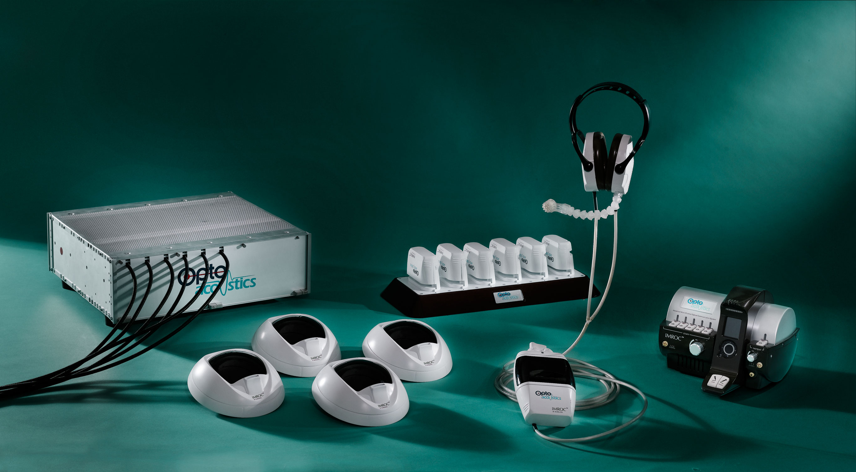
In The Meantime…
Notes:
What if we take it a step further and use the C-arm as bail-out and retrofit the IMRIS room with the Interactive Front End through a Siemens Master Research Agreement, a hemodynamic monitoring system, the MR compatible screens and projectors, and the headsets. All of which could be transferrable to a fully functional ICMR suite, when that’s approved.

Slide 28
What Gets Us To…?
Notes:
So at this point we are wondering if all these work arounds help us or prevent us from getting to where we ultimately want to be. And we are hoping that all of you can help us in answering these questions.

