Slide 1
Progress MRI Guided Adult Rt Heart Catheterization
Alexander (Sandy) Dick, MD
Rebecca Thornhill, PhD
Sophie Chenier, MRT(R,MR)

Slide 2
Summary
iCMR @ NHLBI
NHLBI Hands-On Workshop September 28, 2016
Ratnayaka et al, Eur Hrt J 2012; Rogers et al, CHEST, 2014
Progress to date OHI
IRB
Equipment
Safety

Slide 3
Challenges
Justification
Cost/Access
Limited vendors in small market
Stand alone busy clinical CMR
Safety

Slide 4
Justification MRI Guided Catheterization
Simultaneous structural, functional and hemodynamic assessment
RV afterload, contractility and right ventricle-pulmonary artery coupling
Diagnosis and prognosis
Future MRI guided procedures

Slide 5
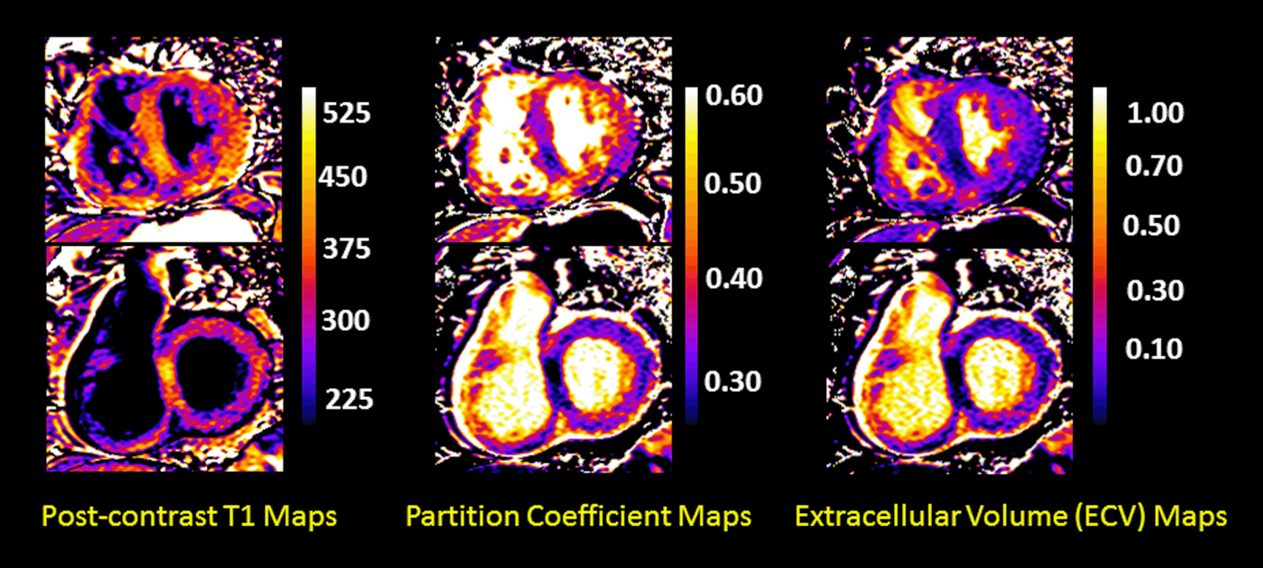
Example of Post contrast T1, partition coefficient and ECV maps of a 68 year-old female with severe chronic thromboembolic pulmonary hypertension, with an mPAP=72 mmHg on right heart catheterization.
Peña E... Mielniczuk L. SCMR 2016.
Example of Post contrast T1, partition coefficient and ECV maps of a 68 year-old female with severe chronic thromboembolic pulmonary hypertension, with an mPAP=72 mmHg on right heart catheterization.

Slide 6
Interventional MRI Suite Equipment List
Item | Mfr | Model | Qty | Cost | Total
Projection System
Projector | InFocus | IN3120HD | 2 | $1500 | $3000
Screen | Da-Lite |  | 1 | $700 | $700
Video Matrix Switch | NTI | SM-16X16-DVI | 1 | $3800 | $3800
Fiber optic extender | NTI | ST-2FODVI-LC | 4 | $600 | $2400
Fiber Cable | NTI | FIBER-2D-LCLC | 4 | $170 | $680
XFM
PC | Dell |  | 1 | $4000 | $4000
Graphics card | Nvidia | GTX970 | 1 | $600 | $600
A/D card | National Instruments | NIUSB-6009 | 1 | $600 | $600
PHYSIO-recording
Invivo and MACLAB |  |  |  | $0 | $0
Electronic Filters | In House |  | 1 | $3000 | $3000
Communication
Wireless headsets (4) | Innovere |  | 1 | $35000 | $35000
TOTAL |  |  |  |  | $53780

Slide 7
Wireless Communication

Slide 8
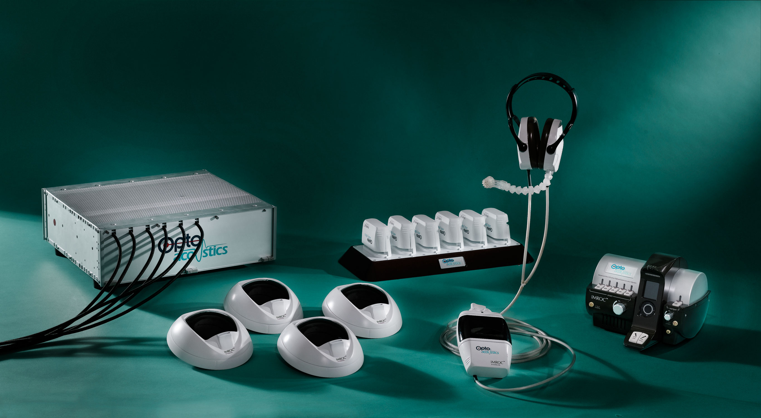
Optoacoustics
IMROC™ Wireless: Complete Freedom and Flexibility
x 6
Hands free MRI noise cancelation communications system

Slide 9
R.F. Shielded Projector

Slide 10
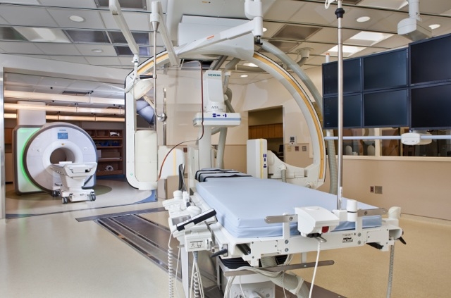
The NIH Lab at Children’s National Medical Center Washington, DC
Notes:
Standard 1.5T magnet….
- Avoid 3T d/t SAR issues which are problematic when using intravascular devices.
- Avoid banding artifacts common with SSFP imaging techniques.
Intermodality transfer table…
- For procedures requiring hybrid imaging
- For bailout from MR to X-ray in emergent situations

Slide 11
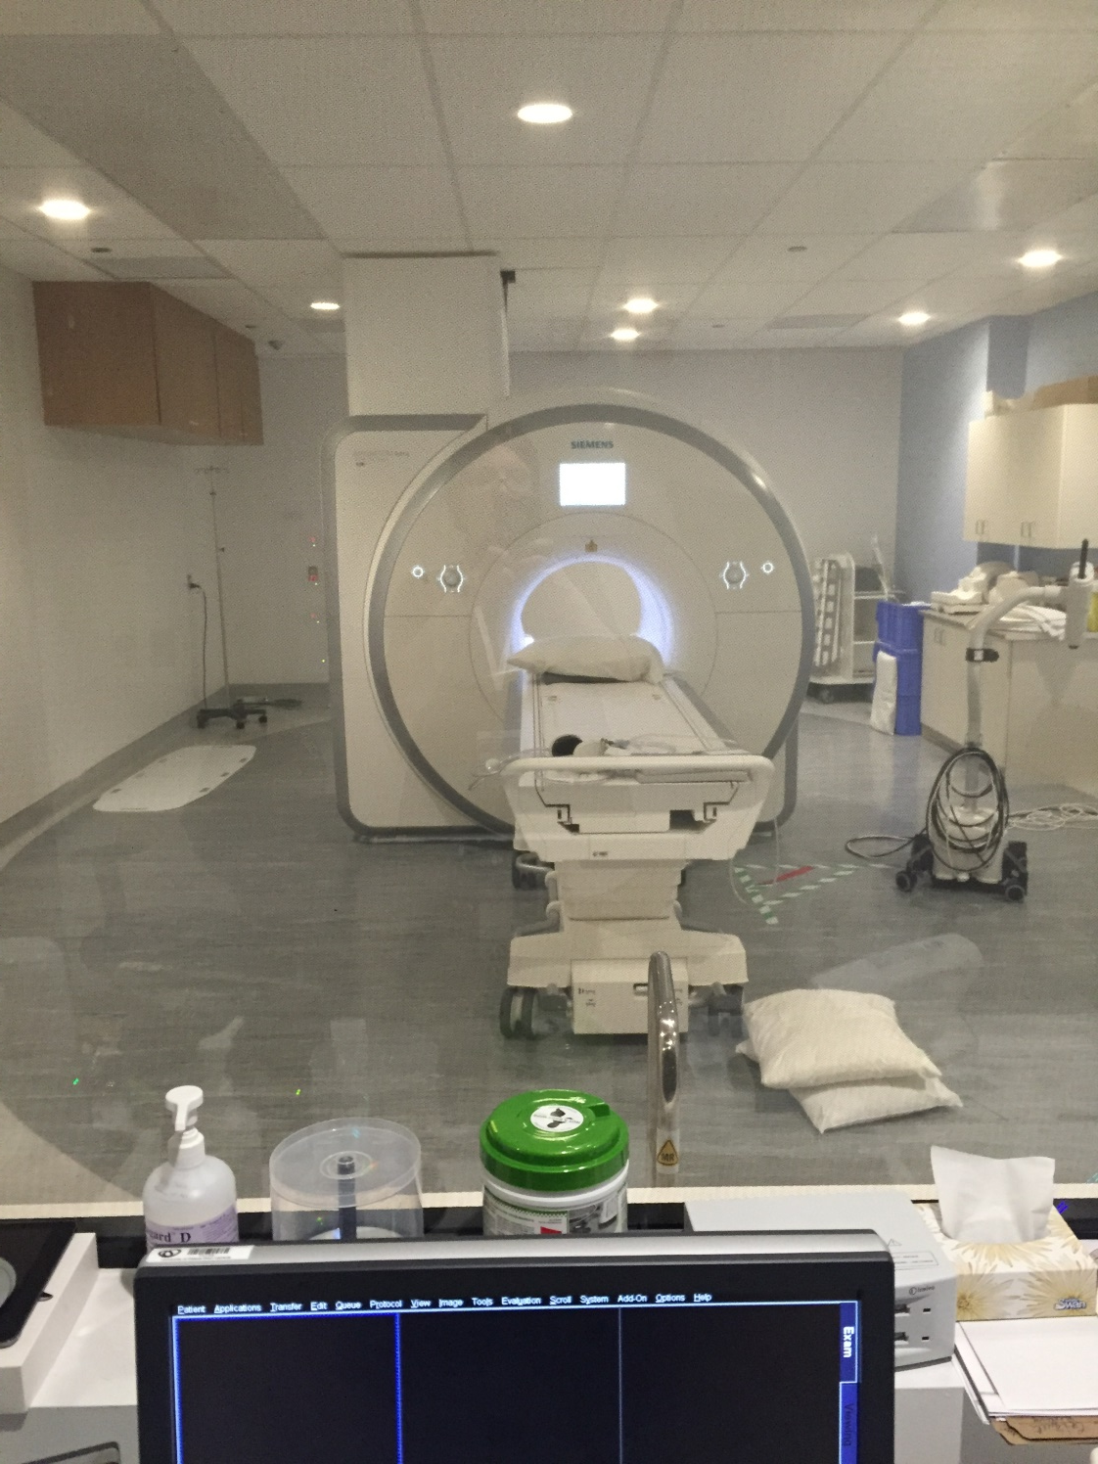

Slide 12
Control Room

Slide 13
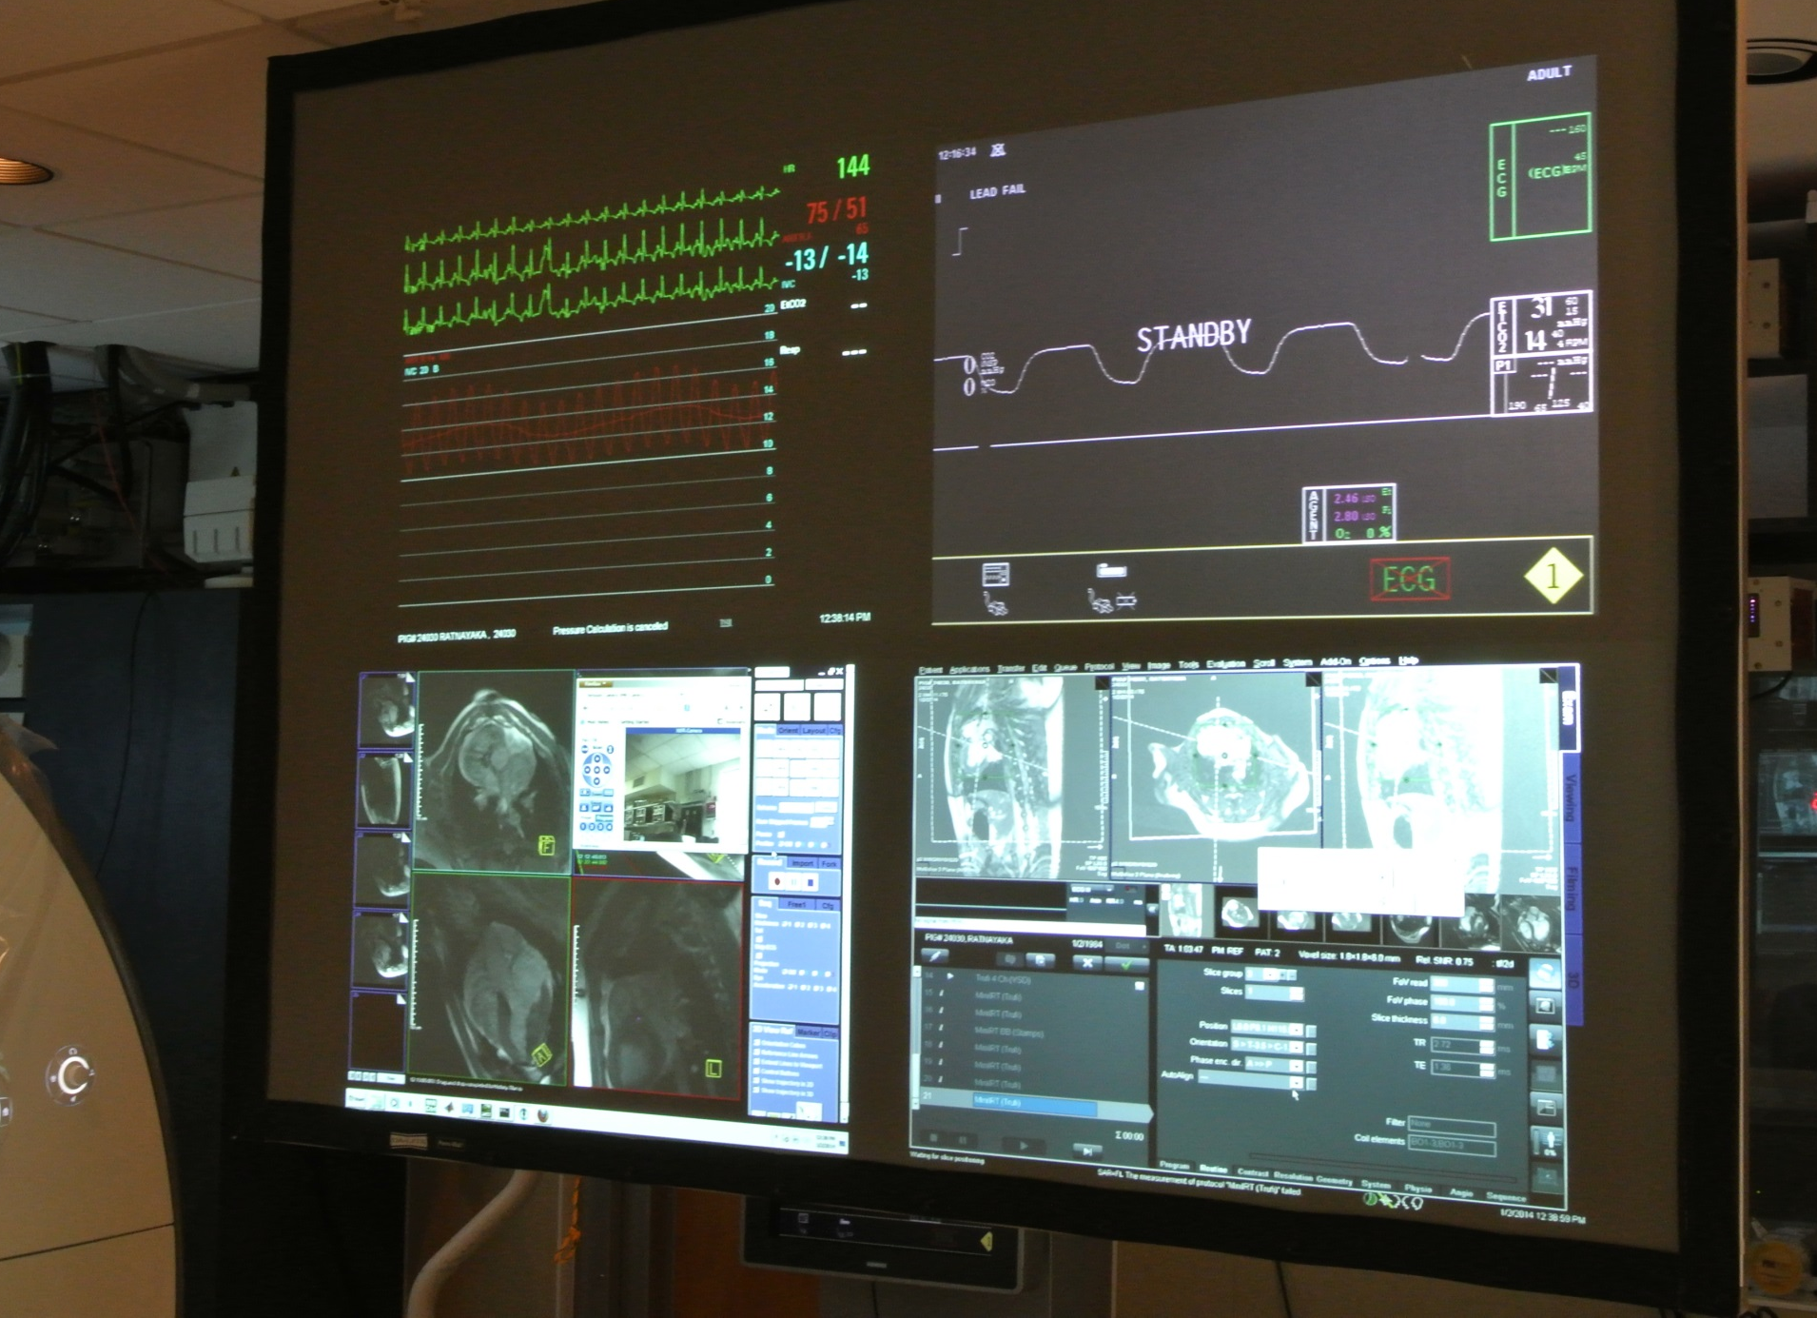
Data Display NHLBI

Slide 15
Safety (What keeps me up at night)
Access in the room
Dedicated removal of needle and wire
MRI safe devices
Arrhythmias
Complete Heart Block, Ventricular Tachycardia,Ventricular Fibrillation
Dedicated observation monitor; arterial access

Slide 16
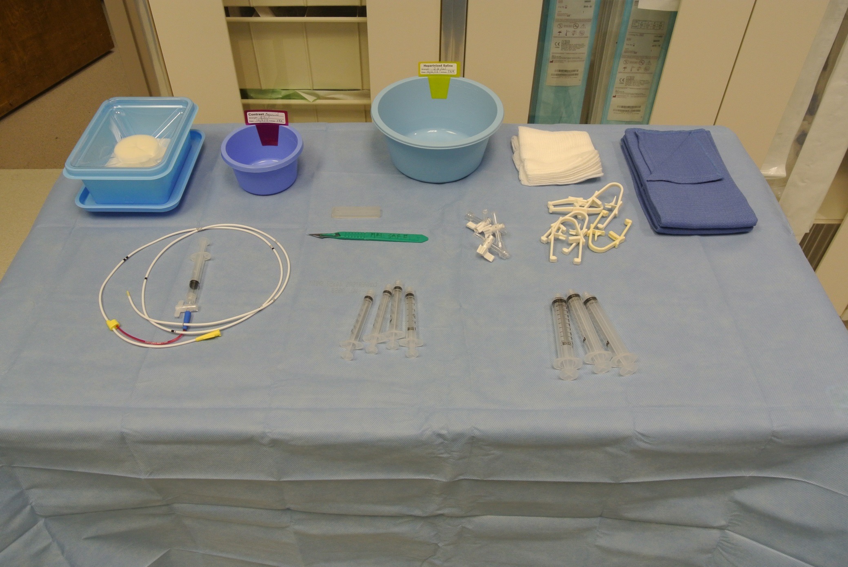
MR Safe Procedure Table

Slide 17
Patient Evacuation
 | 1st Operator | 2nd Operator | Cath/MR Tech | Cath RN | Sedation RN
1 |  | Provide Instructions
2 | Advance patient to scanner home position |  | Open MR bay doors |  | Secure IV line
3 | Remove Surface Coil |  | Remove pt headset |  | Secure airway
4 | Start chest compressions |  | Transfer patient from MR suite |  | Assist Cath RN
5 |  |  | Restricts access to MR suite | Defibrillate/ Administer medications

Slide 18
Summary
iCMR @ NHLBI
Progress to date OHI
IRB
Equipment
Safety

