Slide 1
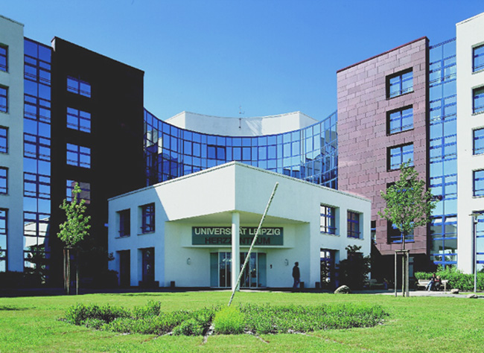
SCMR pre-conference workshop 2.2.2017 Washington D.C.
Update on progress: old EP site
Philipp Sommer, M.D., FHRS, FESC
Heart Center University Leipzig
Dept. of electrophysiology
Notes:
1

Slide 2
Update on progress: old EP site
Disclosures:
Lecture fees and/or travel grants within the last 12 months by
St. Jude Medical, Biosense Webster
Siemens Healthcare, Abbott Medical
Biotronik, Imricor
Boehringer Ingelheim/Bayer/Pfizer/BMS/Daiichi Sankyo.
Member of advisory board or consultant for
St. Jude Medical
Boehringer Ingelheim
Daiichi Sankyo
Research grants from
St. Jude Medical
Imricor
Notes:
2

Slide 3
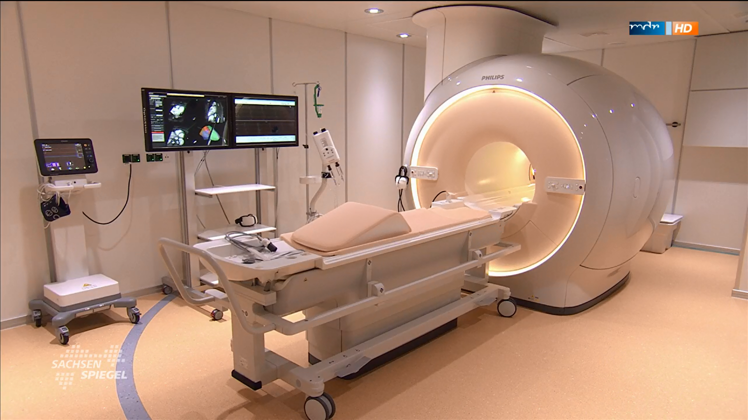
Update on progress: old EP site
iCMR in Leipzig since 6/2015

Slide 4
Update on progress: old EP site
iCMR in Leipzig since 6/2015

Slide 5
Update on progress: old EP site
95% of daily routine: Planning of EP procedures- VT ablation
NICM ICM
© by A. Berruezo & Lluis Serra, Galgo Medical
Notes:
First of all we´re facing a complete different setup. Communication between the operator, the radiologist, and the nurse has to be established using a wireless headset in order to overcome the relevant noise being made by the MR scanner. Electrocardiogram and oxygen saturation monitoring requires MRI compatible equipment, and perfusion lines have to be introduced from outside the MR laboratory. Furthermore no acute defibrillation or cardioversion can be performed in the MR scanner.
Picture “A” displays the magnet room. The patient is sterile and connected to the monitoring units (far left). Catheters are introduced and connected to the patient interface module (far right). The operator (in green) is at the table, the EP nurse (in blue) controls patient’s vital signs. The radiology nurse (in white) advances the MR table into the scanner. Two additional flat screen monitors (right sided to the table) provide data from the Bridge MR EP system and from the real-time MR scans. Picture “B” displays the control room. The host computer of the Bridge MR EP system (left), patient monitor (middle), and MRI user interface (right) are shown.
All studies were performed with a whole-body 1.5T MRI scanner (Gyroscan Intera CV; Philips Medical Systems, Best, The Netherlands) in supine position using a dedicated five-channel-phased-array surface cardiac coil.

Slide 6
Update on progress: old EP site
Practical Aspects
Ablation of typical atrial flutter
MR scanner: Philips Ingenia 1.5T with Philips iSuite®
Catheters: Imricor 4mm irrigated tip catheter (diagnostic + ablation)
irrigation rate 17ml/min; power settings: 40W-60W
IBI generator
Procedure: Patient in deep analgo-sedation (propofol)
Placements of sheats (12F) in control room, eCV to SR
Transfer to scanner room
whole-heart sequence with 4-ch-reconstruction
placement of CS catheter
ablation of cavo-tricuspidal isthmus
LAT mapping with CS stimulation
Notes:
6

Slide 7
Passive Tracking in RA
Update on progress: old EP site
Images:
iCMR Heart Center Leipzig

Slide 8
Auto-registered 3D shells
Update on progress: old EP site
Images: iCMR Heart Center Leipzig

Slide 9
Ablation of cavo-tricuspidal Isthmus in CMR
Update on progress: old EP site
Images: iCMR Heart Center Leipzig
Notes:
Keine Registrierungsschritte, kein Mismatch!!

Slide 10
Ablation of cavo-tricuspidal Isthmus in CMR
Update on progress: old EP site
Images: iCMR Heart Center Leipzig
Notes:
Keine Registrierungsschritte, kein Mismatch!!

Slide 11
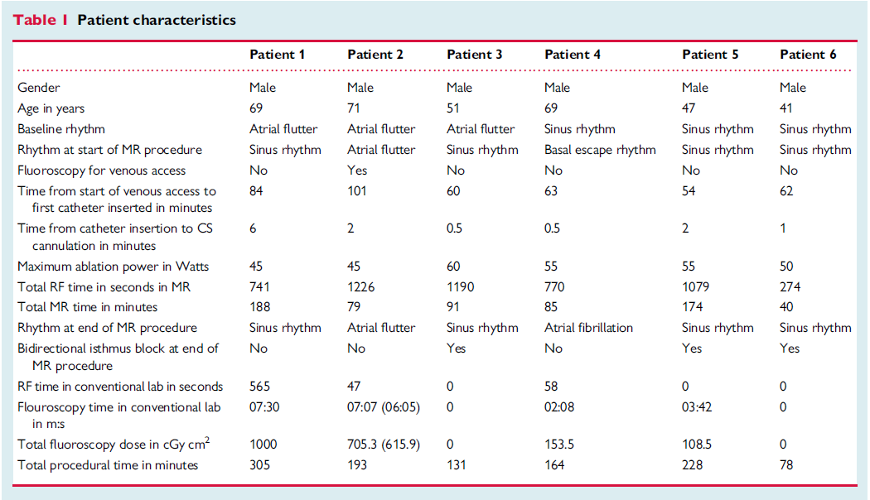
Update on progress: old EP site
Early experience in iCMR @ Leipzig 2015
Hilbert, Sommer. Europace Aug. 2015

Slide 12
Update on progress: old EP site
2016: 5 more flutter patients
 | P #1 | P #2 | P #3 | P #4 | P #5
Gender | m | f | m | m | m
Age | 35y | 56y | 56y | 71y | 73y
Max. Power | 65W | 50W | 50W | 60W | 60W
CS intubation | 50s | 55s | 60s | 50s | 65s
Total MR time | 180min | 120min | 105min | 56min | 48min
Block at end MRI | no | yes | yes | yes | yes
Fluo time | 60s | 0s | 0s | 0s | 0s
Procedure time | 250min | 170min | 110min | 120min | 120min
Unpublished data

Slide 13
Update on progress: old EP site
Lesion visualization after isthmus ablation
Paetsch, Sommer. Circ Cardiovasc Imaging. 2017 Jan;10(1)

Slide 14
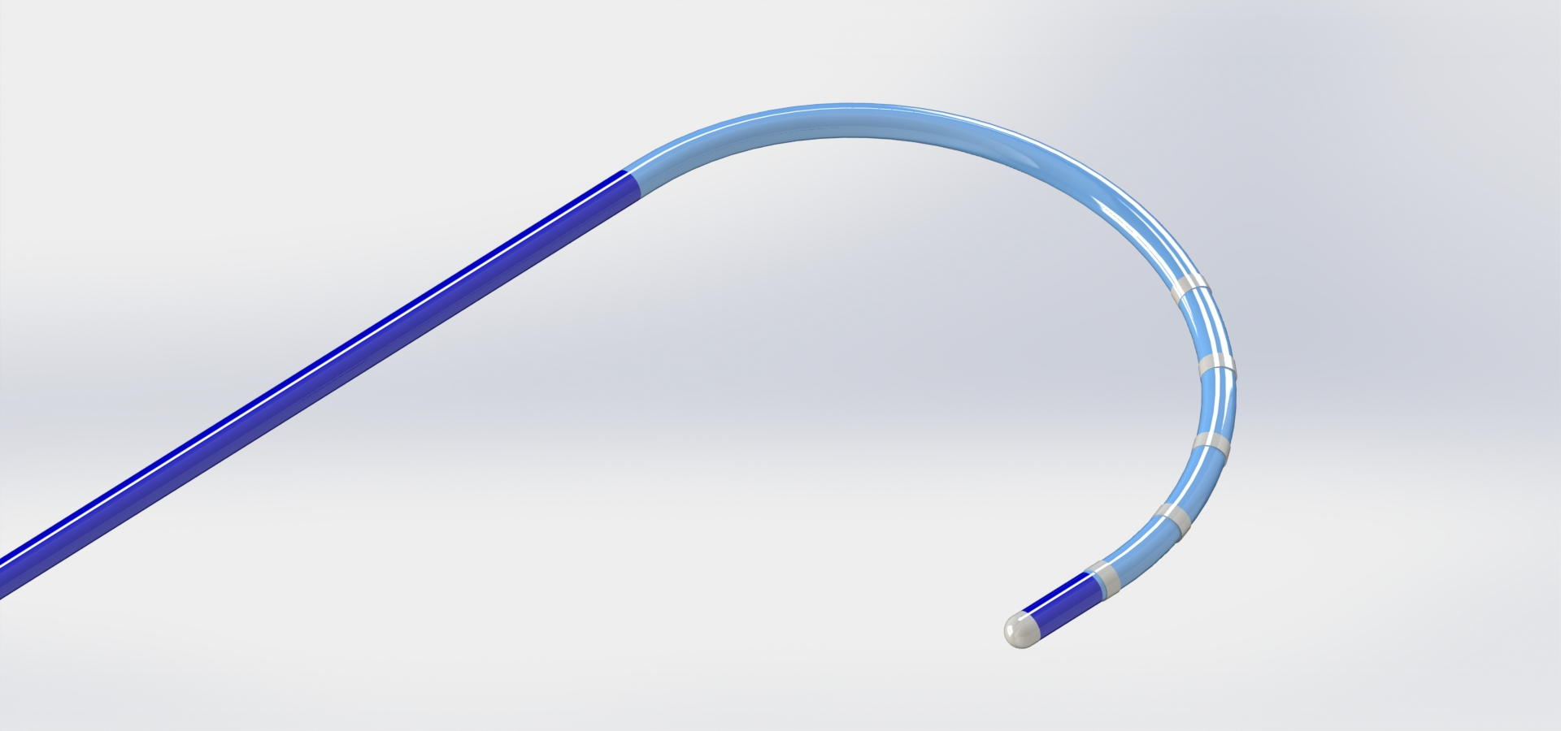
Outlook: new products under developement
Update on progress: old EP site
© Imricor
Notes:
Keine Registrierungsschritte, kein Mismatch!!

Slide 15
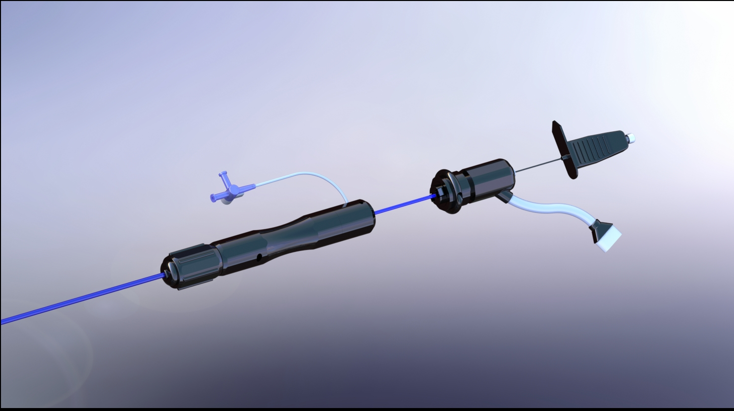
Outlook: new products under developement
Update on progress: old EP site
© Imricor
Notes:
Keine Registrierungsschritte, kein Mismatch!!

Slide 16
Update on progress: old EP site
Conclusion:
Significant progress has been made in terms of catheter maneuverability.
Soon, additional tools like diagnostic multipolar catheters and transseptal sheaths will become available.
Many challenges remain: defibrillators, 3D mapping systems, more catheter diversification.
Steps are small, but still in the right direction!
Notes:
In conclusion Pre- an postinterventional MRI is routinely performed in clinical practice as it provides significant additional informations especially with respect to substrate analysis.
For better passive tracking of the Vision catheter the ferrous marker will replace the inductive coil as tip marker in the future. In addition it is interesting to experiment with much thicker imaging planes or even real-time MIP in order to produce summation images (like fluoroscopy). However, ultimately active tracking is likely to be needed and can be achieved two ways: (i) using scanner algorithms together with MR tracking coils on the Vision catheter, or (ii) bringing MR compatible versions of existing EP tracking technologies (Carto, NavX) into the magnet room.

Slide 17
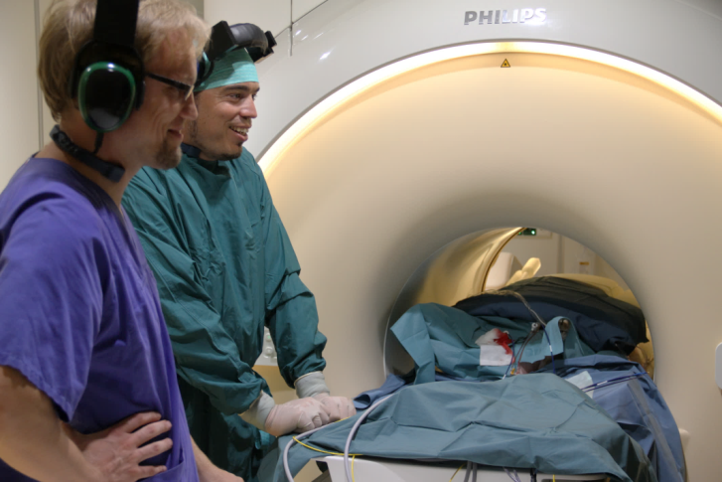
MRI interventional suites: far away?
Thank you!
philipp.sommer@helios-kliniken.de
Notes:
In conclusion Pre- an postinterventional MRI is routinely performed in clinical practice as it provides significant additional informations especially with respect to substrate analysis.
For better passive tracking of the Vision catheter the ferrous marker will replace the inductive coil as tip marker in the future. In addition it is interesting to experiment with much thicker imaging planes or even real-time MIP in order to produce summation images (like fluoroscopy). However, ultimately active tracking is likely to be needed and can be achieved two ways: (i) using scanner algorithms together with MR tracking coils on the Vision catheter, or (ii) bringing MR compatible versions of existing EP tracking technologies (Carto, NavX) into the magnet room.

