Slide 1
EP instrumentation/devices
Bruno Quesson
IHU LIRYC & Inserm U1045
University of Bordeaux - France

Slide 2
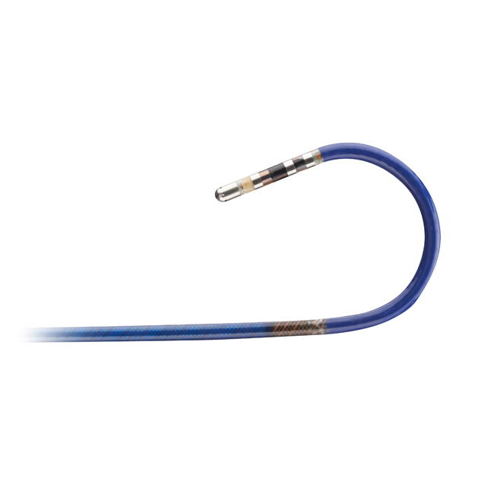
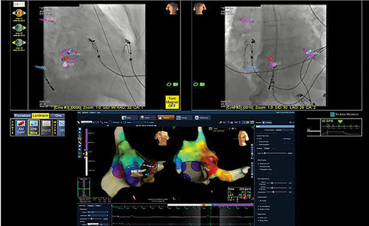
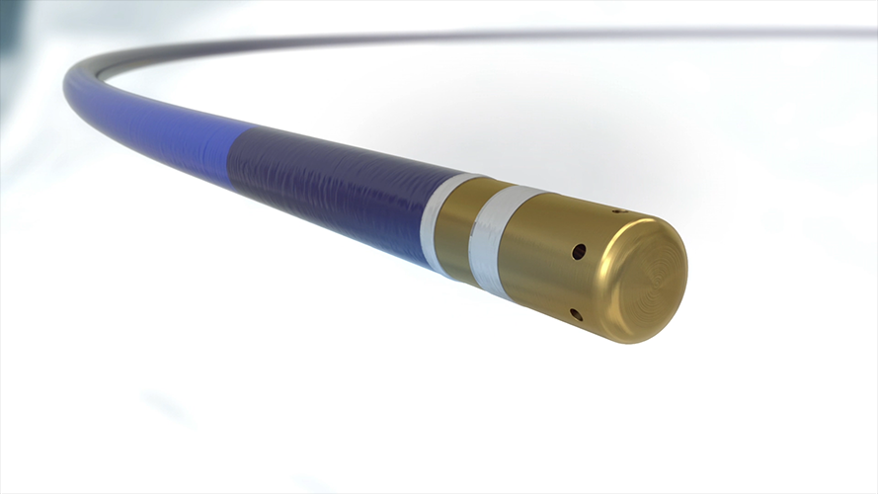
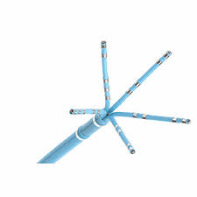
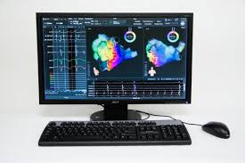
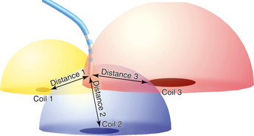
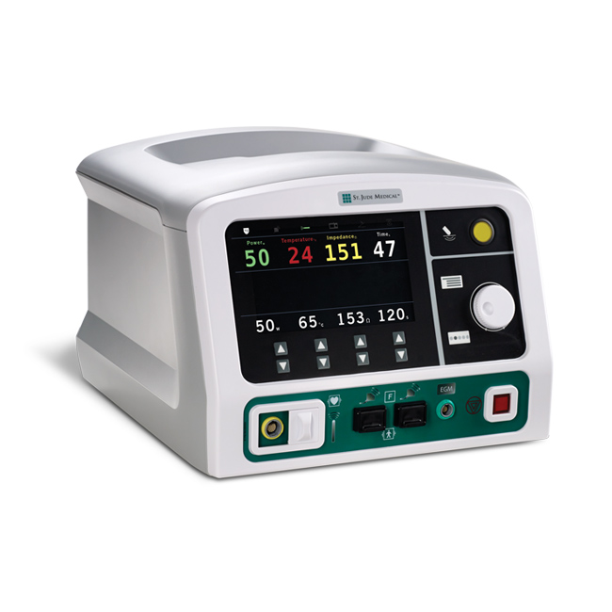
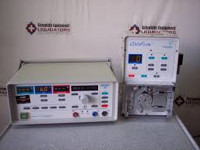
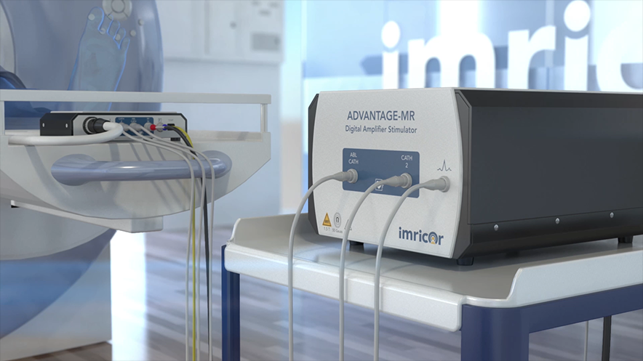
Contact electrophysiology
Catheters
3D Navigation system
Electromagnetic 3D positioning
EP console
+
=
RF ablation device
3D electroanatomical mapping

Slide 3
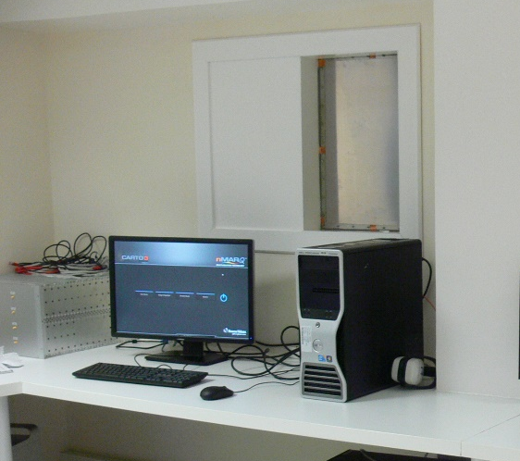
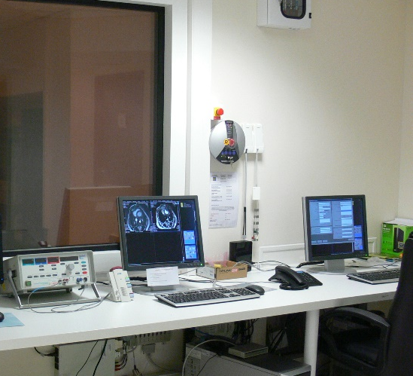
Setup for MR-EP
Acquisition/Reco
MRI
Electrophysiology
EP console
RFA
generator
MR Console
(SIEMENS)
Milli V
~1 Hz
80 V
0.5 MHz
> 100 V
64 MHz

Slide 4
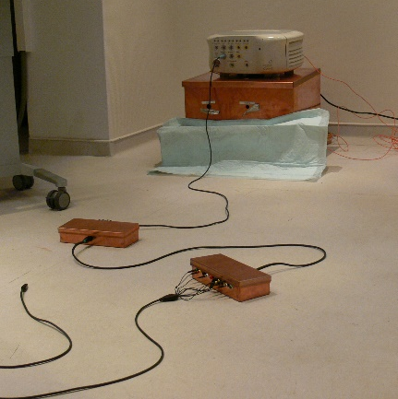
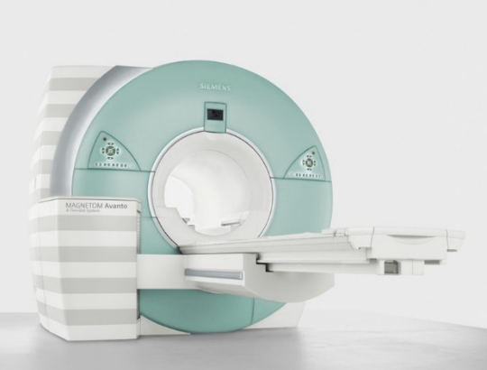
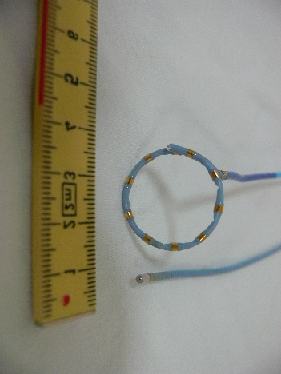
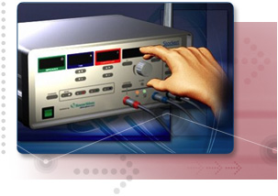
Inside the MR room
1.5T MR scanner
(SIEMENS)
Catheter
EP
Source: usa.healthcare.siemens.com
F
RFA
(Stockert)
F

Slide 5
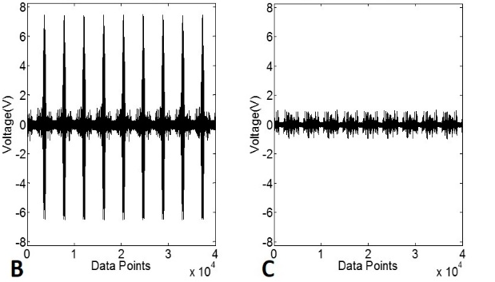
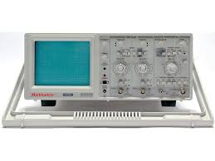
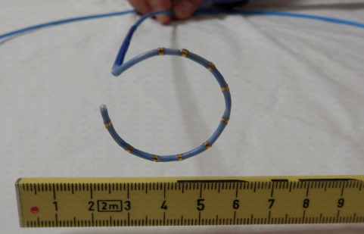
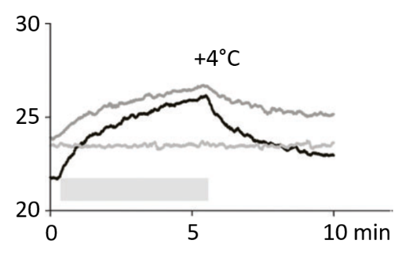
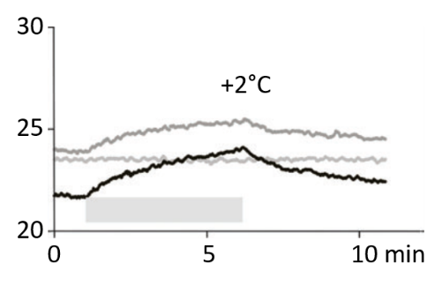
Safety and artifacts
Catheter A
Catheter B
Catheter design
(Material of the electrode)
Heating test
in Agar gel
(0.9% saline)
Catheter perpendicular to B₀
Catheter parallel to B₀
In vivo EP in sheep
Elbes et al, Europace. 2016

Slide 6
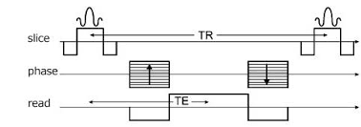
Improving EP during MRI scanning
12 leads ECG
Pertubation = F(Gx, Gy, Gz, δGx/δt, δGy/δt, δGz/δt )
19 coefficients to determine
Learning step
1 - acquire EP signals before MR scanning
2- acquire EP signals during scanning
3- subtract => gradient induced voltages
4- retrieve gradient amplitudes and time derivatives
5- fit data to F to derive the 19 coefficients
During scanning
collect gradient waveforms and use the coefficients to correct ECG
traces during any MRI scanning sequence
Zhang SH et al, Magnetic Resonance in Medicine 75:2204–2216 (2016)

Slide 7
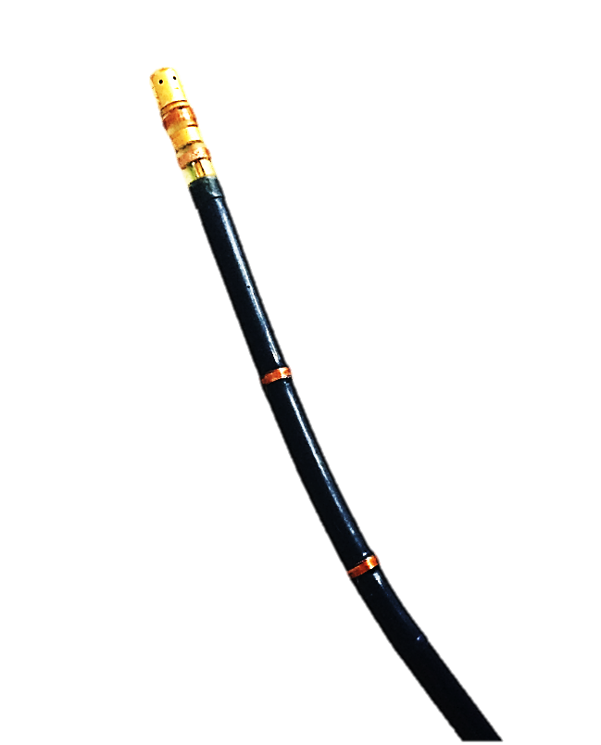
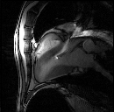
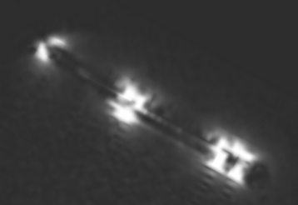
MRI : 3D catheter navigation
In vivo in sheep
3 mm
Micro-coil position detection
Slice position update
Electrodes
X
Y
Z
Micro-coils
RF
X
Imaging sequence
MR compatible catheter
Y
Z
ADC
SAG
Tip tracking slice following sequence
BEAT-IRTTT (Interactive Real-Time Tip Tracking) pulse sequence
Bssfp interleaved with active tracking module
1.8 x 1.8 x 4 mm – FOV: 225 x 225 mm
Frame rate: 3fps
Dumoulin CL, et al. Real-time position monitoring of invasive devices using magnetic resonance, MRM, 1993
Vergara GR, et al. Real-time magnetic resonance imaging-guided radiofrequency atrial ablation and visualization of lesion formation at 3 Tesla, Heart Rythm, 2011
Wech T. et al. Measurement accuracy of different active tracking sequences for interventional MRI, Journal of Magn. Res. Imag., 2013

Slide 8
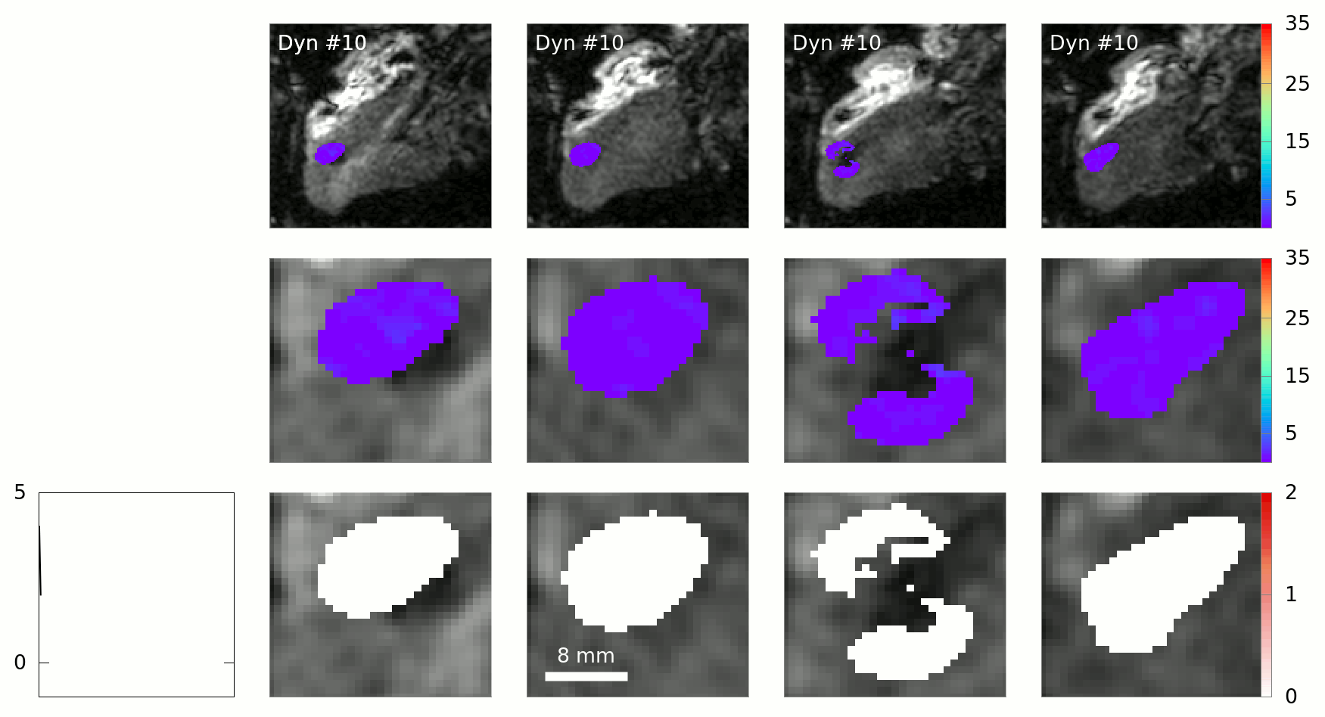
MR-Thermometry
Slice #1
Slice #2
Slice #3
Slice #4
Temperature elevation (°C)
Temperature elevation (°C)
Cumulative thermal dose (°C)
Lethal threshold
Hand-drawn ROI in post-processing
Toupin el al, JCMR 2017

Slide 9
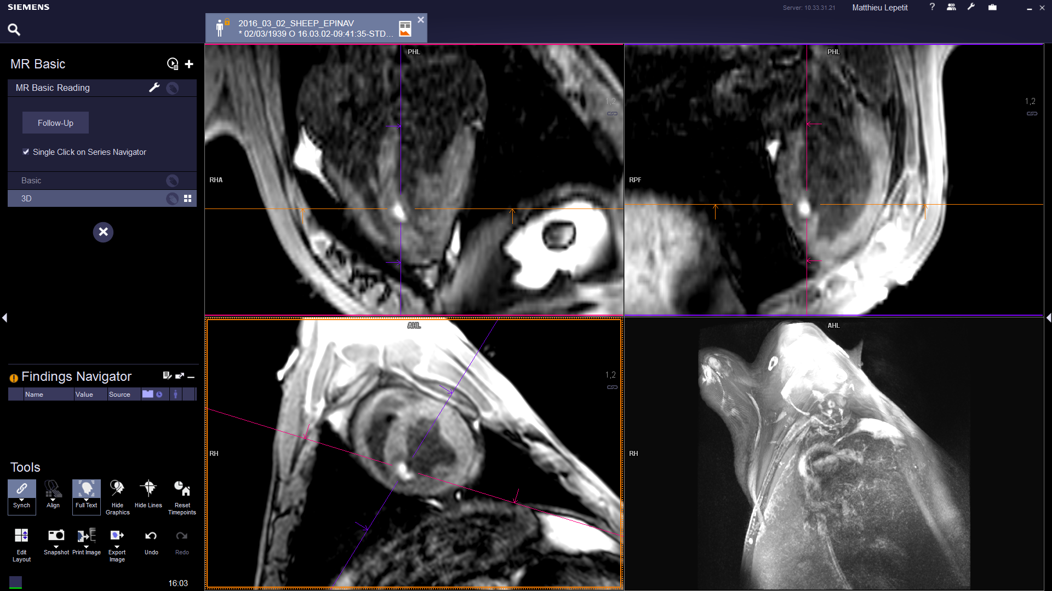
Post-ablation lesion assessment
Voxel size 1.3x1.3x2.5 mm³
31 segments, 60 slices
Two-beats ECG triggered
Respiratory gated
TI = 700 ms
Lesion
IR-3D sequence
Post-ablation visualization of all RF lesions at once in 3D
No contrast agent administration (Gadolinium)
Contrast-to-noise ratio (CNR) = 88.8 ± 38.3
“Towards MRI-guided cardiac ablation procedures with no contrast agent”, Guttman M, Susumu T, Kolandaivelu A et al., SCMR 2015

Slide 10
conclusion
Dedicated Hardware
  Catheters
  Filters
  Navigation system
  Defibrillators
  … (sensors)
Safety and artifact free
  No heating of devices
  Limited image artifact
  EP during MRI scanning
MRI
  Structural imaging (refine target definition), integration into EP consoles (therapy planning)
  Real-time MR-thermometry (control the procedure)
  Post-ablation lesion assessmentg (check treatment)

Slide 11











11
IHU Liryc
IMB
NIH
Valery Ozenne
Solenn Toupin
Pierre Bour
Fabrice Marquet
Thibaud Troadec
Manuel Boissenin
Julie Magat
Jerôme Naulin
Mathilde Merle
Florent Collot
Pierre Jaïs
Arnaud Chaumeil
Fanny Vaillant
Virginie Loyer
Delphine Vieillot
Marion Constantin
… all IHU LIRYC!
Baudouin Denis de Senneville
Michael S. Hansen
Souheil Inati
LABRI
Jenny Benois-Pineau
Pascal Desbarats
Aurélie Emilien
Siemens
Matthieu Lepetit-Coiffé
Financial support:
ANR 11-Tecs-003 TACIT
ANR 11-EQPX0030 Equipex MUSIC
ANR 10-IAHU-04 IHU LIRYC
France Life Imaging

