Slide 1
MR-Guided Endovascular Therapy
Fabio Settecase, M.D., M.Sc., F.R.C.P.C.
Assistant Clinical Professor
Department of Radiology and Biomedical Imaging
University of California San Francisco
San Francisco, CA
NeuroEndovascular Surgery Program
Hoag Neurosciences Institute
Hoag Memorial Hospital Presbyterian
Newport Beach, CA
Newport Harbor Radiology Associates Medical Group, Inc.

Slide 2
Disclosures
No conflicts of interest

Slide 3
Objectives
Endovascular iMR imaging suite considerations
Real-time MR sequences, Road-mapping, IA gadolinium
Pros/cons of active vs passive endovascular device tracking
Overview of pre-clinical and clinical applications of MR guidance for vascular interventions
Review UCSF experience with endovascular iMRI
Emerging clinical applications
Review technical hurdles limiting increased use of MR guidance for endovascular therapy

Slide 4
MR Guidance of Endovascular Therapy
Requires balancing multiple trade-offs:
Image quality
Spatial resolution
Temporal resolution
Patient accessibility
Field of view
Cost
Eg. 3 T has higher SNR but smaller bore => less accessible patient
Open bore has more accessible patient but less B₀, slower gradients, poor field uniformity
Settecase et al., Magnetic Resonance-Guided Passive Catheter Tracking for Endovascular Therapy. Magn Reson Imaging Clin N Am. 2015 Nov;23(4):591-605.
Notes:
On the other hand open bore scanners lack field strength and

Slide 5
MR Guidance of Endovascular Therapy
Ideal magnet:
Short bore (125 cm)
Large diameter (70 cm)
XMR suite (DSA Fluoroscopy suite connected to MRI suite via “floating” table
Notes:
On the other hand open bore scanners lack field strength and

Slide 6
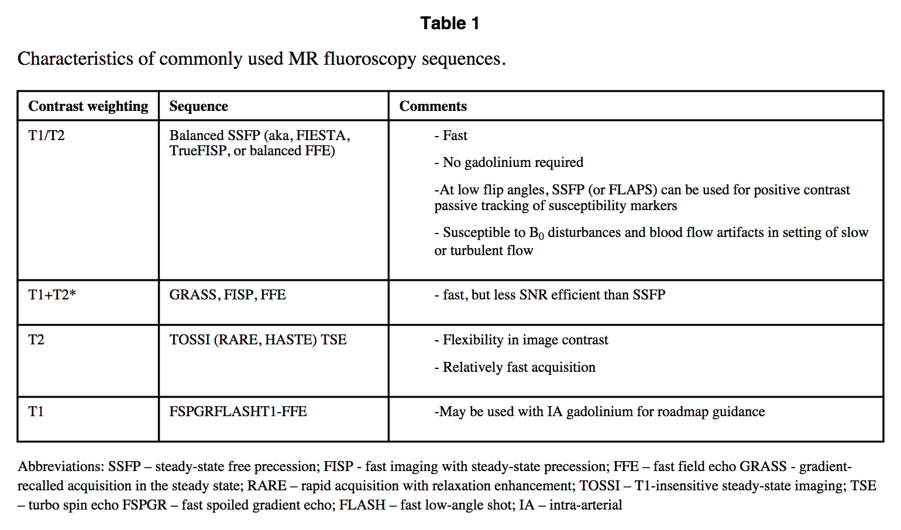
Ideal sequence – depends on properties of the device, tracking method, contrast properties of the tissue of interest, and the need for intravascular contrast
Can interleave
Settecase et al., Magnetic Resonance-Guided Passive Catheter Tracking for Endovascular Therapy. Magn Reson Imaging Clin N Am. 2015 Nov;23(4):591-605.

Slide 7
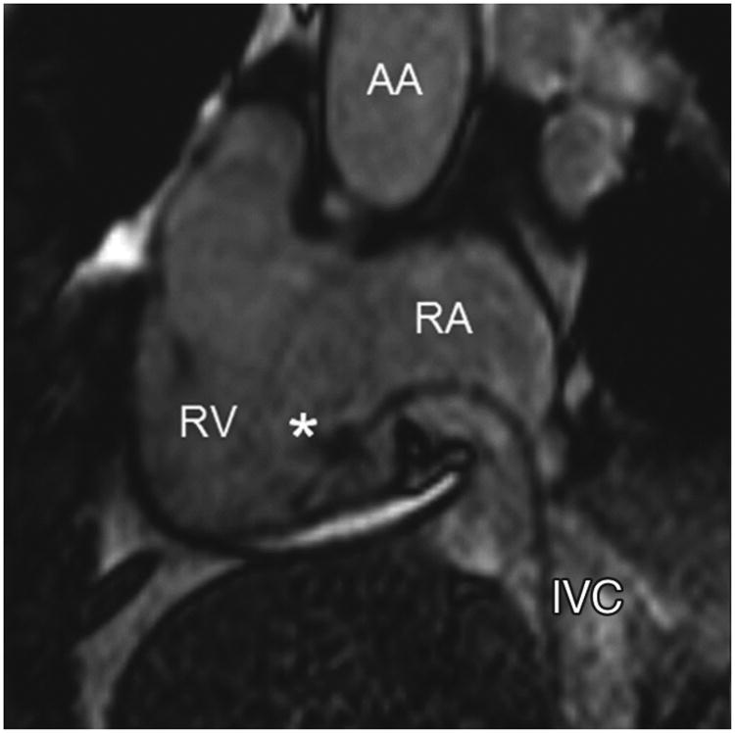
SSFP
Grothoff M, et al. MR imaging-guided electrophysiological ablation studies in humans with passive catheter tracking: initial results. Radiology 2014;271(3):695-702
Notes:
SSFP sequences have become the preferred sequences - excellent bright blood contrast and visualization of devices employing passive tracking due to the high temporal resolution
(short TR), high SNR, and greater sensitivity to magnetic field inhomogeneities

Slide 8
Parallel imaging
Key-hole imaging
Alternative k-space sampling (spiral or radial trajectories, asymmetric truncated k-space sampling)
Exploitation of k-space data sparsity (compressed sensing)
Coupled with high-performance multi-processor computers, real-time MR-guidance is now capable of up to 10 frames/s
comparable to x-ray fluoroscopy/DSA (15-30 frames/s)
Notes:
SSFP sequences have become the preferred sequences - excellent bright blood contrast and visualization of devices employing passive tracking due to the high temporal resolution
(short TR), high SNR, and greater sensitivity to magnetic field inhomogeneities

Slide 9
Road-mapping
Martin AJ, et al. Digital subtraction MR angiography roadmapping for magnetic steerable catheter tracking. JMRI 2014
Notes:
source images are shown on the top row and the roadmapping mode on the bottom row. An IA injection of Gd (2% of IV dose) is used to highlight arterial anatomy (A) and establish the roadmap (E). The MARC catheter is then activated, producing a substantial signal void on the source images (arrows in B-D) and a signal enhancement pattern on the roadmap images that is superimposed on the arterial anatomy (arrows in F-H). The roadmap images can be used to track the device without losing visibility of the local arterial anatomy (using GRE with 40% keyhole kspace sampling = 2 fps). Analogous to DSA roadmapping

Slide 10
IA Gadolinium Contrast
Off-label (FDA)
No adverse events reported from IA administration
Dose limit = 0.3 mmol/L/kg
Lower doses needed per IA injection run (~2% of IV dose)
Newer blood pool agents (Gadomer-17, Vasovist)
Notes:
On the other hand open bore scanners lack field strength and

Slide 11
Interactive Interface
Saikus CE, Lederman RJ, et al. Interventional cardiovascular magnetic resonance imaging: a new opportunity of rimage-guided interventions. JACC Cardiovasc Imaging 2009;2(11):1327

Slide 12
Device Tracking – Passive vs Active
Passive | Active
Simple – no add’l hardware | Faster – automated slice orientation
Inexpensive | Thinner slice thickness (less superimposition of anatomy)
No long wires or connection to current source | Tracking mechanism can be switched on/off
No ohmic or RF heating risk | Ability to visualize both tip and shaft
Can be used at different field strengths
Easier miniaturization
Notes:
passively tracked catheter fell out of plane, was usually achieved within 1-3 attempts. In some cases, however, it took up to 15 attempts, with up to
40 seconds until the catheter tip was relocated!!!!!!

Slide 13
Endovascular iMRI Reports (Jan 2017)
Pre-clinical
Transjugular intrahepatic stent placement (TIPS)
Coronary stent deployment
Closure of atrial septal defects
Aortic Valve implantation
Aortic coarctation repair
Aortic dissection repair
Renal angioplasty and stenting
Renal artery sympathetic denervation
Renal embolization
Iliac artery stenting
IVC filter placement and retrieval
Hepatic artery catheterization
Recanalization of complete carotid occlusion
Carotid stenting
Hepatic arterial delivery of stem cells
Clinical
Iliac, femoral, and popliteal artery angioplasty
Cardiac catheterization
Cardiac electrophysiological ablation
Intramyocardial delivery of Gd-DPTA
Sclerotherapy of low-flow vascular malformations
Notes:
Despite a dearth of MR compatible endovascular devices, the feasibility of commonly performed endovascular procedures has been demonstrated in animal studies

Slide 14
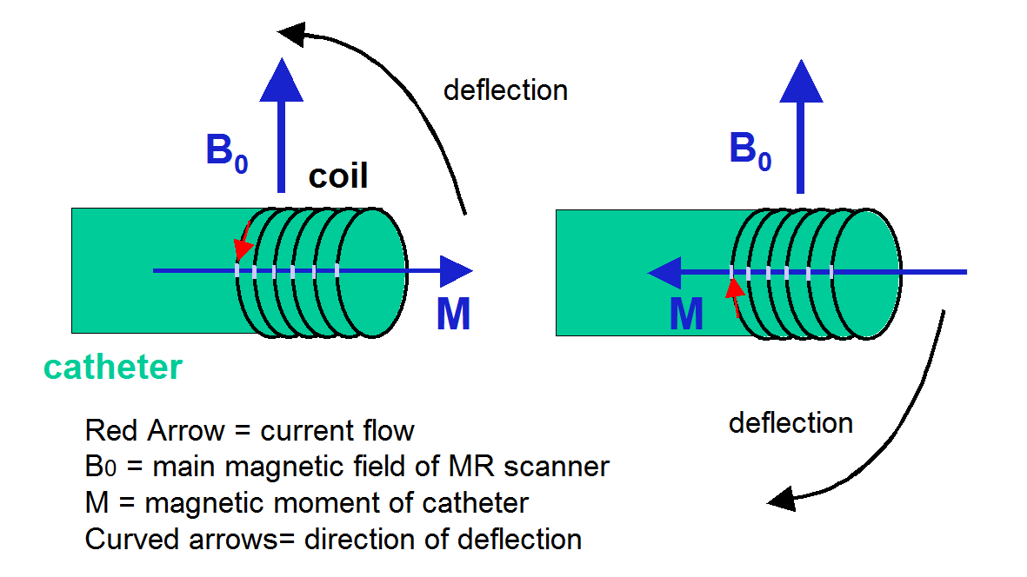
UCSF Experience: Magnetically Assisted, Remotely Controlled (MARC) Catheter
Settecase, F., M. S. Sussman, et al. (2007); Roberts, T. P., W. V. Hassenzahl, et al. (2002); Muller, L., M. Saeed, et al. (2012).
Notes:
Deflection of MARC catheter tip when placed in a magnetic field (Bo) and
magnetic moments (M) are generated by supplying power to the solenoid located at the distal end of the catheter.

Slide 15
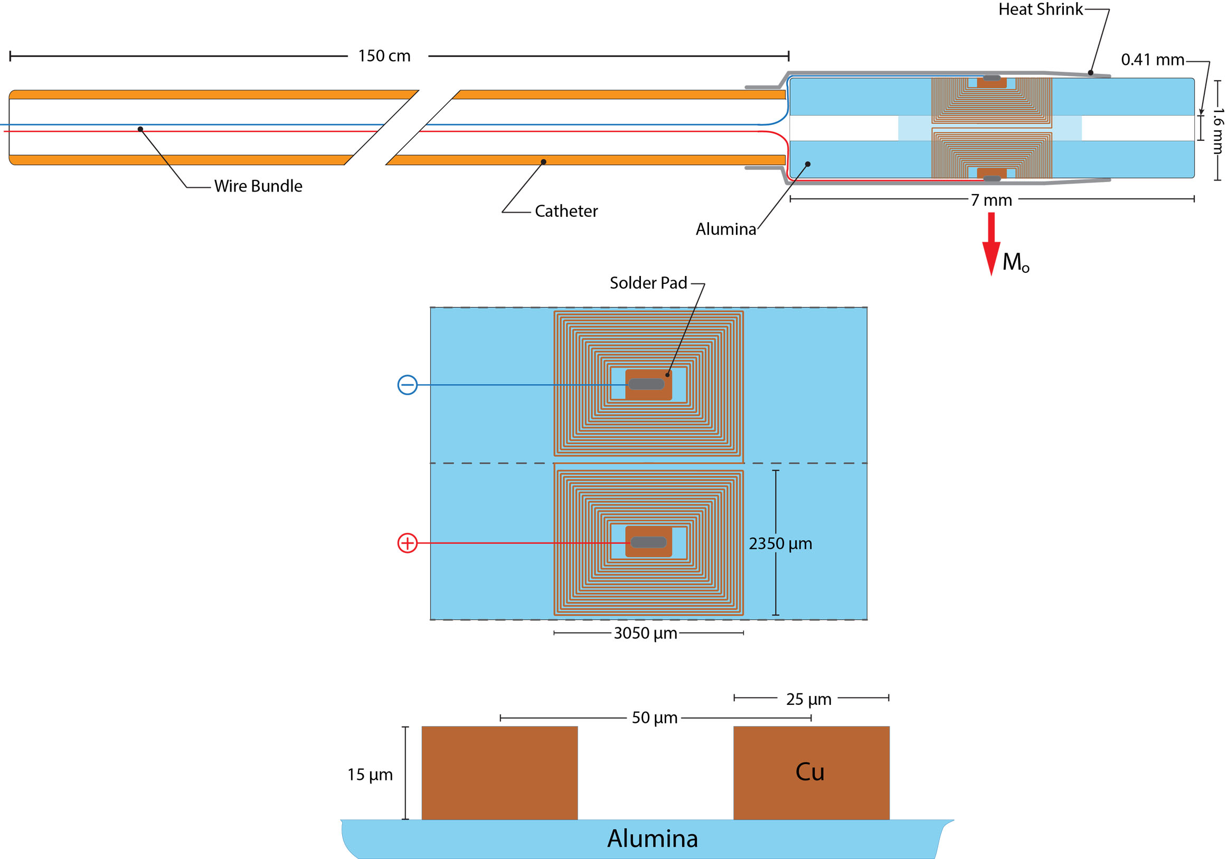
Microcoil Design
Malba, V., et al. (2013)
Courtesy of Steven Hetts, MD
Notes:
The MARC catheter device was constructed using an intramural copper braided catheter (Penumbra, Inc, Alameda, CA) connected to a laser-lithographed saddle coil (UCSF, San Francisco, CA) at the distal tip.

Slide 16
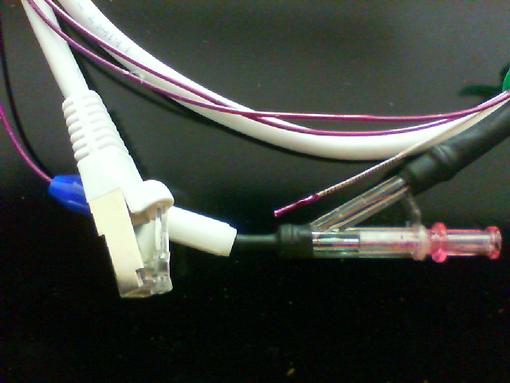
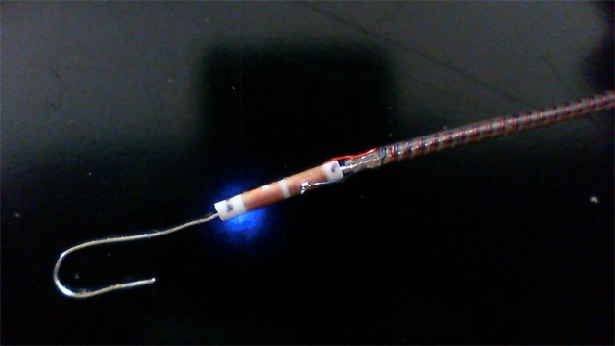
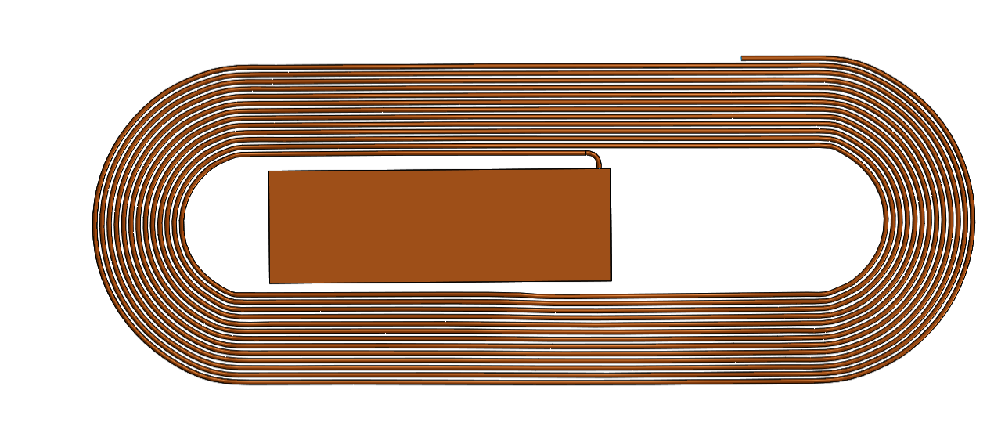
10 mm
Cath. tip
Catheter tip
Copper wire braiding in wall
Access Port
Power connection
(a)
Connection pad
(b)
Connection to paired coil on opposite side
Copper trace layout
Connection pad
(c)
3.5 mm
Courtesy of Steven Hetts, MD

Slide 17
MARC Catheter (in vitro)
Courtesy of Aaron Losey, MD

Slide 18
MARC Navigation into Renal artery
Lillaney et al, Endovascular MR-guided Renal Embolization by Using a Magnetically Assisted Remote-controlled Catheter System. Radiology 2016 281(1): 219-228.

Slide 19
MARC Navigation into Renal Artery
Left Renal Artery Origin
IVC
Aorta
Catheter Tip
A
B
C
D
Lillaney et al, Endovascular MR-guided Renal Embolization by Using a Magnetically Assisted Remote-controlled Catheter System. Radiology 2016 281(1): 219-228.

Slide 20
Renal artery Embolization
t = 0 sec
t = 10 sec
A
B
t = 300 sec
t = 600 sec
C
D
Lillaney et al, Endovascular MR-guided Renal Embolization by Using a Magnetically Assisted Remote-controlled Catheter System. Radiology 2016 281(1): 219-228.

Slide 21
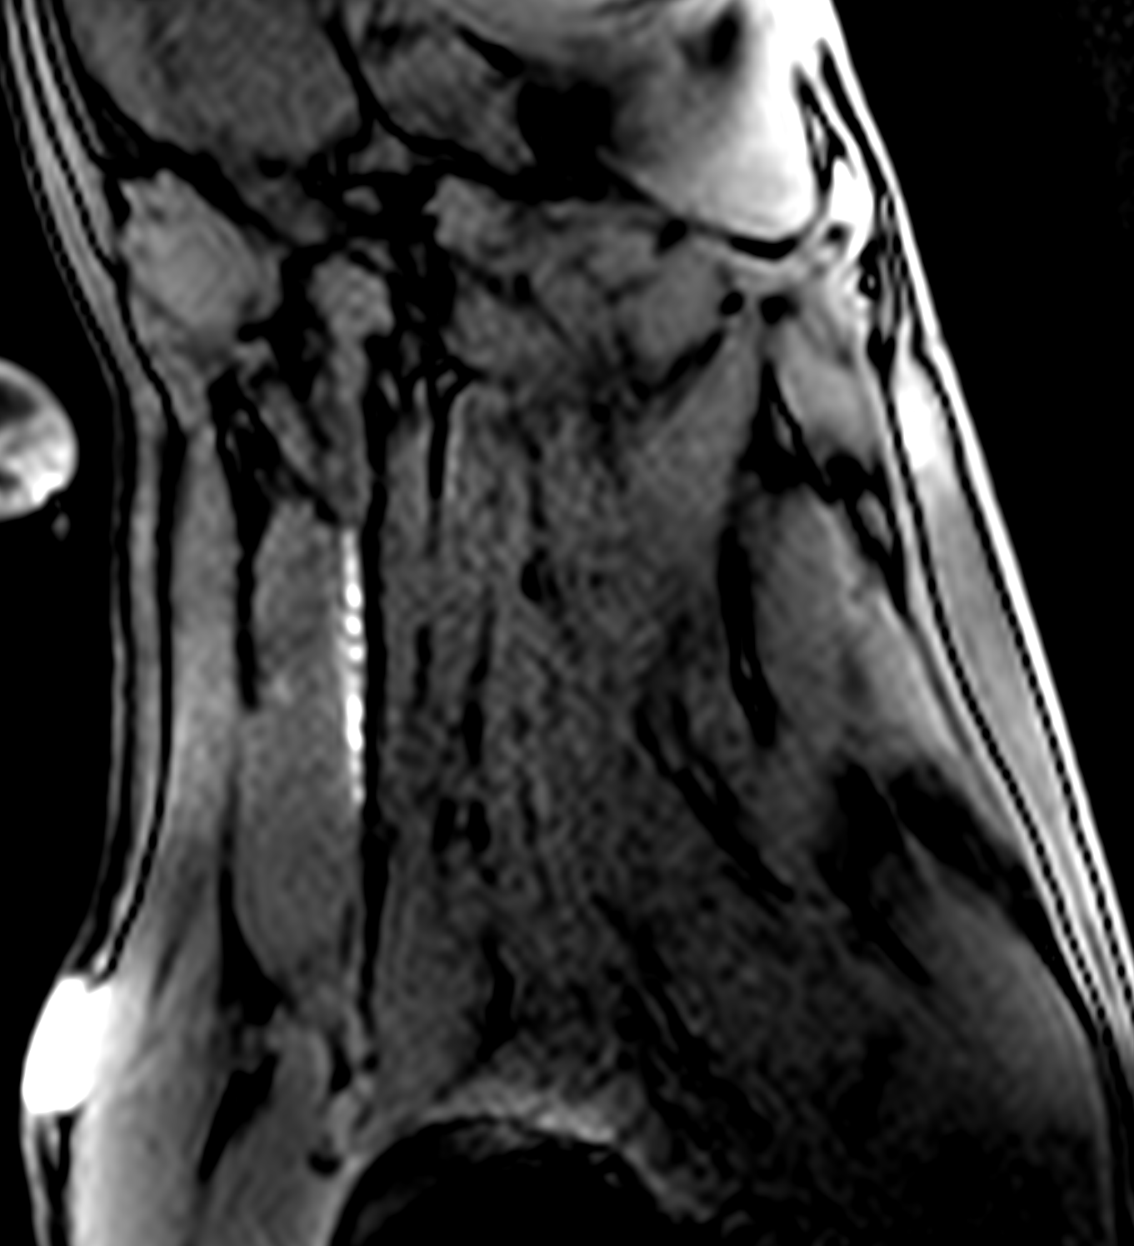
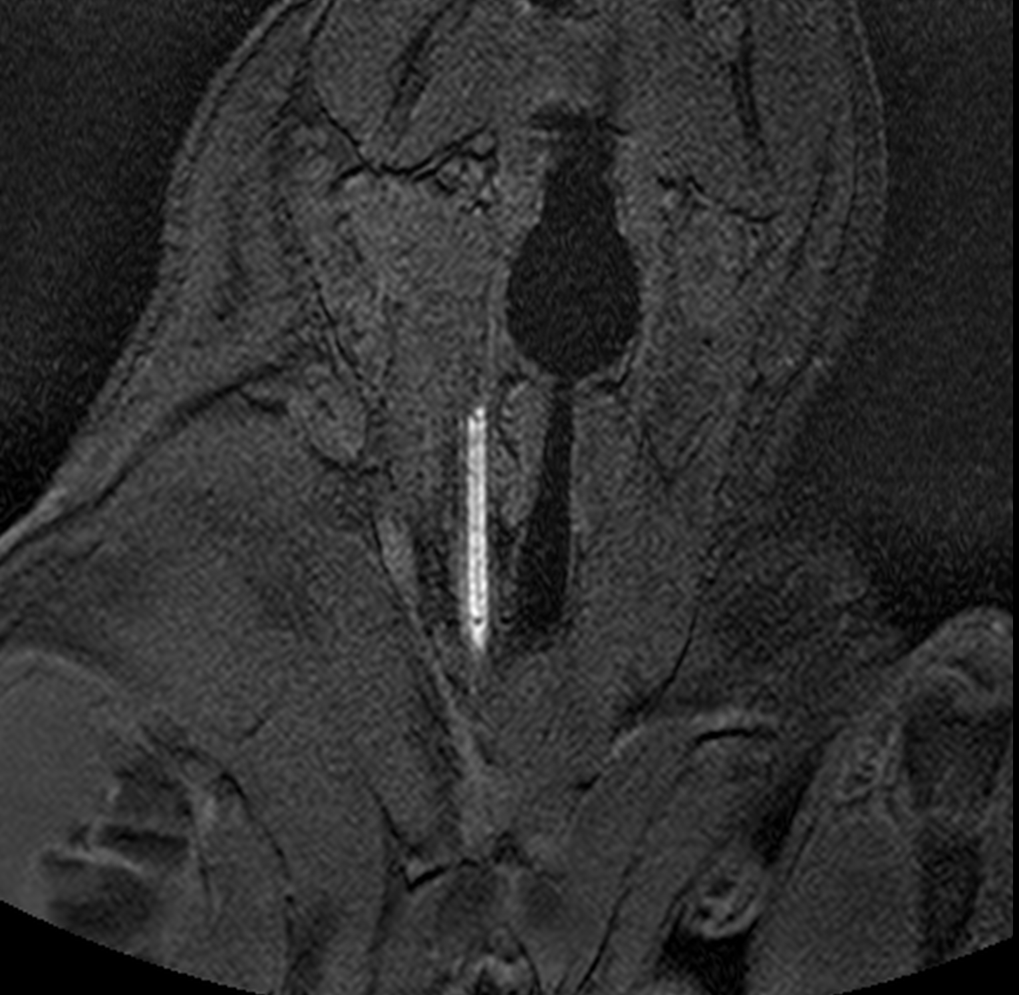
A
B
BSSFP sagittal plane
5 degree GRE coronal plane
Yang JK, et al. Interventional Magnetic Resonance Imaging Guided Carotid Embolectomy using a Novel MRI-Conditional Resonant Marker Catheter: Demonstration of Preclinical Feasibility (Submitted – under review)

Slide 22
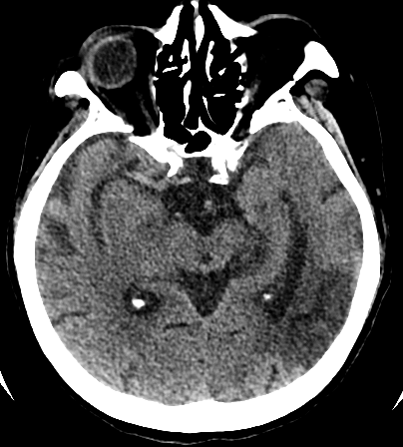
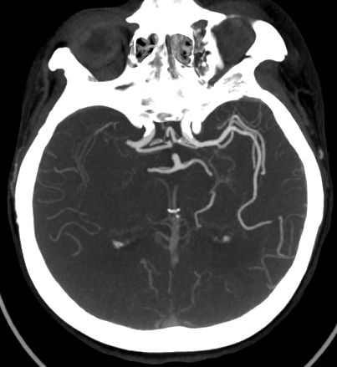
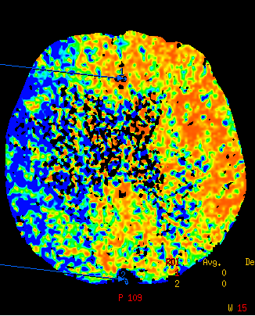
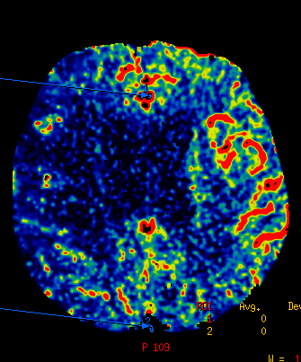
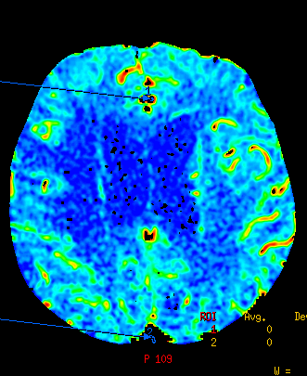
A
B
C
D
E
Notes:
Figure . A. Noncontrast axial CT head demonstrating a hypersense right middle cerebral artery (MCA). An old infarct is seen in the left posterior temporal-occipital lobes. B. Axial CT angiogram MIP reconstruction demonstrating abrupt cut-off of the right M1 segment MCA, compatible with thrombotic occlusion. C. CT perfusion mean transit time (MTT) image at the level of the lateral ventricles demonstrating elevated MTT in the entire right MCA territory (blue areas). D. CT perfusion cerebral blood flow (CBF) image at the level of the lateral ventricles demonstrating decreased CBF in the right MCA territory. E. CT perfusion cerebral blood volume(CBV) image at the level of the lateral ventricles demonstrating a small area of decreased CBV in the right lateral precentral and postcentral gyri (areas lacking green and red). This pattern is consistent with a perfusion mismatch between the ischemic penumbra (MTT and CBF images) and the infarct core (CBV image).

Slide 23
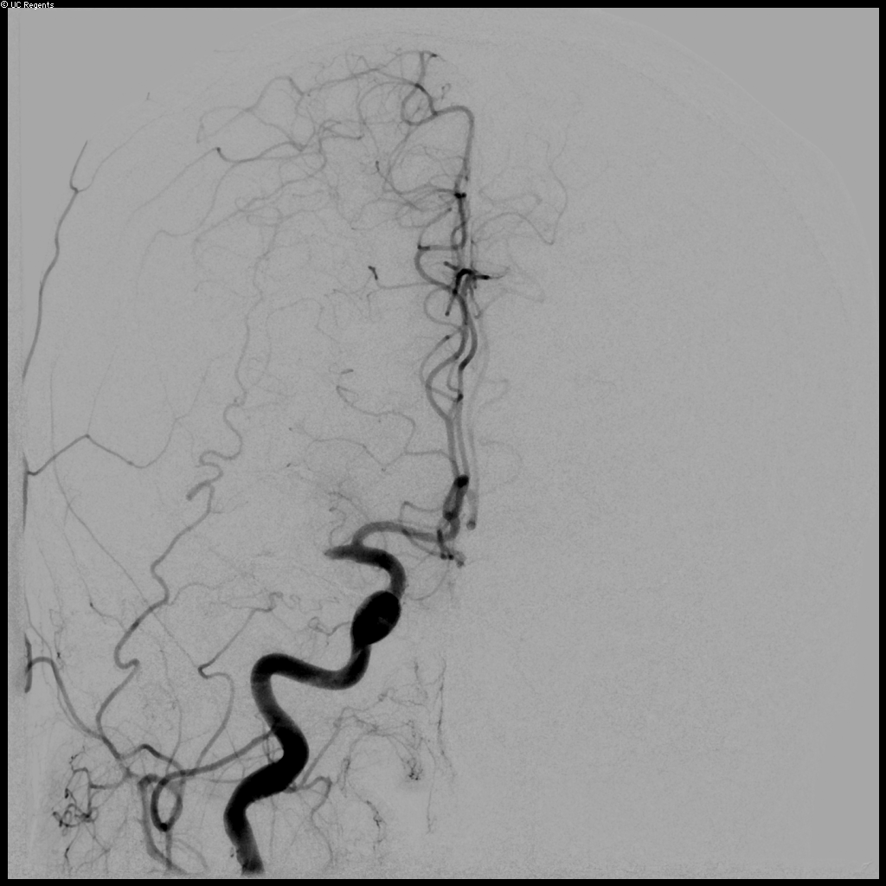
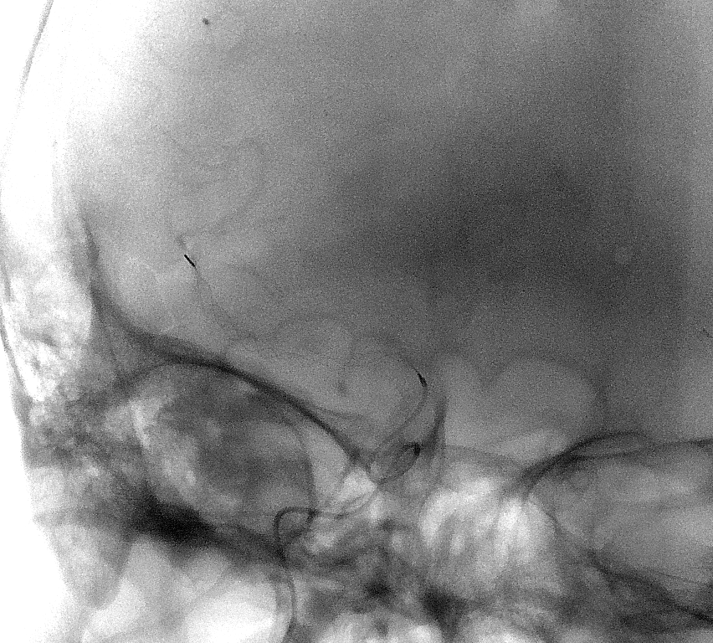
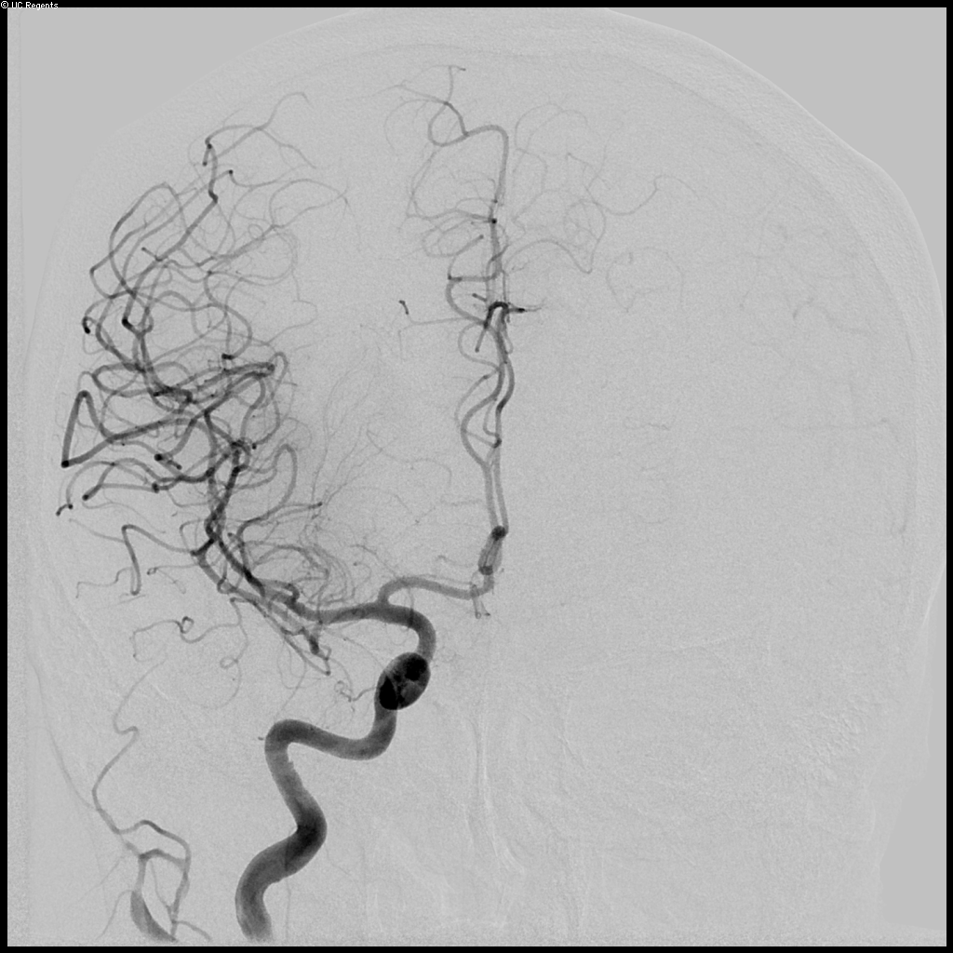
A
B
C
D
Notes:
Figure. A. Cerebral angiogram, right common carotid artery injection, AP projection demonstrating occlusion of the right middle cerebral artery (compare with C). Distal anterior cerebral artery to middle cerebral artery territory collaterals are also noted. B. Fluoroscopic image, RAO-Towne’s projection, demonstrating a atent-treiver device deployed through the thrombus within the right middle cerebral artery. C. Post-thrombus retrieval angiogram, right common carotid artery injection, AP projection demonstrating patency of the M1 segment middle cerebral artery and restoration of flow to the entire right MCA territory. D. Axial diffusion weighted MRI at the level of the lateral ventricles obtained 24 hours after thrombectomy demonstrates acute infarct with the body of the caudate and adjacent corona radiata, and a few scattered punctate infarcts within the right frontal cortex. The area at risk of infarction on CT perfusion, ie, the remainder of right MCA territory, has been prevented from infarcting.

Slide 24
Zuckerberg SFG XMR System (2016)

Slide 25
ZSFG XMR Suite - Acute Stroke Workflow
X-Ray Side
Of XMR Suite
Yes
XR: Unenhanced
FPCT, FPCTA, FPCTP
Complete
Reperfusion
ICU
DSA for Therapy
0-6 h after onset
Acute Stroke
Yes
No
6-24 h or unknown onset
MR: DWI, FLAIR
MRA, MRP,
Gradient/SWI
Viable Tissue
Beyond
Occlusion?
MR: DWI
+/- MRP
+/- Gradient / SWI
MR Side
Of XMR Suite
No
ICU
Courtesy of Steven Hetts, MD

Slide 26
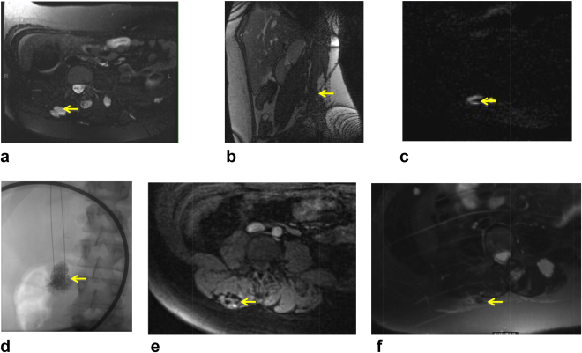
Percutaneous Sclerotherapy of Low‐Flow Vascular Malformations
O’Mara, DiCamillo, et al. MR‐guided percutaneous sclerotherapy of low‐flow vascular malformations: Clinical experience using a 1.5 T MR system JMRI 2016 Oct 31 (e-pub)
Notes:
A 20‐year‐old woman with blue rubber bleb nevus syndrome. a: Pretreatment axial T2 TSE SPAIR with fat saturation demonstrating septated VM (arrow) within the right psoas muscle. b: Needle targeting VM (arrow) with sagittal RT TrueFISP. c: Flow assessment within the lesion (arrow) with axial subtracted FLASH. d: Anterior–posterior planar projection during administration of sclerosant (100% ETOH, arrow) using fluoroscopy. A 19‐cm loop coil used for MR‐guided needle placement can be seen. e: Axial T1 VIBE of VM (arrow) 10 min after treatment showing thrombus within the lesion. f: Axial T2 TSE with fat saturation of healed VM site (arrow) 6 weeks posttreatment.
IF THIS IMAGE HAS BEEN PROVIDED BY OR IS OWNED BY A THIRD PARTY, AS INDICATED IN THE CAPTION LINE, THEN FURTHER PERMISSION MAY BE NEEDED BEFORE ANY FURTHER USE. PLEASE CONTACT WILEY'S PERMISSIONS DEPARTMENT ON PERMISSIONS@WILEY.COM OR USE THE RIGHTSLINK SERVICE BY CLICKING ON THE 'REQUEST PERMISSIONS' LINK ACCOMPANYING THIS ARTICLE. WILEY OR AUTHOR OWNED IMAGES MAY BE USED FOR NON-COMMERCIAL PURPOSES, SUBJECT TO PROPER CITATION OF THE ARTICLE, AUTHOR, AND PUBLISHER.

Slide 27
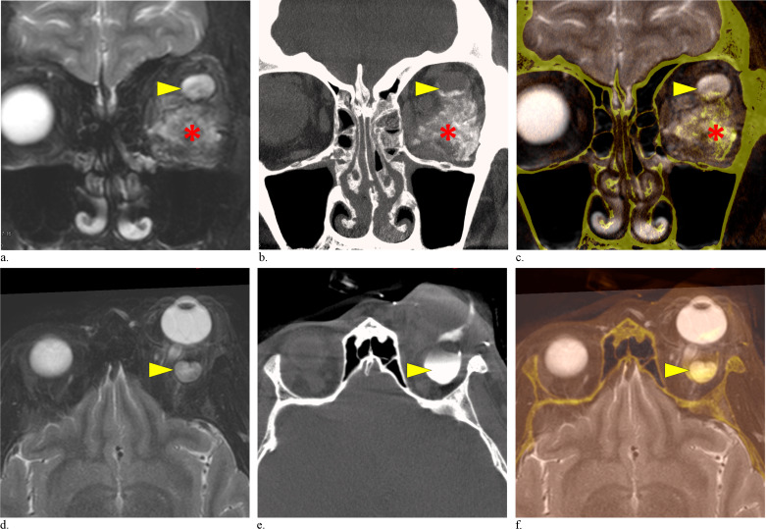
Percutaneous Sclerotherapy of Low‐Flow Vascular Malformations
Harmoush et al. Multimodality Image-Guided Sclerotherapy of Low-Flow Orbital Vascular Malformations: Report of Single-Center Experience. JVIR 2016 27(7): 987–995.e4
Notes:
Intraprocedural cone-beam CT and MR image fusion showing partial distribution of sclerosant within the malformation during staged sclerotherapy. (a–c) First sclerotherapy session. Coronal T2-weighted MR imaging (a), intraprocedural cone-beam CT (b), and cone-beam CT–MR fusion (c) images demonstrate distribution of bleomycin within the entire malformation (asterisk) except for a microcyst (arrowhead) located in the superolateral part of the intraconal space. (d–e) Second sclerotherapy session. Axial T2-weighted MR imaging (d), intraprocedural cone-beam CT (e), and cone-beam CT–MR fusion (f) images demonstrate bleomycin within the previously untreated intraconal cyst (arrowhead).

Slide 28
Endovascular iMRI: Future Directions
Improved iMR spatial and temporal resolution
Reliable device tracking
MR compatible equipment, needles, catheters, guidewires, sheaths
MRI integrated operating rooms (XMR) and multimodality angiography suites
Defining procedures and patients that benefit from MRI guidance and monitoring,
Must show clear benefit over DSA alone
Improvements in clinical outcomes

Slide 29
Acknowledgements
Steven Hetts, MD
Prasheel Lillaney, PhD
Aaron Losey, MD, MS
Alastair Martin, PhD
Maythem Saeed, PhD
Jay Yu, MS
Bradford Thorne
Lee Evans
Sravani Kondapavulur
Parham Moftakhar, MD
Vince Malba, PhD
Caroline Jordan, PhD
Jeff Yang, MS
David Saloner, PhD
Xiaoliang Zhang, PhD
Teri Moore
Dave Barry
Andrew Chu
ASNR Foundation, SNIS Foundation
RSNA R&E Foundation
UCSF Department of Radiology and Biomedical Imaging
Lawrence Livermore National Lab
Penumbra, Inc.
Siemens, Inc.
National Institutes of Health
R01EB012031 (MARC catheter)
R01HL076486 (MARC catheter)
R01CA194533 (ChemoFilter)
R21CA123840 (XMR IA Perfusion)
R21EB020283 (Endovascular MRI)
R25MD006832
T32EB001361
UL1TR000004
Notes:
This project was supported by National Institute of Biomedical Imaging and Bioengineering (NIBIB), National Institutes of Health, through S. Hetts Grant Number 1R01EB012031, and National Institute of Minority Health and Health Disparities (NIMHD), through Grant Number R25MD006832. Its contents are solely the responsibility of the authors and do not necessarily represent the official policies of the NIH or DHHS.

Slide 30
Thank you for your attention Questions? fabio.settecase@ucsf.edu

