Slide 1


10 Year Plan
MR guided fetal intervention
Chris Macgowan, PhD
Senior Scientist – Physiology & Experimental Medicine
Associate Professor – Medical Biophysics / Medical Imaging
Christopher.Macgowan@sickkids.ca

Slide 2

20th Annual Meeting & Exhibition
WASHINGTON, DC ● 1-4 Feb. 2017
Gaylord National Resort
www.scmr2017.org
Conflict of Interests or Relationships
Speaker Name: Chris Macgowan
I have the following financial interest or relationship to disclose with regard to the subject matter of this presentation:
Company Name: Siemens Healthcare Canada
Type of Relationship: Technical support from Siemens scientists

Slide 3
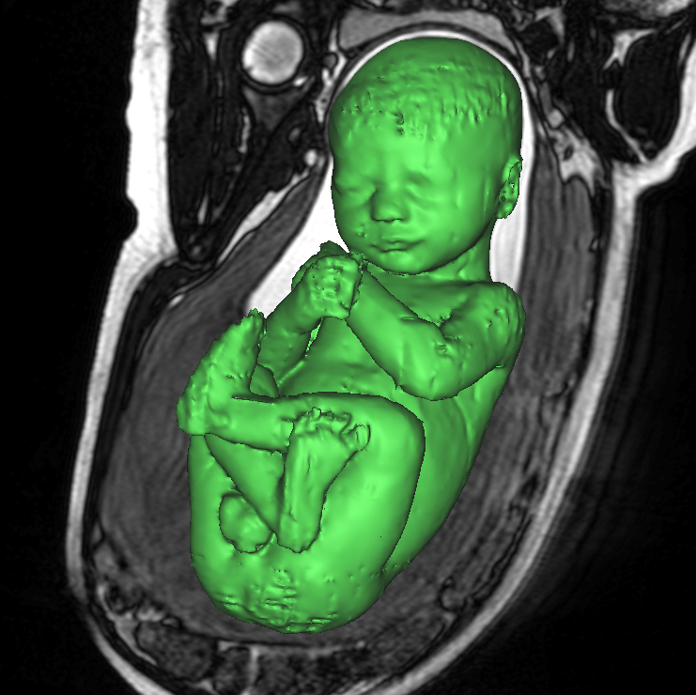
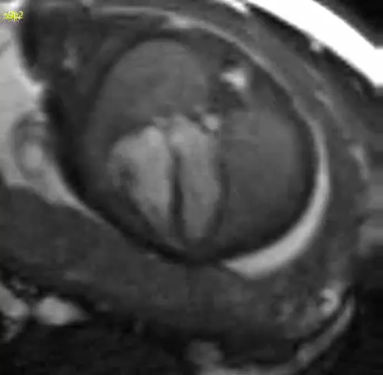
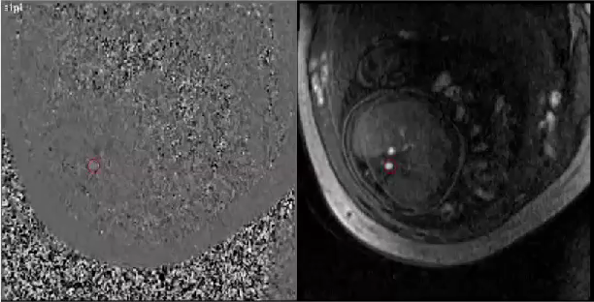
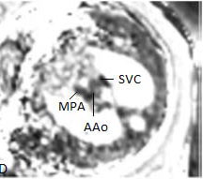
Fetal Cardiovascular MRI
Morphology
fetal development linked to circulation
disrupted in pathology:
  intra-uterine growth restriction (IUGR)
  anemia or polycythemia
  congenital heart disease (CHD)
strengths of MRI:
  morphology
  blood flow
  blood oxygen saturation & hematocrit
Blood Flow
O2 Sat & Hct

Slide 4
Fetal Intervention: Roles of MRI
Monitor normal development & outcomes of intervention
Set quantitative guidelines for fetal intervention & delivery (postnatal support/surgery)
Image-guided intervention?
1. Assess and monitor hypoxic fetal distress:
  heart function / tissue characterization
  blood flow, O₂ and pathological redistribution
  fetal response to maternal oxygen delivery (hyperoxygenation)
2. Quantify anemia / polycythemia:
  direct timing of transfusions
3. Evaluate and treat CHD:
  heart function and complex 3D morphology
  postnatal surgical planning
  identify cases for in utero intervention
  post intervention success
  real-time guidance?

Slide 5
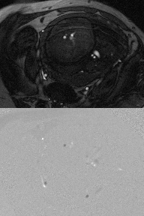
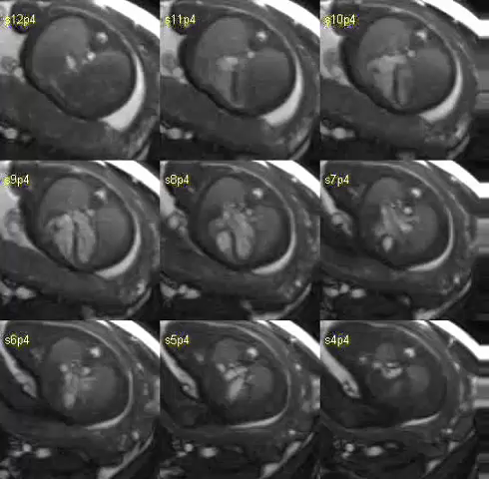
Fetal Cardiovascular MRI
velocity-sensitive (PC) MR
multi-slice SSFP
anatomical images
velocity images
Jansz et al. MRM 2010, 64:1304 Roy et al. MRM 2013, 70:1598

Slide 6
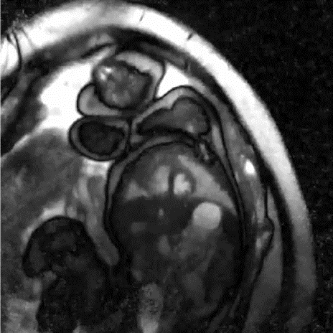
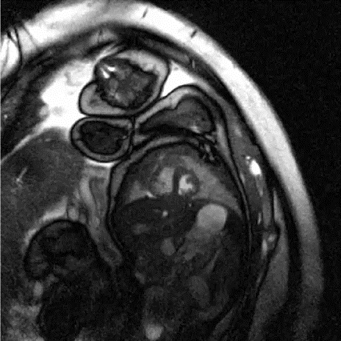
Fetal Cardiovascular MRI
5 cm
Gestational Age: 35 weeks
end-systole
golden-angle radial acq
compressed sensing recon
FOV = 32 x 32 cm²
Resoln = 1 x 1 x 4 mm³
Slices = 20
Acq Time = 3.6 s/slice (73 s)
TR/TE = 5.7 / 2.7 ms
Spokes/points = 640 / 320
end-diastole
Spokes / Real Time frame = 8
Temporal Resoln = 46 ms
Spokes / CINE frame = 32
Temporal Resoln = 23 ms
Feng et al. MRM 2014, 72:707
Hansen et al. MRM 2012, 68:741
Roy et al. JCMR 2017, In Press

Slide 7
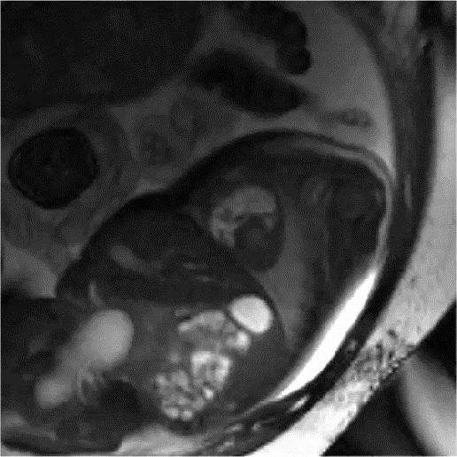
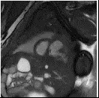
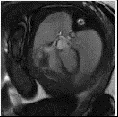
Congenital Heart Disease
hypoplastic left heart
RV diverticulum
SA
LA
aortic stenosis with irregular LV filling

Slide 8
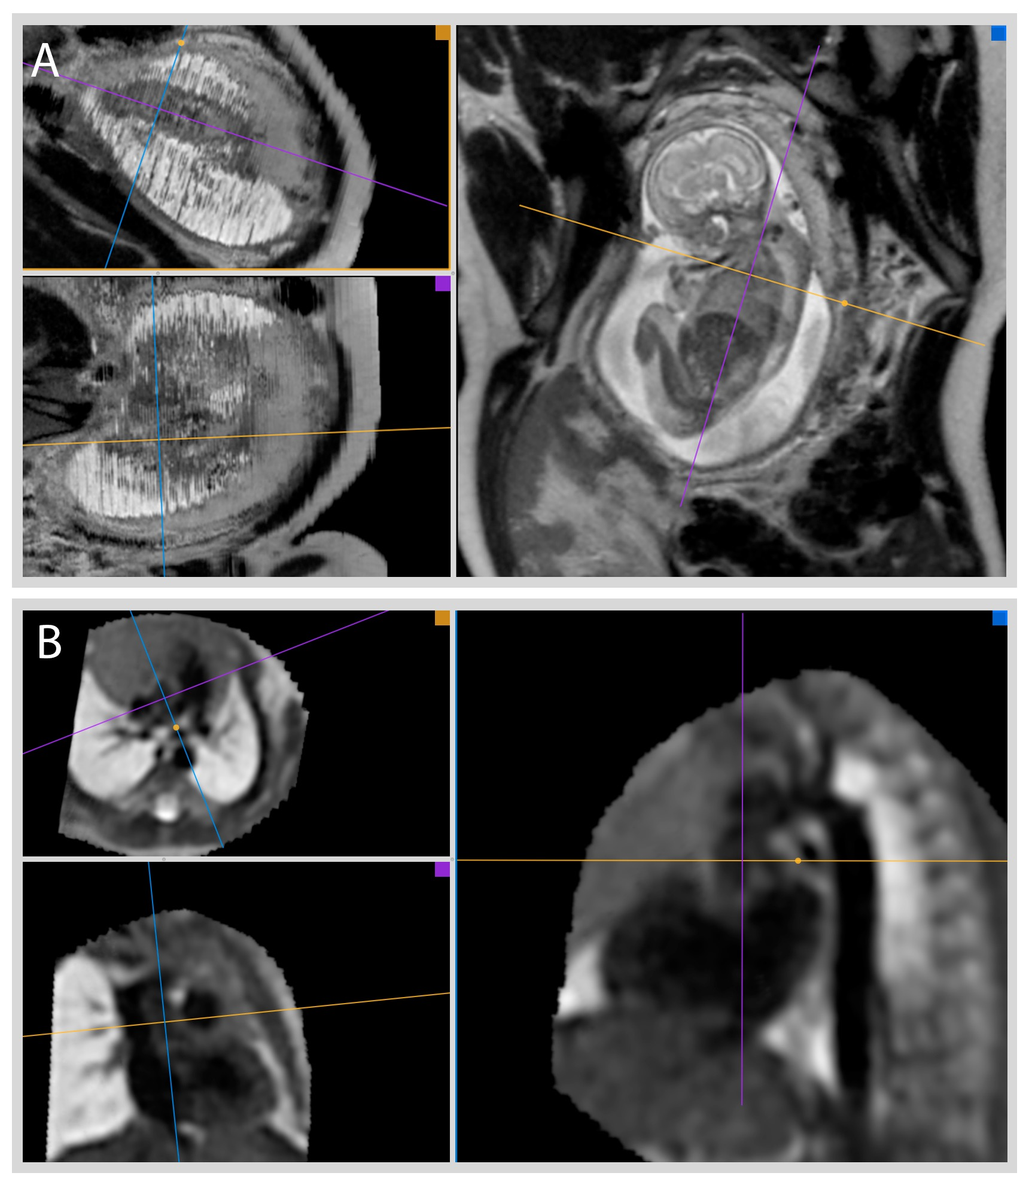

Motion Corrected Slice-to-Volume Recon
Before
After
Slide courtesy D Lloyd, KCL

Slide 9
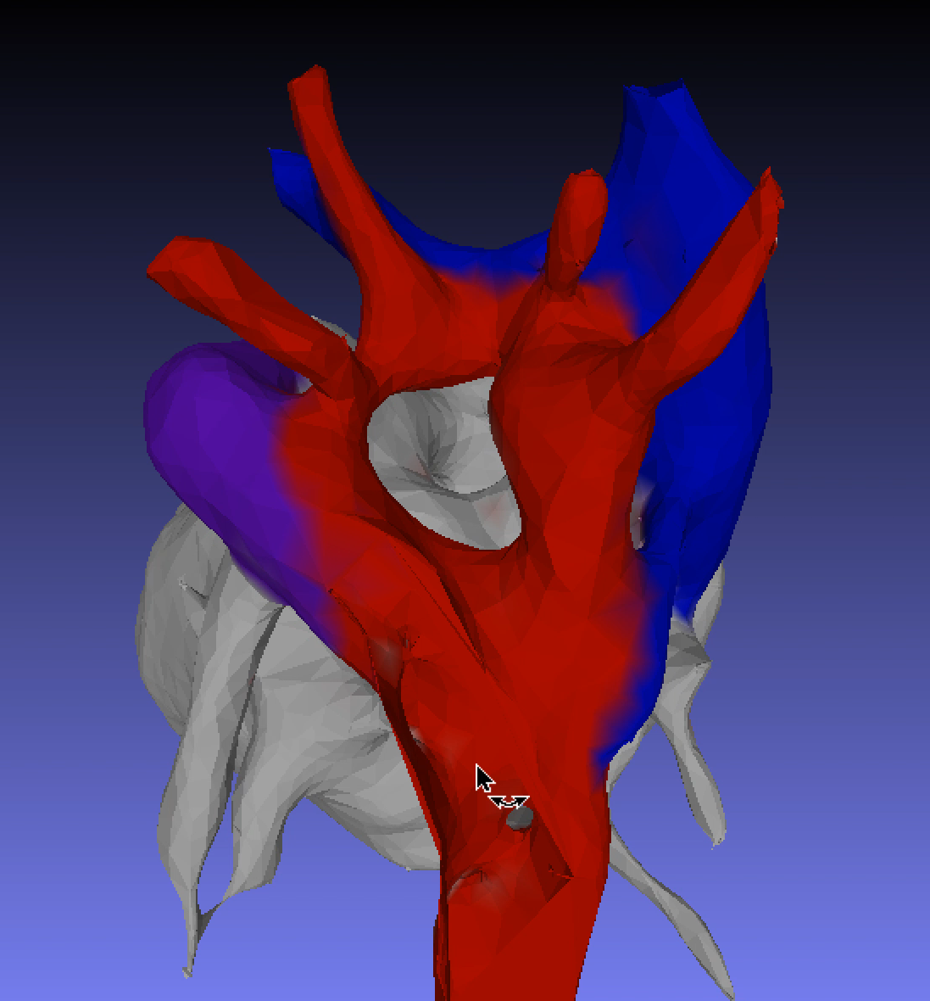
Motion Corrected Slice-to-Volume Recon
Before
After
Lloyd et al. Prenatal Diagnosis 2016, 36:1–10
Slide courtesy D Lloyd, KCL

Slide 10
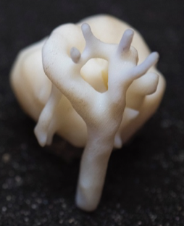
Motion Corrected Slice-to-Volume Recon
Before
1cm
After
Lloyd et al. Prenatal Diagnosis 2016, 36:1–10
Slide courtesy D Lloyd, KCL

Slide 11
Hypoplastic Left Heart Syndrome (HLHS)
High morbidity and mortality associated with postnatal surgery
Aortic stenosis with progression to HLHS
  Fetal aortic valvuloplasty to maintain biventricular circulation
HLHS with intact/restrictive atrial septum
  Fetal atrial septostomy to improve stability at birth and decompress pulmonary flow
Guidelines for identifying candidates for valvuloplasty by ultrasound:
  Retrograde flow in aortic arch
  L-R flow in FO
  Monophasic MV flow
  Severe LV dysfunction
Freud et al. Circulation 2014, 130:638-645
Makikallio et al. Circulation 2006, 113:1401

Slide 12
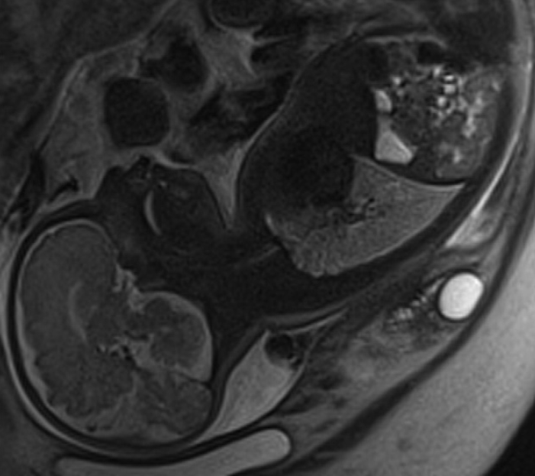
MRI Fetal Flows by Subgroup
lymphangiectasia
Al Nafisi et al. JCMR 2013, 15:65
Chaturvedi et al. Int. J. Cardiol. 2013, 168:2029–2036

Slide 13
Fetal Pulmonary Blood Flow Following Atrial Stenting
Al Nafisi et al. JCMR 2013, 15:65

Slide 14
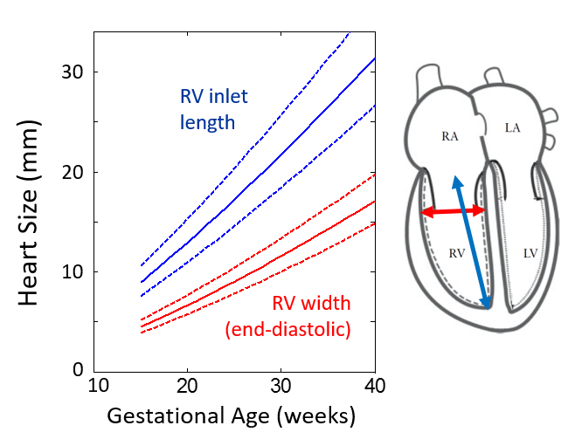
Real-Time Guidance of Fetal Cardiac Intervention
Requires:
  high spatial resolution ≤ 1mm
  high frame rate
  low latency*
  interactive UI
  device visualization
  SAR < 2 W/kg
  larger bore?
  Maternal-fetal alignment for
  percutaneous access within bore
Heart Rates: 110 – 160+ bpm
Firpo et al. Am J Cardiol 2001, 87
Schneider et al. Ultrasound Obstet Gynecol 2005, 26

Slide 15
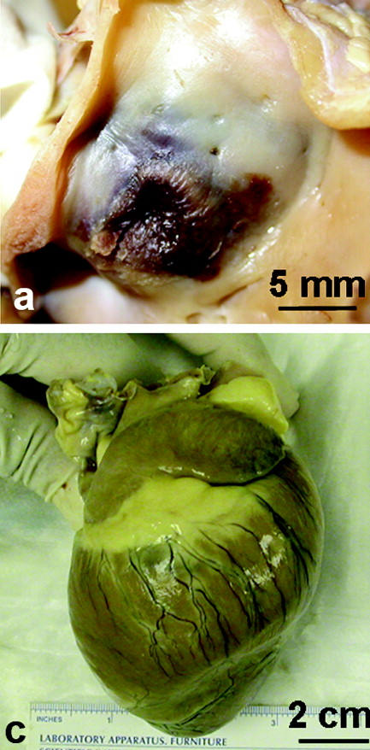
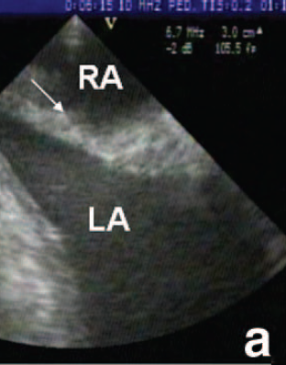
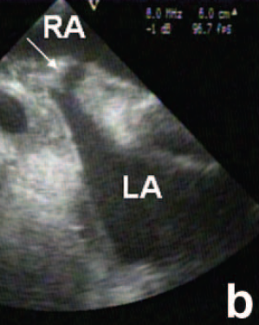
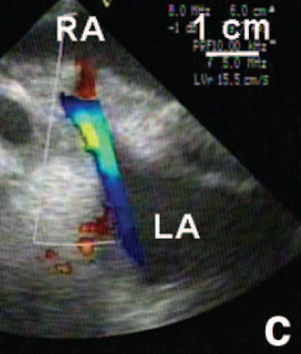
Focused Ultrasound (fUS): boiling histotripsy
ASD creation in canine model
duration = 6 μs
peak negative pressure = 15 MPa
prf = 3.3 kHz
1 MHz transducer
Xu et al IEEE Trans Ultrason Ferroelectr Freq Control 2004, 51:726-736

Slide 16
Summary
Hypoplastic Left Heart
MRI provides non-invasive assessment of fetal cardiovascular physiology
Improve understanding of fetal development and pathology, and interpretation by ultrasound
Identify subjects that would benefit from intervention
Guide & monitor therapy:
timely delivery, maternal O₂, transfusion, cath/fUS
aortic stenosis with irregular LV filling

Slide 17
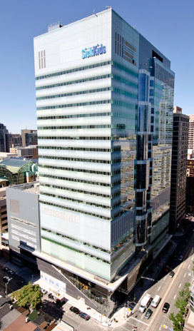




Acknowledgements
SickKids
Mike Seed
Chris Roy
Sharon Portnoy
Milan Prsa
Liqun Sun
Shi-Joon Yoo
Mashael Al-Rujaib
Bahiyah Al Nafisi
Meng Yuan Zhu
Prashob Porayette
Brahmdeep Saini
Mount Sinai, Toronto
John Kingdom
Johannes Keunen
Tim van Mieghem
King’s College London
David Lloyd
Jo Hajnal
Reza Razavi
Funding
SickKids Research Tower

