Slide 1
PVR, right heart function
with MRI exercise
CMR 2018
Barcelona, February 1st 2018
Guido Claessen, MD, PhD
University Hospitals Leuven, Belgium
guido.claessen@uzleuven.be

Slide 2
Why would we want to assess the heart during exercise?
Patients are often asymptomatic @ rest, but exhibit symptoms during exercise
Insights into mechanisms limiting exercise capacity
Early diagnosis of disease
RV contractile reserve: more prognostic information than resting measures
Grünig E et al. Circulation 2013, 2. Kusunose K et al. Circ Cardiovasc Imaging 2013

Slide 3
Cardiac output can only be as good as your worst ventricle
N = 124 pts with
precapillary PH
RV contractile reserve more prognostic than resting hemodynamics
Peak VO2 & PASP increase: independent prognostic predictors
Grünig E et al. Circulation 2013;128:2005-2015
Notes:
Another feature of PH is that pts are primarily symptomatic during exercise...

Slide 4
Relationship between PAP,
RV function & vascular load
La Gerche et al. The Right Heart Springer Press

Slide 5
Exercise CMR
La Gerche et al. Circ Cardiovasc Imaging. 2013 Mar 1;6(2):329-38

Slide 6
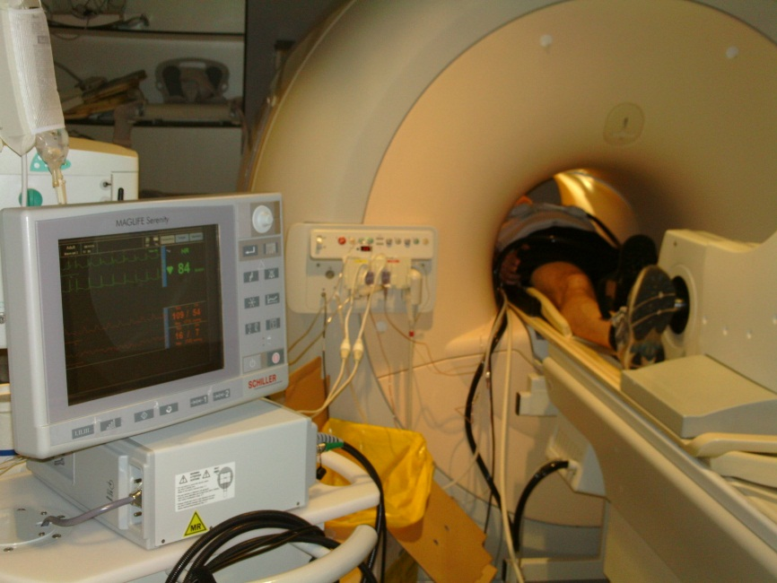
Validation against invasive ‘gold standard’
Pilot phase:
n = 15 (13 ♂, 2 ♀)
age: 32 ± 7 years
Validation phase:
n = 19 (17 ♂, 2 ♀)
age: 37 ± 9 years
 | Athletes (n=10) | Arrhythmia patients (n=6) | Heart failure patients (n=3)
Age (years) | 35 ±9 | 38 ±26 | 63 ±13§
Body Mass Index (kg/m²) | 22.7 ±1.3 | 25.7 ±3.5 | 24.4 ±4.5
Maximal power upright (Watts) | 370 ±66 | 304 ±60‡ | 97 ±55§
La Gerche et al. Circ Cardiovasc Imaging. 2013 Mar 1;6(2):329-38

Slide 7
CO: validation against ‘gold standard’
La Gerche et al. Circ Cardiovasc Imaging. 2013 Mar 1;6(2):329-38

Slide 8
CO: reproducibility
La Gerche et al. Circ Cardiovasc Imaging. 2013 Mar 1;6(2):329-38

Slide 9
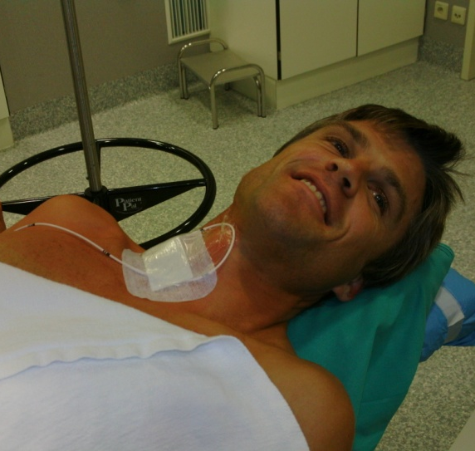
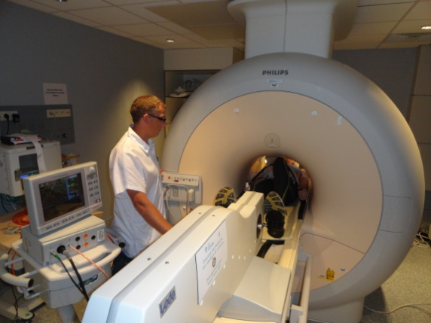
Exercise hemodynamics in precapillary PH
7 controls
14 pts with CTEPH
Disproportionate increase
in RV afterload
No increase in
stroke volume
Claessen et al. Heart 2015;101:637–644.

Slide 11
A dilating ventricle is a failing ventricle

Slide 12
RV reserve correlates with exercise capacity – resting measures DO NOT
Claessen et al. Heart 2015;101:637–644.

Slide 13
Detecting mild pulmonary vascular disease
Pts with dyspnea after previous pulmonary embolism –
and normal resting mPAP
(N = 13)
(N = 12)
(N = 25)
CTED = Chronic thrombo-embolic disease
Claeys et al. AHA abstract. New Orleans 2016

Slide 14
Evaluation of therapy during exercise
Pts with normal resting mPAP after pulmonary endarterectomy
(N = 7)
Claessen et al. J Am Heart Assoc 2015; 4: e001602

Slide 15
Conclusions
ExCMR is feasible and accurate to evaluate cardiac volumes and function during strenuous exercise
Exercise rather than resting measures predict exercise capacity and treatment effect
Exercise measures enable identification of subtle cardiovascular disease
Further studies are needed to establish the clinical benefit of early diagnosis and initiation of therapy

Slide 16
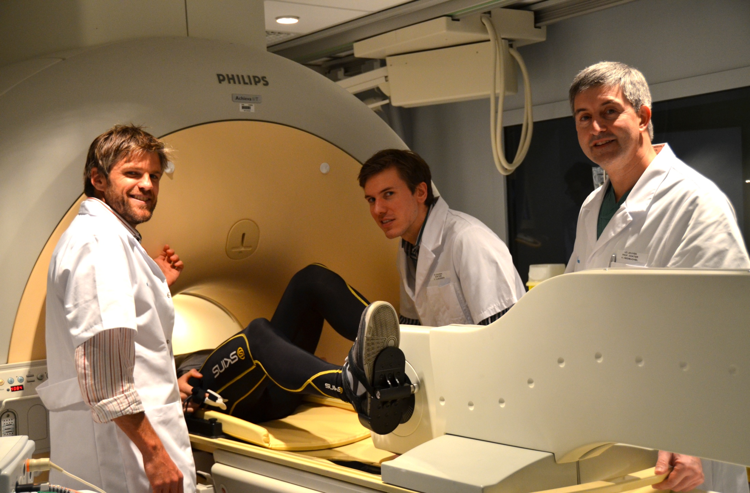
Acknowledgements
Prof. Dr. Hein Heidbuchel
Prof. Dr. Marion Delcroix
Prof. Dr. Andre La Gerche
Prof. Dr. Rik Willems
Prof. Dr. Piet Claus
Prof. Dr. Johan Van Cleemput
Prof. Dr. Steven Dymarkowski
Prof. Dr. Jan Bogaert
Prof. Dr. Jens-Uwe Voigt
Dr. Jean-Yves Wielandts
Dr. Mathias Claeys
Dr. Frederic Schnell
Dr. Alexander Van De Bruaene
Dr. Thibault Petit
Prof. Dr. Marc Gewillig
Prof. Dr. Stefan Janssens
Stefan Ghysels
Kris Byloos
Guido Putzeys
The volunteers…

