Slide 1
Interventional CMR using off-the-shelf devices
Dr. Toby Rogers, MA, BM BCh, PhD
Dr. Adrienne Campbell-Washburn, PhD
Cardiovascular Branch, Division of Intramural Research National Heart, Lung, and Blood Institute National Institutes of Health Bethesda, MD, United States

Slide 2
Acknowledgements
Robert Lederman, MD
Kanishka Ratnayaka, MD
Daniel Herzka, MD
William Schenke, BA
Jonathan Mazal, MA
Jaffar Khan, MD
Elena Grant, MD
Adrienne Campbell-Washburn, PhD
Raj Ramasawmy, PhD
Peter Kellman, PhD
Laurie Grant, RN
Annette Stine, RN
Merdim Sonmez, PhD
Ozgur Kocaturk, PhD
Michael Hansen, PhD
Marcus Chen, MD
Burcu Basar, BS
Anthony Faranesh, PhD

Slide 4
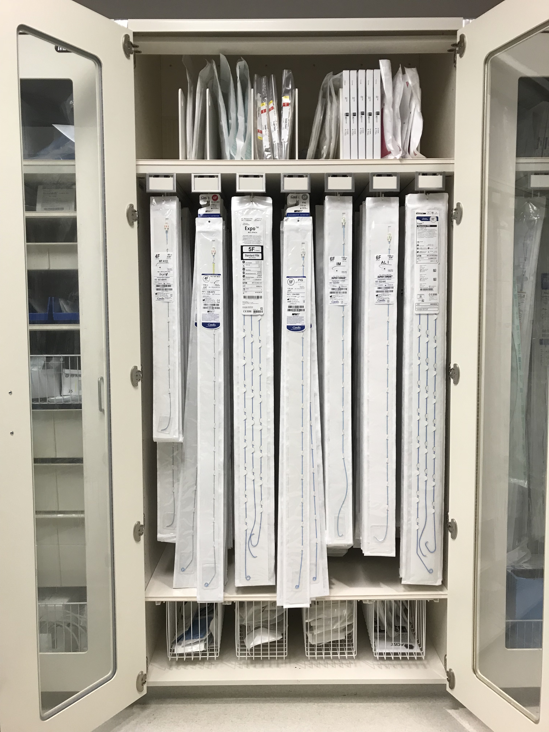
X-ray guided interventions
Image courtesy of Bill Schenke and Delaney McGuirt

Slide 5
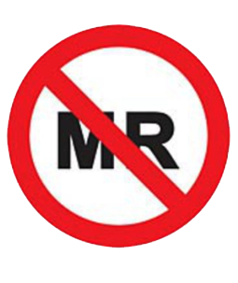
X-ray guided interventions
Image courtesy of Bill Schenke and Delaney McGuirt

Slide 6
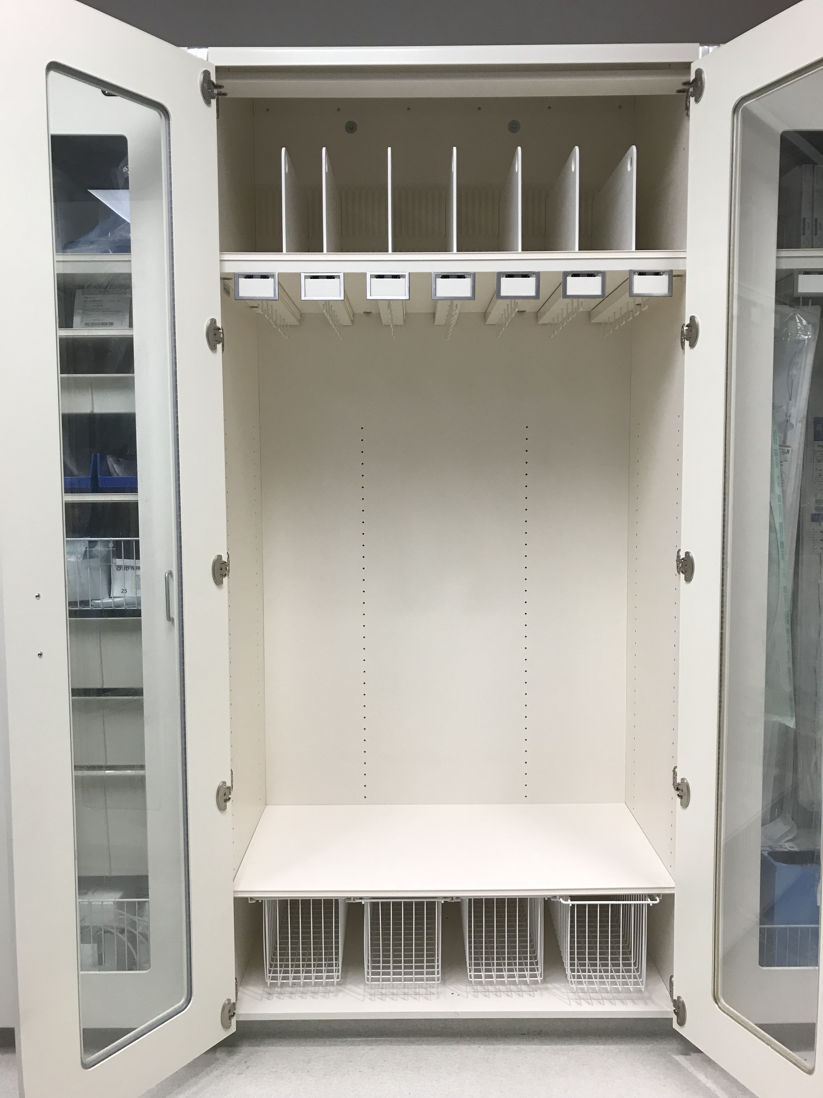
iCMR guided interventions
Image courtesy of Bill Schenke and Delaney McGuirt

Slide 7
Device safety
Heats during imaging

Slide 8
iCMR guided interventions
Image courtesy of Bill Schenke and Delaney McGuirt

Slide 9
Non-metallic catheters
Cook, Flow Directed Balloon Catheter, Model #: FDB5.3-35-80
Medtronic, Pulmonary Wedge Pressure Catheter, Model #: 150075
Vascor, Balloon Wedge Pressure Catheter, Model #: 172-110P
Edwards, True Size Monitoring Catheter, Model #: 111F7
Edwards, True Size Hi-Shore Monitoring "T" Tip Catheter, Model #: T111F7
Arrow, Balloon Wedge Pressure Catheter, Model #: AI-07127
Edwards, True Size Monitoring “S” Tip Catheter, Model #: S111F7

Slide 10
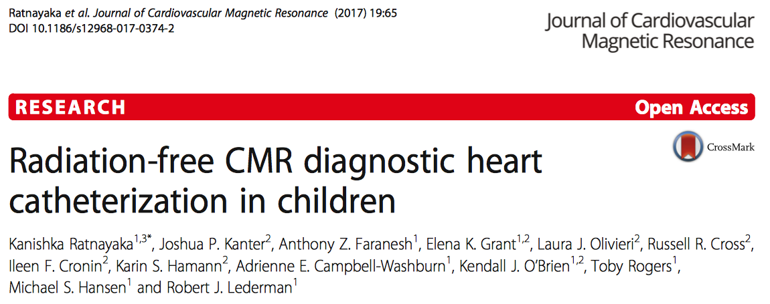

Slide 11
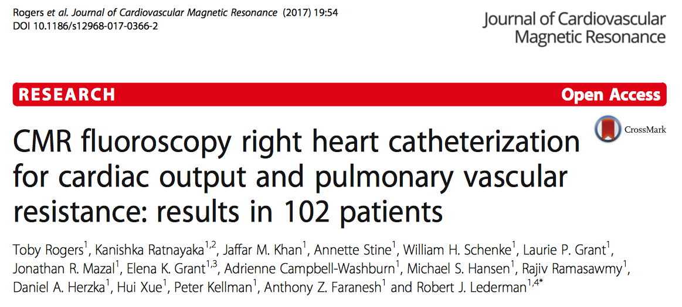

Slide 12
MR fluoroscopy guided cardiac catheterization

Slide 13
Heating is related to imaging parameters
2 min MR fluoroscopy
ΔT = 18°C
Standard MR Fluoroscopy
ΔT (°C)
ΔT = 11°C
70x reduction
ΔT = 2.3°C
ΔT = 0.22°C
ΔT = 0.15°C
Spiral MR Fluoroscopy
time
0.035” 145cm Nitinol guidewire (Nitrex, Medtronic)
Image courtesy of Adrienne Campbell-Washburn, PhD
Notes:
Guidewire type

Slide 14
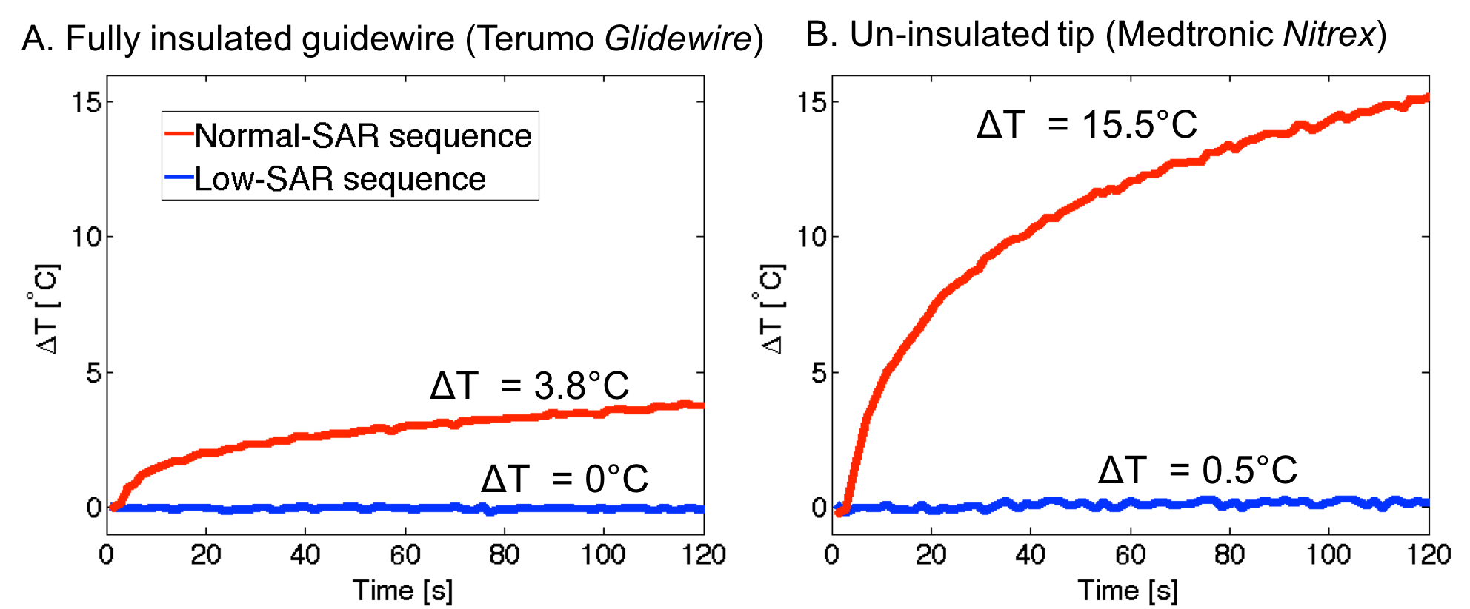
Not all metallic guidewires are the same

Slide 15
Clinical trial
Methods
7 patients
46±20 years
4 (57%) women
Clinically-indicated MR fluoroscopy right heart catheterization at the NIH Clinical Center
0.035” 150cm angled-tip Terumo Glidewire and Edwards T-tip balloon end-hole catheter

Slide 16
Clinical trial
Endpoints
Procedural success
Guidewire and catheter conspicuity
Adverse events
Pre- and post-procedure D-dimer and plasma free Hgb

Slide 17
Clinical trial
Results
100% procedural success
Guidewire imparts incremental stiffness and conspicuity to the catheter shaft
Guidewire tip often not visible
No adverse events
No change in blood assays

Slide 18
MR fluoroscopy IVC → SVC
Spiral gradient echo
Low flip angle (10°)
Long TR spiral readout (10msec)
Off-the-shelf 0.035” guidewire (Terumo)

Slide 19
iCMR guided interventions
Image courtesy of Bill Schenke and Delaney McGuirt

Slide 20
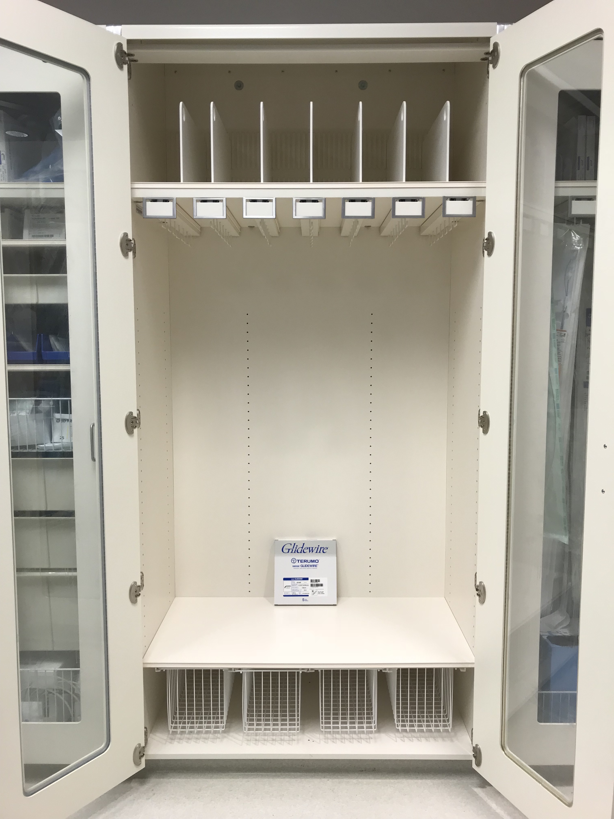
iCMR guided interventions
Image courtesy of Bill Schenke and Delaney McGuirt

Slide 21
Summary
Most X-ray catheters and guidewires heat during standard MR fluoroscopy
Engineering dedicated devices for MRI is hard
Engineering devices for MRI with the required mechanical properties to perform interventions is even harder

Slide 22
Summary
First-in-human report of cardiac catheterization with a commercially available metallic guidewire
Low-SAR MR fluoroscopy enables select metallic guidewires to be used safely for MR interventions
Modifying imaging parameters rather than re-engineering devices will accelerate clinical translation of MR interventions

Slide 23
CAUTION!

