Slide 1
MR guided electrophysiology imaging and catheters
Solenn TOUPIN, PhD
Electrophysiology and cardiac modeling institute – Bordeaux, France

Slide 2
Disclosure
Employee of Siemens Healthineers France

Slide 3
MR guided electrophysiology imaging and catheters
Catheter guidance
Ablation monitoring
Post-ablation lesion
imaging

Slide 4
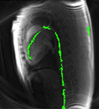
Catheter guidance : passive tracking
b-SSFP with positive contrast
b-SSFP
b-SSFP with partial SAT
Balloon catheter filled with air
Through-place dephasing for guidewire visualization
Balloon catheter filled with Gd
Courtesy of Adrienne Campbell
Adapted from supplementary material video
Real-time MRI-guided right heart catheterization in adults using passive catheters, K Ratnayaka A Faranesh, EHJ 2013
Improved passive catheter tracking with positive contrast for CMR-guided cardiac catheterization using partial saturation (pSAT), M Forte, K Pushparajah et al, JCMR 2017
Positive contrast spiral imaging for visualization of commercial nitinol guidewires with reduced heating, A. E. Campbell-Washburn, T. Rogers et al, JCMR 2015

Slide 5
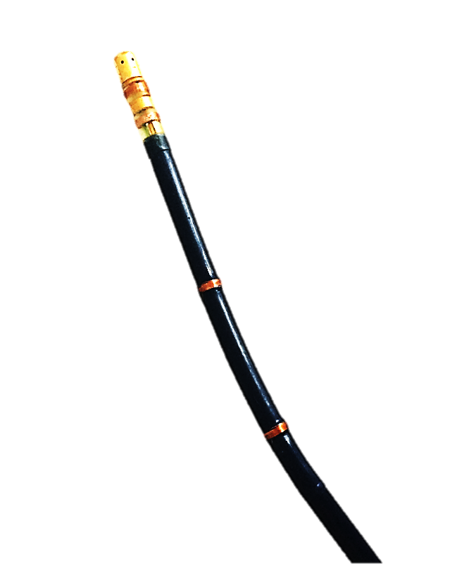
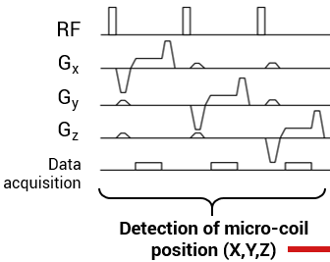
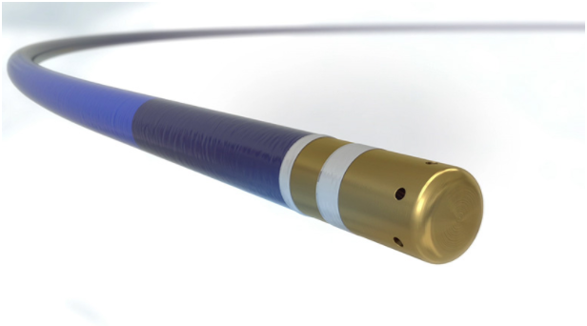
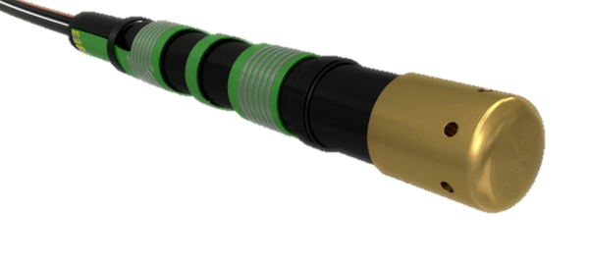
Catheter guidance : active tracking
Micro-coils
B₀
Magnetic field gradient
Frequency peak

Slide 6
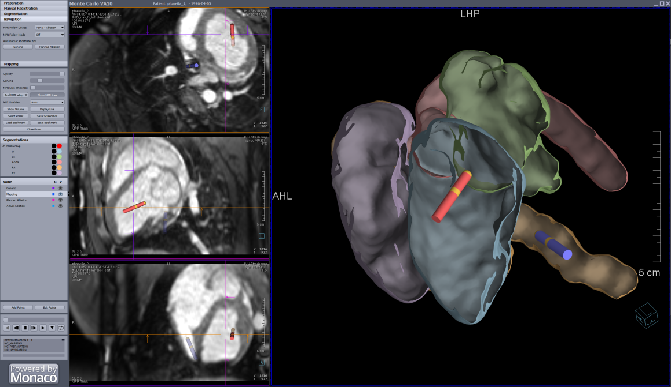
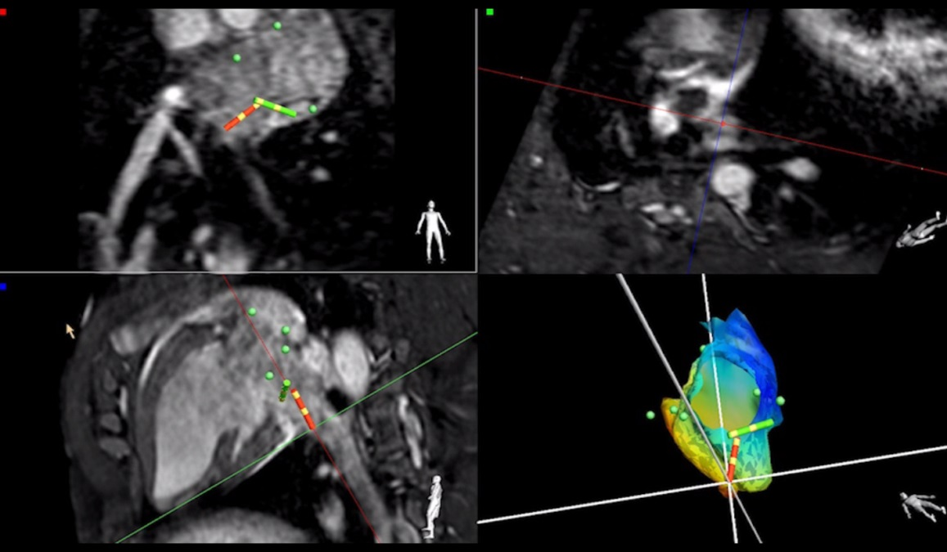
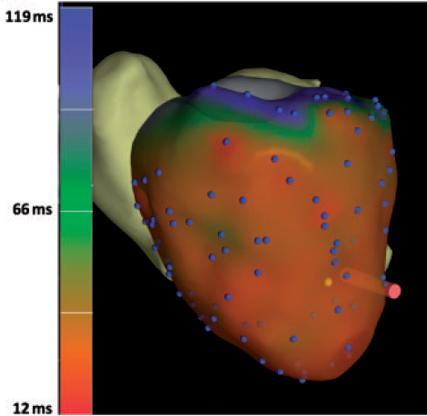
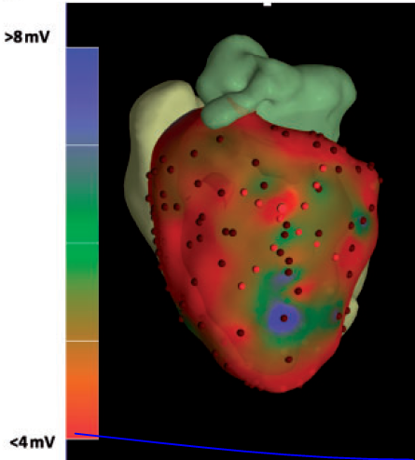
Interactive interface
Compatible with active and passive tracking
3D volume and segmentation of heart chambers
Real-time interactive sequence (b-SSFP)
Electro-anatomical mapping if coupled to an EP software
Markers for mapping and ablation spots
Epicardial electroanatomical mapping, radiofrequency ablation, and lesion imaging in the porcine left ventricle under real-time magnetic resonance imaging guidance—an in vivo feasibility study, R. Mukherjee, S. Roujol et al, JCMR 2017
Gaspar et al., EHJ 2014

Slide 7
Ablation monitoring: real-time MR thermometry
Challenges for iCMR :
High temporal resolution ~1s
High spatial resolution
Motion correction between phase maps
Inline calculation of MR thermometry
Temperature precision < 2°C

Slide 8
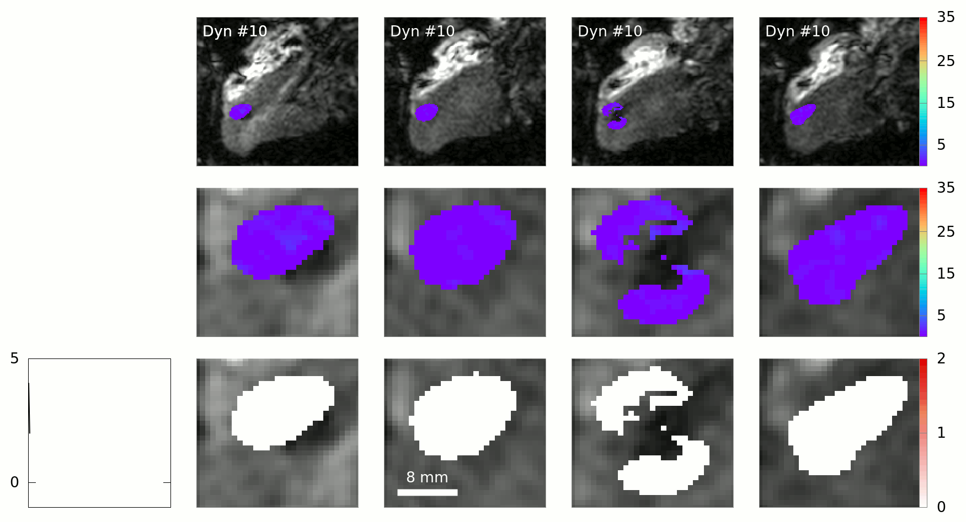
Ablation monitoring : real-time MR thermometry
Slice #1
Slice #2
Slice #3
Slice #4
Temperature (°C)
Temperature (°C)
Cumulative thermal dose
Lethal threshold
Feasibility of real-time MR thermal dose mapping for predicting radiofrequency ablation outcome in the myocardium in vivo, S. Toupin, P. Bour et al JCMR 2017

Slide 9
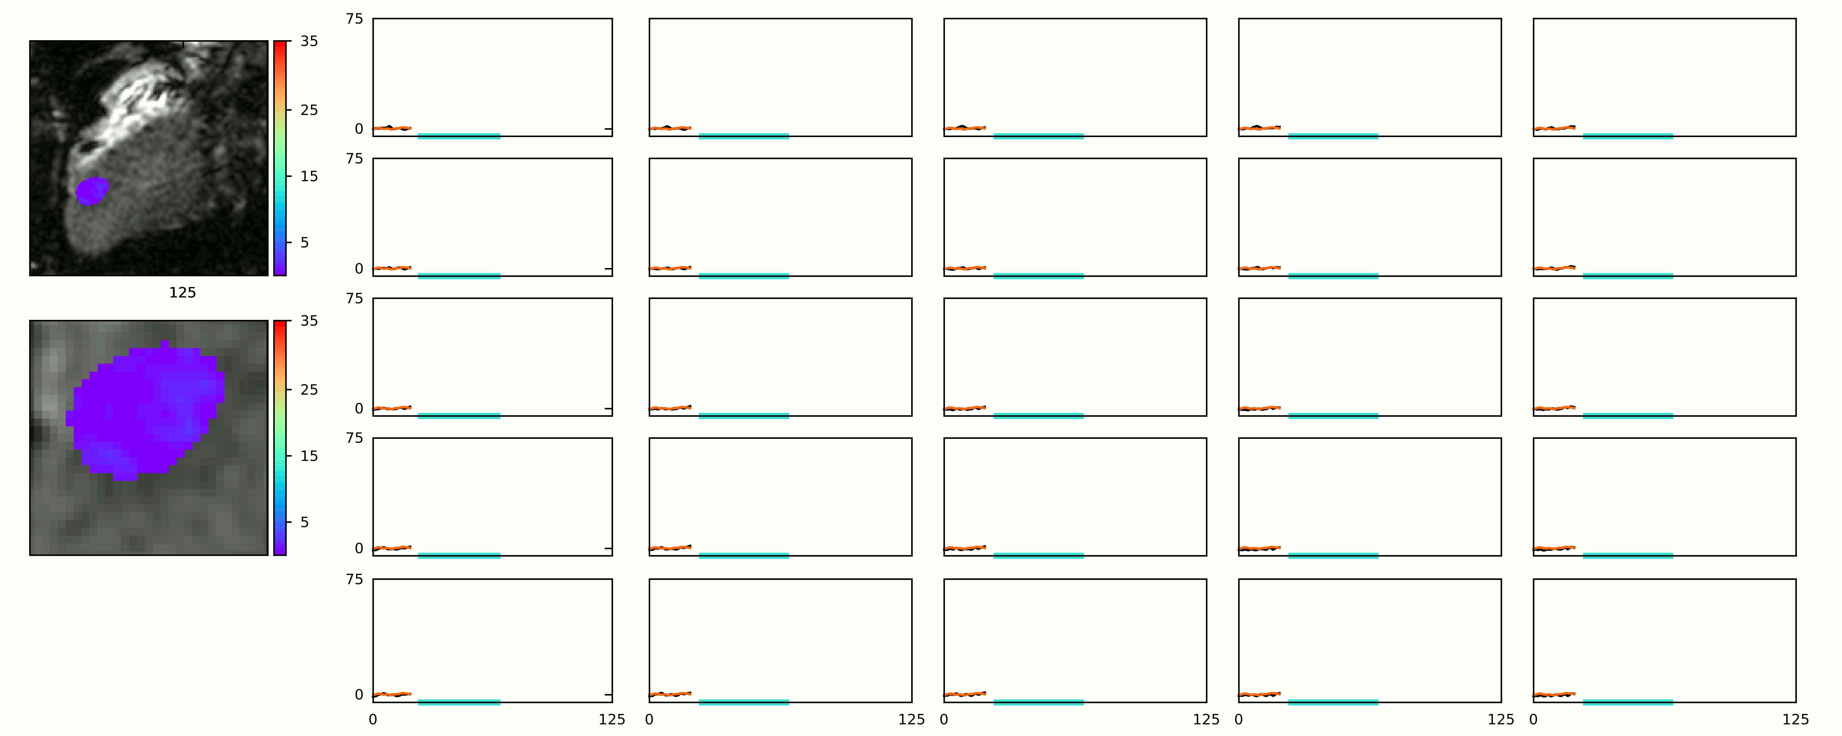
Ablation monitoring : real-time MR thermometry
Temperature evolution (°C) in 5x5 voxels
Time (s)
Feasibility of real-time MR thermal dose mapping for predicting radiofrequency ablation outcome in the myocardium in vivo, S. Toupin, P. Bour et al, JCMR 2017

Slide 10
Ablation monitoring : MR dosimetry
Thermal dose
Thermal dose
Gross macroscopy
T1-w imaging
Epicardial electroanatomical mapping, radiofrequency ablation, and lesion imaging in the porcine left ventricle under real-time magnetic resonance imaging guidance—an in vivo feasibility study, R. Mukherjee, S. Roujol et al, JCMR 2017
Feasibility of real-time MR thermal dose mapping for predicting radiofrequency ablation outcome in the myocardium in vivo, S. Toupin, P. Bour et al, JCMR 2017

Slide 11
Ablation monitoring : chemoablation
Real-time visualization of ablation lesions
Irreversible necrosis
Transmural lesions

Slide 12
Post-ablation visualization of lesion
Late gadolinium enhancement
15 min after injection
Vijayakumar et al.: Assessment of cardiac RF ablation lesions by DCE-MRI. Journal of Cardiovascular Magnetic Resonance 2014
85 min after injection
Gross pathology
Adapted from Figure 1
Characterization of radiofrequency ablation lesions with gadolinium-enhanced cardiovascular magnetic resonance imaging, T Dickfeld, R Kato, J Am Coll Cardio, 2006

Slide 13
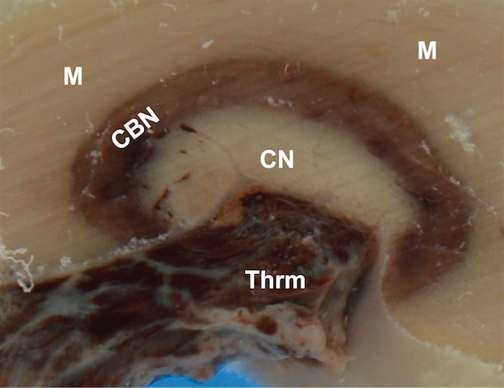
Post-ablation visualization of lesion
Non contrast T1 weighted volume: TI 700-800 ms
Post-ablation visualization of all RF lesions at once in 3D
Absence of contrast agent
Voxel size 1.1x1.1x2.5 mm³
2 RR ECG triggered
Respiratory gated
T1w
T1w (MPR SAX)
Gross Photography
M: Normal myocardium
CBN: Contraction band
necrosis / hemorrhage
CN: Coagulation necrosis
Thrm: Thrombus
Courtesy of Michael Guttman
Non-Contrast-Enhanced T1-Weighted MRI of Myocardial Radiofrequency Ablation Lesions
M. Guttman, S Tao et al, MRM 2017
Gross Photography

Slide 14
Acknowlegments
Bruno Quesson
Valery Ozenne
Pierre Bour
Slides
Christopher Piorkowski
Adrienne Campbell
Michael Guttman
Rainer Schneider
Thomas Pohl

