Slide 1
Interventional CMR Course Real-time Phase Contrast MRI: Present & Future
Rajiv Ramasawmy, PhD
Laboratory of Cardiac Intervention
National Heart, Lung and Blood Institute
Thursday 1st February 2018
CMR 2018

Slide 2
Interventional CMR | Real-time Phase Contrast MRI: Present & Future
Disclosures
I have no financial interests or relationships to disclose with regard to the subject matter of this presentation.

Slide 3
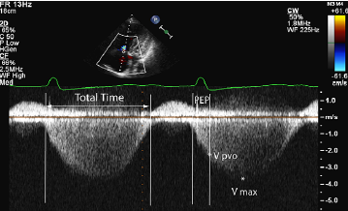
Interventional CMR | Real-time Phase Contrast MRI: Present & Future
Measuring cardiac output
Fick
Estimated VO₂
Blood sampling
Thermodilution
Regurgitation/shunt insensitive
Limited repeats
Ultrasound
- Real-time stroke volume (mL)
Cardiac output (L/min)
$${CO}_{Fick}= \frac{VO_{2}}{C_{a}−C_{v}}$$
Haddad 2009
$${CO}_{Td}= \frac{V_{i}\left(T_{B,0}−T_{i}\right)K}{\int{T_{B}dt}}$$
$$CO=SV ×HR$$
iCMR: Beat-to-beat CO to guide provocations
Pulmonary vascular resistance (PVR)
Notes:
WHY do we want beat-to-beat?

Slide 4
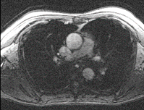
Interventional CMR | Real-time Phase Contrast MRI: Present & Future
Phase Contrast MRI 101: Velocity Encoding
Gradients (G)
Phase world
Slice exc.
Imagacq.
static
moving
$φ$ = 0
$φ$ ≠ 0
time
$$v= \frac{Δφ}{γ ΔM_{1}}$$
Phase (φ)
moving
time
static
“flow compensated”
“flow encoded”
“phase difference”
Real world
Magnetic field
Space

Slide 5
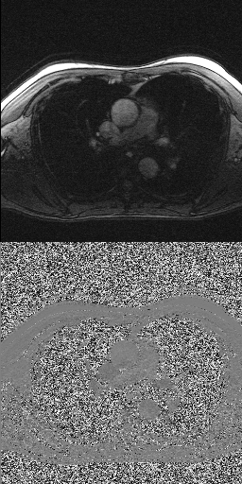
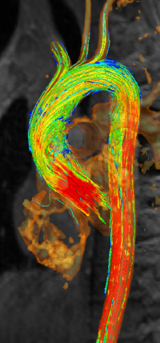
Interventional CMR | Real-time Phase Contrast MRI: Present & Future
Phase Contrast MRI 101
2D flow
4D flow
Robust
Stroke volume
Cardiac output
Free-breathing, retrospectively ECG-gated acquisition at high spatial resolution ~2-3 minutes
Pretty pictures
Visualize abnormal flow
Wall shear stress
CFD of intervention outcomes
Free-breathing, retrospectively ECG-gated acquisition ~ 15-20 minutes
Dyverfeldt 2015

Slide 6
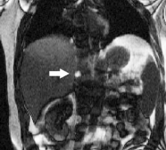
Interventional CMR | Real-time Phase Contrast MRI: Present & Future
Real-time flow
Temporal resolution: 40 ms/25 fps
Spatial resolution: 2.5 x 2.5 mm²
(4D flow CMR consensus statement, Dyverfeldt et al., 2015)
Exercise/pediatric heart rates ~140 bpm (~ 15 ms/65 fps temp res)
Flow
Time
Catheter-guiding real-time ~10 frames/sec
Rogers 2017
Non-acc Acq. | Temp res. | Frames/sec
Cartesian | 200 ms | 2.5
EPI | 100 ms | 10
Radial | 350 ms | 2.9
Spiral | 100 ms | 10

Slide 7
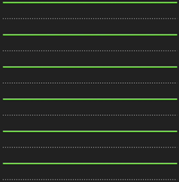
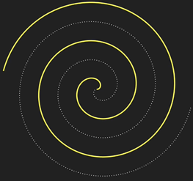
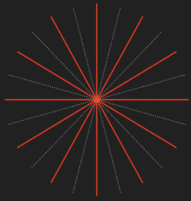
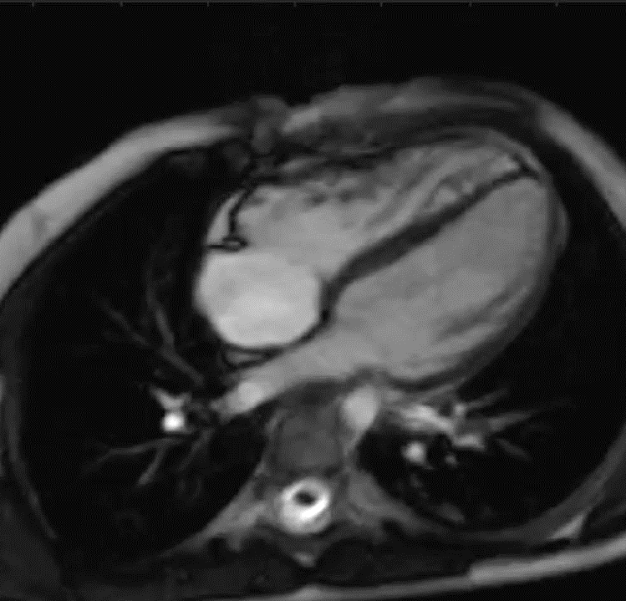
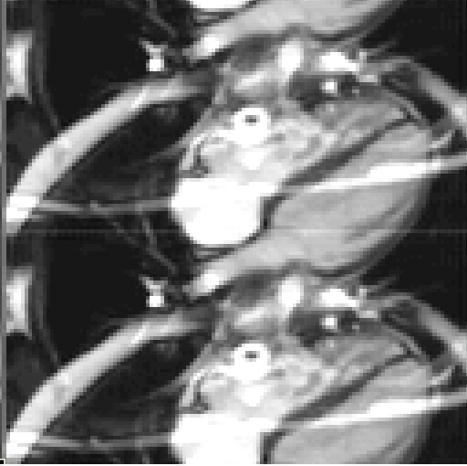
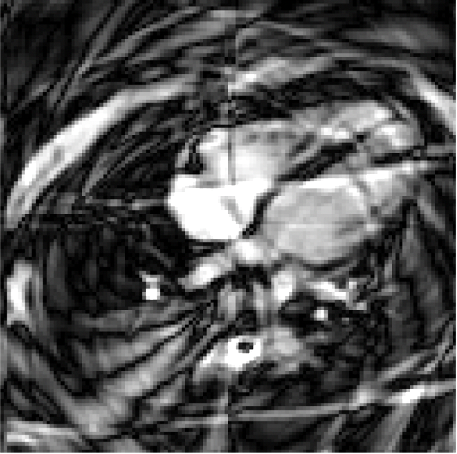
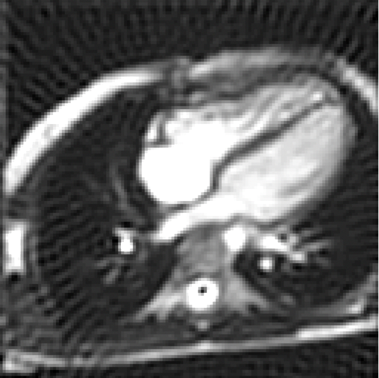
Interventional CMR | Real-time Phase Contrast MRI: Present & Future
Real-time flow – MRI acquisition methods
EPI
Spiral
Radial
Cartesian
Accelerated
Spiral
Radial
“Wrap”
“Swirl”
“Streak”
7

Slide 8
Interventional CMR | Real-time Phase Contrast MRI: Present & Future
Image reconstruction
GRAPPA
Iterative SENSE
Temporal encoding
Sparse encoding
k
FT
GRIDDING
IFT
t

Slide 9
Interventional CMR | Real-time Phase Contrast MRI: Present & Future
Ideal real-time workflow
Acquisition (temporal resolution)
1
2
3
4
5
Reconstruction
1
2
3
4
Processing
1
2
3
4
Feedback

Slide 10
Interventional CMR | Real-time Phase Contrast MRI: Present & Future
“Real-time” image reconstruction
Temp. res | Recon. latency | Technique (source)
44 ms | 27 ms | Spiral flow SENSE (Kowalik 2012)
50 ms | 48 ms | radial SENSE (Sorenson 2009)
40 ms | 160 ms | Radial flow (Joseph 2014)
18 ms | 116 ms | Spiral GRAPPA (Lingala 2017)

Slide 11
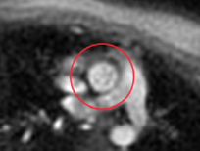
Interventional CMR | Real-time Phase Contrast MRI: Present & Future
Image Analysis
Segmentation
Manual: 12 s/frame
Automatic: 70 ms/frame
Real-time data can self-generate bins for registration
Motion correction
Gadgetron: Open-source and in-line
Barber 2016
Odille 2011
Real-time with MoCo

Slide 12
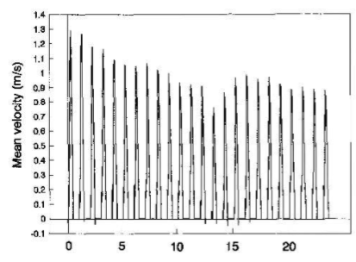
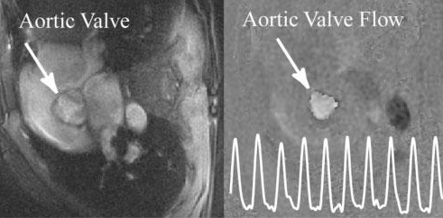
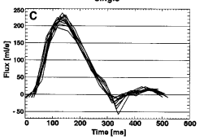
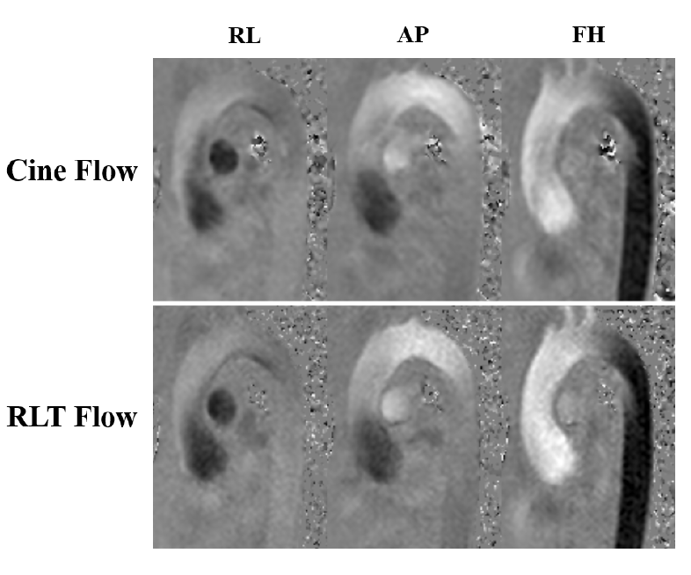
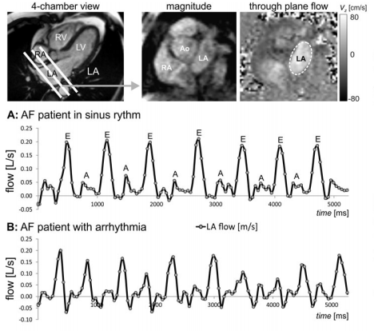
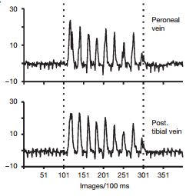
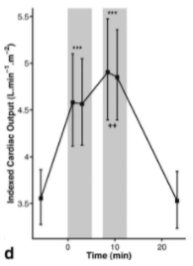
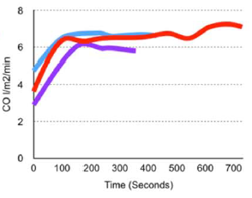
Interventional CMR | Real-time Phase Contrast MRI: Present & Future
Real-time flow examples: Past and present
Gatehouse 1994
Koperich 2012
Nezafat 2005
Sun 2017
Jones 2011
Markl 2015
Barber 2016
Joseph 2012

Slide 13
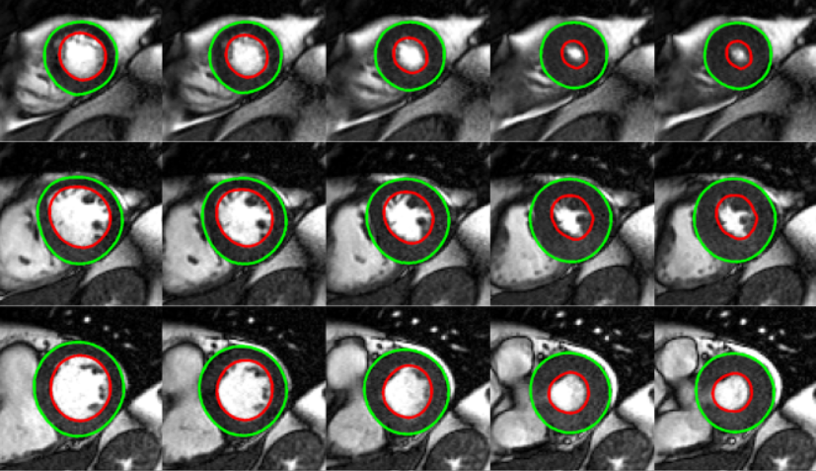
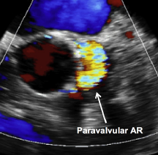
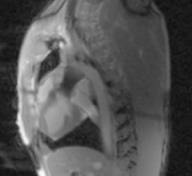
Interventional CMR | Real-time Phase Contrast MRI: Present & Future
Future methods and applications
Methods:
Machine-learning to accelerate reconstruction and analysis
Cloud reconstruction
iCMR real-time flow applications:
Pressure-Volume loops
Trans-catheter valve replacement assessment
Sinning 2013
Miller 2016
Tan 2018

Slide 14
Acknowledgements:
Robert J. Lederman, MD
Kanishka Ratnayaka, MD
Elena Grant, BM BCh
Toby Rogers, BM BCh
Jaffar Khan, BM BCh
Dan Herzka, PhD
Anthony Z. Faranesh, PhD
Michael S. Hansen, PhD
Adrienne Campbell-Washburn, PhD
Peter Kellman, PhD
Hui Xue, PhD
Matthew Restivo, PhD
Mahamadou Diakite, PhD
Burcu Basar, BSc
Delaney McGuirt, BS, RT
Jonathan Mazal, MS, RA
William H. Schenke, BS
Katherine Lucas
Laurie P. Grant, RN, NP
Annette M. Stine, RN
Jennifer Steeden, PhD - UCL
rajiv.ramasawmy@nih.gov

