Slide 1

ICMR Defibrillators
Ehud J Schmidt¹
JHU/BWH/Stanford prototype: Ehud J Schmidt^{1,4}, Ronald D Watkins², Menekhem M Zviman^{1,3}, Michael A Guttman¹, Wei Wang⁴, Hassan Elahi¹, Eric S Meyer¹, Ron Berger¹, Henry R Halperin¹
PinMed/Iowa/NHLBI prototype: V. Shusterman^{5,6}, Denice Hodgson-Zingman⁶, Daniel Thedens⁶ , Xiaodong Zhu⁶ , Stacy Hoffman⁵ , Jessica Sieren⁶ , Gina M. Morgan⁶ , Anthony Faranesh⁷ , Rajiv Ramasawmy ⁷ , Adrienne Campbell-Washburn³, Barry London⁶
¹Cardiology, Johns Hopkins University, Baltimore MD. ² Radiology,
Stanford University, Stanford CA, ³University of Pennsylvania, Philadelphia PA
⁴Radiology, Brigham and Womens’ Hospital, Boston MA
⁵PinMed, Inc., Pittsburgh PA, ⁶The University of Iowa, Iowa City IA,
⁷NHLBI, Bethesda, MD

Slide 2
Declaration of Relevant Financial Interests or Relationships
Speaker Name: Ehud J Schmidt
Presented Defibrillation and 12-lead ECG systems are not FDA Regulatory Cleared
Patents have been submitted for the MRI-compatible External Defibrillator, and the Pain-less defibrillation by Johns Hopkins University
JHU prototype Grant Support: NHLBI R01-HL094610
Pinmed prototype Grant Support: NHLBI contract HHSN268201500009C
US government employees: Anthony Faranesh, Rajiv Ramasawmy, Adrienne Campbell-Washburn
Pinmed employees: Vladimir Shusterman, Stacy Hoffman
Notes:
2

Slide 3
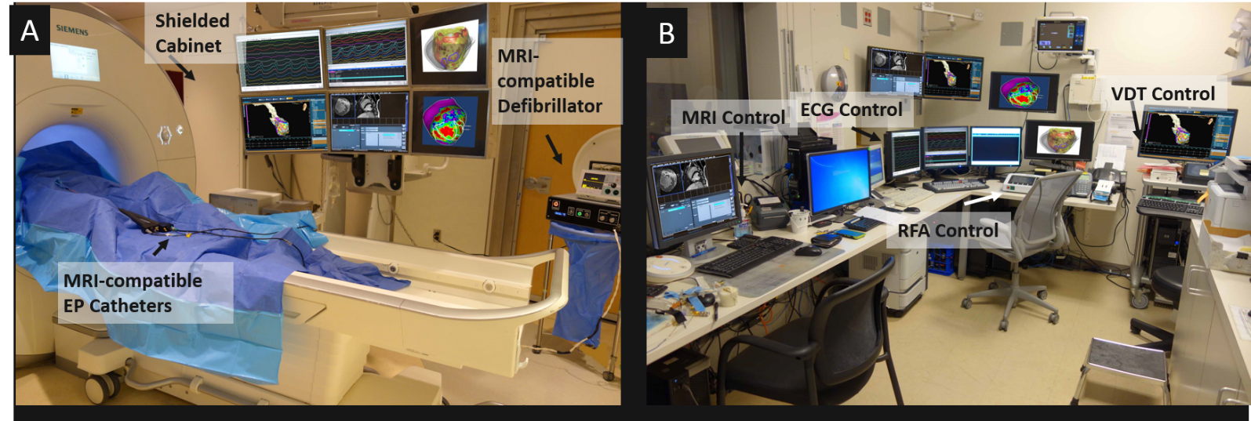
Topics
Why is Defibrillation in MRI required?
Requirements for MRI-compatible defibrillation systems
System Design
System Testing
Human Volunteer safety and RFI testing
Animal defibrillation results
Addressing the Muscle contraction issue
Reducing Motion and Pain

Slide 4
Need for Defibrillation in MRI Suite
MRI Imaging/intervention on severely-ill patients is not performed
12-lead ECG monitoring of patients not commercially available.
without 12-lead ECG, detection of acute ischemia may be very late!
Defibrillation now requires;
  Patient removal from magnet bore
  Coils and other peripherals disconnected
  Patient removal from MRI table and MRI suite
valuable time is lost, with each minute reducing survival by 5%
Patient populations currently excluded from MRI imaging
Acute tachycardia or higher-risk post-infarct patients
Trauma (stroke, spine & orthopedic trauma)
MRI exercise stress tests on higher-risk patients
Patient populations currently excluded from non-cardiovascular
Or cardiovascular MRI-guided intervention
Unstable (Blood Pressure, Heart Rate) patients
Patients with implanted devices*
Patients with ischemic histories

Slide 5
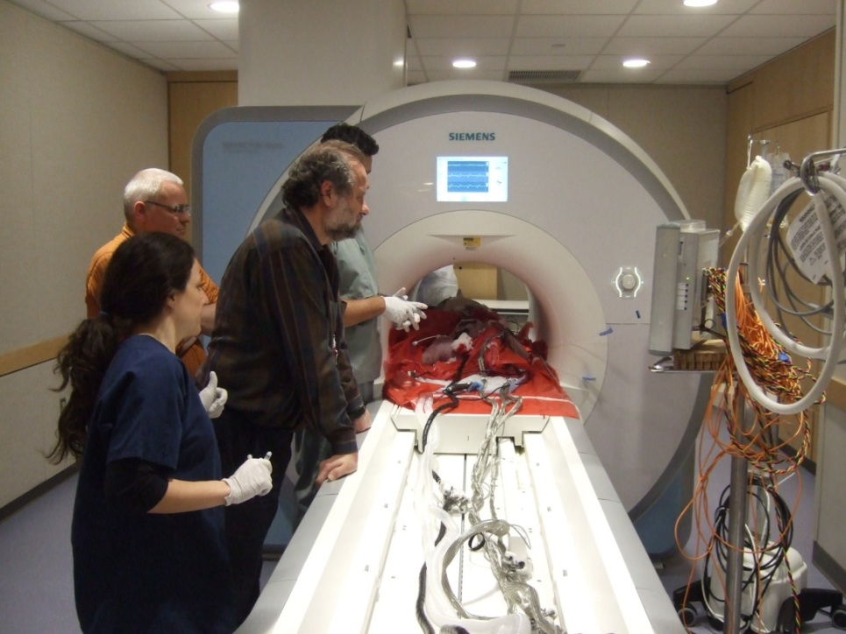
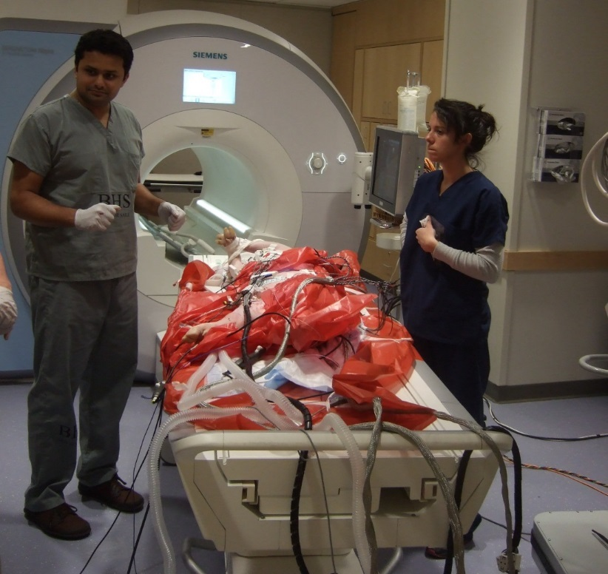
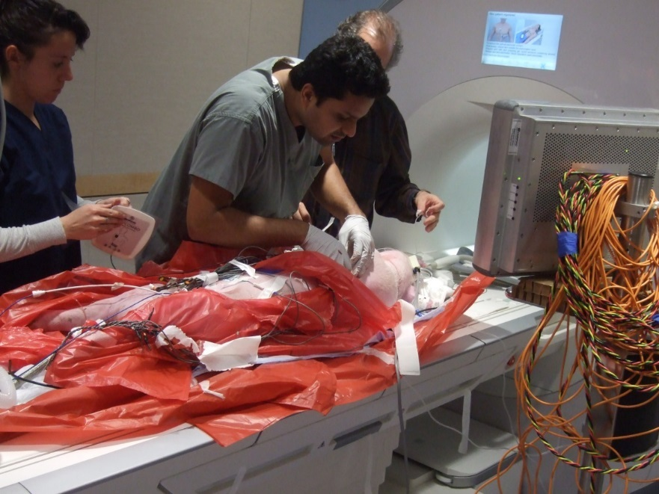
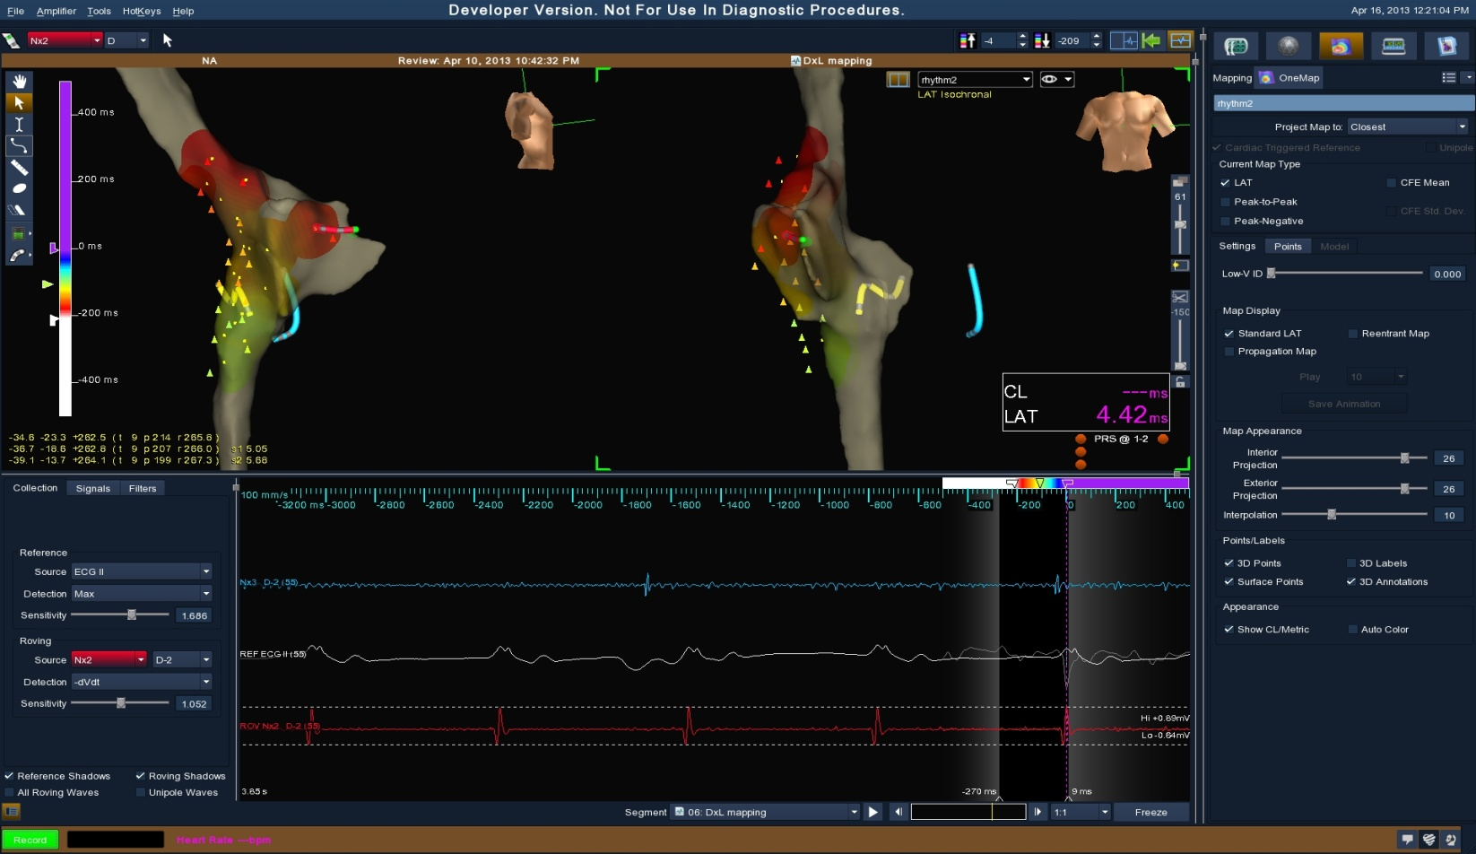
Ventricular Tachycardia during EP Atrial Fibrillation ablation
2 hrs into procedure =>MRI Table undocked for Defibrillation.
Swine Example of Late Detection of VT in a 3T MRI study

Slide 6
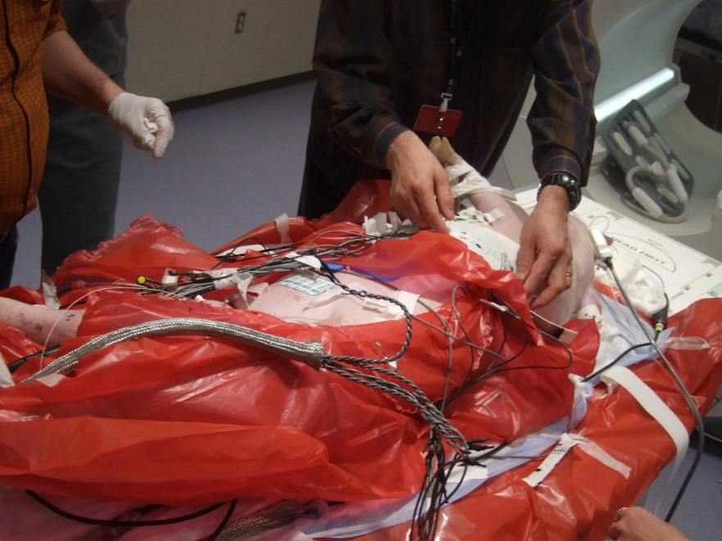
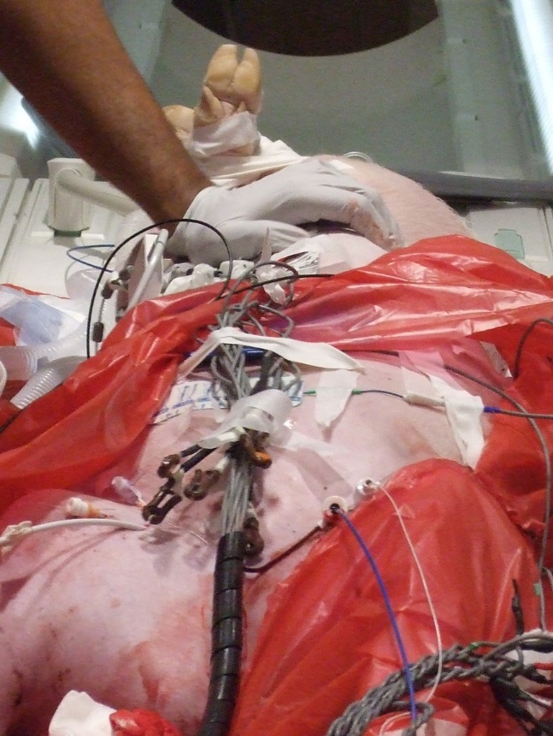
Swine Example of Late Detection of VT in a 3T MRI study
Defibrillation & CPR performed in the MRI Room
Defibrillation is frequently performed during
Human EP (VT) interventions!

Slide 7
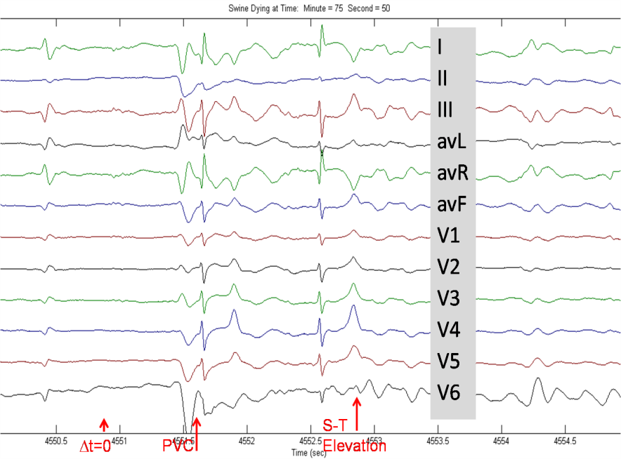
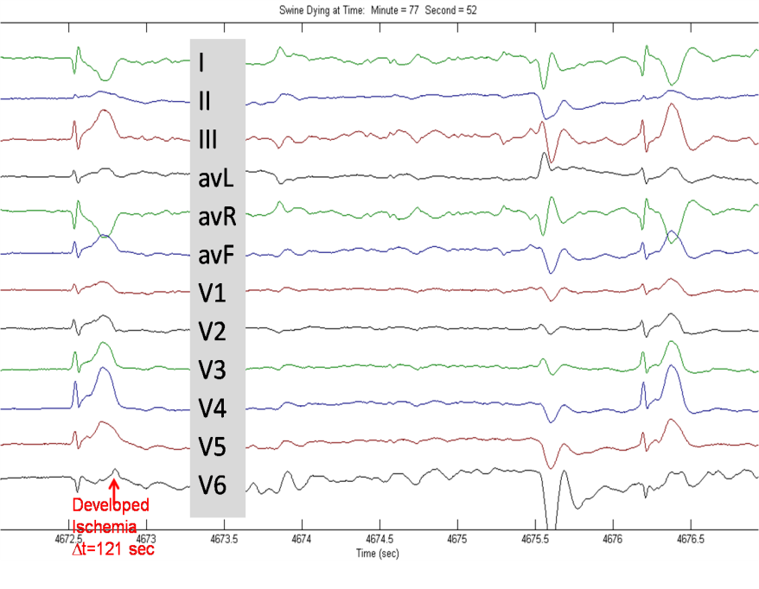
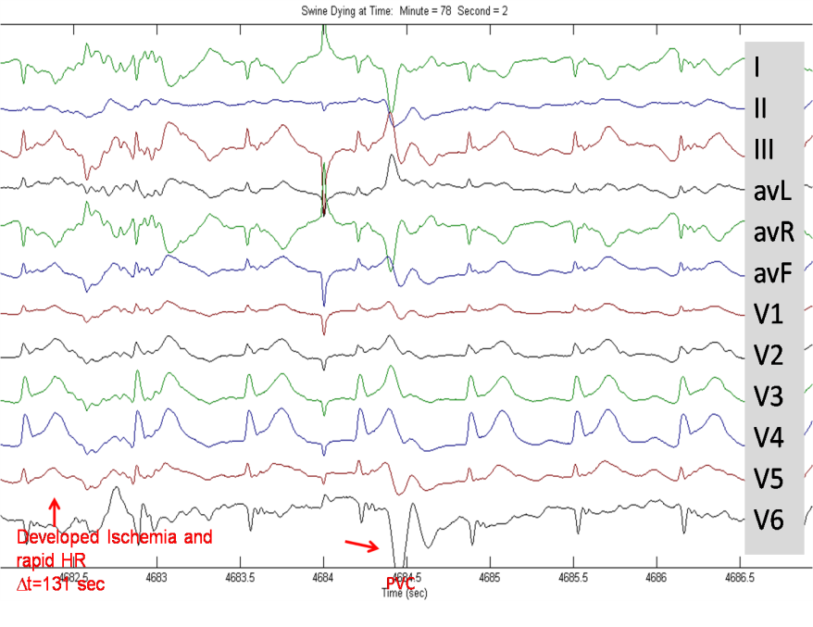
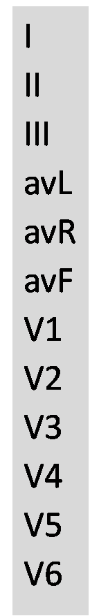
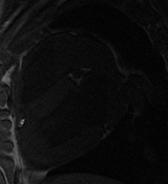
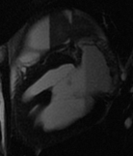
Detection of Acute Ischemia in a 1.5 T MRI with a 12-lead ECG
Balloon in LAD
Inflated to 20 Atm.
20 min until death
Continuous ECG
Continuous MRI
7
Contrast MRA
T2
Tse ZTE et. al MRM 2013, Circulation 2012

Slide 8
Requirements for an MRI-compatible Defibrillator
On demand (2 KV) defibrillation in the MRI Magnet
Defib. Generator (or control) in the MRI Room
Pads continuously on patient & connected to generator
Generator always ON, in ECG monitoring mode
Generator senses ECG pads (Zoll: 67 KHz) - ready for Defib delivery
Unhindered MR Imaging performance
Minimal SNR loss due to connection of defibrillator and pads
Minor Image artifacts due to defibrillation pads
RF heating <1.5 Cº @ 4 Watts/kg SAR
MRI system and peripherals withstand defibrillation pulses
Patient monitoring system
12-lead ECG monitoring system
MR Imaging equipment (MRI electronics, MRI coils)

Slide 9
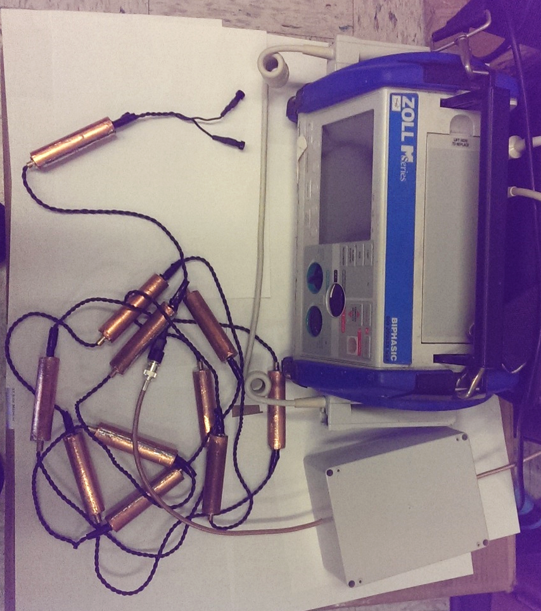
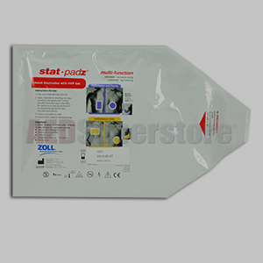
MRI-Compatible Defibrillator Components (JHU system)
Zoll Medical
M-Series
Defibrillator
Generator
10-Pole Low-Pass
Filter
Twisted Pair
High-voltage
Cable w/ RF Baluns
every 30 cm
Zoll Stat Padz
Multifunction
Defibrillation
Pads
Differential Mode
Unit
Common Mode
Unit
MRI-Compatible Defibrillator Block Diagram
Defibrillator
Generator
Low Pass
Filter
Unit
Defib. Pads
(Disposable)
High Voltage
Twisted Pair
Cable
RF Baluns

Slide 10
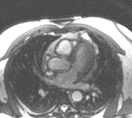
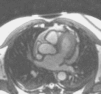
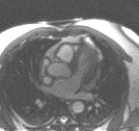
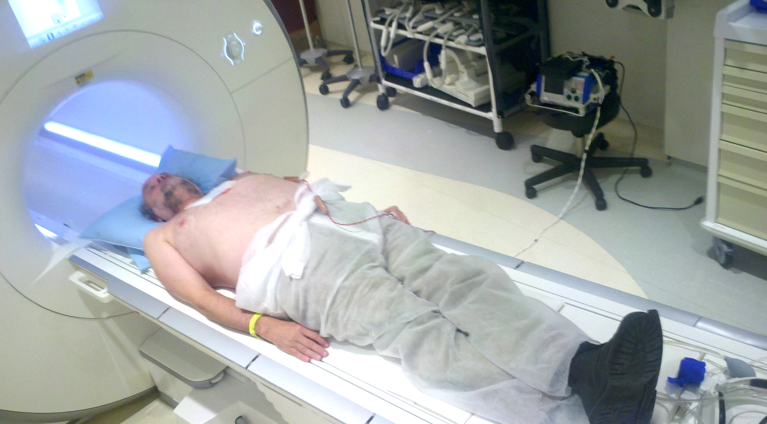
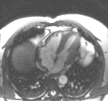
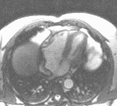
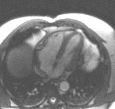
Human MRI SNR and Safety testing
pad artifact
LP Filter
SSFP
Slice 1
Zoll M
Defibrillator
Generator
Defibrillation Pad
Baluns
SSFP
Slice 2
System OFF
System ON
Battery power
System ON
A/C Line power
System Layout In MRI Suite
Defib Pad artifacts extend only 6 mm from surface (SSFP)
SNR Reduction of 1.6 dB=17% (A/C power) , 0.8 dB=8% (battery power)
~90dB reduction in 63.8 MHz noise
No RF heating during imaging

Slide 11
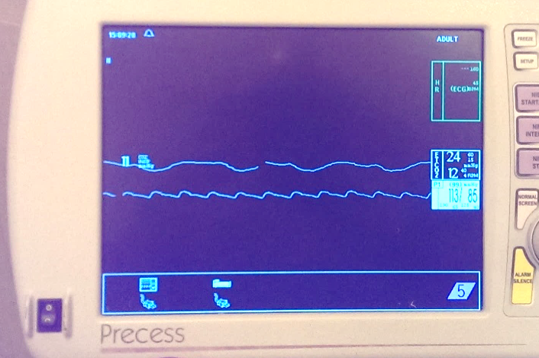
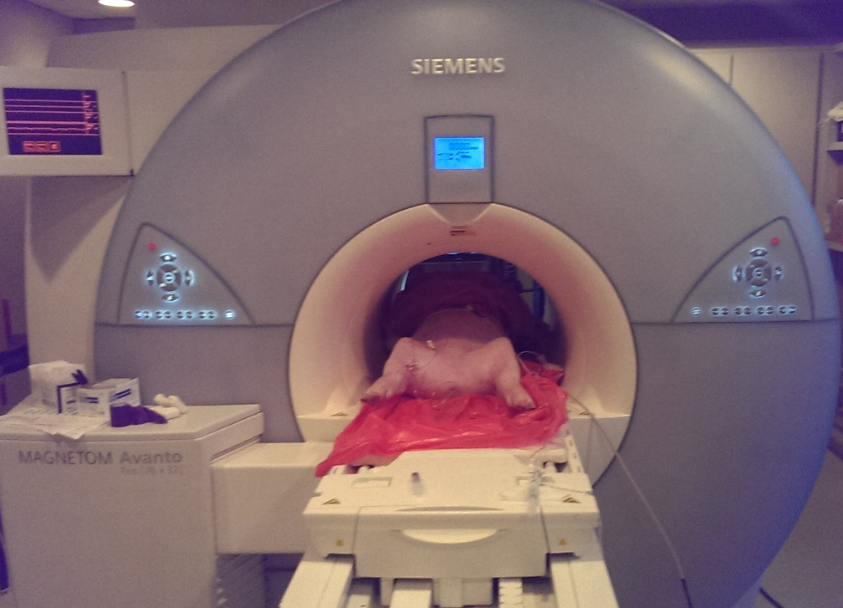
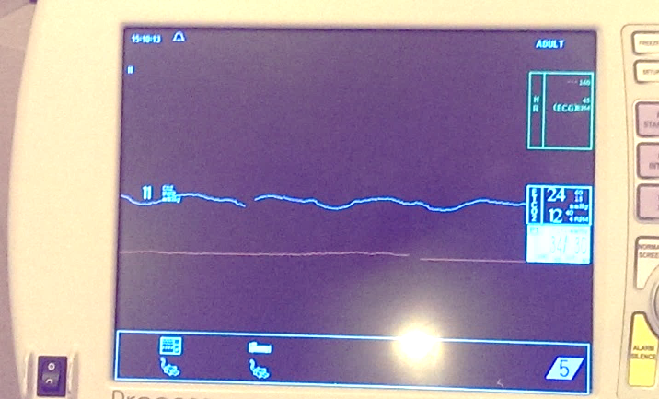
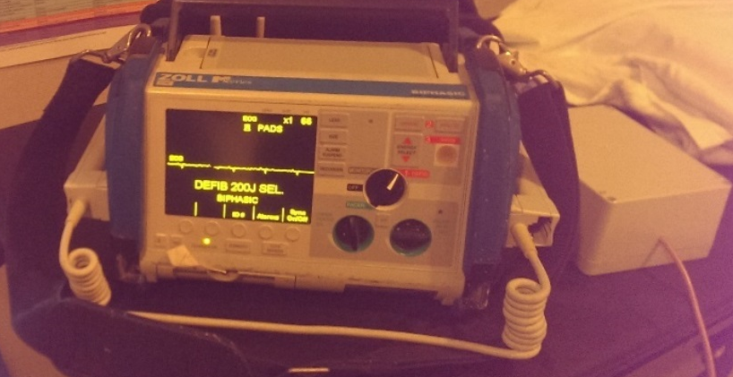
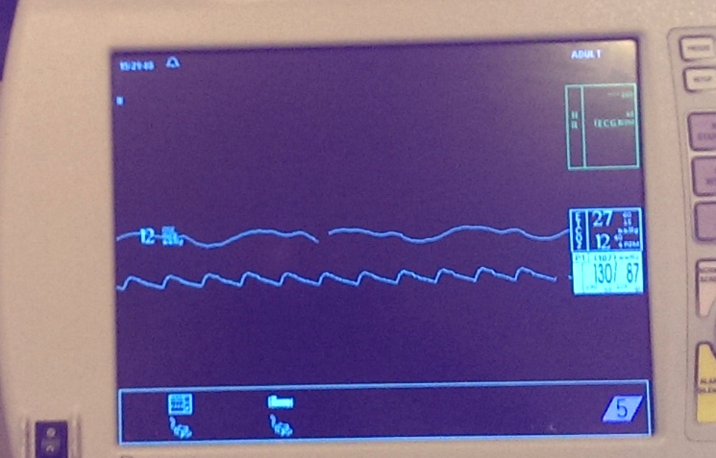
Swine Fibrillation and Defibrillation Testing (II)
Hemodynamic Display before Fibrillation
Defibrillation
Cable
Hemodynamic Display during cardiac arrest
Swine in 1.5T MRI during cardiac arrest
Hemodynamic Display after
Defibrillation
Zoll Generator and filter in MRI room

Slide 12
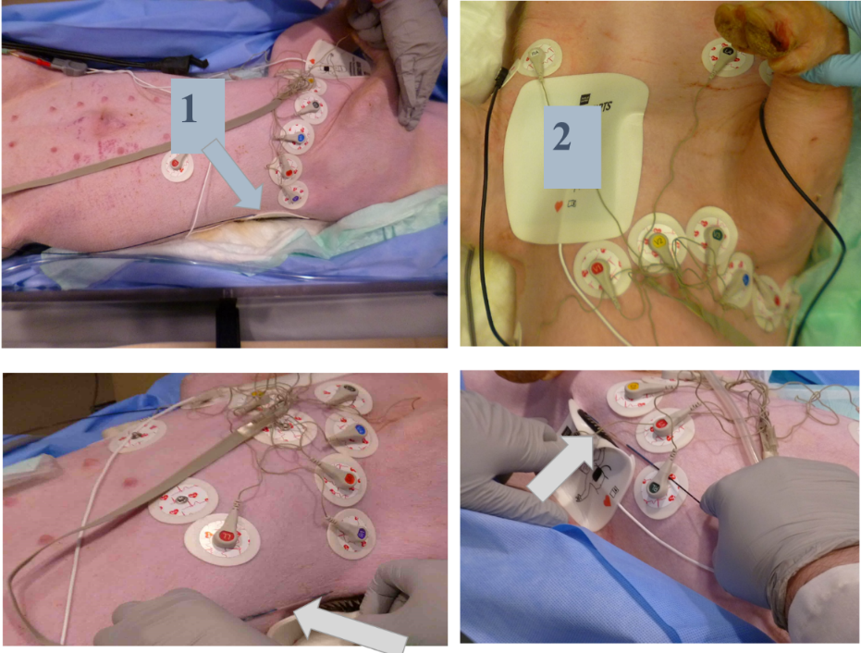
Defibrillation Experiments (Pinmed)
Medtronic LifePak20defibrillator
custom cables (Pinmed)
12 lead Mri compatible ECG (Pinmed)
1.5 T MRI
Defibrillator pads in the left-posterior axillary (1) and right subclavian (2).
Temperature under defibrillator pads recorded using fiber-optic temperature probes (arrows).
18 experiments.
Defibrillation inside bore during continuous 2D SSFP imaging.
Shusterman V et. al, Circulation 2017;136:A13735

Slide 13
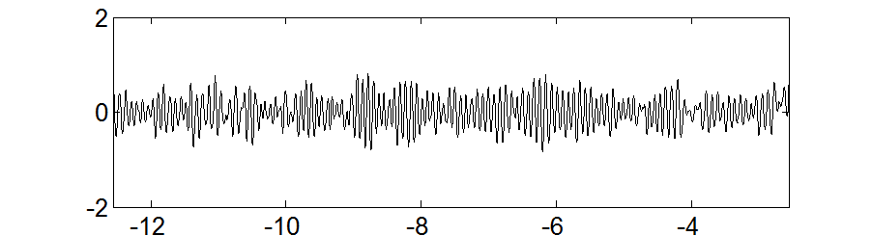
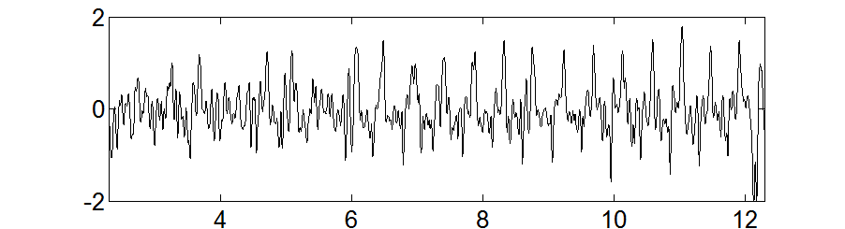
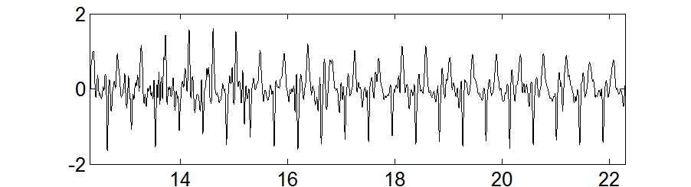
Swine Defibrillation Success (Pinmed)
Defibrillation successful in 100% of experiments at 1.5 T
10% reduction in SNR with Defibrillation Generator ON.
ECG in lead V1 before defibrillation and after defibrillation during MRI scanning (SSFP) in a swine;
Fibrillation
Post-Defibrillation
ECG [mV]
ECG [mV]
Time [sec]
Time [sec]
ECG [mV]
Time [sec]
Shusterman V et. al, Circulation 2017;136:A13735

Slide 14
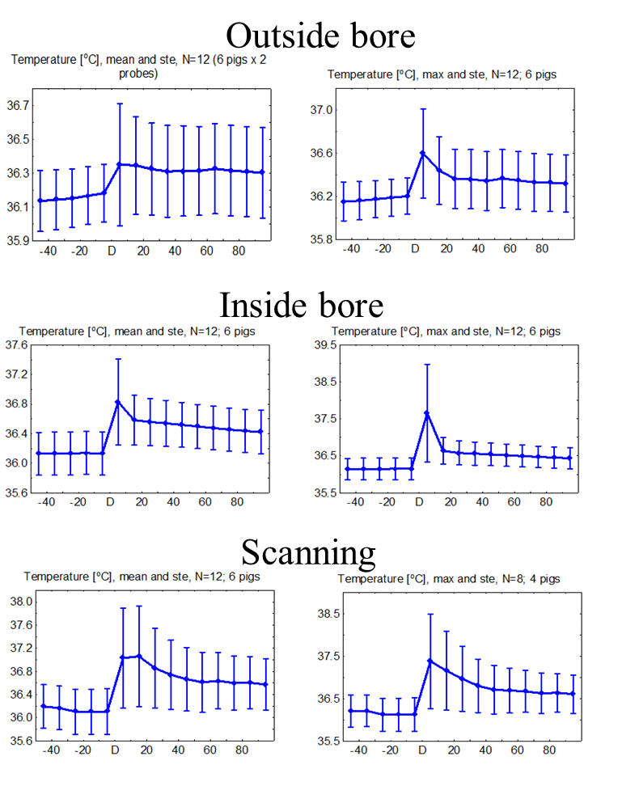
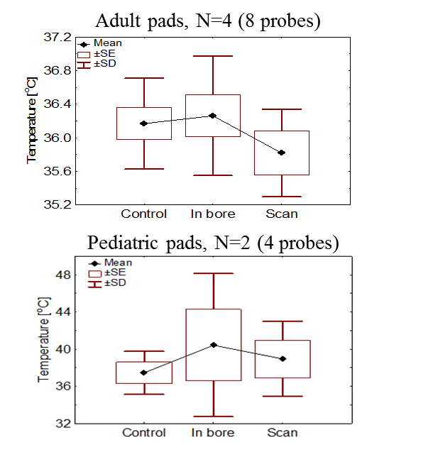
Temperature changes during defibrillation (Pinmed)
Temp. changes before, during and
after defib
Temperature 10 sec after defibrillation
Max

Slide 15
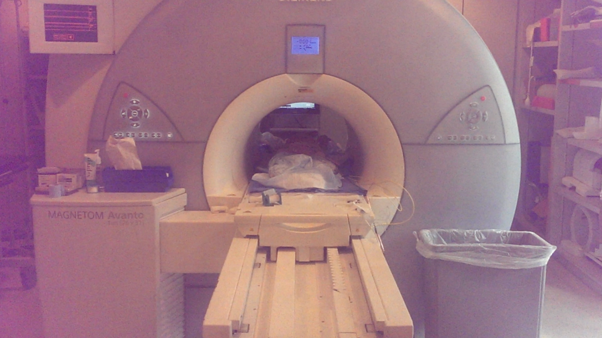
MRI Defibrillation in action (small swine subject)
Note:
1. jump has nothing to do with MRI
Magnetic field !!
Magnetic (Lorentz) accel. (3T) ~0.33ms-²
Levitation accel. (1g)=9.8ms-²
The Jump you see is >7g=70ms-²
2. Completely due to abdominal
muscle contraction.

Slide 16
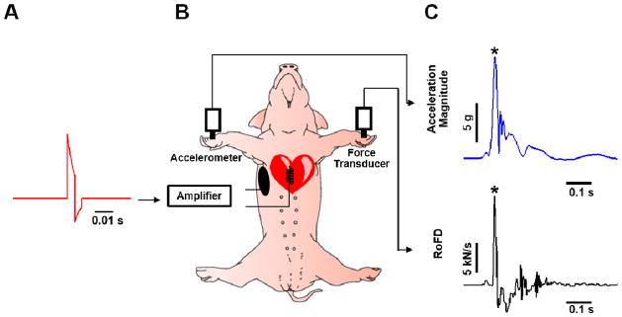
Defibrillation without Muscle Contraction
Hunter DW et. al, Heart Rhythm 2016;13(5): 1142

Slide 17
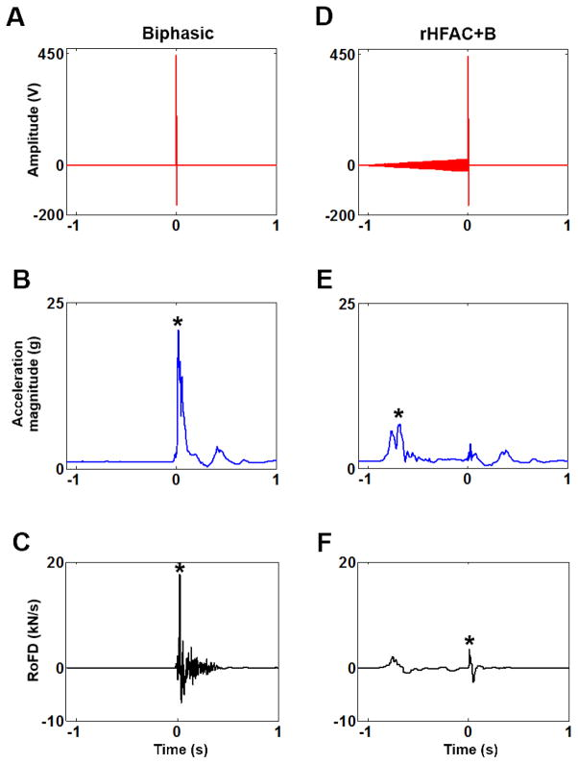
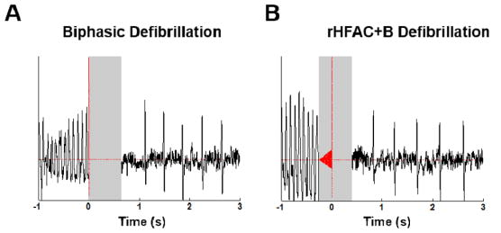
Defibrillation with minimal Muscle contraction
Modified Defibrillation Waveform
Preparation: 1 kHz waveform, ramped over 1s from 0->25V
Biphasic Voltage: 480 V for 4 ms per phase (9J)
71% mean reduction in acceleration (to ~4.7g)
72% mean reduction in force (pain)
Same success in swine defibrillation as with Biphasic
levitation
Hunter DW et. al, Heart Rhythm 2016:13(5) 1142

Slide 18
Defibrillation in the MRI
MRI-compatible external defibrillators
Constructed by adding Radio-Frequency filters and changing cables.
Patient imaged with pads on chest and defibrillator ON in monitoring mode (charged and measuring ECGs) to shorten response time
Insignificant imaging SNR penalty (~7%)
No patient (pad) heating risk due to MRI RF pulses
Proper function of defibrillator inside the bore.
Motion during defibrillation reduced by modifying defib waveform
Thank You

Slide 19
Publications
Schmidt EJ, Watkins RD, et al. A magnetic resonance imaging–conditional external cardiac defibrillator for resuscitation within the magnetic resonance imaging scanner bore. Circ Cardiovasc Imaging. 2016;9:e005091. doi:
Shusterman V, Hodgson-Zingman D, et al. External Defibrillation During MRI: Feasibility and Safety Circulation. 2017;136:A13735
Hunter DW, Tandri H, et al. Tetanizing pre-pulse: a novel strategy to mitigate ICD shock-related pain Heart Rhythm. 2016 May ; 13(5): 1142–1148.

