Slide 1
MRI catheterization guide wires
Christian Meierhofer
Pediatric Cardiology and Congenital Heart Disease
German Heart Center Munich
Technical University of Munich
Germany

Slide 2
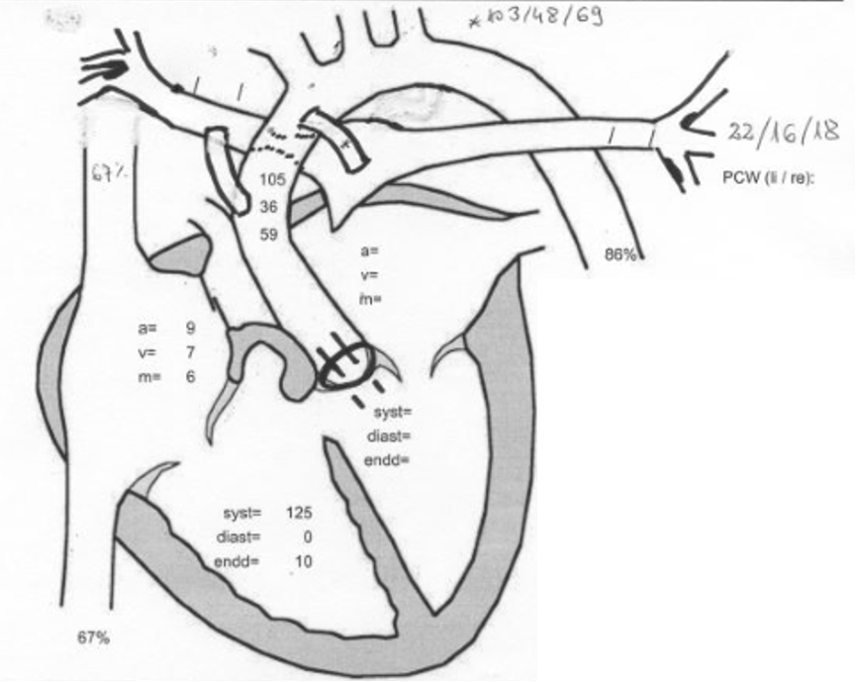
PA, VSD
till age of 12 yrs - 17 cathlab procedures

Slide 3
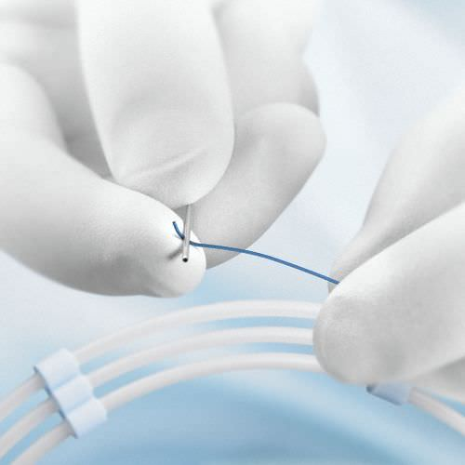
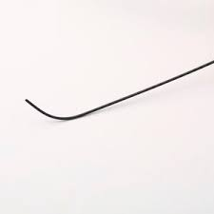
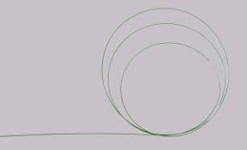
Guide wires…
Made of stainless steel or metallic alloys
- guides - the catheter through blood vessels and heart structures
often PTFE coated soft tip
Less trauma to intima wall
Flexible tip and rigid end
Solid guide wires
Less cath tip flaring, vessel damage, blood clotting
Wrapped guide wires
More versatile, often Teflon or heparin –coated
Certain torque
Fixed or movable core

Slide 4
Guide wires…
Different tip constructions
Straight
Angled
J-shaped
Different length
Different diameters
0.014 – 0.038’’
Different stiffness
Safety
Is it possible to bend the tip 180 degrees
Wrapped wire
junction of stiff core to external coils/sleeve

Slide 5
Guide wires for conventional use
„Noodle“wire
Standard
Terumo wire
„Heavy duty“
Extra stiff
Super stiff
Ultra stiff
Back-up
Stiffness of guide wires of 0.035“
Notes:
5
all wires except the noodle and terumo wire are more or less shapeable to individual needs

Slide 6
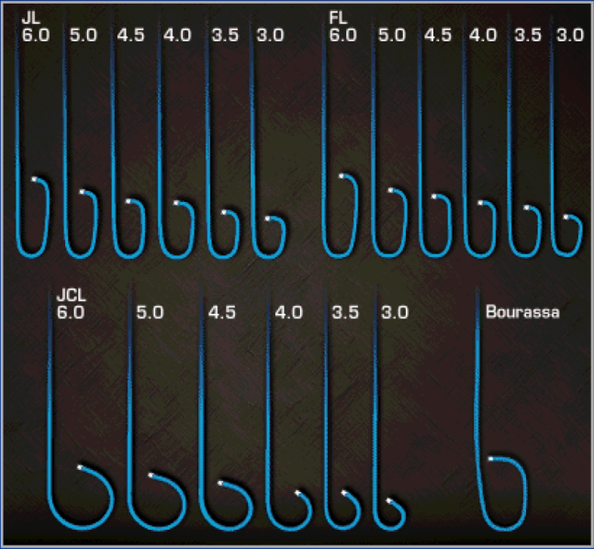
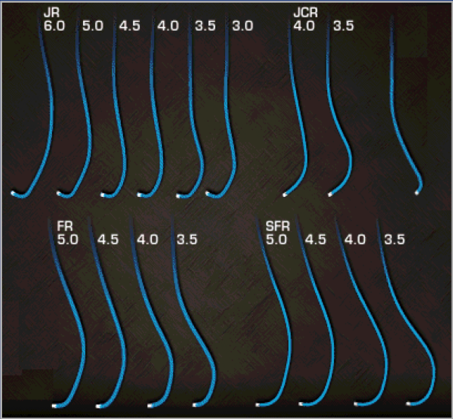
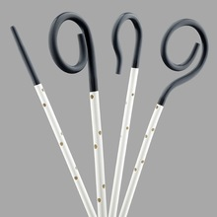
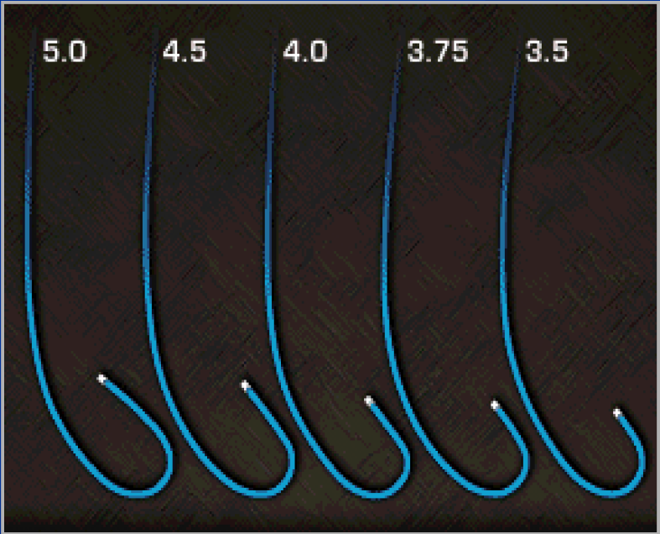
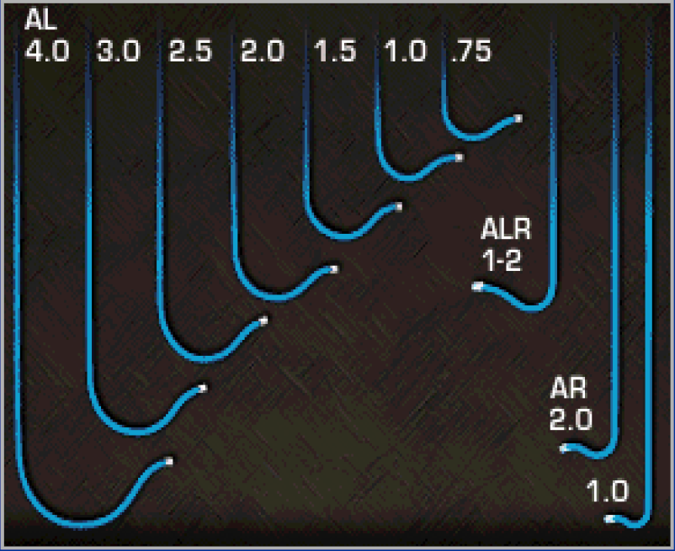
Most catheters are not suitable
Several MR-compatible
diagnostic catheters
are available
some coronary catheters …
Notes:
6
MR-Catheter desireable

Slide 7
The quality of imaging -
spatial resolution
extreme subatretic coarctation
Notes:
7
Extreme coarctation how to get through with MRI resolution?
Is there a communication or not?

Slide 8
The quality of imaging
spatial resolution and stent-caused drop outs
Stiff guide wire is mandatory
Krueger, Circulation 2006
Notes:
8
Experience with the kind of stent artifact
Need for other stents???
Stability of balloon
Rapid pacing – making the procedure more complex
Stiff wire

Slide 9
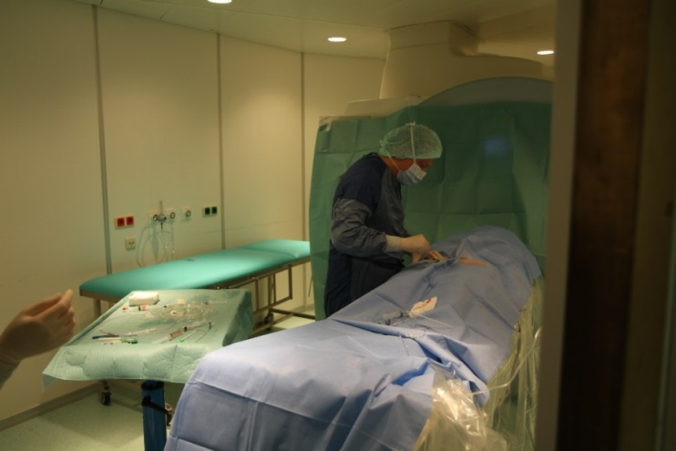
MR compatible guide wire
PMCF 11/2015 - 12/2016
Primary Endpoints
Handling
CE/FDA/Health Canada-certified guidewire
Diameter 0.035’’ (0.89 mm)
Length 180 cm
Steerability
Visibility
Safety
Notes:
Secondary Endpoints
To confirm usability: Absence of MRWire related events such as damage to vessel walls, or other device related events
• To confirm feasibility: Absence of MRWire related events such as device deficiencies, obstruction in catheter, non-visibility in MRI (if guidewire related) and positive assessment of structural integrity
Prospective, multi-centre PMCF study with CE certified device.
Primary Endpoints 5.1.
Primary Endpoint: Procedural Success defined as “Was procedural success reached?”: yes/no
Procedural success (only during procedure) means that all of the following questions are answered with “yes”:
• Could the MRWire be inserted successfully through the introducer device (handling) ?
• Could the MRWire be introduced successfully to the anatomical target lesion (steerability) ?
• Was the MRWire sufficiently visible in MRI to allow steering to the target lesion (conspicuity) ?
And
the following question is answered with “no”:
Did any adverse event, related to the MRWire occur?
Secondary endpoints
• To confirm usability: Absence of MRWire related events such as damage to vessel walls, or other device related events
• To confirm feasibility: Absence of MRWire related events such as device deficiencies, obstruction in catheter, non-visibility in MRI (if guidewire related) and positive assessment of structural integrity

Slide 10
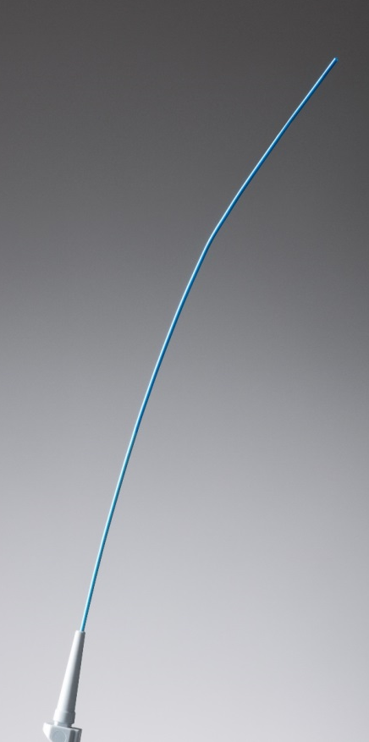
Certification of guidewire 2.0 (teflon sleeve)
Europe December 2017
USA November 2017

Slide 11
Clinical impression of our interventionalist
Overall impression:
good guide wire

Slide 12
Conclusion
Guide wires with straight and angled tip available
Guide wires different stiffness still not available
Diagnostic cath is feasible in not too complex anatomies
Interventions for selected cases
Notes:
12
emergencies have to be anticipated.

Slide 13
Safety issues and quality control
Select patients well
plan your emergency case
Notes:
13
emergencies have to be anticipated.

Slide 14
Outlook
Need for interventionalists to get involved
Different wires for different purposes
Special catheters
Better imaging resolution

