Slide 1
Clinical Update on the use of iCMR at Texas Children’s Hospital
Cory V. Noel, M.D.
Assistant Professor – Director of Cardiac MRI
Pediatric Cardiology

Slide 2
No Disclosures
…other than we have not actually performed a MRI-guided cardiac catheterization

Slide 3
Outline
TCH experience…through eyes of a lowly clinician
Overall goals of the program
Pitfalls and words of caution

Slide 4
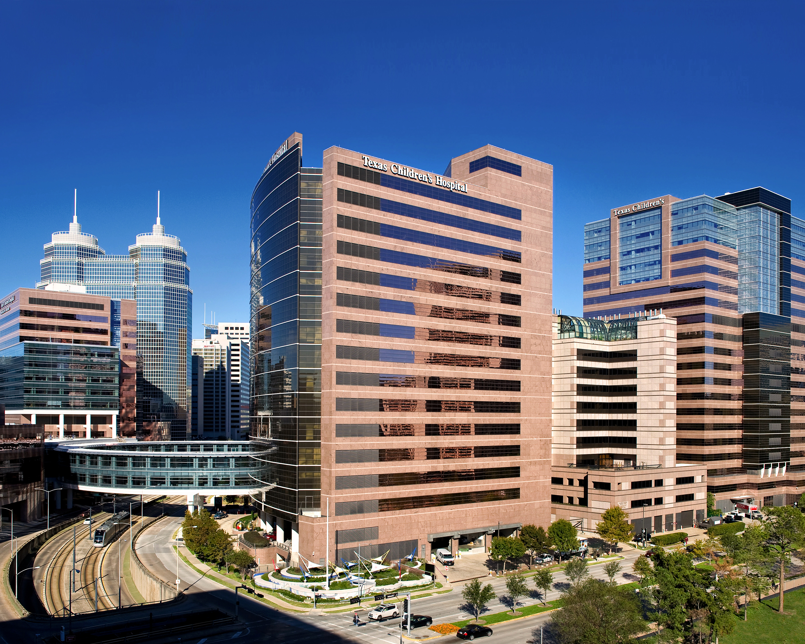
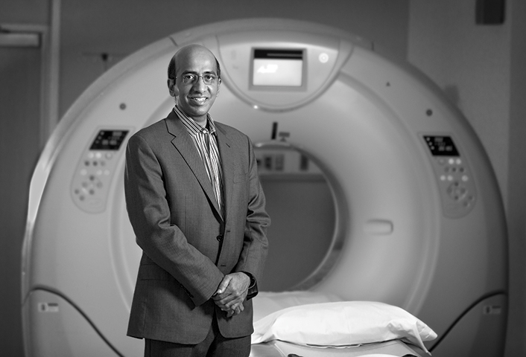
Timeline

Slide 5
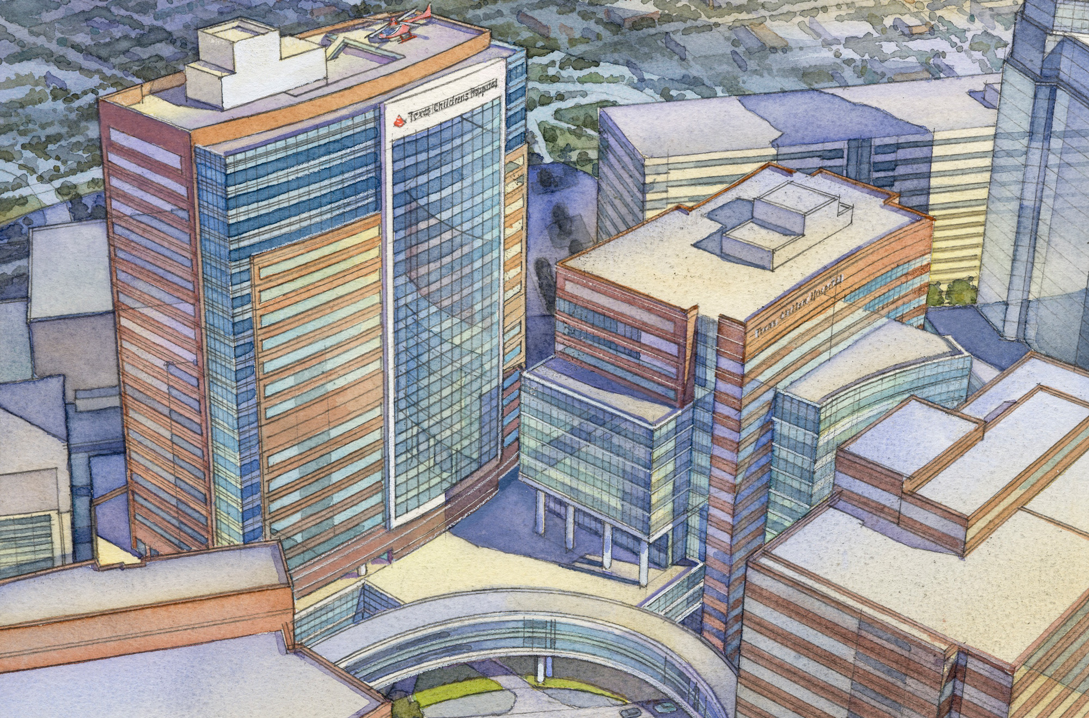
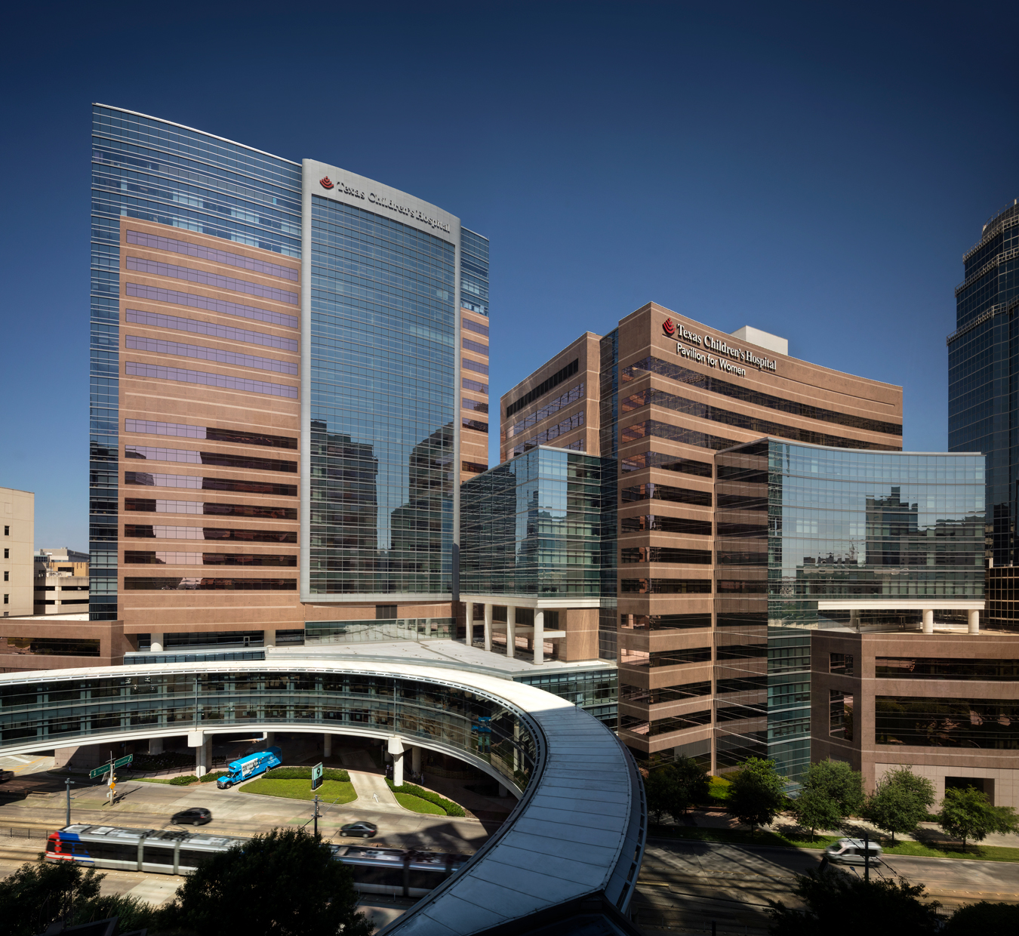
TCH Expansion

Slide 6
iCMR as part of New Building Advantages
Funding should be more than adequate…to an extent
Freedom in the design and layout

Slide 7
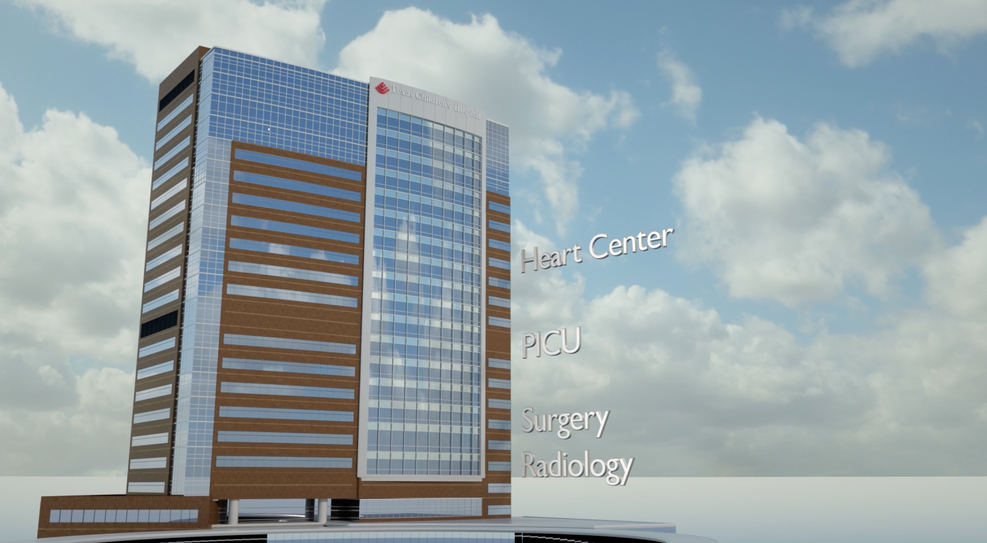
iCMR part of New Building Disdvantages
Where is iCMR?

Slide 8
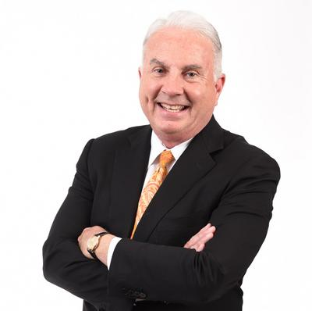
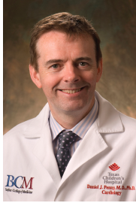
iCMR part of New Building Disdvantages
∞

Slide 9
Getting Started
iCMR course at NIH / Children’s National - 2016
SCMR pre-conference courses
Identifying goals

Slide 10
Identifying Goals
Step-wise approach to MRI-guided catheterization
Which population could receive great benefit at the lowest risk for a novel program
Endomyocardial biopsy versus pulmonary hypertension

Slide 11
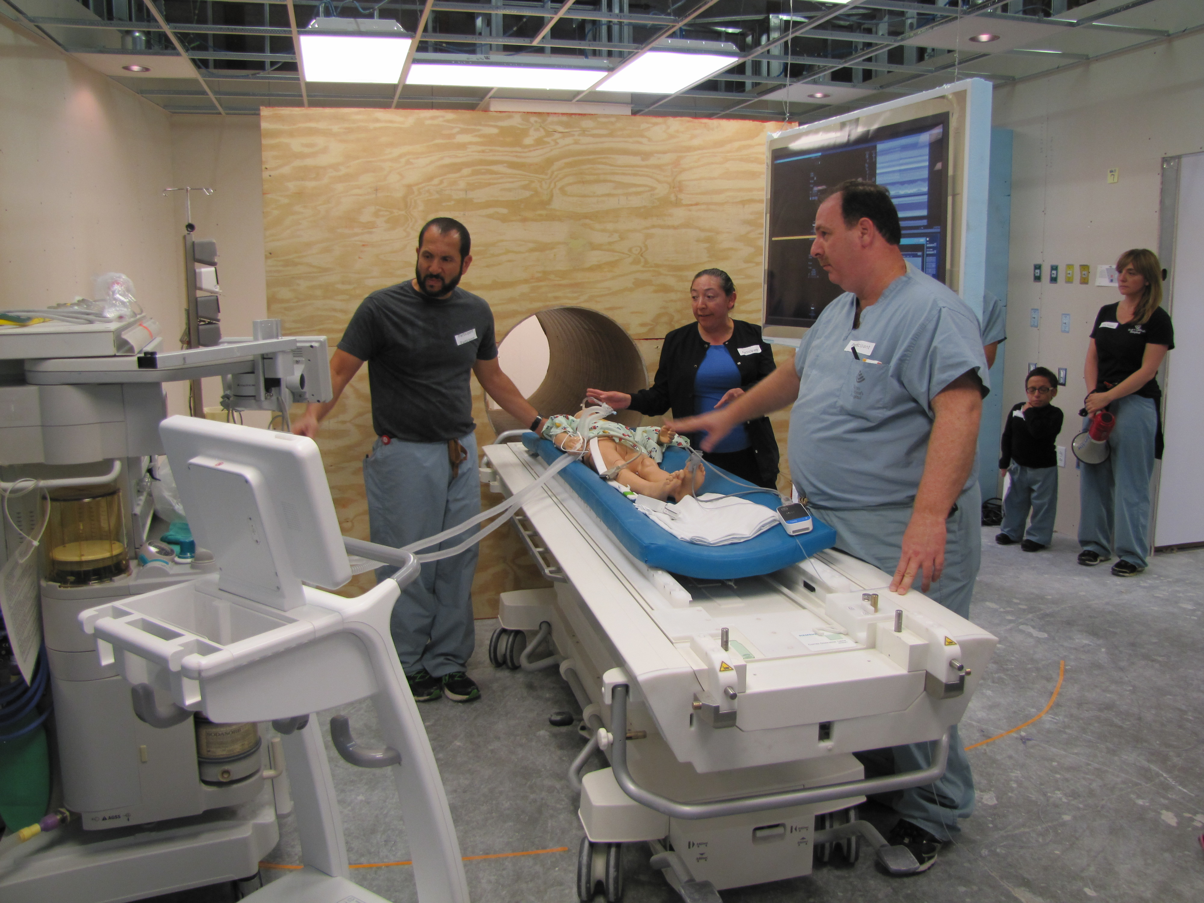
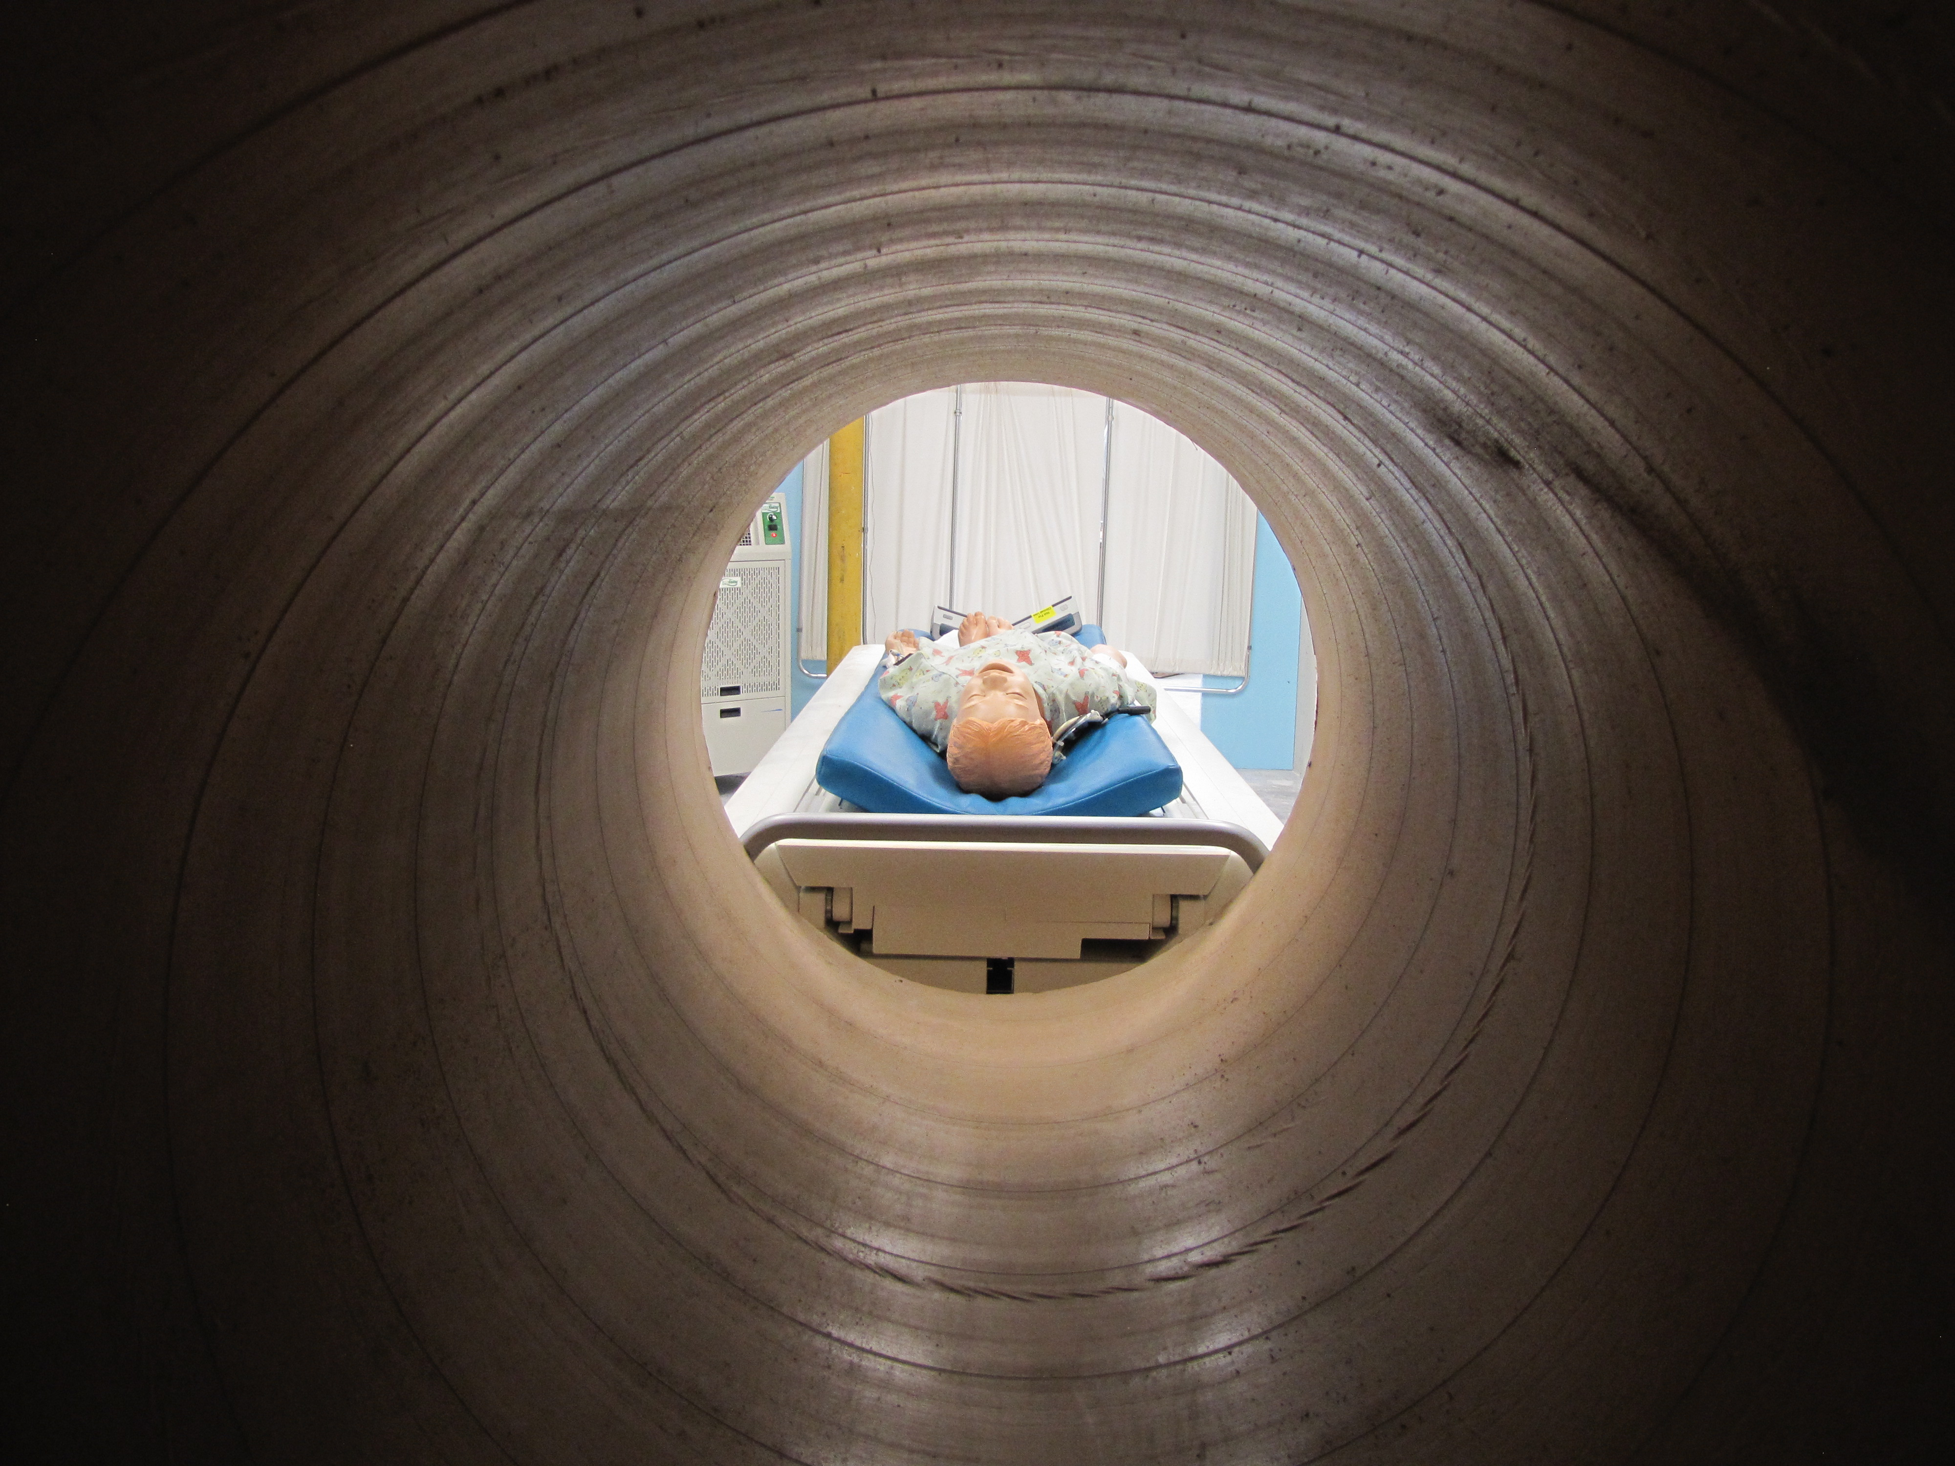
Simulation Center

Slide 12
Preparation Pitfalls

Slide 13
Preparation Pitfalls
Need a point person who is aware of all aspects related to iCMR with it their primary focus
Multiple vendors
Safety issues and approval
Unique aspects not relatable to other projects
Can centralize the meetings
Active site visit not completed

Slide 14
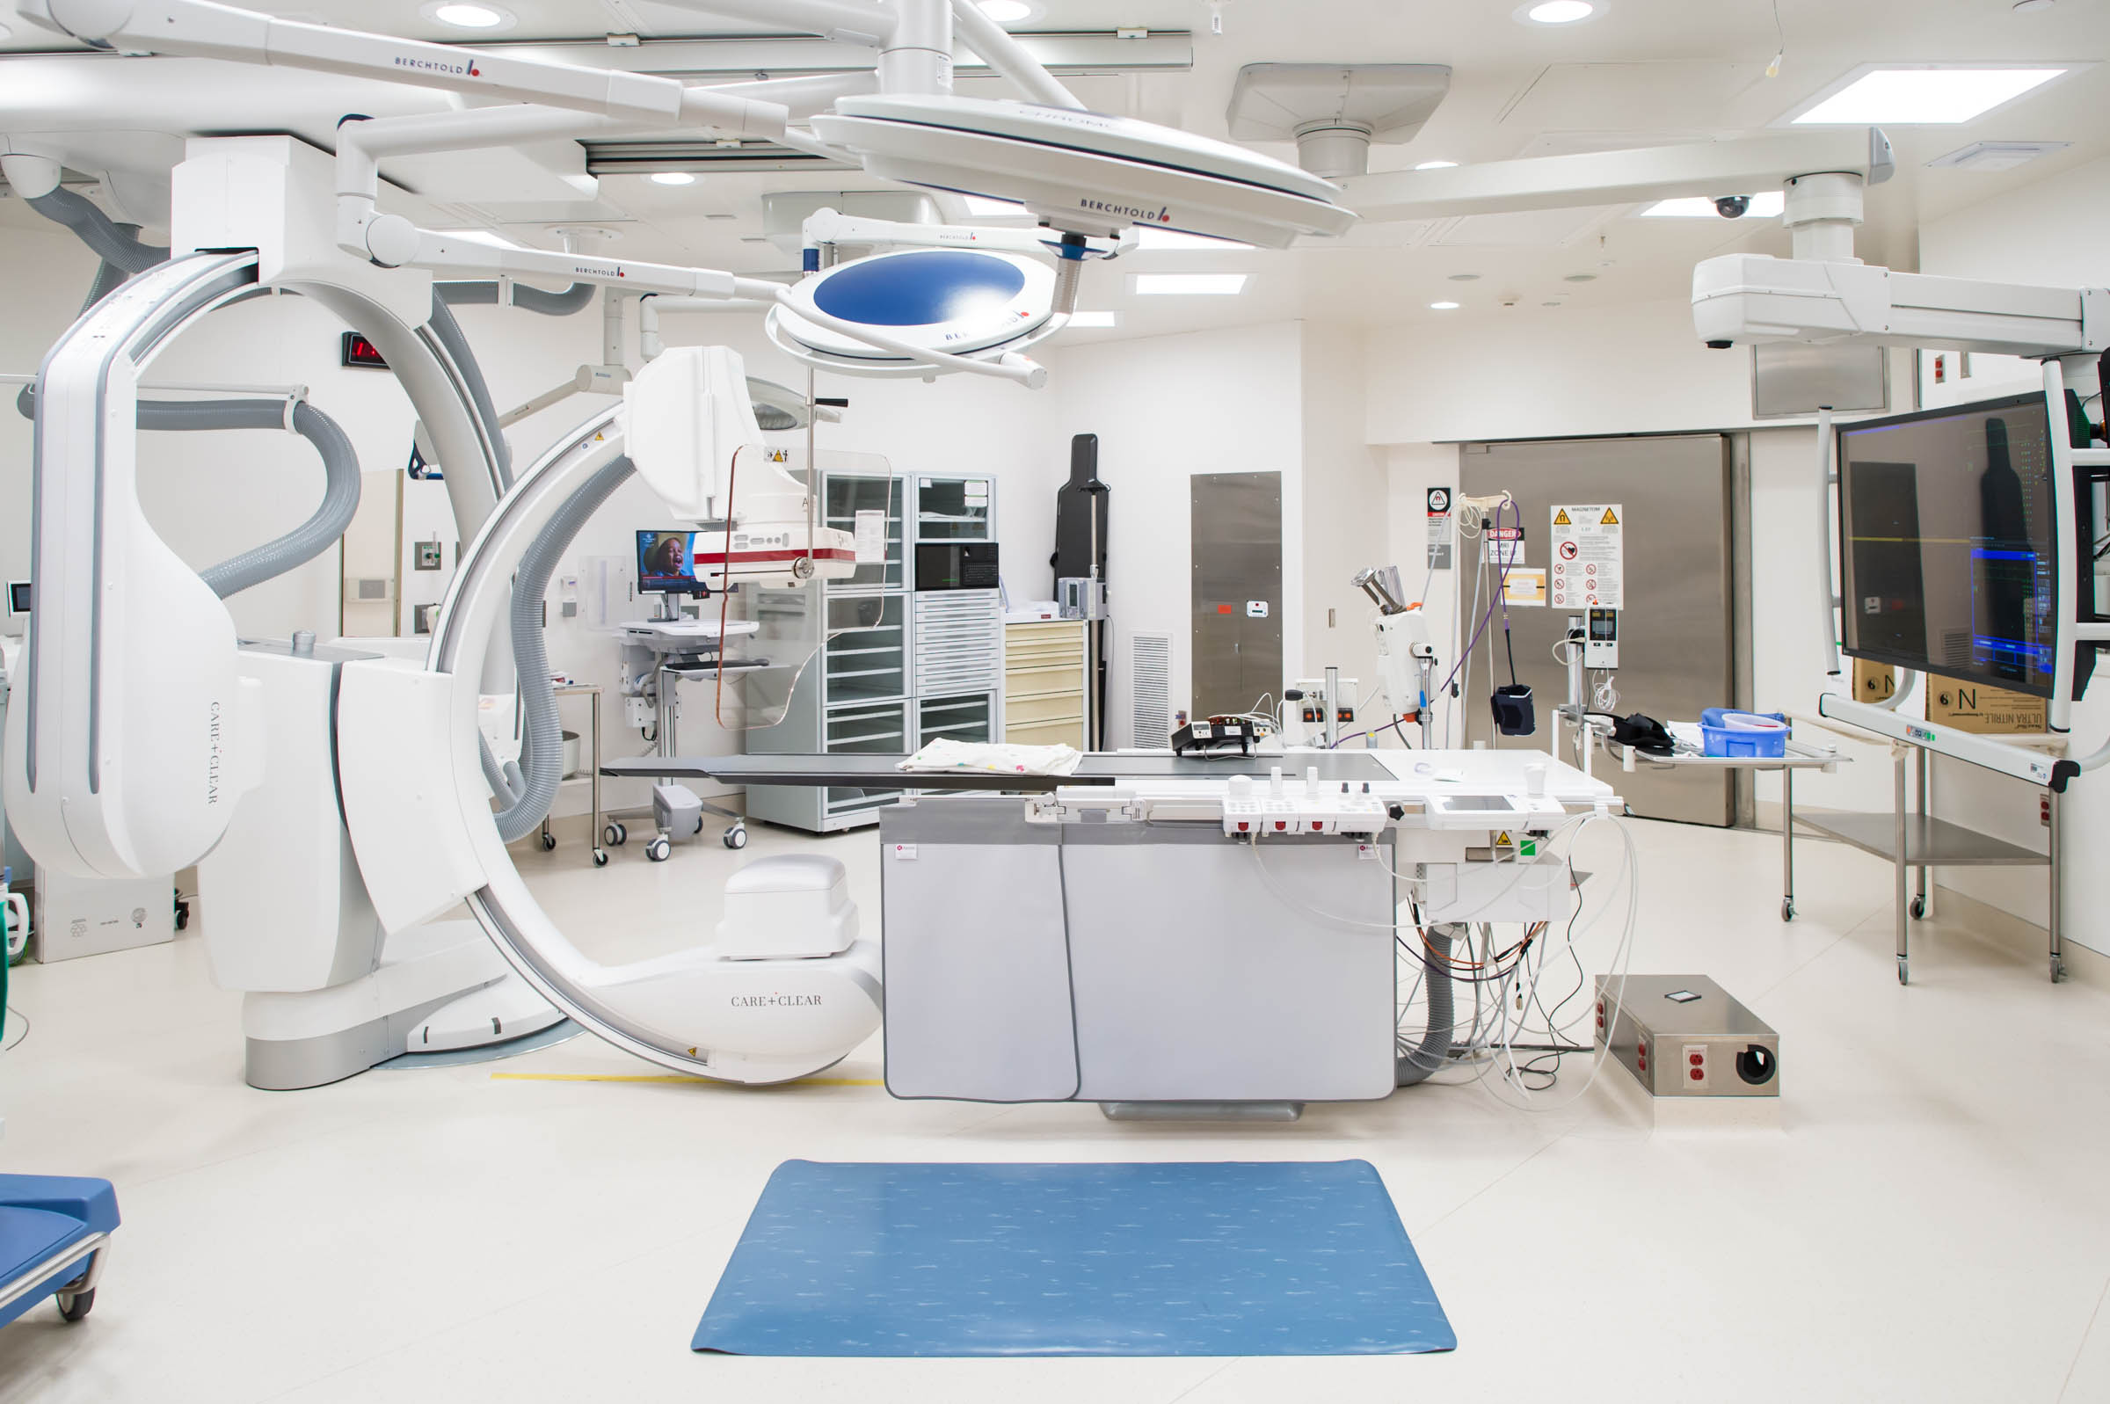
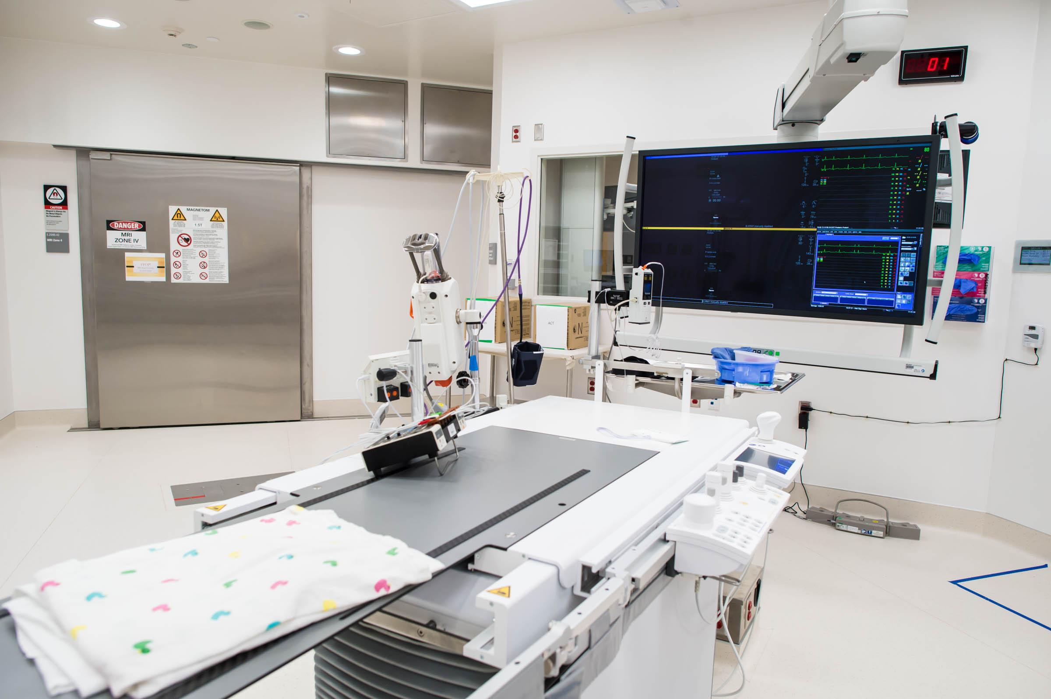
Finished Product

Slide 15
3 Step Approach
Cardiac MRI to catheterization laboratory
Cardiac catheterization laboratory to MRI suite
Cardiac MRI-guided catheterization

Slide 16
12 y/o ccTGA, Ebsteinoid valve
RVEDVi – 113 mL / m^2
LVEDVi – 89 mL / m^2
LV Mass 45 gm / m^2
Qp:Qs of 1.9:1

Slide 17
16 y/o unbalanced AVSD, s/p Fontan
No significant A-P collateral burden
Qp:Qs of 0.8:1
Closure of Fontan fenestration

Slide 18
6 y/o coronary artery fistula
Moderately dilated right coronary artery
Normal myocardial perfusion
Cath angiography demonstrates small, pulsatile egress into left ventricle; no intervention performed

Slide 19
1 y/o DORV, s/p BT shunt & atrial stent
Right and left heart hemodynamic catheterization
Qp:Qs of 0.8:1
Baffling of left ventricle to anterior aorta is unlikely to be successful
Nikaidoh procedure planned

Slide 20
Meeting prior to each case
Define roles and objectives
Discuss contingency plans
Identify small issues that may be preventable
Prevent “discovery rounds”

Slide 21
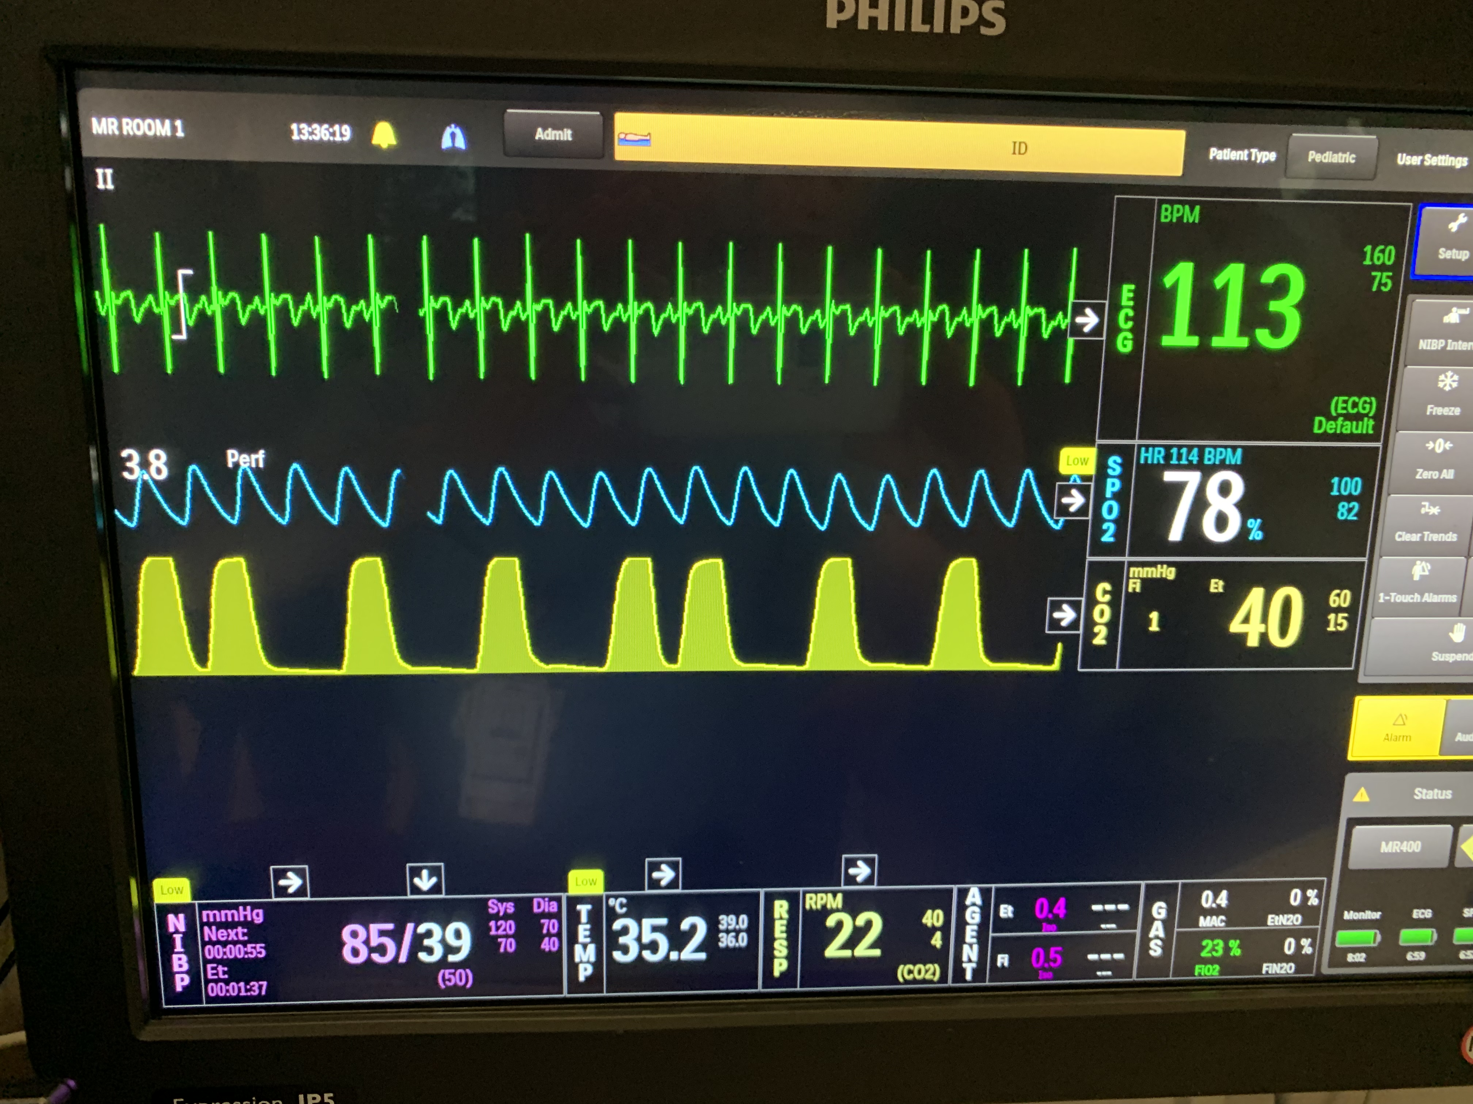
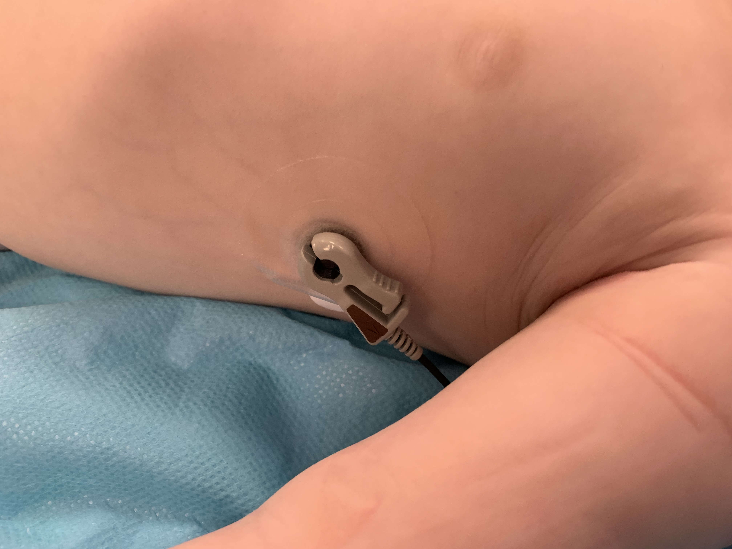
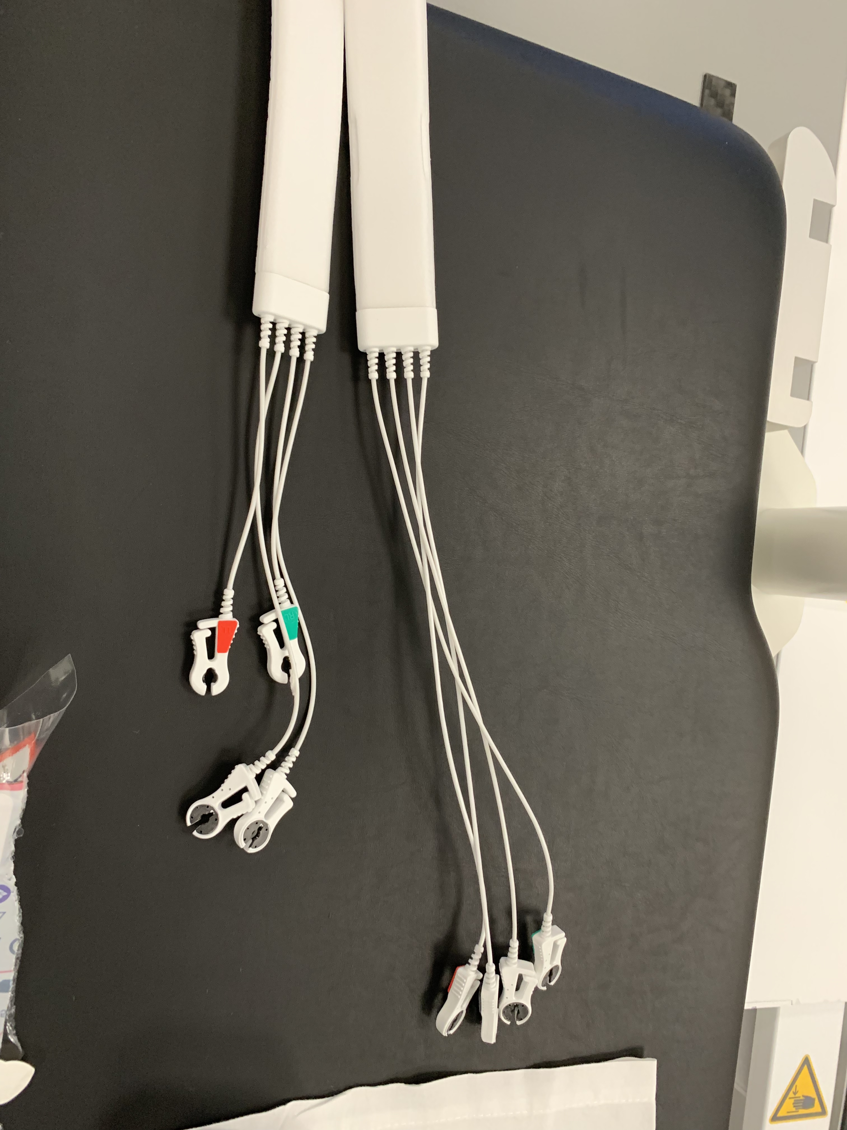
Continued Learning - Monitoring

Slide 22
Continued Learning - Transitioning

Slide 23
Continued Learning - Transitioning

Slide 24
Continued Learning - Transitioning

Slide 25
Conclusion
Need a leader in each area
Well defined goals and objectives can tighten focus
Regular meetings continues to identify problem areas prior to disruption
Step-wise approach allows a more manageable schedule

Slide 26
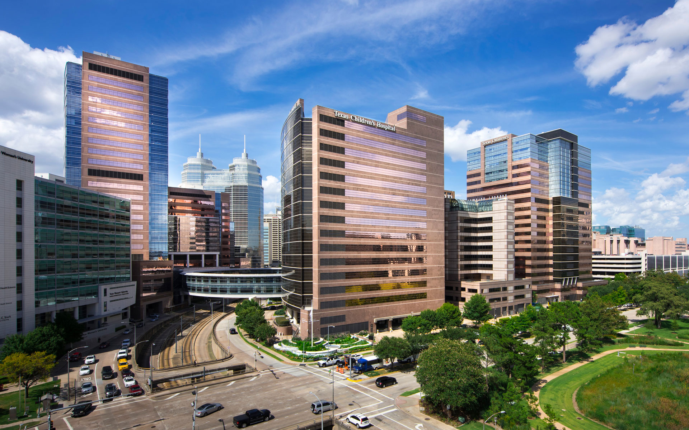
Thank you
Notes:
Text
Text
Text
Text

